Slide 1

ACCURATE INSTITUTE OF MANAGEMENT & TECHNOLOGY GREATER NOIDA
METAL DETECTOR ROBOT VEHICLE USING DTMF
PROJECT TEAM:
DIVYATA CHAUDHRY
GYANESH UNIYAL
PRINCE KUMAR
VAISHALI YADAV
Under the guidance of:
MR. H P SINGH

Slide 2
OVERVIEW
Objective
Proposed system
Dual Tone Multi Frequency
Light Dependent Resister
Module description
Hardware and software requirements
Expected output
Advantages and Disadvantages

Slide 3
OBJECTIVE
The main objective of our project is to build a robotic vehicle that can sense metals ahead of it.
An obstacle sensor is used protect the robot from collision.

Slide 4
PROPOSED SYSTEM
This project is divided into modules for better understanding of the circuit . The modules include
Microcontroller Board
Motor Control Driver
Metal Detector
LDR sensor

Slide 5
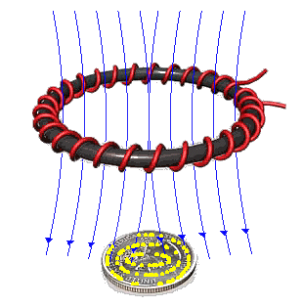
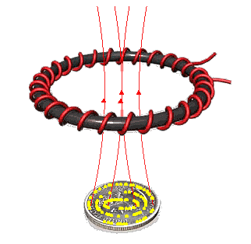
METAL DETECTOR
The operation of metal detectors is based upon the principles of electromagnetic induction.
The single-coil detector is the one used in a real metal detector.
A pulsing current is applied to the coil, which then induces a magnetic field.
When the magnetic field of the coil moves across metal, such as the coin, the field induces eddy currents in the coin.
The eddy currents induce their own magnetic field, which generates an opposite current in the coil, which induces a signal indicating the presence of metal.

Slide 6
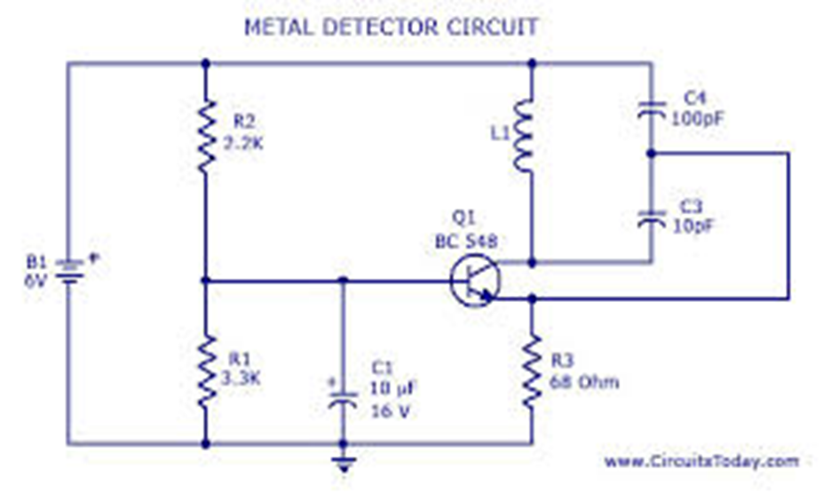
METAL DETECTOR CIRCUIT

Slide 7
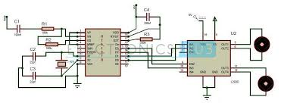
METAL DETECTOR ROBOTIC VEHICAL CIRCUIT DIAGRAM

Slide 8
LIGHT DEPENDENT RESISTER
The way an LDR works is that they are made of many semi-conductive materials with high resistance.
The reason they have a high resistance is that are very few electrons that are free and able to move because they are held in a crystal lattice and are unable to move.
When light falls on the semi conductive material it absorbs the light photons and the energy is transferred to the electrons, which allow them to break free from the crystal lattice and conduct electricity and lower the resistance of the LDR.

Slide 9
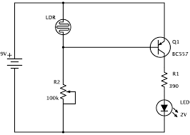
LDR CIRCUIT DIAGRAM

Slide 10
LDR SENSOR

Slide 11
DUAL TONE MULTI FREQUENCY
The DTMF technique outputs distinct representation of 16 common alpha numeric characters (0-9, A-D, *, #) on the telephone. The lowest frequency used is 697Hz and the highest frequency used is 1447Hz.
Mobile is based on DTMF Technology. When you press a button of mobile keypad, a connection is made that generates a resultant signal of two tones at the same time. These two tones are taken from a row frequency and a column frequency. The resultant frequency signal is called "Dual Tone Multiple Frequency". These tones are identical and unique.
A DTMF signal is the algebraic sum of two different audio frequencies, one from low frequency group and other from high frequency group.

Slide 12
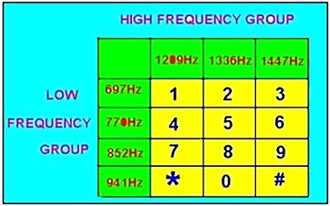
When you send these DTMF signals to the telephone exchange through cables, the servers in the telephone exchange identifies these signals and makes the connection to the person you are calling.
When you press the digit 5 in the keypad it generates a resultant tone signal which is made up of frequencies 770Hz and 1336Hz. Pressing digit 8 will produce the tone taken from tones 852Hz and 1336Hz. In both the cases, the column frequency 1336 Hz is the same. Signals are digital signals which are symmetrical with the sinusoidal wave.

Slide 13
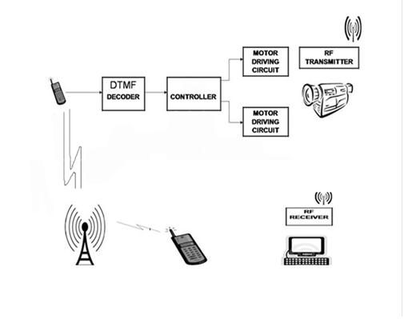
DTMF CIRCUIT DIAGRAM

Slide 14
FLOWCHART OF OPERATION
START
:
initialise input and
output ports
key pressed
If key=2
MOVE UPWARD
if key=4
MOVE LEFT
if key=5
STOP
if key=6
MOVE RIGHT
if key=8
MOVE BACKWARD

Slide 15
SOFTWARE REQUIREMENT
Keil an ARM Company makes C compilers, macro assemblers, real-time kernels, debuggers, simulators, integrated environments, evaluation boards, and emulators for ARM7/ARM9/Cortex-M3, XC16x/C16x/ST10, 251, and 8051 MCU families.
Compilers are programs used to convert a High Level Language to object code. Desktop compilers produce an output object code for the underlying microprocessor, but not for other microprocessors.

Slide 16
EXPECTED OUTCOME
The Robot will be able to moves in all four directions:
Right, Left, Front, Back .
The Robot will be able to sense metal ahead of it.
It has one additional feature that in the absence of light it automatically glows the LED with the help of LDR(Light Dependent Resister).

Slide 17
ADVANTAGES
Consistency of performance.
24/7 continuous working.
Reduced amount of operator errors.
Can be made to perform even the most dangerous tasks without concern.

Slide 18
DISADVANTAGES
Precise programming needed (time, training)
New products require complete reprogramming.
Complex and expensive equipment to buy and install.

Slide 19
APPLICATION
Detecting Metal.
It can be use for treasure hunt.

Slide 20
