Slide 1

VOYA Finance – Payroll Administration

Slide 2
Topics
Demo
Team
Technologies
Client side architecture
Unit Testing approach

Slide 3
Team
UI Development | Sandhya
 | Prince Antony
Server side development | Sundar
 | Sushanta
 | Chowda
Business Analyst | Barbra
UI Wireframe | Mathew
Framework support | Johm
Program Manger | Shailendra
.

Slide 4
Technologies
Responsive | Sandhya
 | Prince Antony
Server side development | Sundar
 | Sushanta
 | Chowda
Business Analyst | Barbra
UI Wireframe | Mathew
Framework support | Johm
Program Manger | Shailendra
.

Slide 5

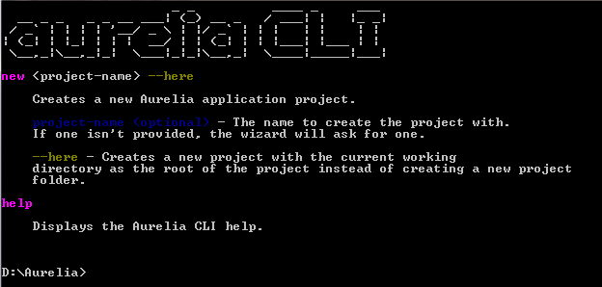
Aurelia framework setup
Prerequisites
  Install NodeJS 4.x or above
Install Aurelia CLI
  execute the command in the working folder “npm install aurelia-cli –g “
To test the aurelia installation , run the below command
  If the installation is complete, then the above command will shows
.

Slide 6
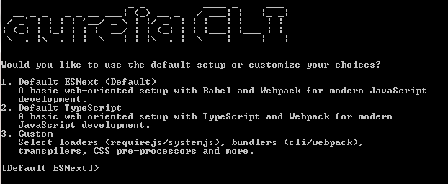
Aurelia New Project Setup
Go to the folder where we created aurelia-cli
Execute the command “au new yourprojectname” as below
.

Slide 7


index.html
app.bundle.js
vendor.bundle.js
css(s)
images
sass
babel
webpack and gulp
node modules
Aurelia framework
Testing framework
Karma & protractor
aurelia custom components
Aurelia-ux
aurelia-bootstrapper
aurelia-router
aurelia-cli
state
aurelia-store
aurelia-fetch-client
aurelia-core
REST API
database

Slide 8

Client
components
index
.html
view
employee.html
view-model
employee.js
resources
common
models
employee.js
elements
constants
layouts
attributes
actions
employee-action.js
logging
exceptions
services
value converters
employee-service.js
auth-service.js
utils
Server
binding behaviors
auth
state
aurelia-store.js
Employee-state.js
REST API
custom valuator
store

Slide 9
Angular6 CLI
Control Comp
Control Comp
Control Comp
Page Component
Services
Actions
HttpClient
Dispatch
Testing framework
Karma & protractor
RxJS Store
Subscribe
s
R1
API
R1
State
Reducers
Server App

