Slide 1


Fifth Third Commercial Team – Knowledge sharing session

Slide 2

Agenda
DevOps History and What is DevOps
Evaluation of software development
The Problem :FaceBook
DevOps Tools
Software development life cycle
Challenges
Certificates & Opportunities

Slide 3
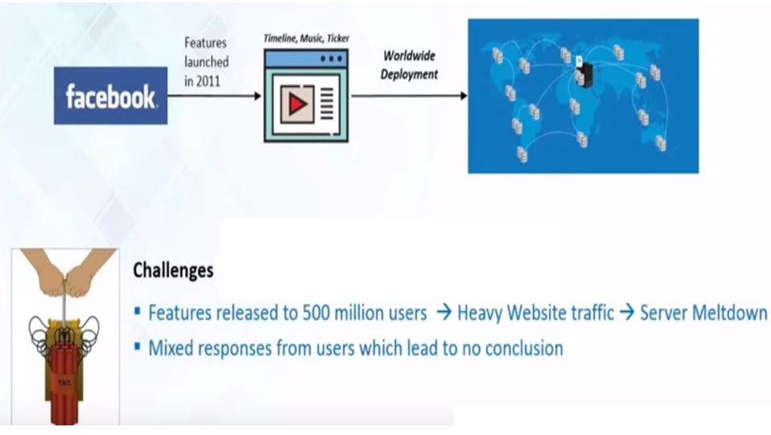
The Problem

Slide 4
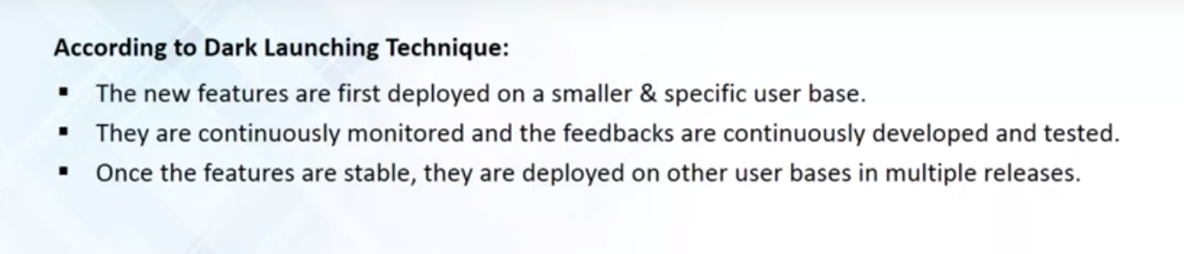
The Dark Launching Technique

Slide 5
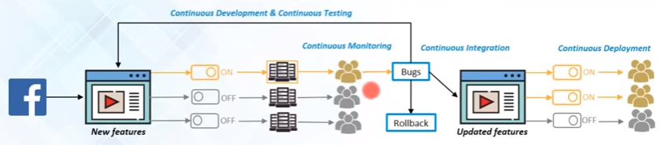
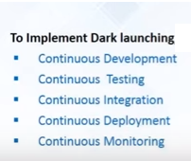
The Dark Launching Technique

Slide 6
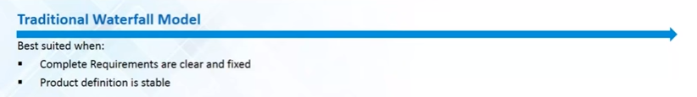


Evaluation of software development

Slide 7
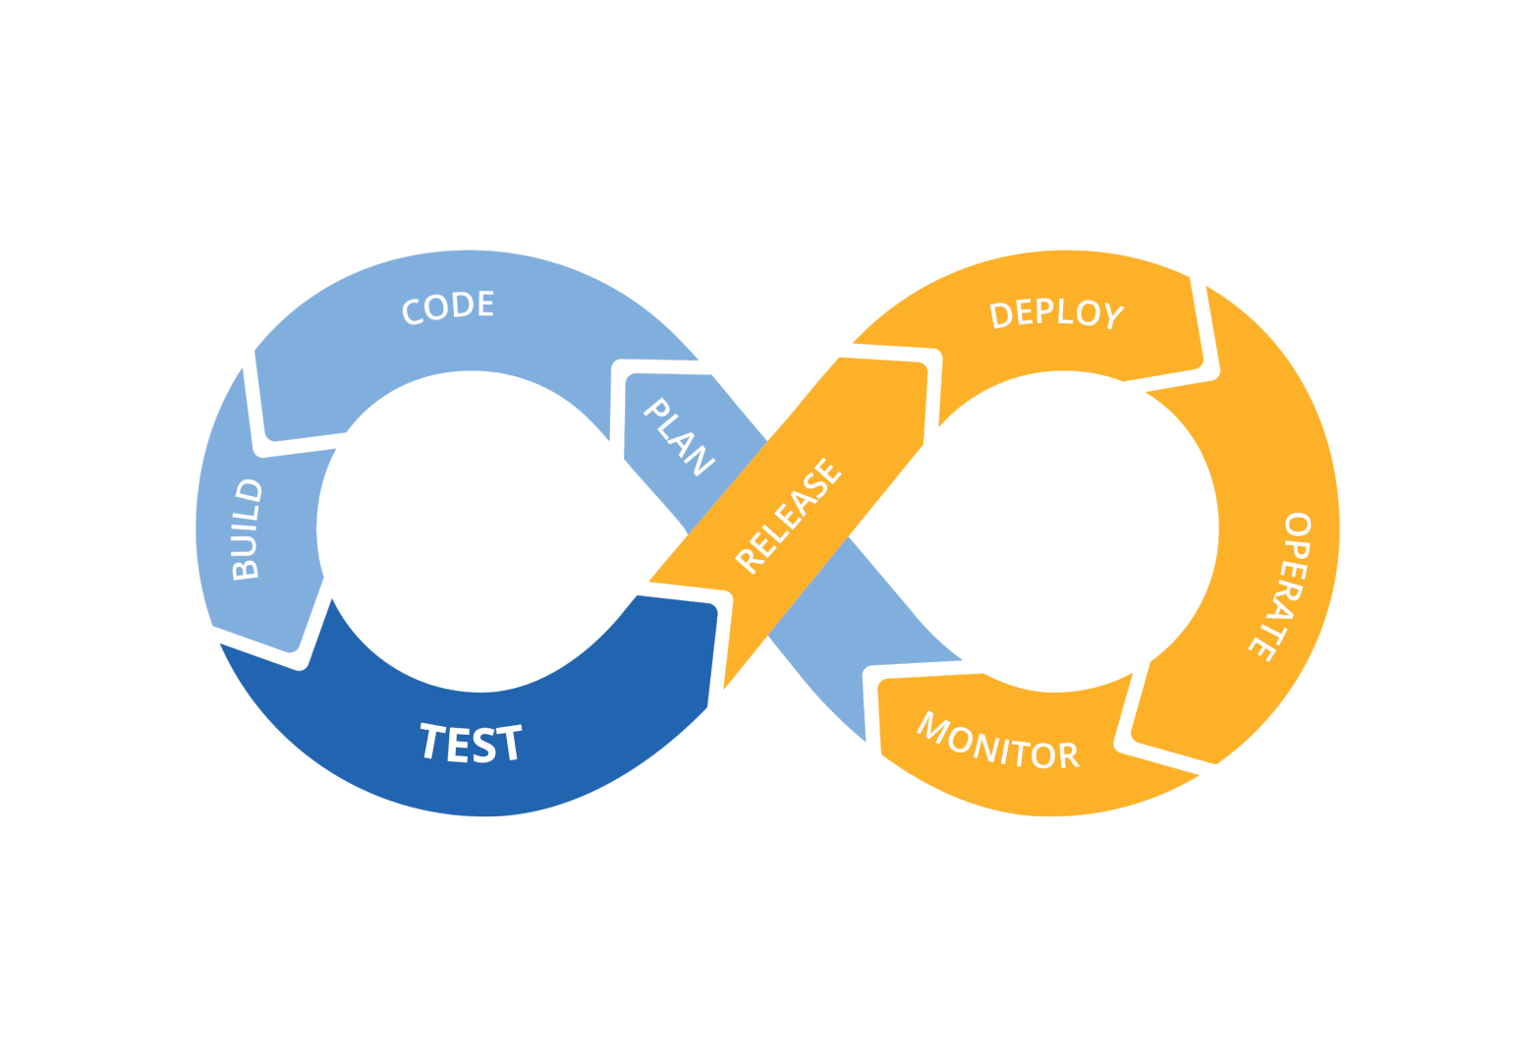
SDLC

Slide 8
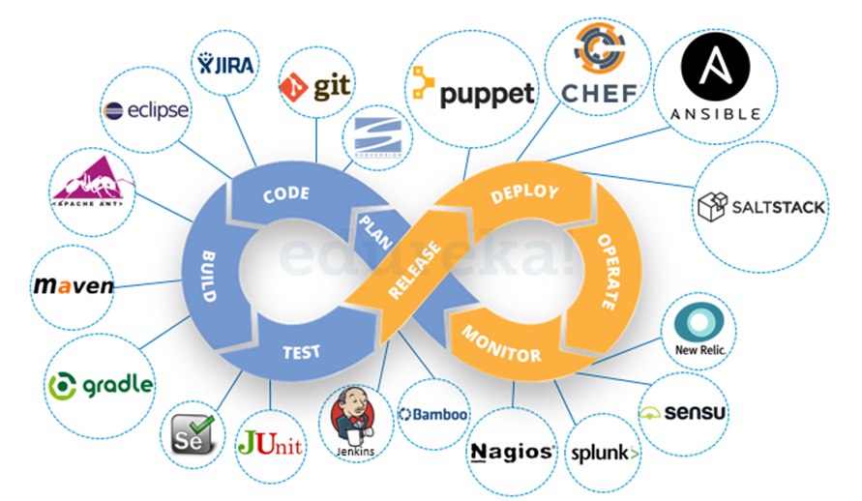
SDLC with Tools

Slide 9
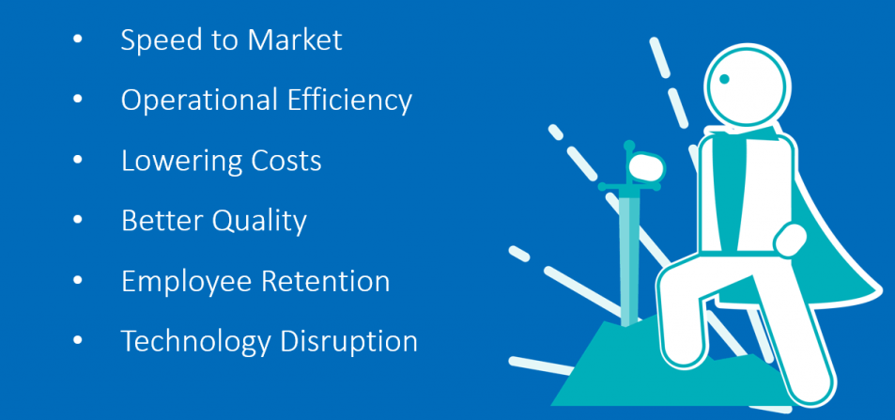
Factors for DevOps Adaption

Slide 10
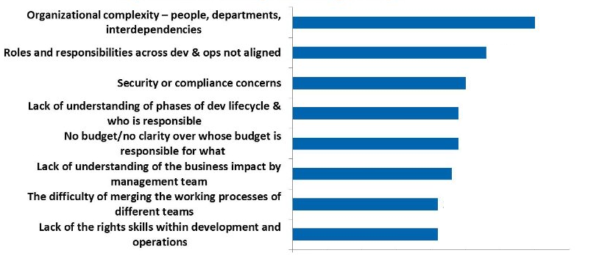
Top Obstacles to Implement DevOps

Slide 11
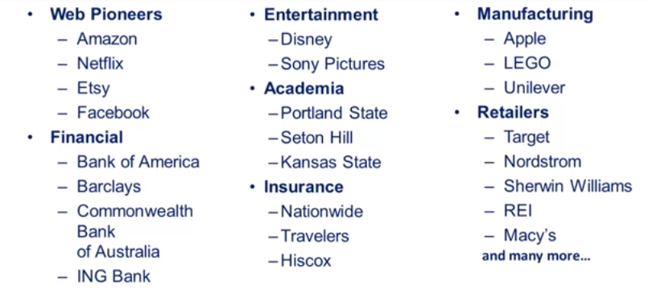
Companies Using DevOps

Slide 12
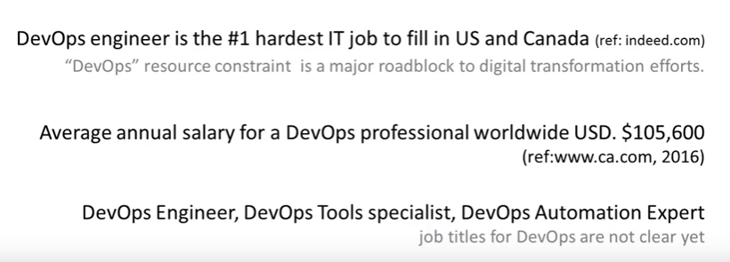
Opportunities

Slide 13

DevOps Certifications
DevOps Test Engineering (DTE)
Continuous Delivery Architecture (CDA)
DevOps Leader (DOL)
DevSecOps Engineering (DSOE)
DevOps Foundation Certification
New AWS Certification for DevOps Engineers
WS Certified DevOps Engineer - Professional

Slide 14
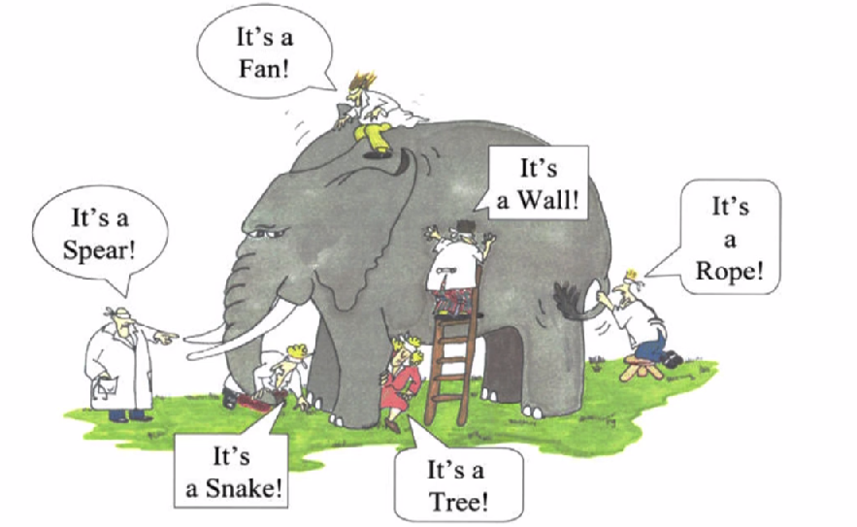
Blind Believe

Slide 15
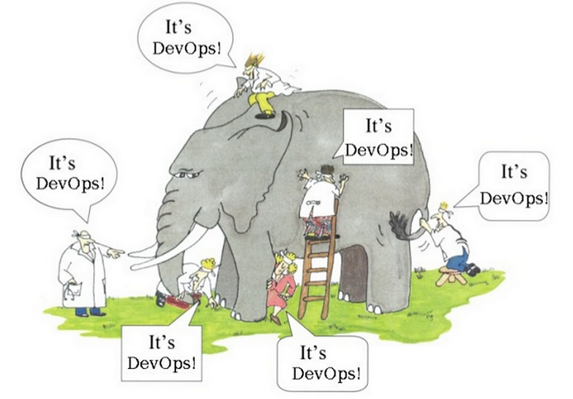
Half Knowledge

