Slide 1
Proof of Concept on Project Management Tool By Salesforce

Slide 2
Problems and Challenges
Project Esitmation and Planing
Project Tracking
Problem
Report Generation
Most of them
Are in MS Excel
Organization
Level project
Visibility

Slide 3

Solution
A module which will handle all about project
A module for member creation
and assignments
Project
A module for creating Backlogs
Member
Backlogs
To monitor project
progress by Burned down chart
Burned
Down
Project
Management
Tool
Sprint
A module for creating and a complete sprint management
To see the complete
View of the project by
Backlog and user story
Story
Board
Tasks
Issue
Tracker
A module to create backlog tasks
and its estimation & Allocation
A complete module for tracking defects, and Issues

Slide 4
Challenges for the Solution
01
Technology
To select the right technology is the big challenge
04
Skills
Team is new to the technology
02
Software license
Software is only free for development.
05
Requirement
Due to the lack of experience in Agile tools
03
Dev. Environment
ODC restriction and white room policy
06
Current deliverable
Team’s primary responsibility is current project deliverable

Slide 5
Decision Making on Technology – A Road Junction
MVC
Dot Net
AngularJS
ReactJS
Other UI frameworks
Core Java
MS SQL, Oracle, …etc…
Salesforce Lightning Component framework .
Event-driven architecture
Device-aware and crorss browser
Uses an event-driven architecture for better decoupling between components. Any component can subscribe to an application event, or to a component event they can see
Apps use responsive design and provide an enjoyable user experience. The Lightning Component framework supports the latest in browser technology such as HTML5, CSS3, and touch events
Performance
Uses a stateful client and stateless server architecture that relies on JavaScript on the client side to manage UI component metadata and application data
Rich Component Ecosystem
Faster Development
Create business-ready components and make them available in the Salesforce app, Lightning Experience, and Communities
Empowers teams to work faster with out-of-the-box components that function seamlessly with desktop and mobile devices.

Slide 6
Technology Selection – Salesforce Lightning components
Lightning Component framework is a UI framework for developing dynamic web apps for mobile and desktop devices. It's a modern framework for building single-page applications engineered for growth.
The main reason for SLC are:
The latest innovation
Lightning Builder
AppExchange Apps
Lightning Community
Free for Development
Development can be done from anywhere in the world
WRONG
CHOICE
WRONG
CHOICE
WRONG
CHOICE
WRONG
CHOICE
WRONG
CHOICE
WRONG
CHOICE
WRONG
CHOICE
WRONG
CHOICE
WRONG
CHOICE
WRONG
CHOICE
Salesforce
WRONG
CHOICE
WRONG
CHOICE
WRONG
CHOICE
WRONG
CHOICE

Slide 7
PoC Scope
In Scope
Out Scope
Project creation:
Define a root project in the project tree.Create sub projects under the root project
Member creation :
Define a new member and assign a
user name and privileges to the user
Assign members to project
Project execution modules
Backlog creation
Sprint creation - Add Backlogs
sprint
Task/User story creation
Add tasks to backlog
Story board
Burned down chart
Release management
Testing module
Defect managing and tracking
Backlog goals
Issue tracker
History
Approval workflow
Other dashboards

Slide 8
SWOT ANALYSIS
STRENGTH
WEAKNESS
A self motivated team.
Willing to learn and execute new technology
Development environment availability
d
OPPORTUNITY
THREAT
Technology c be used for new proposals.
More understanding on the new Agile based Projects
Salesforce software license and deployment

Slide 9
Our GOALS
To improve business objectives and software delivery alignment from implementing
To improve their ability to quickly adapt to changing priorities from implementing
To improve project visibility, and thus improved decision-making capabilities from implementing
To improve delivering software projects faster and more predictably
A Agile Tool

Slide 10
Screens

Slide 11
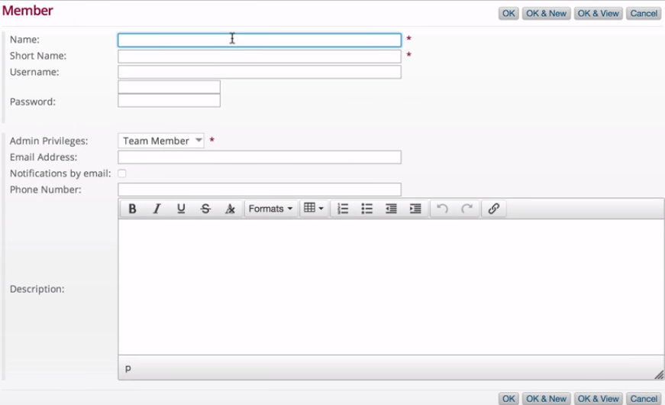
Create Member

Slide 12
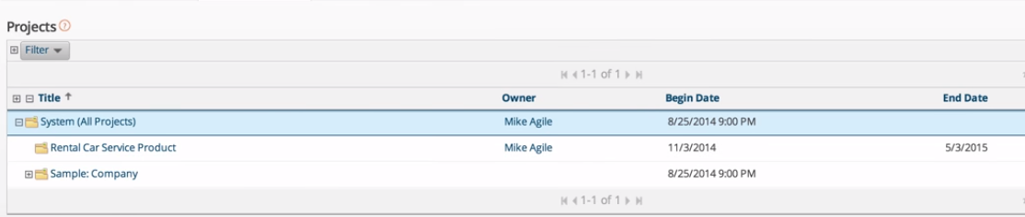
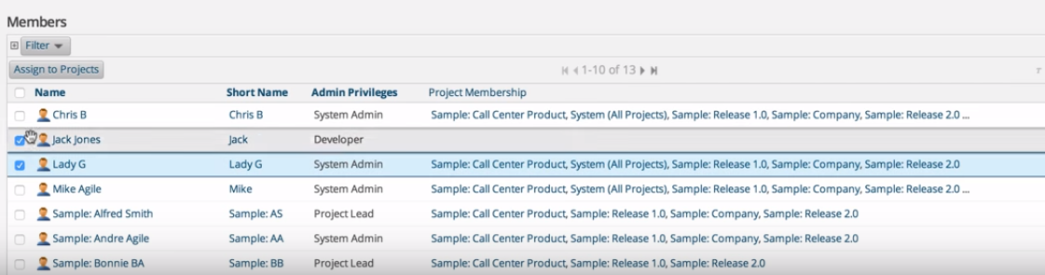
Assign Member to Project

Slide 13
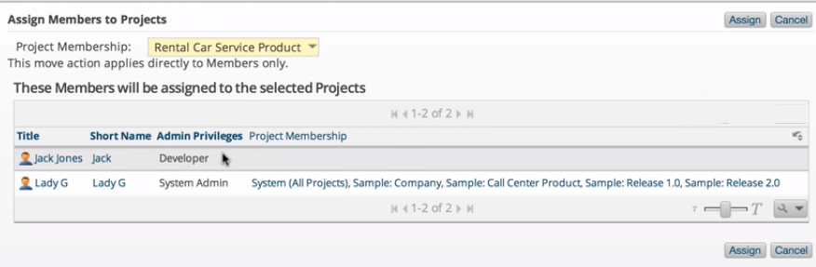
Confirm Project Assignment

Slide 14
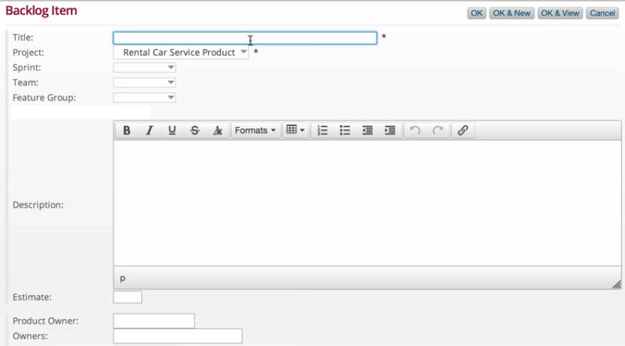
Product Backlog

Slide 15
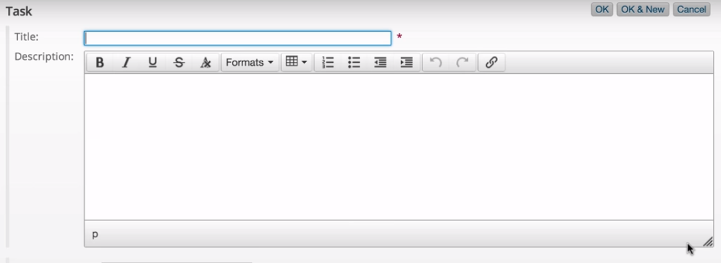
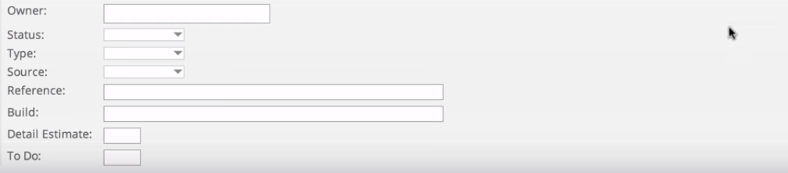
Task Creation

Slide 16
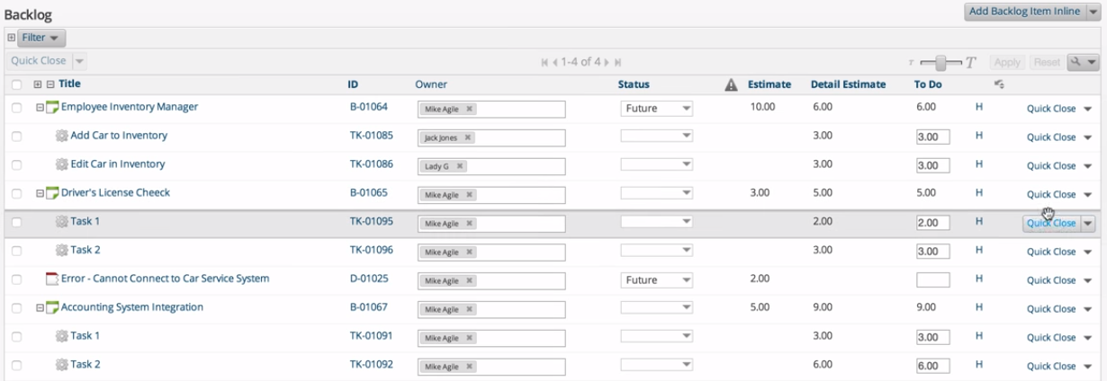
Backlog dashboard

Slide 17
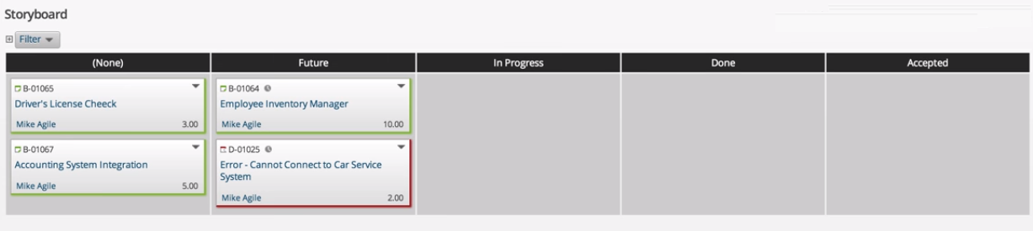
Storyboard

Slide 18
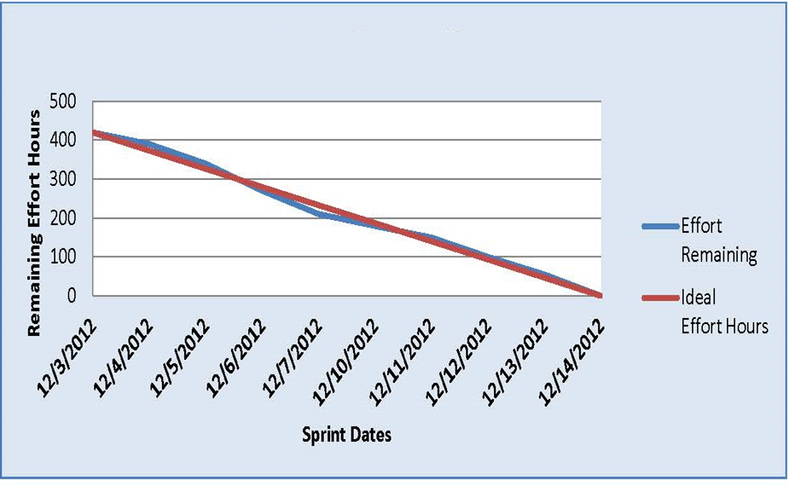
Burned-Down Chart

Slide 19

THANK
YOU

