Slide 1
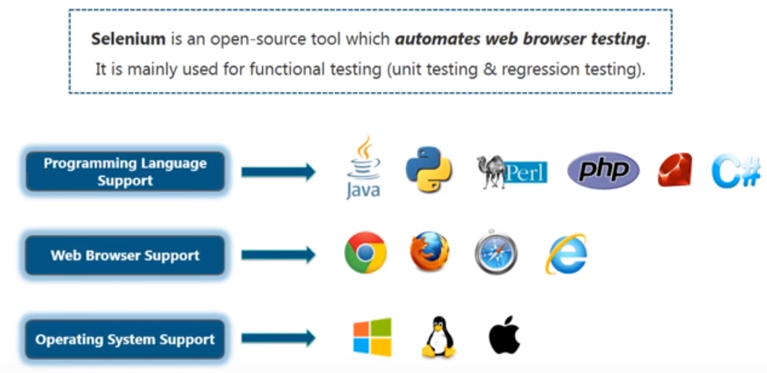
Selenium Automation Testing Tool

Slide 2
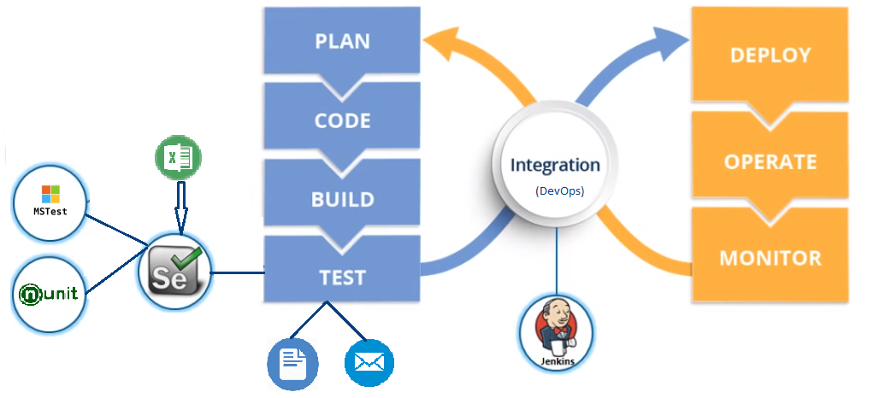
Selenium Role in DevOps Lifecycle

