Slide 1
Proof Of Concept On Project Management Tool By Salesforce

Slide 2
Agenda
Problems & Challenges
Solution for the Problems
Challenges for the solutions
Scope of PoC
Technology decision
SWOT analysis on Salesforce
Pricing and License
Our GOAL
PoC Screens
Demo on how its work
Questions & Feedback

Slide 3
Problems & Challenges
Project Estimation and Planning
Project Tracking
Problems
Multiple Report generation
Most of them
are in MS Excel
Organization
level project
visibility

Slide 4

Solution For The Problem
A module which will handle all about project
A module for member creation
and assignments
Project
A module for creating Backlogs
Member
Backlogs
To monitor project
progress by burned-down chart
Burned
Down
Project
Management
Tool
Sprint
A module for a complete sprint management
To see the complete
View of the project by
Backlog and user story
Story
Board
Tasks
Issue
Tracker
A module to create backlog tasks
and its estimation & Allocation
A complete module for tracking defects and Issues

Slide 5
Challenges For The Solution
01
Technology:
To select the right technology is the big challenge
04
Skills Set:
Team is new to the technology
02
Software license:
Software is only free for development.
05
Requirement:
Due to the lack of experience in Agile tools
03
Dev. Environment:
ODC restriction and white room policy
06
Current deliverable:
Team’s primary responsibility is current project deliverable

Slide 6

Decision Making on Technology – A Road Junction
MVC
Dot Net
AngularJS
ReactJS
Other UI frameworks
Core Java
MS SQL, Oracle, …etc…
Event-driven architecture
Device-aware and cross browser
Uses an event-driven architecture for better decoupling between components. Any component can subscribe to an application event, or to a component event
Responsive design and grate user experience. The Lightning Component framework supports the latest in browser technology such as HTML5, CSS3, and touch events
Performance
Uses a stateful client and stateless server architecture that relies on JavaScript on the client side to manage UI component metadata and application data
Rich Component Ecosystem
Faster Development
Create business-ready components and make them available in the Salesforce app, Lightning Experience, and Communities
Empowers teams to work faster with out-of-the-box components that function seamlessly with desktop and mobile devices. Drag-and-drop components on a Lightning Page

Slide 7
Technology - SWOT ANALYSIS
STRENGTH
WEAKNESS
Open source Aura framework.
Out-of-the-Box Component Set
Free development IDE
Development can be done anywhere.
Very good community, Resources and Support
Some Salesforce data and features aren’t available in the Lightning component. And some features don’t have full parity with what’s available in Salesforce Classic.
SWOT
OPPORTUNITY
d
THREAT
Technology can be used for new proposals.
Showcase our skillset to organization
Since 53 is aiming cloud computing and salesforce in 2019, a team will be ready by that time
Salesforce software license cost
and deployment
There is a chance for security
leakage if we not follow the
complete security policy

Slide 8
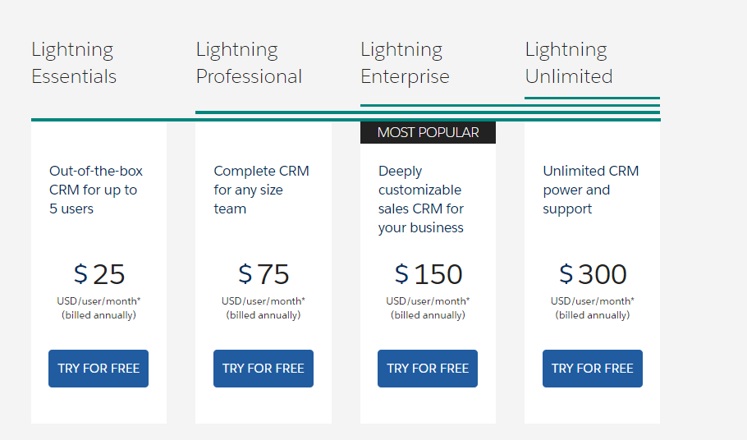
Technology - Pricing

Slide 9
PoC Scope
In Scope
Out Scope
Project creation:
Define a root project in the
project tree.
Create sub projects under the
root project
Member creation :
Define a new member
user name and privileges to
the user
Assign members to project
Project execution modules:
Backlog creation
Sprint creation - Add Backlogs
Task/User story creation
Add tasks to backlog
Story board
Burned down chart
Release management
Testing module
Defect managing and tracking
Backlog goals
Issue tracker
History
Approval workflow
Other dashboards

Slide 10
Our GOALS on PoC
To improve business objectives and software delivery alignment
To improve the ability to quickly adapt to changing priorities
To improve project visibility, and thus improved decision-making capabilities
To improve delivering software projects faster and more predictably
A Agile Tool

Slide 11
Screens

Slide 12
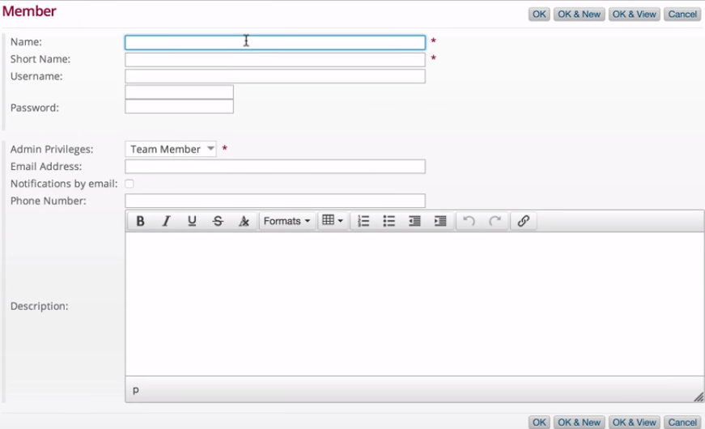
Create Member

Slide 13
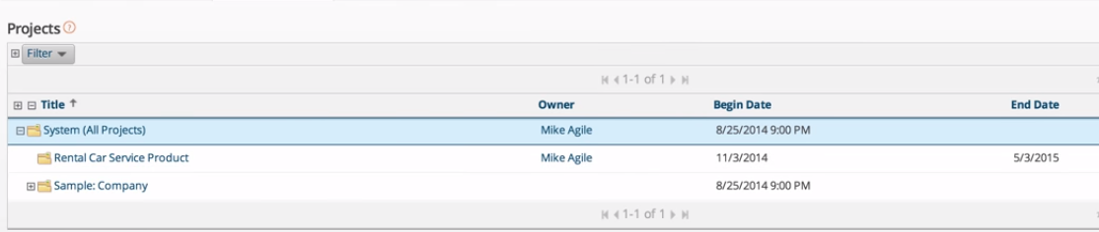
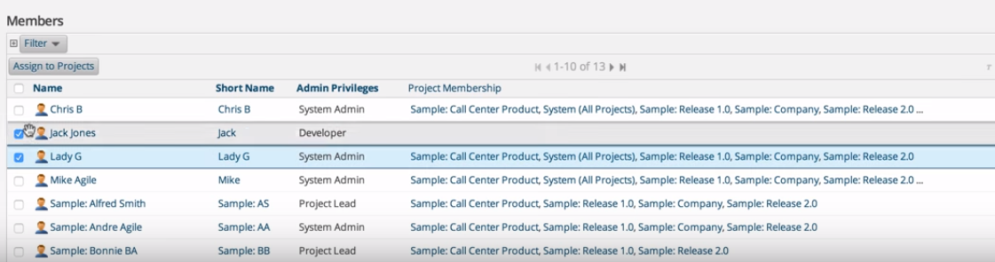
Assign Member to Project

Slide 14
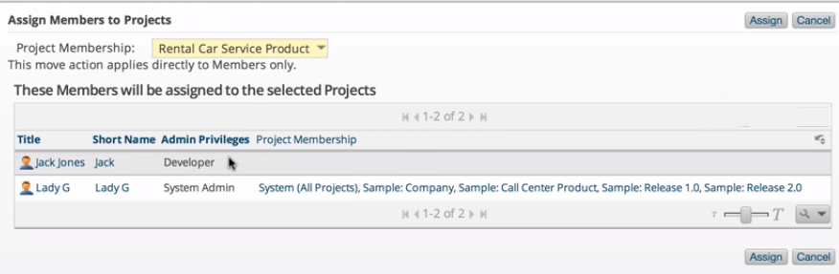
Confirm Project Assignment

Slide 15
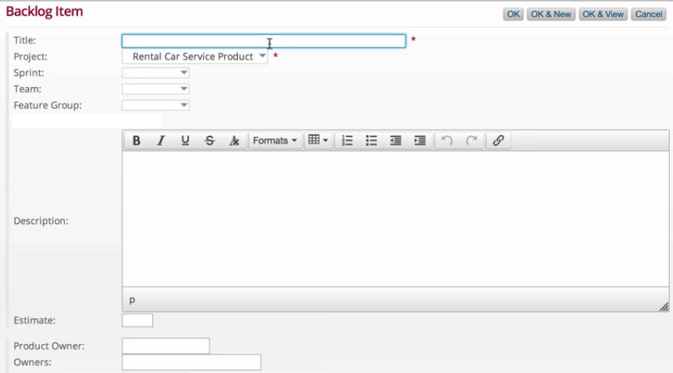
Product Backlog

Slide 16
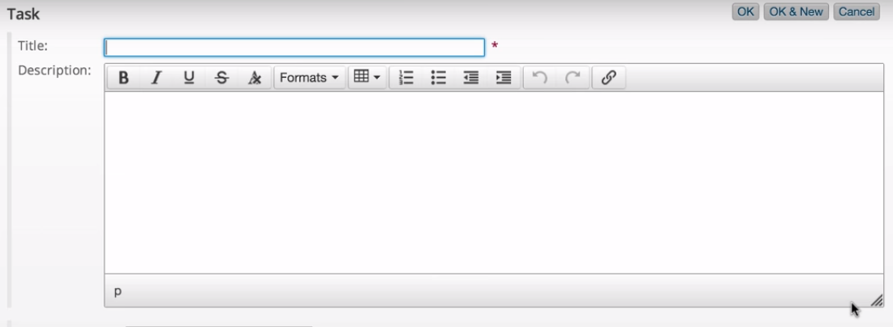
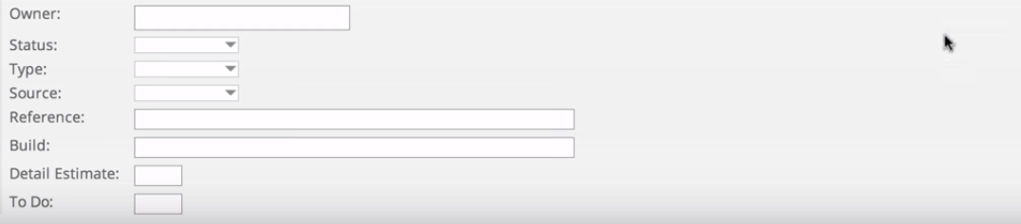
Task Creation

Slide 17
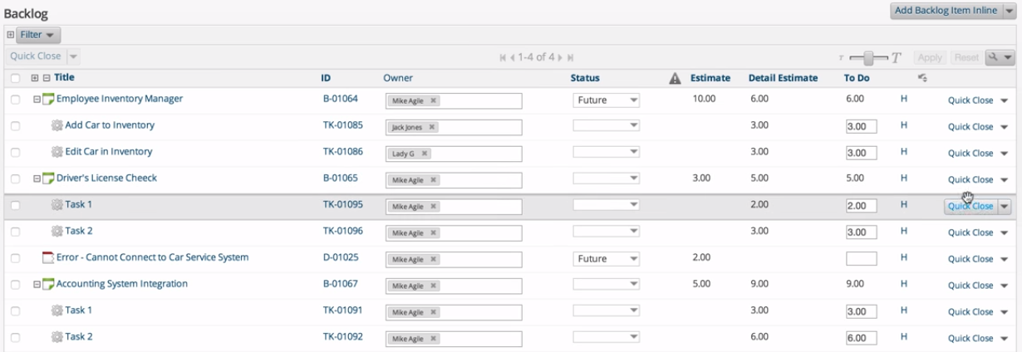
Backlog dashboard

Slide 18
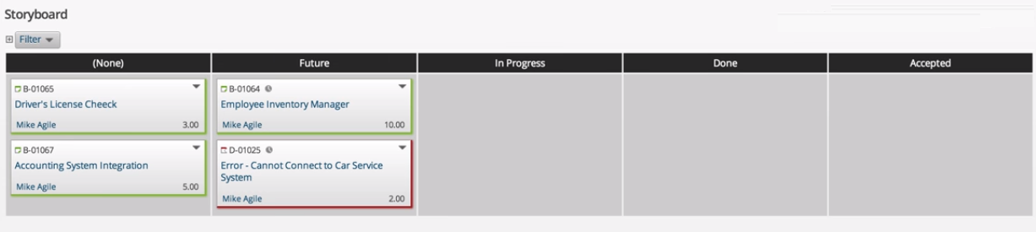
Storyboard

Slide 19
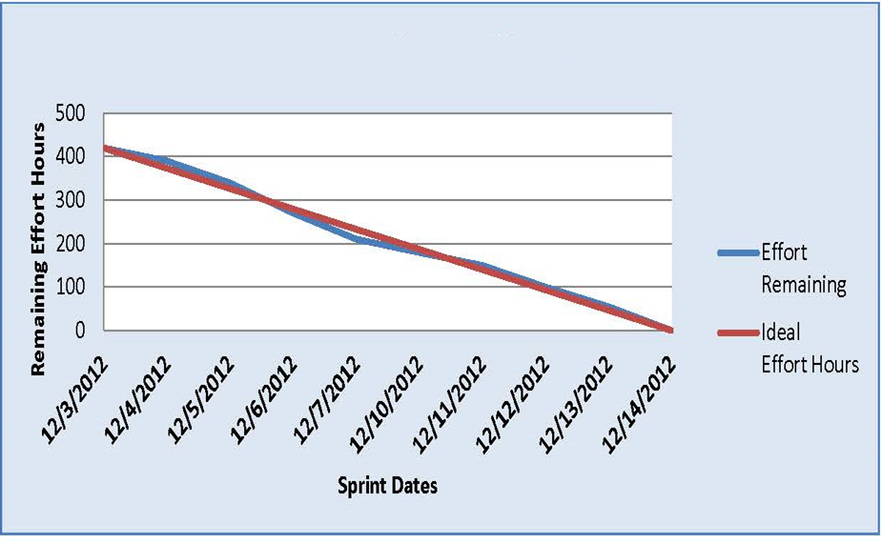
Burned-Down Chart

Slide 20

THANK
YOU

