Slide 1
Project Management System
An Agile Tool on Salesforce

Slide 2
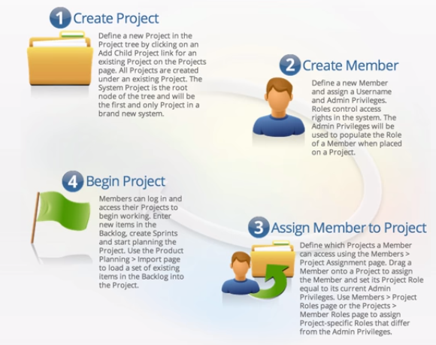
Scope of POC

Slide 3
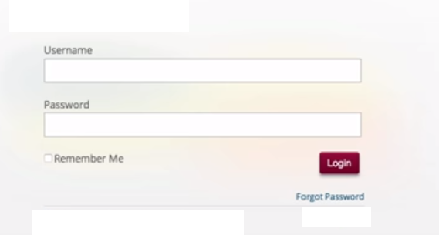
Login Screen

Slide 4
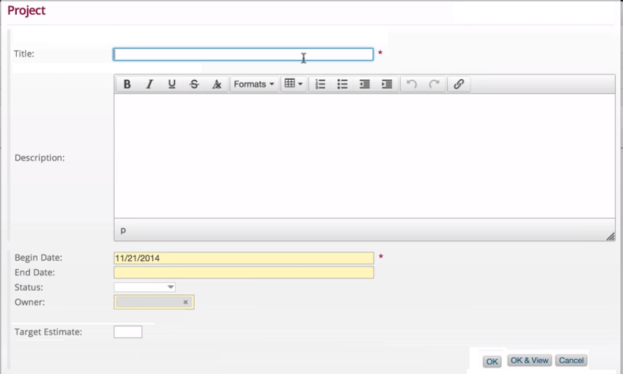
Create Project

Slide 5
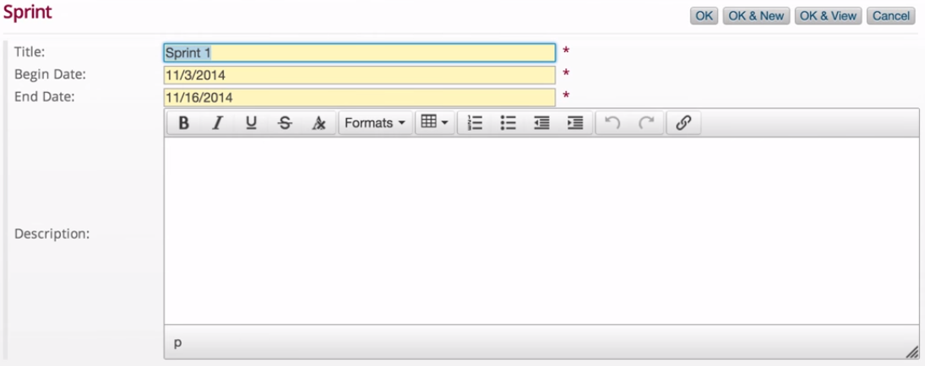

Create Sprint

Slide 6
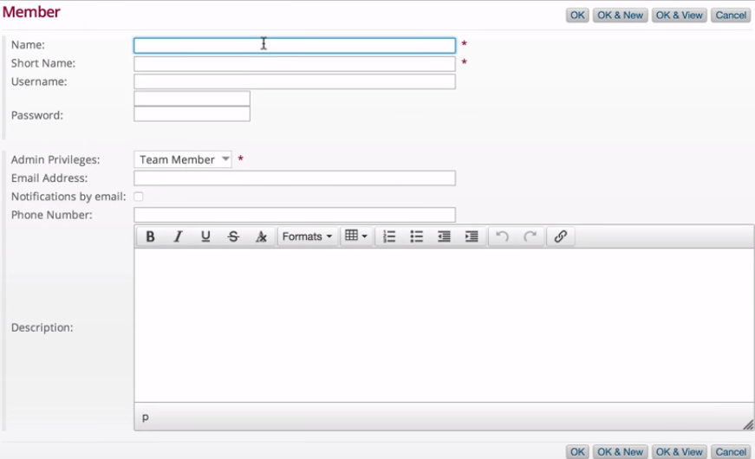
Create Member

Slide 7


Assign Member to Project

Slide 8

Confirm Project Assignment

Slide 9
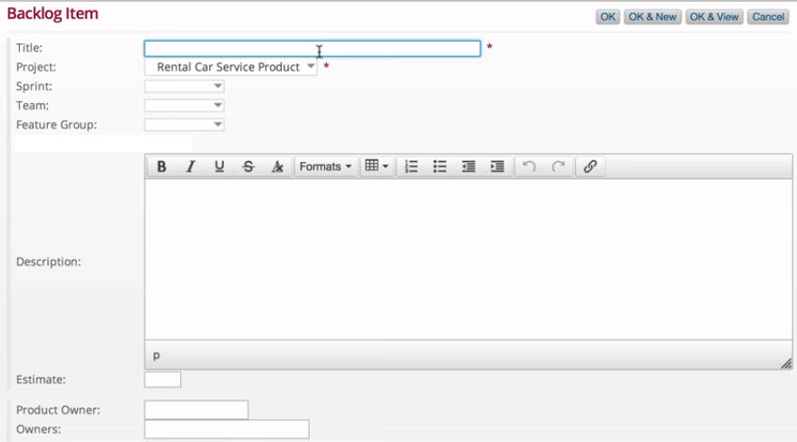
Product Backlog

Slide 10
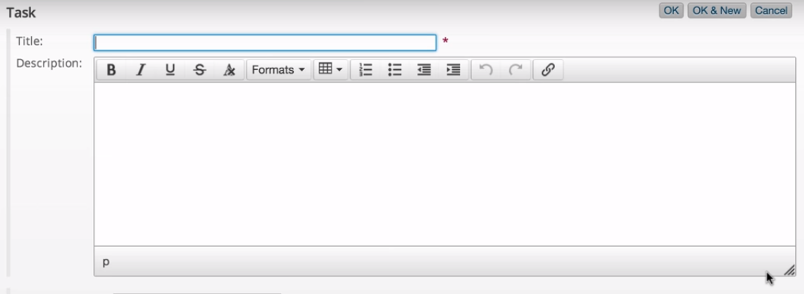

Task Creation

Slide 11
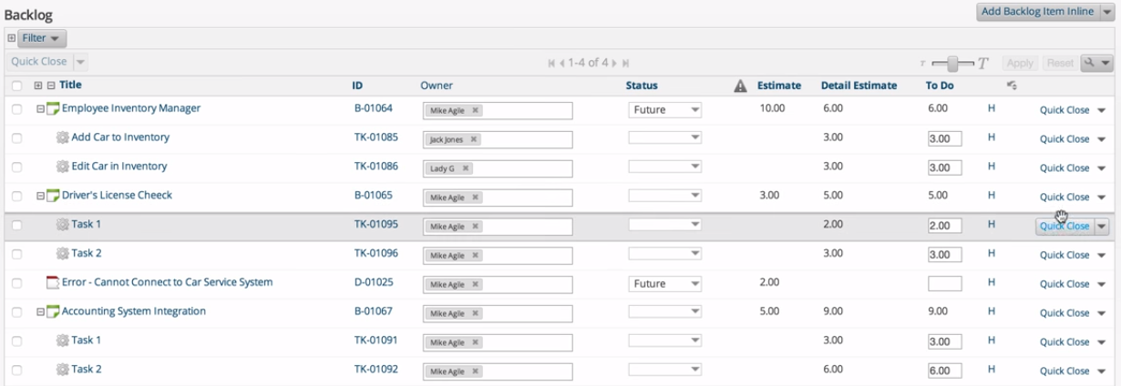
Backlog dashboard

Slide 12

Storyboard

Slide 13
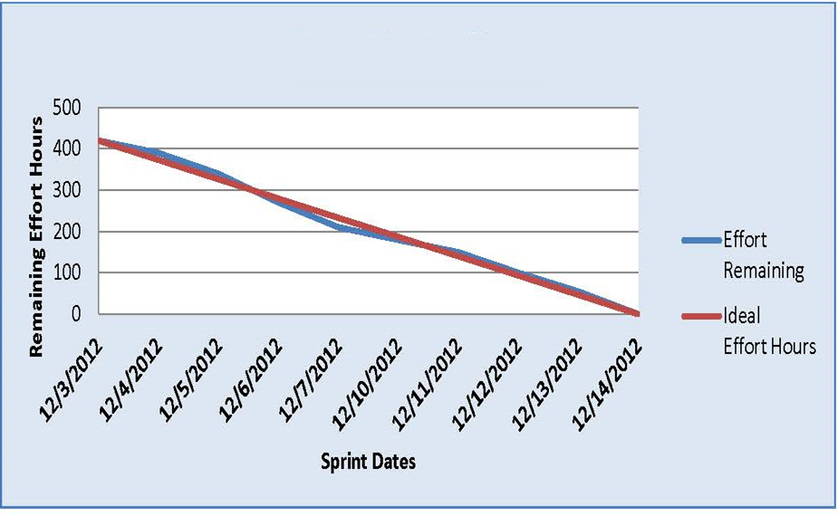
Burned-Down Chart

