Slide 1
SonarQube

Slide 2
Agenda
Introduction
History
Feature
Edition
Architecture
Installation
User guide
SonarLint
MSBuild

Slide 3
SonarQube
SonarQube is an open source platform for continuous inspection of code quality perform automatic reviews with static analysis of code to detect bugs, code smells and security vulnerabilities.
It is supported for 25+ languages such as
Java
C/C++
C#
PHP,
Flex JavaScript
Python

Slide 4
Sonarqube History
Sonarqube was developed by SonarSource ,an open source software industry founded in 2008
Sonarqube is written in Java language.
The other product of Sonarsource are
Sonarqube
SonarLint
SonarCloud
Motto : ”Continuous Inspection is as better as Continuous Integration”

Slide 5
Features
Continuous Inspection
Detect Tricky Issues
Multi Language
Devops Integration
Centralize Quality

Slide 6

Edition

Slide 7
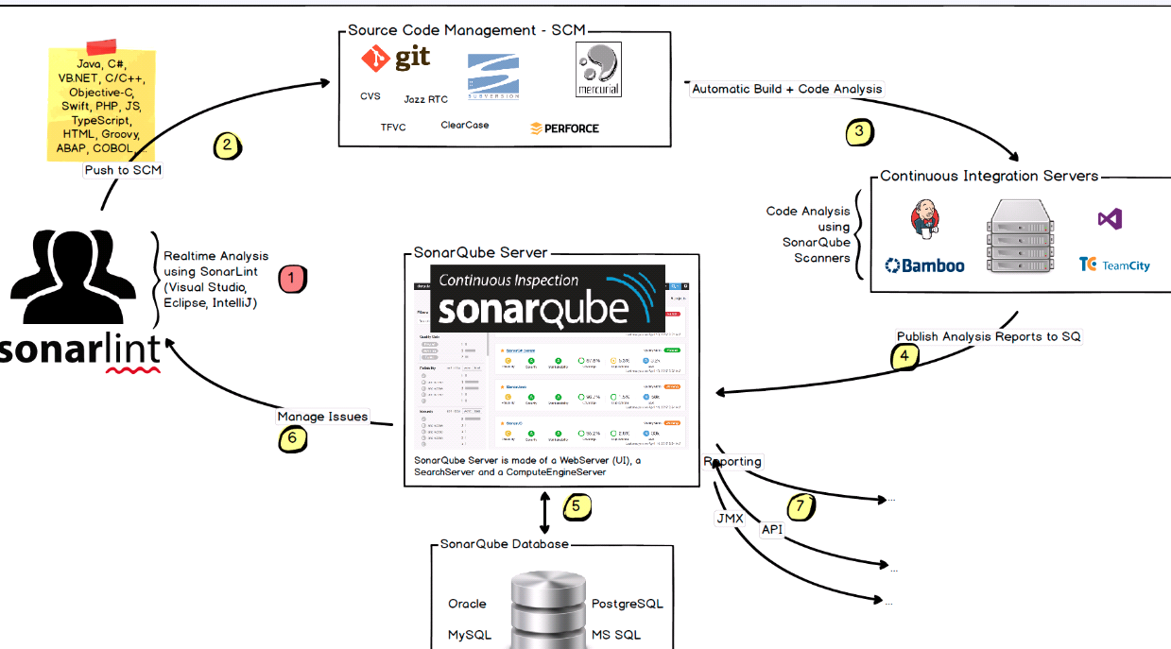
Architecture

Slide 8
Prerequisites
SonarQube is to have Java (Oracle JRE 8 or Open JDK 8) installed on your machine.
The SonarQube server requires at least 2GB of RAM to run efficiently and 1GB of free RAM for the OS.
The amount of disk space you need will depend on how much code you analyze with SonarQube.
Database-Microsoft SQL server, MYSQL, Oracle,

Slide 9
Installation

Slide 10
Installation of Sonarqube
Download the sonarqube latest version and unzip the folder
https://www.sonarqube.org/downloads/
Set environment variable
C:\SonarQube\bin
# On Windows, execute:
C:\sonarqube\bin\windows-x86-xx\StartSonar.bat
# On other operating system, execute:
/etc/sonarqube/bin/[OS]/sonar.sh console

Slide 11
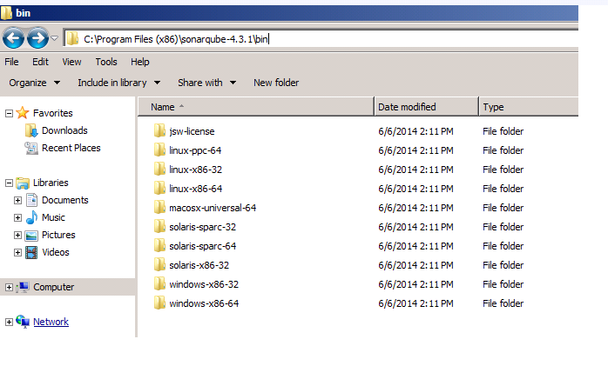
Sonarqube

Slide 12
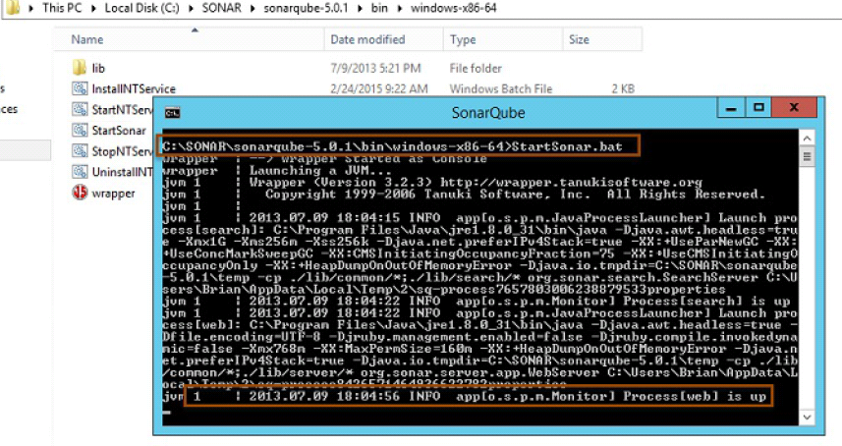
Sonarqube

Slide 13
Installation of plugin
Download the latest sonar-csharp-plugin-X.Y.jar. Use version 4.1 or higher of the plugin.
Locate the directory into which the SonarQube was installed e.g. C:\SonarQube\SonarQube-5.1\. This directory will have an
extensions\plugins\ subdirectory.
Copy sonar-csharp-plugin-X.Y.jar to this directory from the downloaded package above.

Slide 14
Installation of scanner
Download the latest SonarQube Scanner for MSBuild from the SonarQube downloads.
Right-click on the downloaded .zip file and click on the Unblock button.
Unzip MSBuild.SonarQube.Runner-[v ersion] on to a drive. Example: C:\SonarQube\bin

Slide 15
Configuration

Slide 16
Config file
Basic configuration of SonarQube consists of making a few updates to the sonar.properties file.
This file is located in the conf folder located under the SonarQube installation folder. Example: C:\SonarQube\SonarQube-5.1\conf.
In the extracted folder navigate to Conf folder, edit sonar.properties file to change the default setting. By default SonarQube uses port 9000.

Slide 17
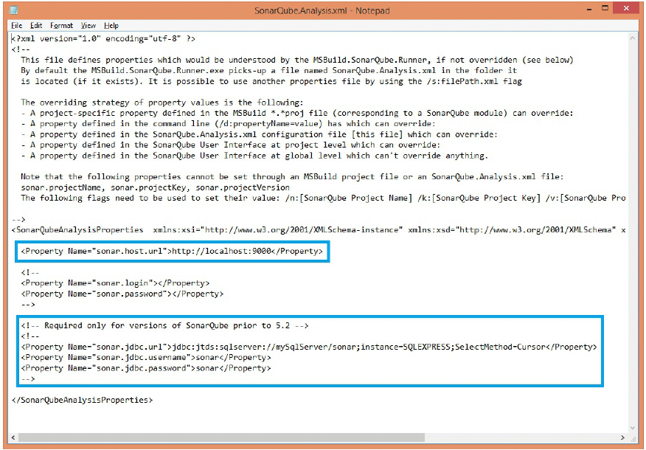
Config file

Slide 18
User Guide
Quality gate
Quality profile
Issues
Rules

Slide 19
Quality Gate
a set of Boolean conditions based on measure thresholds against which projects are measured.
users can be notified when a quality gate fails.
Quality Gates can be accessed by any user (even anonymous users). All users can view every aspect of a quality gate.
The quality gate "Sonar way" is provided by SonarSource, activated by default and considered as built-in and so read-only.

Slide 20
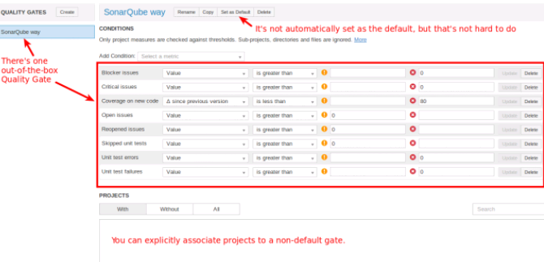
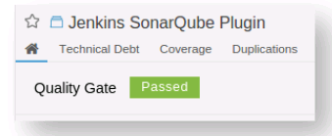
Quality gate

Slide 21
Issues
Sonarqube raises issue every time when a code breaks the coding rule.
Each issue are categorized with severity of the issue
Blocker issue
critical issue
Major issue
Minor issue
There are seven different things you can do to an issue (other than fixing it in the code!): Comment, Assign, Confirm, Change Severity, Resolve, Won't Fix, and False Positive.
Issue tags and rule assignment.

Slide 22
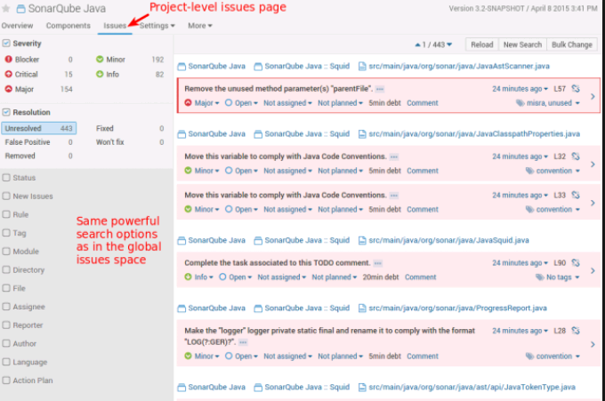
Issues

Slide 23
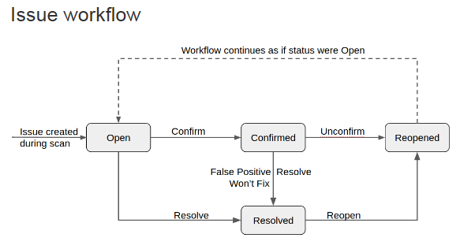
Issue workflow

Slide 24
Rules
In Sonarqube, Plugins contribute rule which are executed on source code and generate issues.
The three basic category of rule is Reliability, Maintainability and security
The Rules page is the entry point where you can discover all the existing rules or create new ones based on provided templates.

Slide 25
Built-in-Rule tag
Tags are a way to categorize rules and issues.
Some tags are language-specific, but many more appear across languages.
Users can add tags to rules and issues, but most rules have some tags out of the box.
brain-overload - there is too much to keep in your head at one time
bad-practice - the code likely works as designed, but the way it was designed is widely recognized as being a bad idea.
bug - something is wrong and it will probably affect production
clumsy - extra steps are used to accomplish something that could be done more clearly and concisely. (E.G. calling .toString() on a String).
confusing - will take maintainers longer to understand than is really justified by what the code actually does
design - there is something questionable about the design of the code
lock-in - environment-specific features are used

Slide 26
Code Viewer
The code viewer is the heart of SonarQube: it displays the source code of a file (both source and test files), and its high-level statistics:
Lines
Issues (generated by the rules activated on the quality profile)
Test coverage by unit or integration tests
Duplications within the same file or in other files
SCM information like who last committed a specific line and when

Slide 27
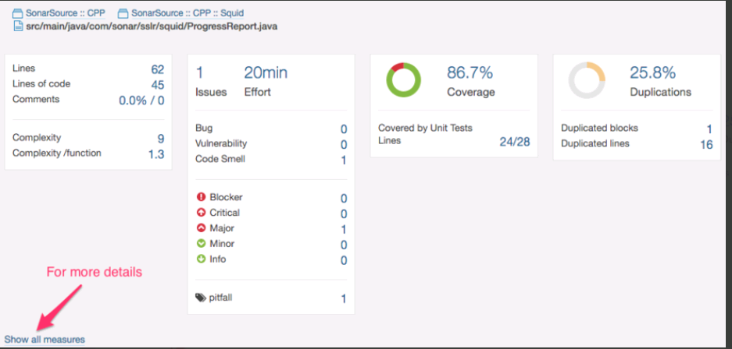
Code Viewer

Slide 28
SonarLint

Slide 29
SonarLint
SonarLint is a Visual Studio 2015 and 2017 extension that provides on-the-fly feedback to developers on new bugs and quality issues injected into .NET code.
SonarLint is free, open source, and available in the Visual Studio Gallery
Simply open a file within a project or a solution, start coding, and you will start seeing issues detected by SonarLint.

Slide 30
Features
Instant View-SonarLint highlights code issues with markers on open files. It also provides an issues summary table for a selected component in the IDE, including the creation time of the issue.
On-fly detection-Issues appear as you type code.
Smart Education-Error descriptions come with issue detection

Slide 31
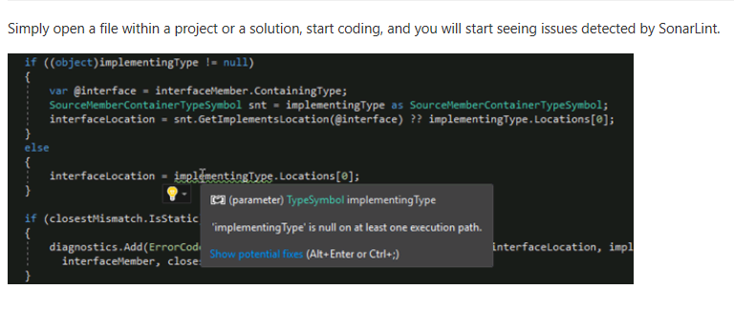
SolarLint

Slide 32
MSbuild
Run the MSBuild.SonarQube.Runner.exe begin phase
MSBuild.SonarQube.Runner.exe begin /key:{SonarQube project key} /name:{SQ project name} /version:{SQ project version}
The begin phase takes four arguments:
begin
/key:{the proj ect key of the SonarQube project to which the build relates}
/name:{the proj ect name of the SonarQube project}
/version:{the proj ect v ersion of the SonarQube project}
The aliases /k:, /n: and /v: can also be used.
>

Slide 33
Thank you

