Slide 1
Code Review Strategy
SBL

Slide 2
Current and Proposed
Tools
Manual
Proposed Tools
MS Test & MOQ
53 Coding standards
SonarQube
MS Code Analyzer
React Coding standard
FxCop
Mocha-Chai
Functional review
StyleCop
ReportGenerator
SOLID principles
NDepend
OpenCover
MS Best practices and experience

Slide 3
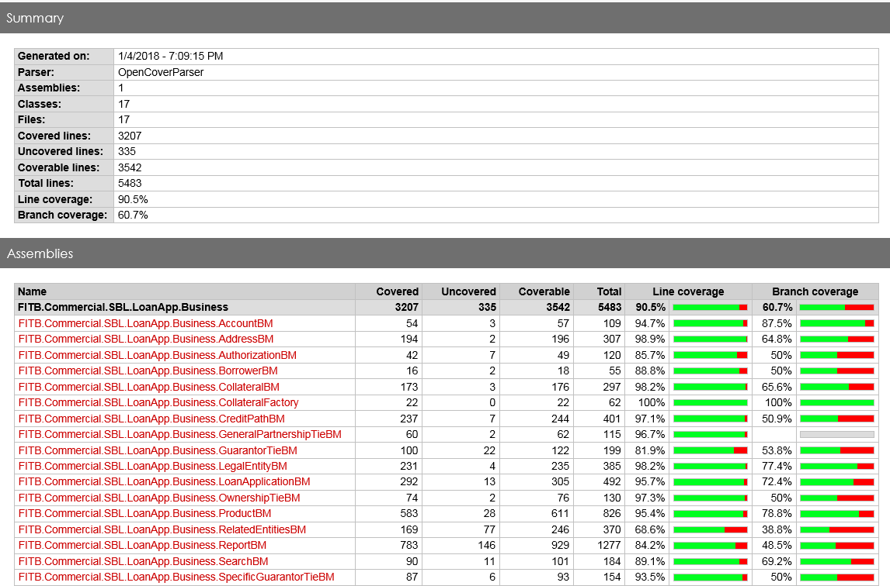
Code Review Report

Slide 4
Additional Steps
We have followed SOLID principles keeping our code Loosely Coupled and stressing on Readability.
Used design patterns like Factory pattern, Abstract Factory pattern, Façade pattern and also implemented Dependency Injection and IOC concepts.
Our code is rightly segregated with no redundancy making it more maintainable.
  Advantage of doing all the above we have already seen as we have been able to quickly debug and fix the logged defects on many occasions which has been appreciated by the business users.
We have used MSTest and MOQ to write unit tests with zero dependencies on databases which have helped developers write and test the code without any UI or database.
All the Credit path dependent IDs like Collateral type IDs, Product type IDs, Loan Type IDs and Status IDs are made configurable in database. This has helped us in managing the difference in credit path IDs across environments.
All the APIs and API methods are made configurable. Any changes to any API method can be handled by just updating the config files.
All the Disclosures and Financial Needs Checklist documents are made dynamic and configurable. Any changes to Prior Submit/After Submit disclosures or Financial Needs Checklist can be done without any code change. This is not just with changing the existing list even the new documents can be added without any code change/deployment.
  For CR 204158 – Adding new checklist for individual borrower and updating a checklist item for non-individual borrower/guarantor was done without any code change within 10 mins.
We have achieved the Combining of PDFs and updating the page numbers dynamically by making using of multiple Open source components there by avoiding buying of any licensed component.
We have implemented Versioning and Attribute routing for Web Api - With this for any requested method the internal scan does not have to happen on all the existing API methods.
On the UI side we have used Redux effectively to maintain the all the state and common data and hence avoiding multiple calls to API for the same data.
We have built state independent common components such as Grid, TextArea, Spinner, Dialog Box, etc which can be used in any react application.
We have abstracted the UI components such that we can replace our state management mechanism (Redux) without requiring huge effort.
We have taken care of small things like using constants, using right access modifiers, using enums wherever necessary, using latest C# features, writing testable methods, given meaningful method & variable names. All these will help in maintaining the code base over a period time.
We brought in Font Awesome icons which has helped us to build an appealing UI without requiring the actual images.
We have taken the initiative to speed up the requirements and built Documents/Flow charts around Related Entities, Renewals, Address, Progress Icons and etc. which has helped to complete the requirement documents.
We have taken many deviations to make the UI and application user friendly, knowing very well that these will later be defects counted against us.
We have given solutions to many flow specific requirements like Collateral-Product mapping, Guarantor check, Removals and etc.
We have given importance to even minor details (even though they were not asked for) like showing the exclamatory icons, error icons on the dialogs, having the similar fields aligned/ordered and etc.
We have absorbed many CRs without making much noise throughout the development and QA cycle. Most of the CRs we could have easily pushed back but we have absorbed them to provide the important functionalities and deliver a better application.
Throughout QA and UAT cycle we have followed up with multiple teams repeatedly and taken the lead to close out the defects. We have also worked with BA continuously on updating the requirements.
With FNA not giving us much time we have shown proactiveness in providing the contract for data exchange, defined and provided them with all the codes which are needed for the integration even though many of these should have been provided by them.

Slide 5
Thank you

