Slide 1

SBL
Code Quality Strategy
(Development)

Slide 2
AGENDA
1
4
TOOLS
BEST PRACTICES
Fifth Third and Microsoft tools which is using currently in SBL
Followed the best standards and principals for Coding and Design
2
5
REPORTS & METRICS
WE PROPOSE
Reports & Metrics which we generated from the approved tools and those we produced to customer as part of 53 internal process and SLK
New proposals which will give us better quality and project visibility
3
6
CHALLENGES
MANUAL PROCESS
Manual process which we follow to make sure the code quality
Challenges, Suggestions, improvement area, Question & Answer and Future plan

Slide 3





TOOLS
MSTest & MS Code Analyzer
A testing framework is defined in MS Visual Studio, which will help developer to write unit test for business logics and same can be automated before build and deploy
MOQ – Metaphysics of Quality
It is a mocking framework for C#/.NET. It is used in unit testing to isolate your class under test from its dependencies
Fiddler & Swagger
To test API Services request & Response, Patterns and protocols..
ReportGenerator &OpenCover
Using OpenCover (Metrics) and ReportGenerator (Report) to get Unit Testing Code Coverage Metrics in .NET
Mocha-Chai
A third party plug-ins approved UI testing framework for ReactJS & Redux based applications

Slide 4
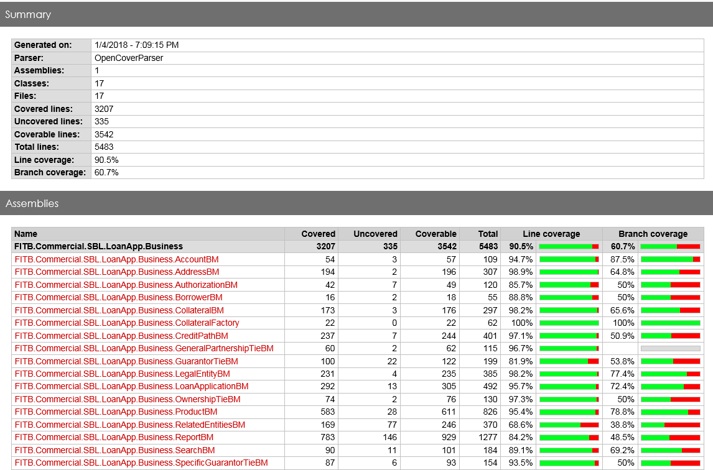
Sample Report and Metrics
4

Slide 5
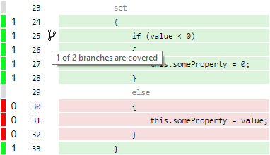
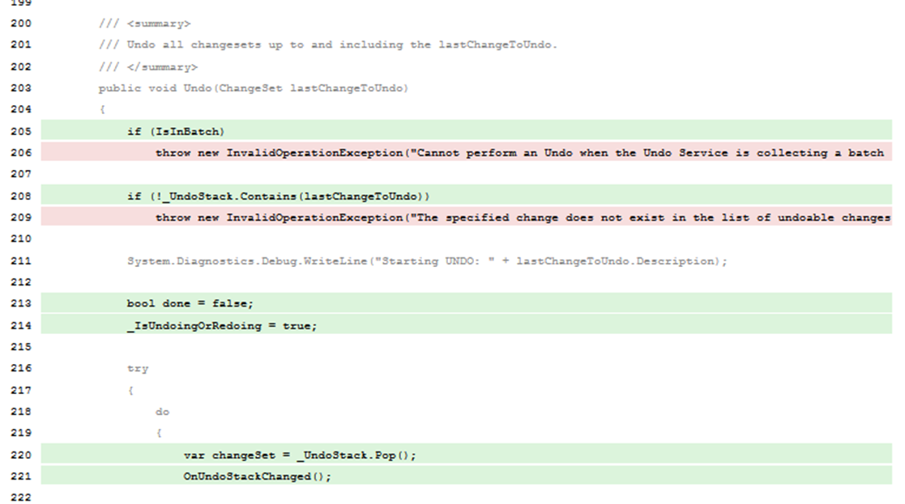
Report in Detail
Branch Coverage
Covered, Uncovered & Coverable
5

Slide 6
Manual Process
53 Coding Standard
SLK/53 Defined UI Standard
53 provided well defined coding standard which we have done a walkthrough to the team before we start the development and followed the same during our development
SLK come-up with ReactJS framework standard which is well appreciated and received by Customer. 53 provided UI look and feel standard for the Font, Color and Style
Functional Review
Most important review: Leads will do functional and logical review with the developer according to the business.
Developer’s peer review is part of this mode
Brainstorming Session
MS Framework Standards
For the complex and conflict decision on the review output, we (offshore /onshore leads & 53 tech team) gather through WebEx call to take final decision on the changes
Along with all above , Leads will apply the MS framework best practices and standards. Most of the code refactoring happened in this mode of review.

Slide 7





Most of the SBL application Coefficients , Constants, URLs, Mapping fields are configured in DataBase
We have used React based build-in highly responsive components which help us to improve quality
Configurable
Reusable
Responsive
Design
Security
UI modules developed by reusable state independent common components, which can be used across 53
We have followed SOLID principals and major design patterns to make sure the reusability & maintainability
To make sure the application authentication and authorization , we have implemented Token and Azman.
Other Quality Factors
Which we followed apart from the Tools and Manual process.

Slide 8




Proposed Tools
SonarQube
To do continuous inspection , Detect Tricky Issues, More reports and metrics , The complete control on the application quality and health.
FxCop & StyleCop
Two useful tools for code analysis and build-in pre –defined rules which will be common for across the applications. Can write our own custom rules according to our coding standards
Selenium WebDrivers
Can write automation testing scripts in C# (or any other languages) for end-to end web testing. A free open source dll. We gave demo to Customer on SBL
We Recommend
NDepend
The tool supports a large number of code metrics, allowing to visualize dependencies using directed graphs and dependency matrix and much more .. It is a paid licensed tool
SonarQube because, it provides the capability to not only show health of an application but also to highlight issues newly introduced. With a Quality Gate in place, you can fix the leak and therefore improve code quality systematically. A free open source java based tool

Slide 9
Performance
Challenges we faced
We were not able to execute performance testing from the dev side due to the lack of tools and resources
We have address all those issues by re-design the non-performance modules
Non Functional
Was not able to reproduce some of the system compatible issues like screen size and browser related issues.
By using the Chrome simulator we could address all those issues
Vendor’s Apps
SBL will talk to n number of external systems which is handled and maintained by the other vendors, Dev team couldn’t do a end to end unit testing due to the lack of the accessibility to the those systems
Data Discrepancy
We have faced some challenges when the application went to production due to the data format which we have not tested during the development due to the lack of test data availably

Slide 10
THANK YOU!
Questions & Suggestions
10

