Slide 1











Training On
=>
ReactJS
Redux

Slide 2
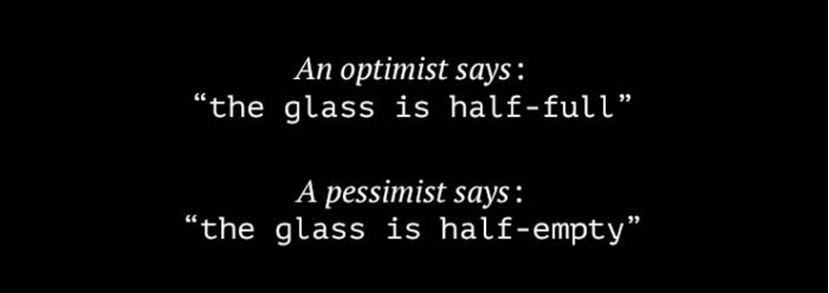
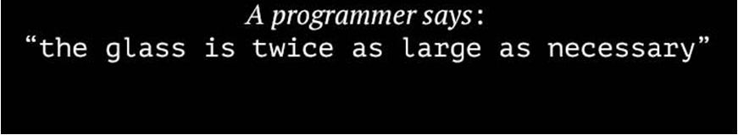

Slide 3
About this program
Why internal organization level training
How we will run this training
PPT slides – For theory & concepts
Demos – Developing sample codes
Develop a module which will cover all the topics
Scenarios & open discussion
Live project walkthrough
What you should know – Prerequisite
HTML
CSS – (Not that important)
Basic JavaScript
Programming fundamentals (Functions, Conditionals, Loops… etc)
Good to have UI Design skill
Commitment

Slide 4
Course Outline
Introduction to ReactJS (1hr)
ReactJS – History
Comparison between other library/frameworks
What it is good for
What is not so good for
When, Where and How to use
How it’s work – Virtual DOM
Setting up Project(1hrs)
Intro to Text Editors
Node.Js , npm, Babel & node_module
Package.json
Webpack
Bundle.js
Sample Hello World

Slide 5
Course Outline
React Presentational Components(12hrs)
JSX & ES6
Props & State
Data transfer between components: Parent-Child
PropTypes, and Stateless Functional Components
Utility functions – Lodash.js
Conditional rendering
CSS/Bootstrap in React – Conditional styling
Handling events in React
Form Validations in React
Router – Intro to SPA Navigation functionality
React Containers
React component Lifecycle
React Unit testing

Slide 6
Course Outline
Redux Architecture – A state machine(4hrs)
Why Redux
Store
Dispature
Action Creator
Actions
Reducers
ReactJS-Redux with Web API– by using axios.js

Slide 7
Course Outline
Live Project (6hrs)
Production project architecture
Develop a sample Project based on the above topics
Best practices
Real time Scenarios and Solutions
Open Discussion

Slide 8

End of this course WE should feel...

Slide 9
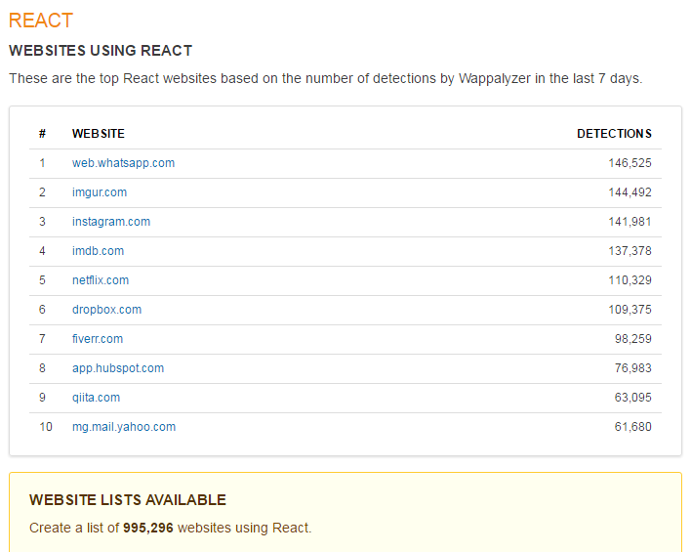
ReactJS Popularity
https://wappalyzer.com/applications/react

Slide 10
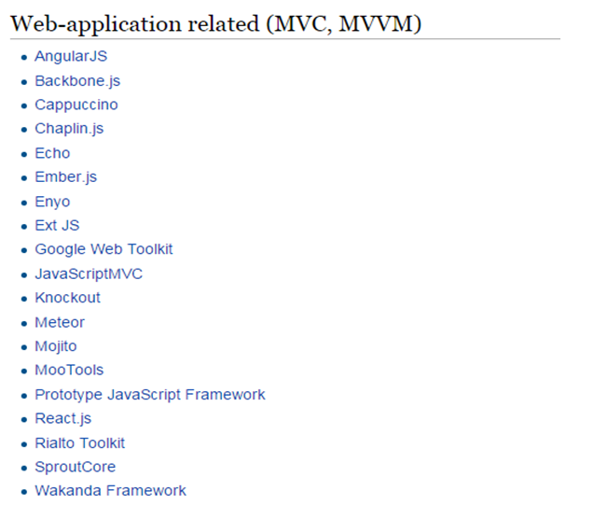

Frameworks & Libraries

Slide 11


About React
A Javascript library for UI
Maintained by facebook and instagram
Having a huge community
https://facebook.github.io/react
https://github.com/reactjs
Can be the “V” in MVC
Is ideal for large scale single page application
Use high speed virtual DOM
Use clean and easy to understand JSX syntax
Since 2013
Redux(2015 june) or Flux architecture based
Unit testing , logging, state management
What is not for
Server side framework/technology
Javascript framework (like Angular2)
Design Pattern
Platform or language (.Net, Java ..)

Slide 12
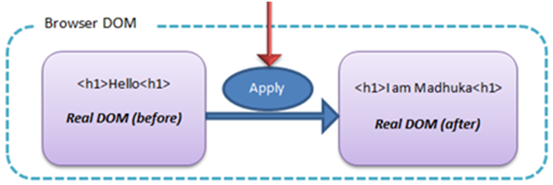
How other libraries works
Javascript/JQuery
Backbone/Angular1.x Views

Slide 13
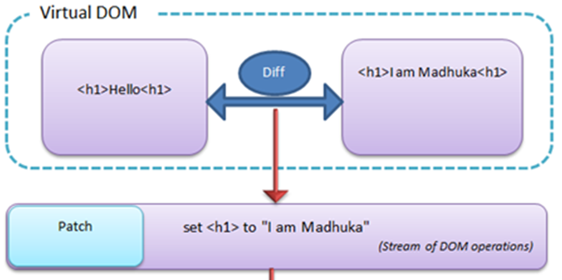
Why React is Fast - Virtual DOM
JavaScript
React
React

Slide 14


ReactJS Project Setup
ES6
Node.JS -
node –v - To check the installed node.js version
Npm – Node Package Manager
npm install <package_name> --save
Node_Modules
Package.Json
Server (local web server) configuration
Babel
Webpack
Bundle.js

Slide 15

Node.js, npm, ES6, babel, webpack & bundle.js
Node.js
WebPack
Bundle.js
.js
.js
npm
.js
.js
ES5
Support all ES5 features
Packages
Translate
Support many ES6 features
react
Doesn’t support some ES6
babel
ES6
axios
Required for react
Use Next generation
JavaScript today !
React-Dom
JQuery
redux
lodhash
Webpack

Slide 16
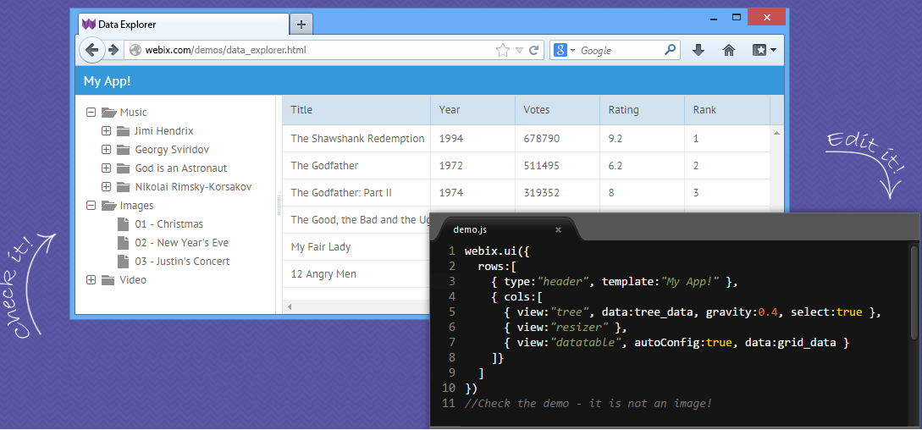
Components

Slide 17
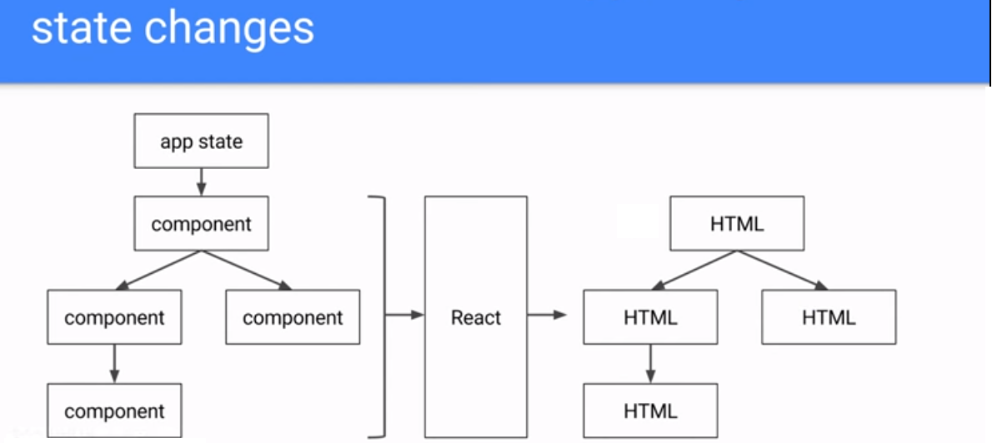

Slide 18

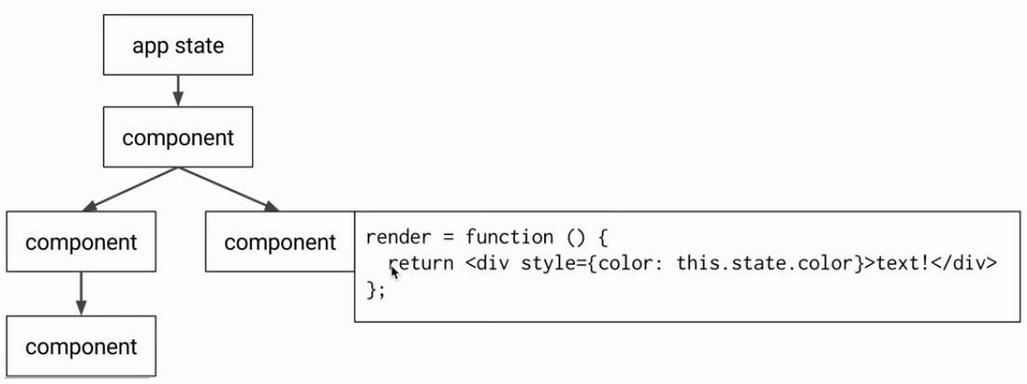

Slide 19
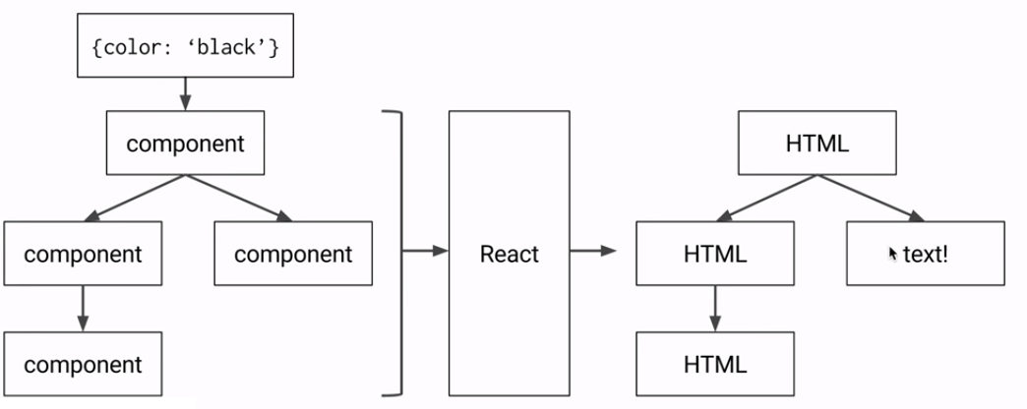

Slide 20
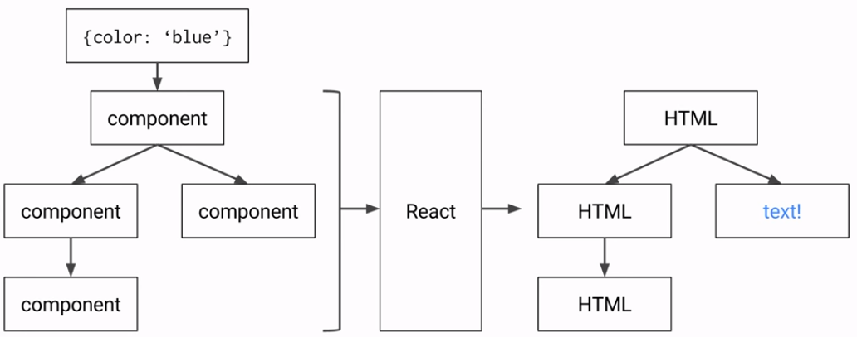

Slide 21
Redux
Why Redux
How its works
What are the components in Redux
A sample application
Redux

Slide 22
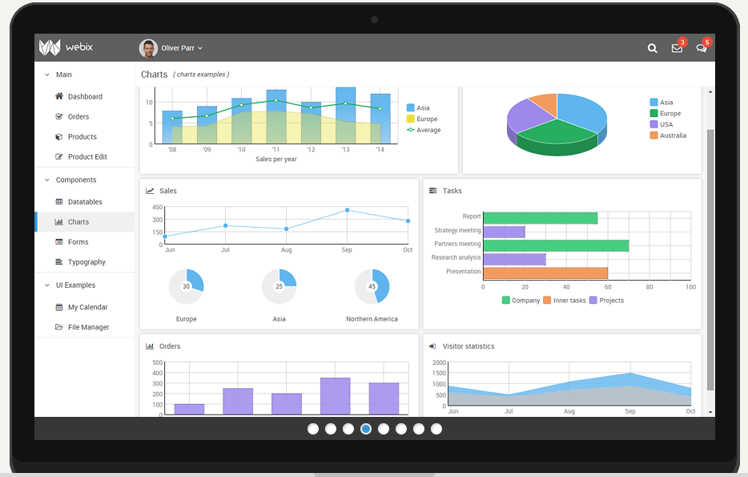
SPA Components

Slide 23

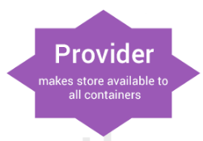

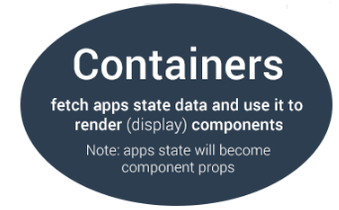

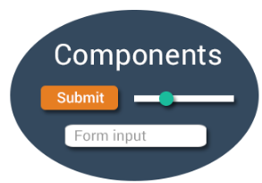

InitilaTodo
NewTodo
Web API
Actions
Any change made to the application state
User

Slide 24
Borrower
Common
Owner1
Owner2
Ties
LE Common
Product
Common
Collateral Common
Products
Guarantor
P1
P2
P3
Owner
1
Owner
2
Owner3
LoanApplication Reducer

Slide 25
company-reducer(companyInfo)
default-reducer(defaultTodo)
ToDos
Employees
ExtEmployees
defaultTodo
All Reducer(state)

Slide 26
app.js
React-Redux Project Folder structure
App
routers
root-app.js
components
user-component.js
todo-component.js
containers
person-container.js
node-module
actions
todo-action.js
user-action.js
webpack
.config.js
reducers
default-reducer.js
Todo-user-reducer.js
package.json
constants
app-constants.js
server
utils
common.js
public
img/css
buddile.js
index.html

Slide 27

You can ‘React’ Now!

