Slide 1
UI Framework Discussion

Slide 2
Agenda
Client side Frameworks, Libraries and Components
Comparison
Angular1.x, Angular2 and ReactJS
Popularity
Performance matrix
More on ReactJS
Why ReactJS
How React works
React based websites
Prerequisite - Start-up kit
Configurations
Syntax – Code snippets
Architecture
Flux
Redux
How its work
Open discussion & Questions

Slide 3
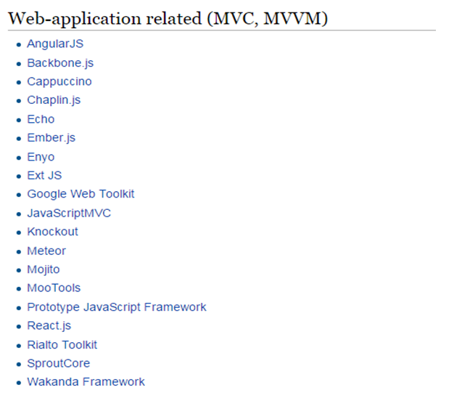
Frameworks & Libraries

Slide 4
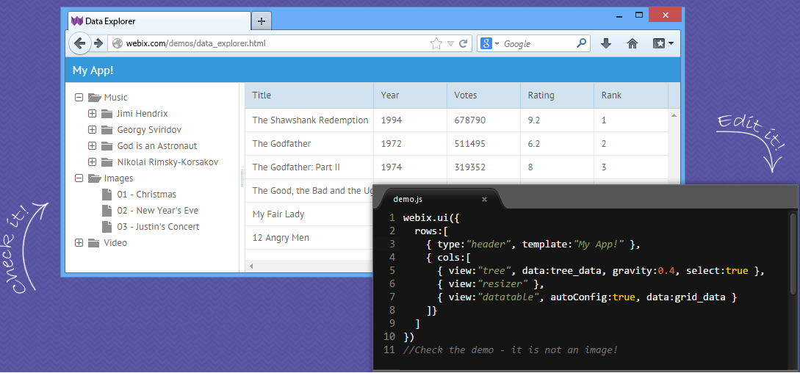
Components

Slide 5

Native Components

Slide 6
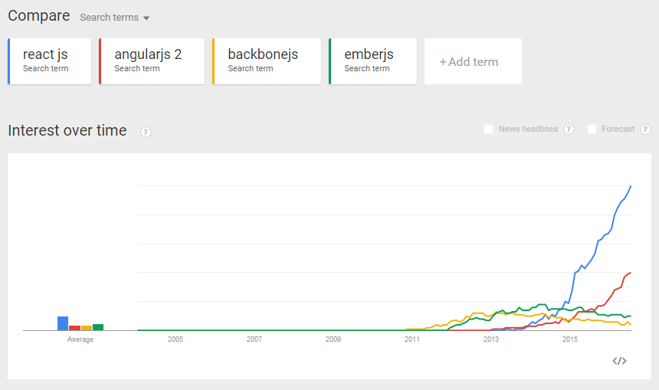
Google Trends
https://www.google.com/trends

Slide 7
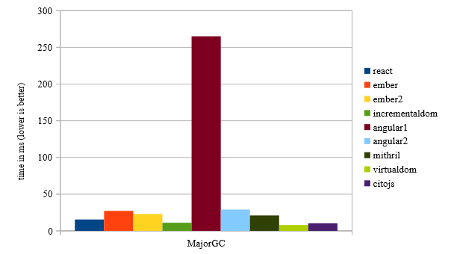
Performance Comparison – Virtual DOM
https://auth0.com/blog/2016/01/07/more-benchmarks-virtual-dom-vs-angular-12-vs-mithril-js-vs-the-rest/

Slide 8
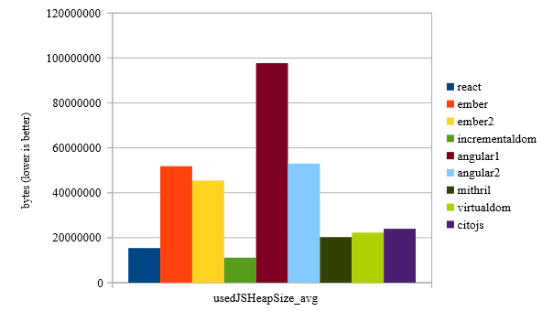
Performance Comparison – Memory usage
https://auth0.com/blog/2016/01/07/more-benchmarks-virtual-dom-vs-angular-12-vs-mithril-js-vs-the-rest/

Slide 9
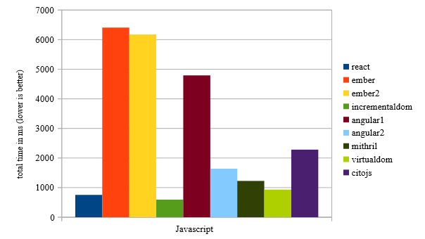
Performance Comparison – JavaScript Execution Time
https://auth0.com/blog/2016/01/07/more-benchmarks-virtual-dom-vs-angular-12-vs-mithril-js-vs-the-rest/

Slide 10


Angular 1.x Vs Angular 2
Angular 2 is mobile oriented & better in performance.
5 times faster than 1.x
Angular 2 provides more choice for languages.
Es5, es6 and TypeScript
Angular 2 implements web standards like components.
AngularJS 2.0 is not easy to setup as AngularJS 1.x.
Angular 1.x controllers and $scope are gone.
Structural directives syntax is changed.
Angular 2, directly uses the valid HTML DOM element properties and events.
<button ng-click="doSomething()"> - A1
<button (click)="doSomething()"> - A2
One-way data binding directive replaced with [property].
Two-way data binding: ng-model replaced with [(ngModel)]
Way of Bootstrapping Angular Application is changed:
Ways of Dependency Injection is Changed- syntax changed.
Way of routing is Changed- syntax changed.

Slide 11
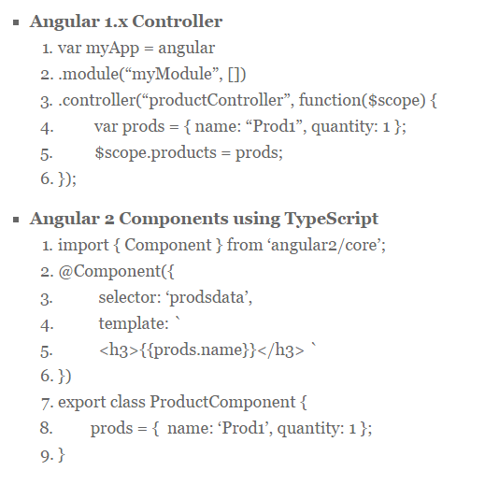
Controller

Slide 12
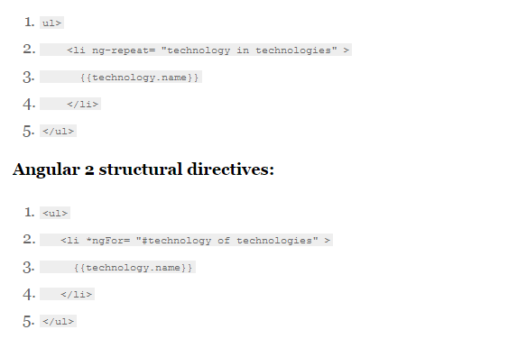
Structural

Slide 13

Why ReactJS
Maintained by facebook and instagram
Having a huge community
https://facebook.github.io/react
https://github.com/reactjs
Resources and Forums
Stackoverflow,
Discuss.react.org
HitHub Social Coding
Official sites
Redux.js.org
Can be the “V” in MVC
Is ideal for large scale single page application
Use high speed virtual DOM
Use clean and easy to understand JSX syntax
Since 2013
Redux(2015 june) or Flux architecture based
Unit testing , logging, state management

Slide 14
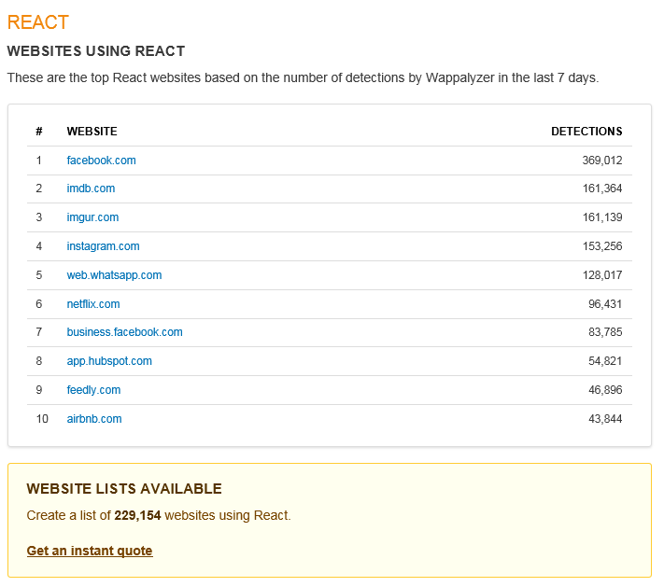
ReactJS based websites
https://wappalyzer.com/applications/react

Slide 15
Why slow
DOM
query
write
JavaScript Logic
DOM
render
Backbone/Angular1.x Views

Slide 16
Why ReactJS is fast
DOM
render
React Virtual DOM
getDOMNode()
JavaScript Logic

Slide 17
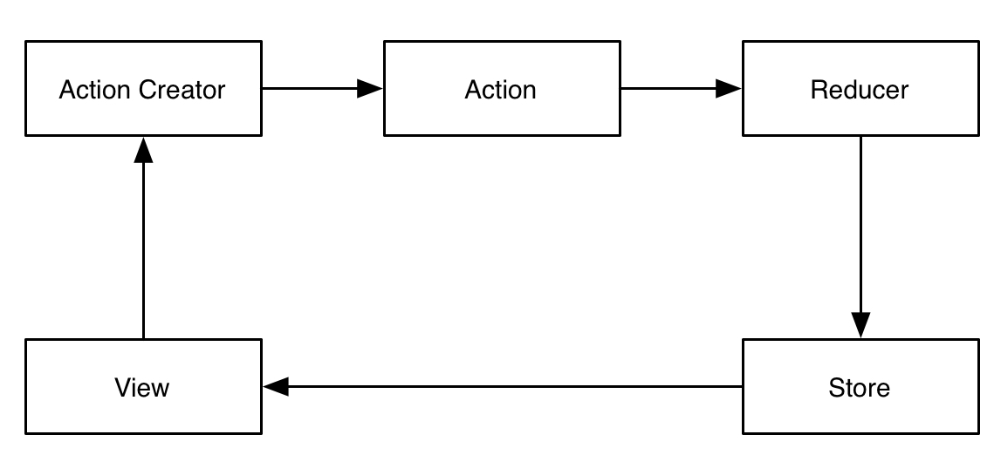
Redux Architecture

Slide 18
Redux Architecture - Detail

Slide 19
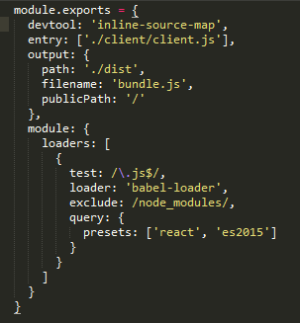
WebPack config

Slide 20
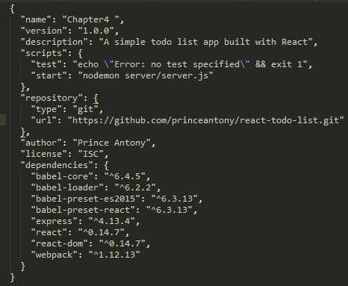
package.json

Slide 21
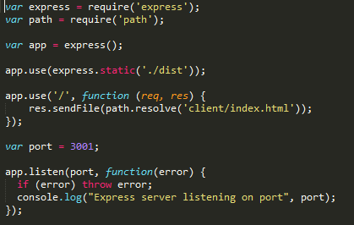
Run time server config

Slide 22
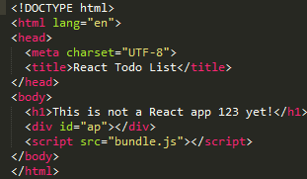
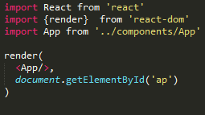
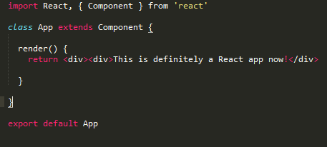
ReactJS Syntax
Bundle.js

Slide 23

You can ‘React’ Now!

