Slide 1
ReactJS-Redux

Slide 2

Agenda
About ReactJS
Why we chosen React and Redux
How React works
React based websites
Performance matrix
Redux Architecture
Open discussion & Questions

Slide 3
Why ReactJS
Maintained by facebook and instagram
Having a huge community
https://facebook.github.io/react
https://github.com/reactjs
Resources and Forums
Stackoverflow,
Discuss.react.org
HitHub Social Coding
Official sites
Redux.js.org
Can be the “V” in MVC
Is ideal for large scale single page application
Use high speed virtual DOM
Use clean and easy to understand JSX syntax
Since 2013
Redux(2015 june) or Flux architecture based
Unit testing , logging, state management

Slide 4
Why slow
DOM
query
write
JavaScript Logic
DOM
render
Backbone/Angular1.x Views

Slide 5
Why ReactJS is fast
DOM
render
React Virtual DOM
getDOMNode()
JavaScript Logic

Slide 6
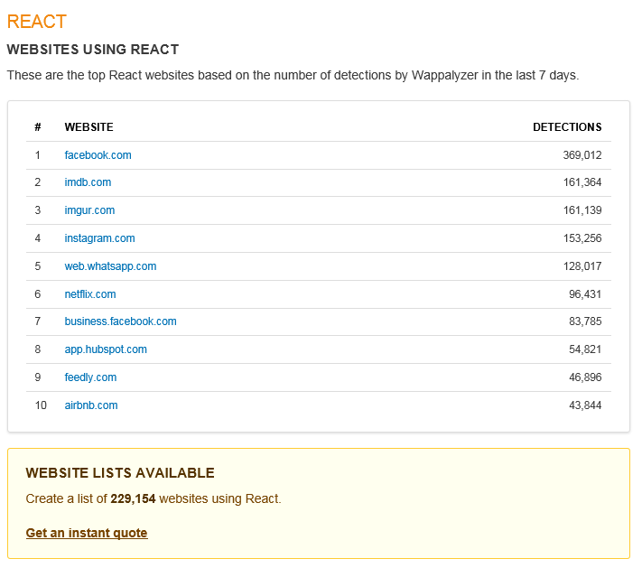
ReactJS based websites
https://wappalyzer.com/applications/react

Slide 7
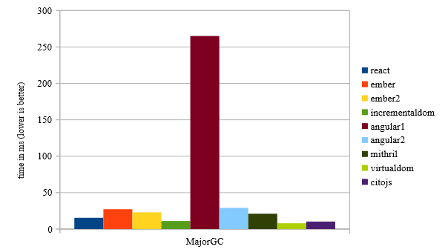
Performance Comparison – Virtual DOM
https://auth0.com/blog/2016/01/07/more-benchmarks-virtual-dom-vs-angular-12-vs-mithril-js-vs-the-rest/

Slide 8
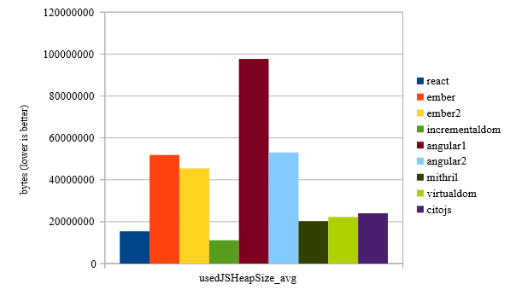
Performance Comparison – Memory usage
https://auth0.com/blog/2016/01/07/more-benchmarks-virtual-dom-vs-angular-12-vs-mithril-js-vs-the-rest/

Slide 9
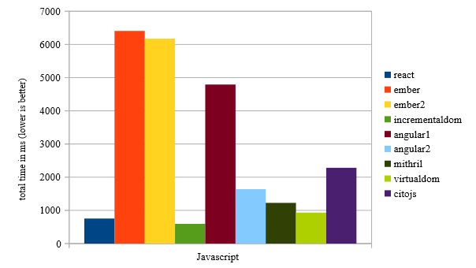
Performance Comparison – JavaScript Execution Time
https://auth0.com/blog/2016/01/07/more-benchmarks-virtual-dom-vs-angular-12-vs-mithril-js-vs-the-rest/

Slide 10
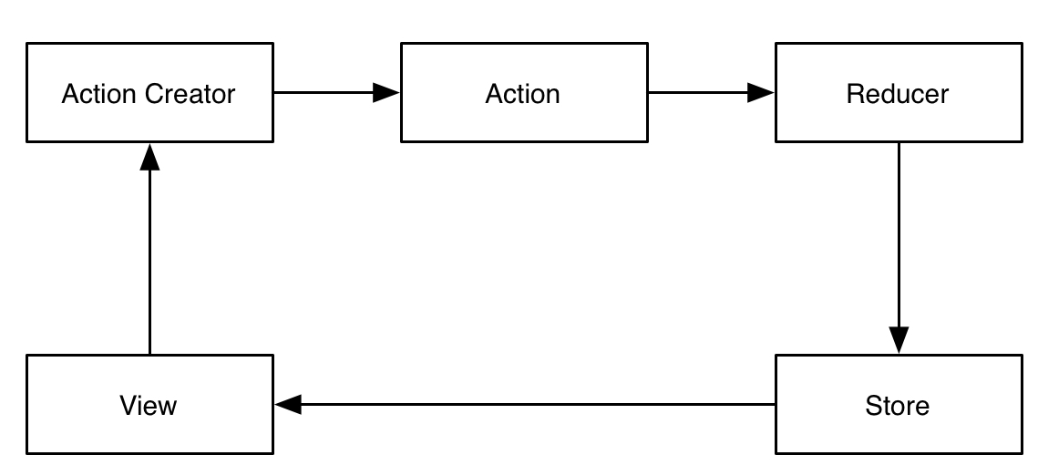
Redux Architecture

Slide 11
Redux Architecture - Detail

