Slide 1
ReactJs-Redux

Slide 2
FAQ
Why React, how its work
Components
Webpack
Config
Package.json
Server.js
State
Props
JSX

Slide 3
FAQ
Maintained by facebook and instagram
Having a huge community
Can be the “V” in MVC
Is ideal for large scale single page application
Uses a high speed virtual DOM
Use clean and easy to understand JSX syntax

Slide 4
JavaScript objects are faster than DOM object
The React V-DOM is a JavaScript object
React never read from the “real” DOM
React only write to “real” DOM if required
React efficiently handles DOM updates

Slide 5
Why slowdown
DOM
query
write
JavaScrip Logic
DOM
render
Backbone/Angular1.x Views

Slide 6
Why React is fast
DOM
render
React Virtual DOM
getDOMNode()
JavaScrip Logic

Slide 7
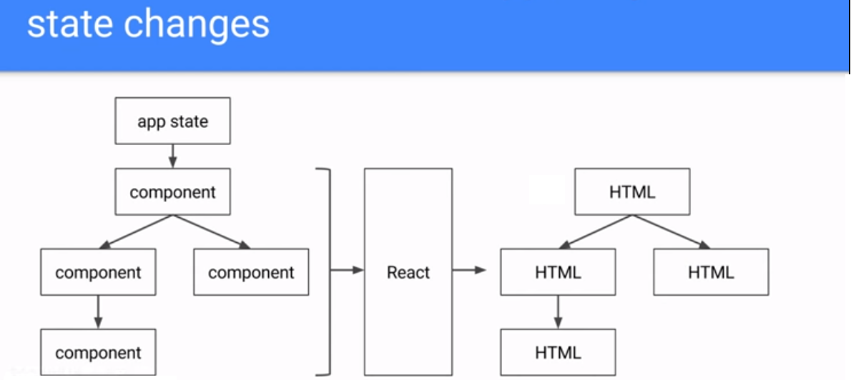

Slide 8
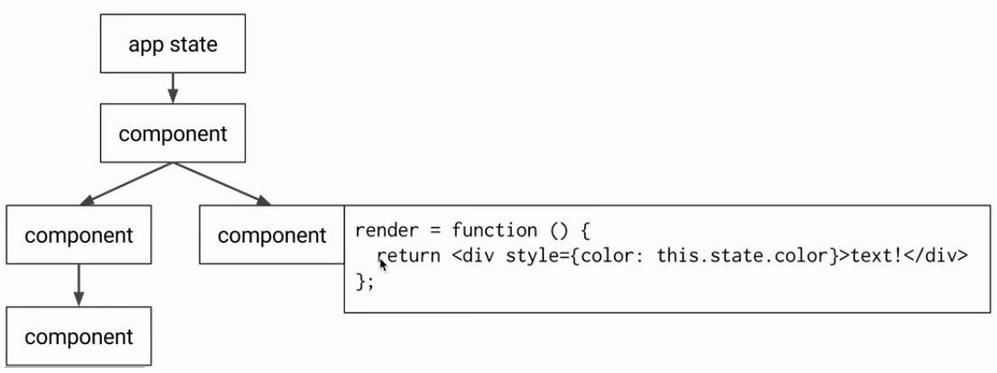

Slide 9
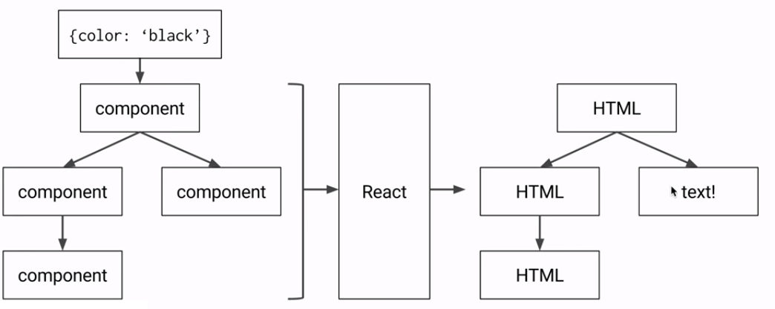

Slide 10
