Slide 1
CogniStream
Developer Flow-State & Cognitive Load Analytics
Data Analytics Internship Project
Prepared by Prince Kumar

Slide 2
1. Project objective
Understand how developer work habits relate to task success.
Study cognitive load as a possible early-warning signal.
Clean, analyze and visualize the dataset.
Deliver an interactive dashboard for decision-oriented insights.

Slide 3
2. Dataset overview
500 developer-task records and 9 numeric fields.
Measures include coding hours, sleep, distractions, commits, bugs, AI usage and cognitive load.
Target: task_success — 0 means unsuccessful, 1 means successful.
No date, developer ID or team ID is available; analysis is cross-sectional.

Slide 4
3. Data preparation
Preserved the raw CSV and created a processed analysis copy.
Validated expected columns and converted fields to numeric types.
Checked duplicates, missing values and domain ranges.
Result: 500 valid rows retained; 0 duplicates, 0 missing cells and 0 invalid rows.

Slide 5
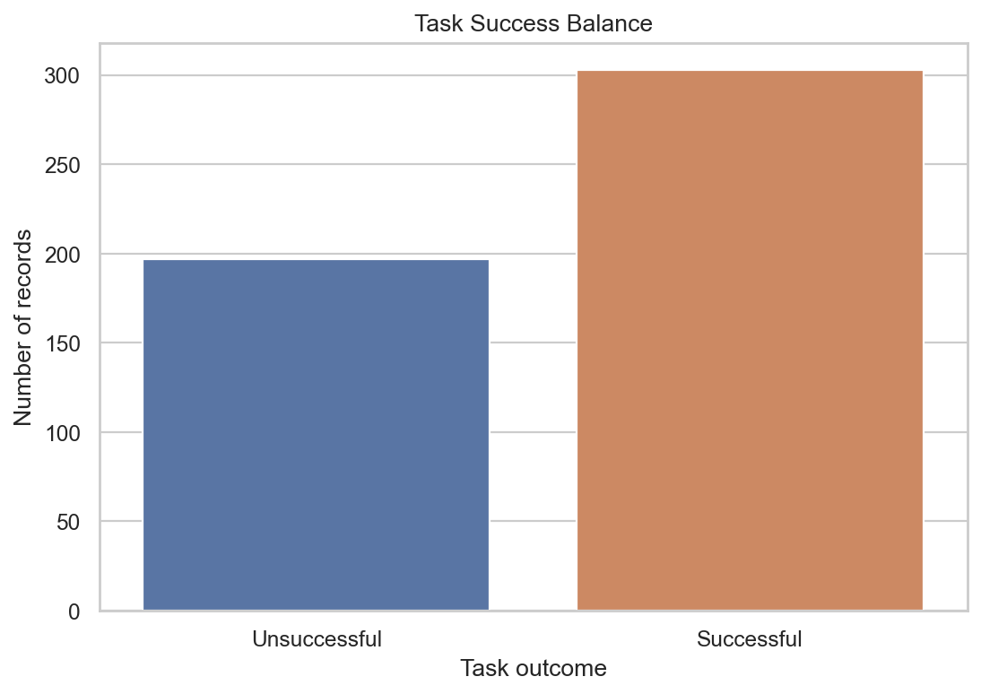
4. Task-success distribution
303 records are successful and 197 are unsuccessful. The observed task-success rate is 60.6%.

Slide 6
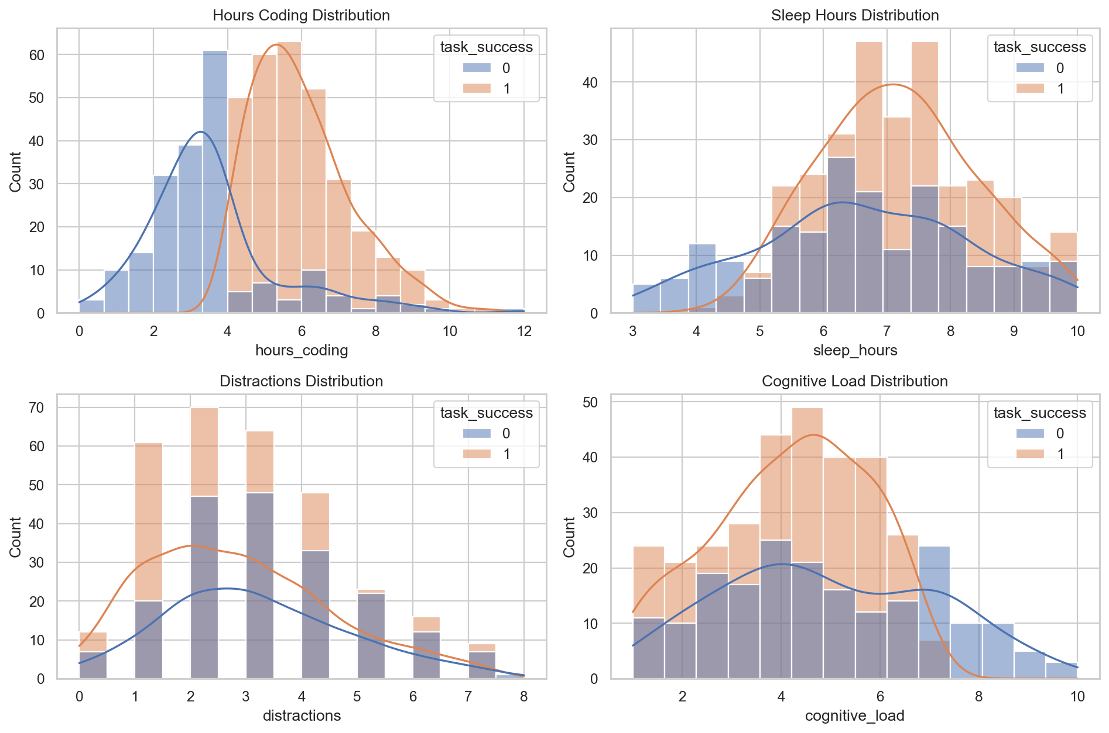
5. Feature distributions
The plots show the operating ranges of coding hours, sleep, distractions and cognitive load, split by outcome.

Slide 7
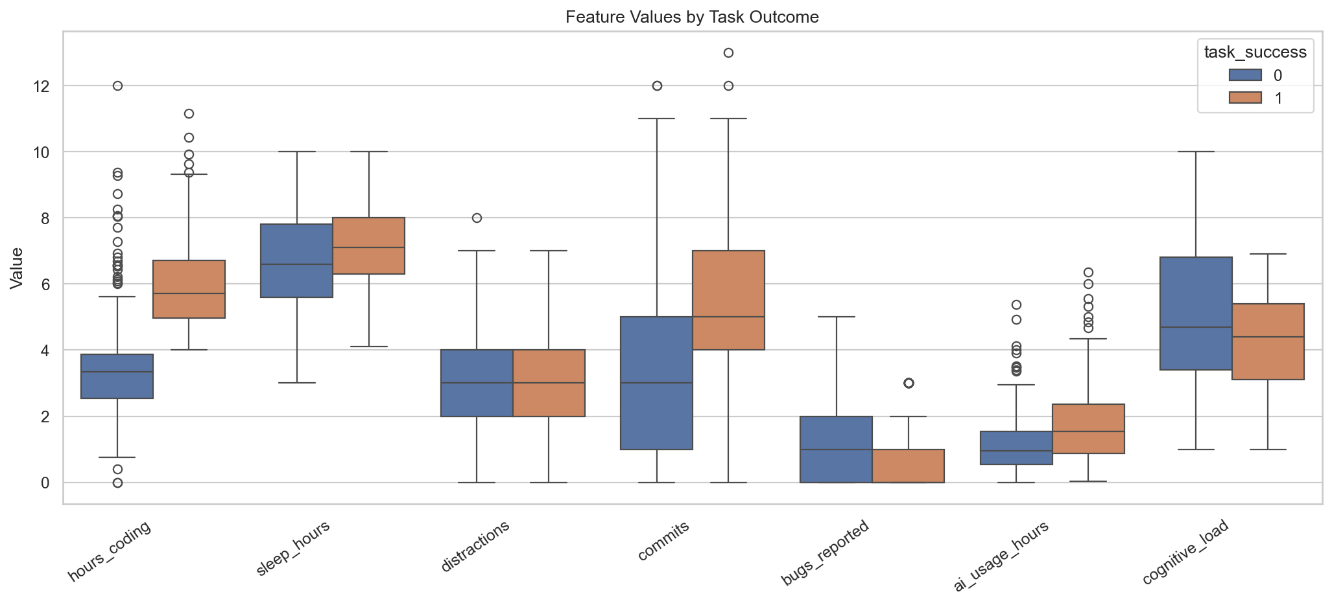
6. Productivity comparison
Successful records show higher average coding hours and commits, while unsuccessful records show more bugs and slightly higher cognitive load.

Slide 8
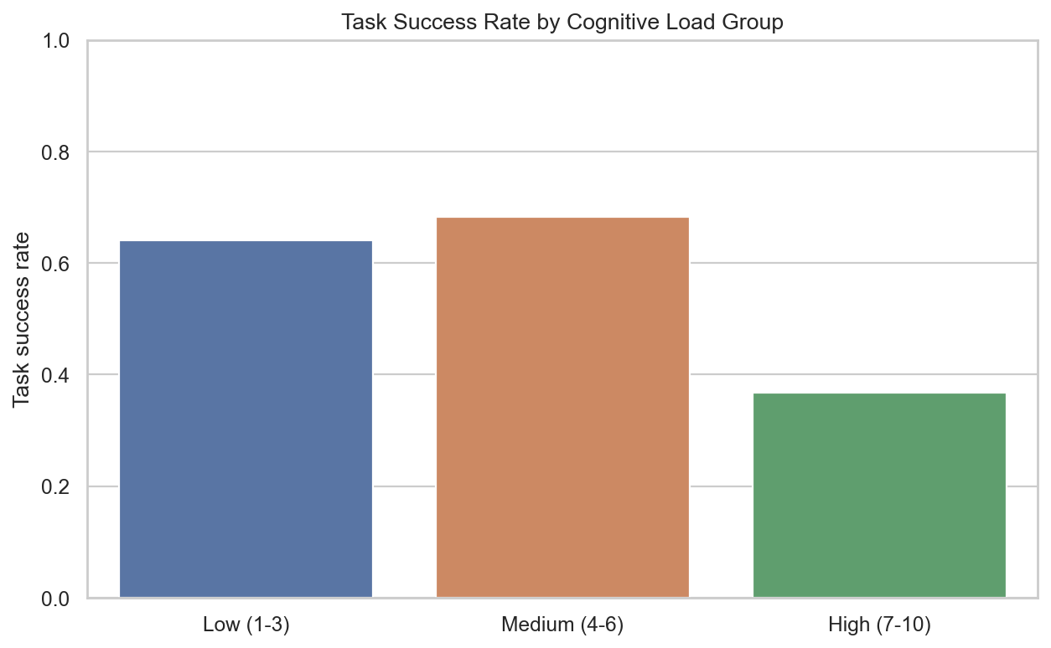
7. Cognitive-load analysis
The high-load group has the lowest observed success rate: 36.8%, compared with 64.1% for low load and 68.2% for medium load.

Slide 9
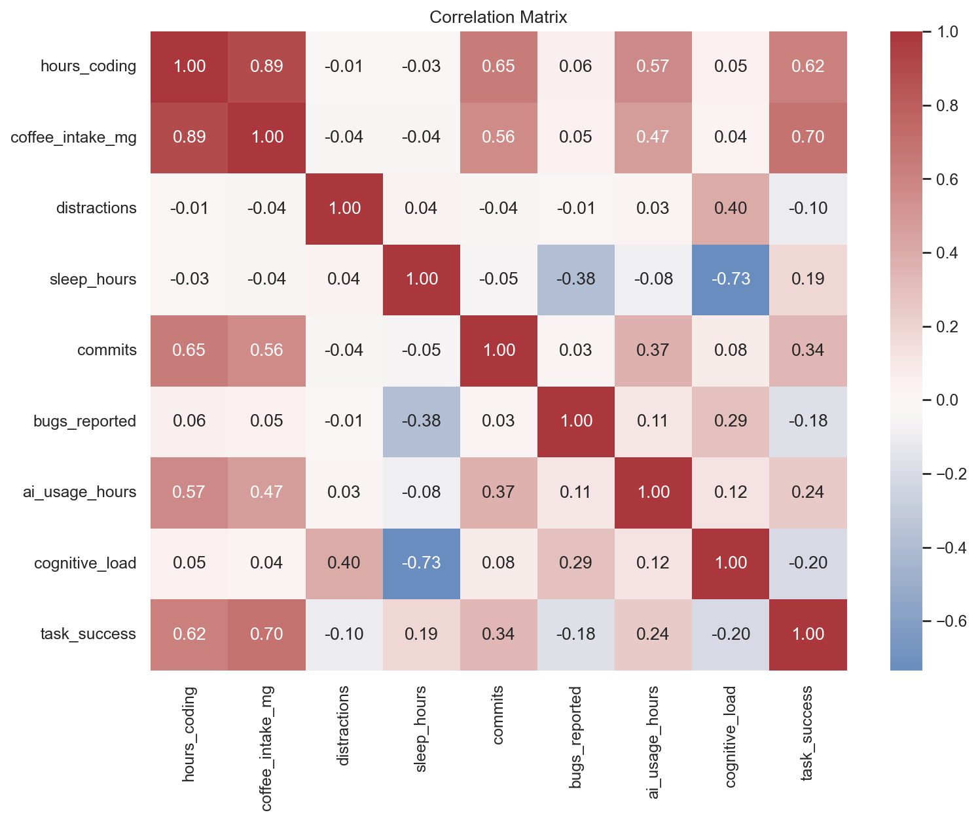
8. Correlation overview
Correlation helps prioritize questions for deeper analysis; it does not prove causation.

Slide 10
9. Key findings
Successful records: 5.98 average coding hours, 5.35 commits and 0.70 bugs.
Unsuccessful records: 3.53 average coding hours, 3.47 commits and 1.10 bugs.
High cognitive load: 36.8% success rate and 1.25 average bugs.
Medium cognitive load: 68.2% success rate and 0.86 average bugs.

Slide 11
10. Dashboard design
KPI cards: records, task-success rate, average cognitive load, coding hours and bugs.
Filters: task outcome and cognitive-load group.
Charts: outcome balance, success rate by load, coding hours vs load and selectable feature comparisons.
The dashboard is implemented in dashboard/app.py using Streamlit.

Slide 12
11. Recommendations
Use cognitive load, bugs and distractions as monitoring indicators.
Investigate high-load records early rather than relying only on final task outcomes.
Use coding hours and commits as productivity context, not as standalone performance targets.
Collect dates and anonymized developer/team IDs in the next dataset version.

Slide 13
12. Limitations and conclusion
This is observational data; relationships should not be described as causal.
The data has no longitudinal or team-level identifiers.
The dashboard provides a practical monitoring prototype.
Next step: validate patterns with larger, dated and anonymized observations.

