Slide 1
DOCUMENT INTELLIGENCE PLATFORM
AI-Powered Extraction, Validation & API Platform for Financial Documents
AI Engineer Internship — Technical Case Study Submission
Prince Bhandari
princebhandari22@gmail.com

Slide 2
THE CHALLENGE
Manual document processing doesn't scale
1
Inconsistent Layouts
2
OCR & Image Quality Issues
Invoices, balance sheets, P&L and cash flow statements arrive in native PDF, scanned PDF, JPG or PNG — every vendor formats them differently.
Scanned receipts and photographed invoices introduce noise, skew and misreads that break naive extraction.
3
No Validation Layer
4
No Central Record
Manually re-keying totals is slow, and errors in financial line items go unnoticed without automated cross-checks.
Processed results live in inboxes and spreadsheets, with no queryable API or dashboard for the team.

Slide 3
SOLUTION OVERVIEW
End-to-end processing pipeline
Upload
(PDF/JPG/PNG)
→
File
Validation
→
OCR /
Text Extraction
→
LLM
Extraction
→
Financial
Validation
→
Postgres
Storage
→
REST API +
Dashboard
Every request is processed synchronously: the moment a file is uploaded, it moves through validation, OCR, structured LLM extraction and financial-formula validation before the result is persisted and surfaced through the API and dashboard.
Separation of concerns
Fail-safe by design
OCR, extraction, validation, persistence and API layers each live in their own module — never one monolithic file.
Invalid files, OCR failures and model errors are caught and logged, never exposed as raw stack traces.

Slide 4
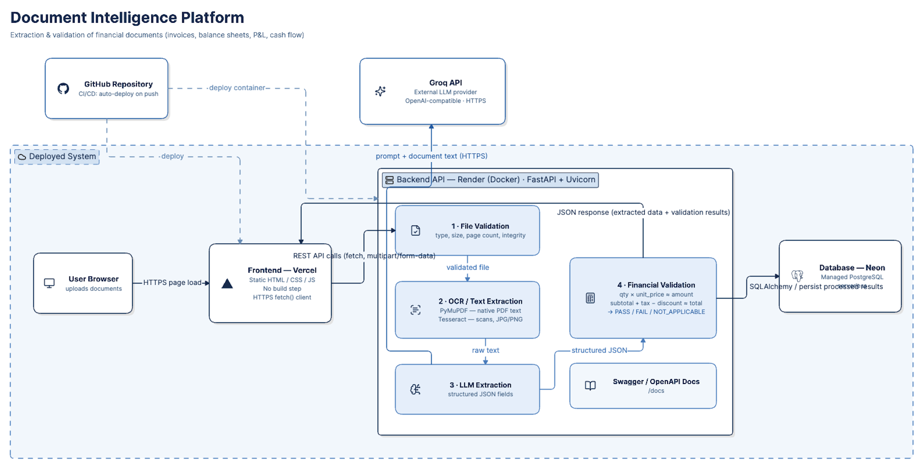
SOLUTION OVERVIEW
End-to-end processing pipeline

Slide 5
TECHNOLOGY STACK
Chosen for reliability within a 3-day build window
FastAPI
Tesseract OCR
Groq (Llama)
BACKEND FRAMEWORK
TEXT EXTRACTION
LLM EXTRACTION
Auto-generates Swagger/OpenAPI docs required by the case study, native Pydantic validation, async-ready.
Free, open-source, runs locally — no API key or rate limits for scanned images and image-based PDFs.
Free-tier inference, OpenAI-compatible API, fast enough for synchronous request handling.
PostgreSQL (Neon)
Render
Vercel
PERSISTENCE
BACKEND HOSTING
FRONTEND HOSTING
Free serverless Postgres; SQLAlchemy repository pattern keeps storage swappable.
Docker-based deploy with a free tier; installs Tesseract as a system dependency via the Dockerfile.
Zero-config static hosting for the HTML/CSS/JS dashboard, instant global CDN, no cold starts.

Slide 6
SCOPE
Four document types, one consistent pipeline
Invoice
Balance Sheet
Profit & Loss
Cash Flow Statement
invoice_number, vendor, customer, subtotal, tax, discount, shipping, total, line items
total_assets, total_liabilities, total_equity per reporting period
revenue, cost of sales, gross/operating/net profit per period
operating, investing, financing cash flow, opening/closing cash
Document type is selected in the frontend at upload time and sent as request metadata — automated schema classification is out of scope per the assignment brief.

Slide 7
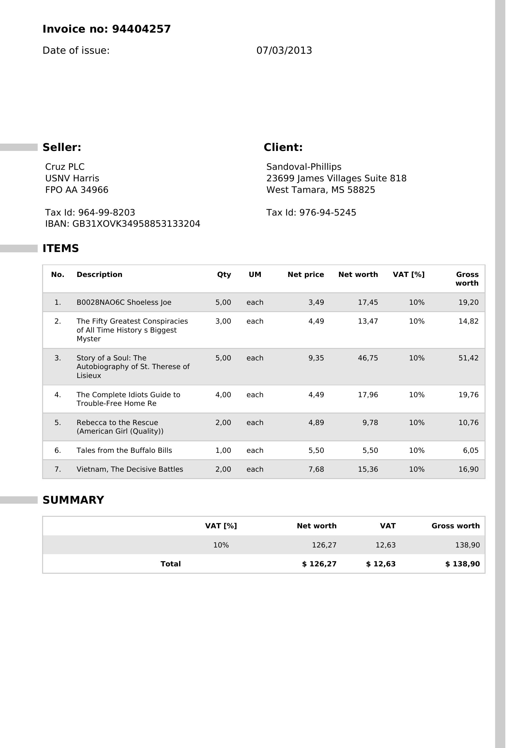
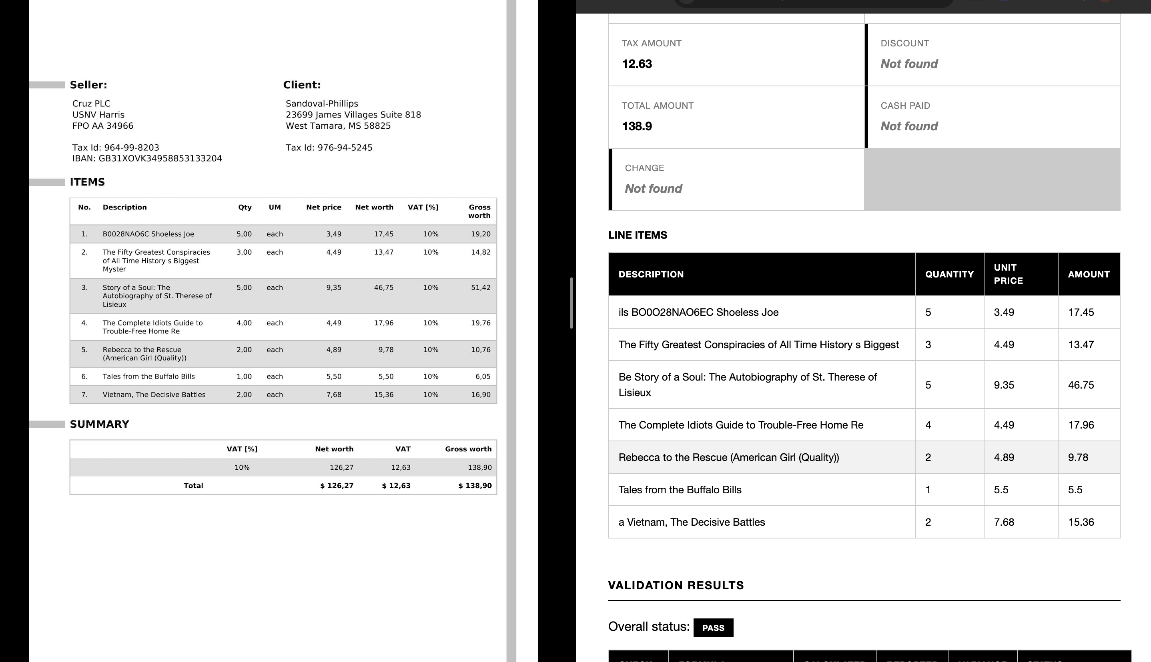
EXTRACTION IN ACTION
Source document → structured, grounded JSON
Source invoice (JPG)
Extracted fields, line items & PASS validation shown live in the dashboard

Slide 8
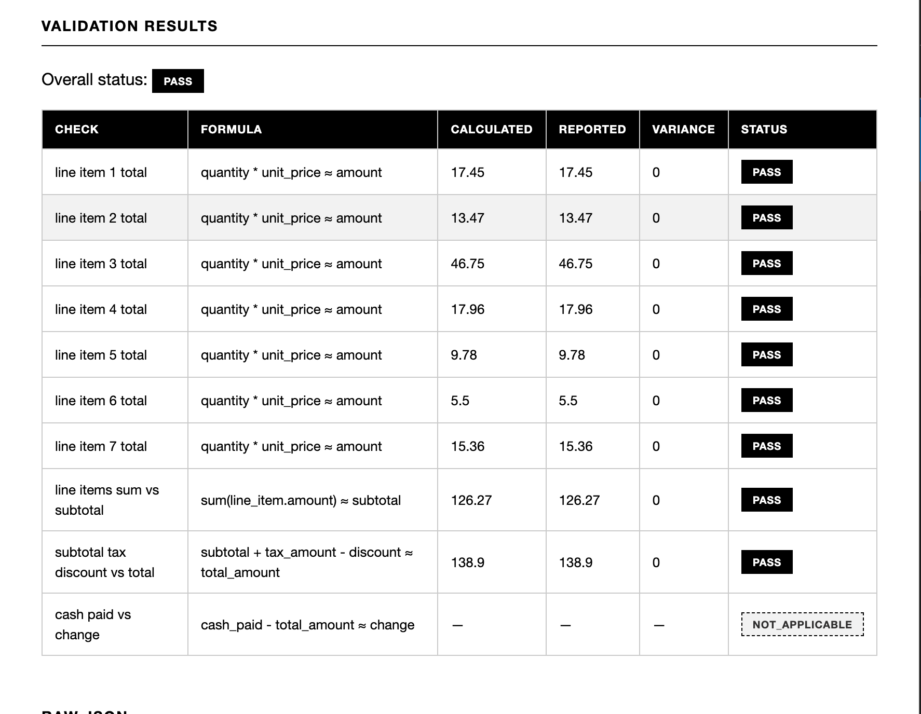
FINANCIAL VALIDATION
Every check is grounded in the actual document, never assumed
Example formulas checked
• quantity × unit_price ≈ line amount
• sum(line items) ≈ subtotal
• subtotal + tax + shipping − discount ≈ total
• total_liabilities + total_equity ≈ total_assets
• revenue − cost_of_sales ≈ gross_profit
• operating + investing + financing ≈ net cash change
If a required field is missing, the check returns NOT_APPLICABLE — the system never assumes or invents a value.
Actual validation output from a processed invoice — every check shows the formula, calculated value, reported value, variance and PASS/FAIL/NOT_APPLICABLE status.

Slide 9
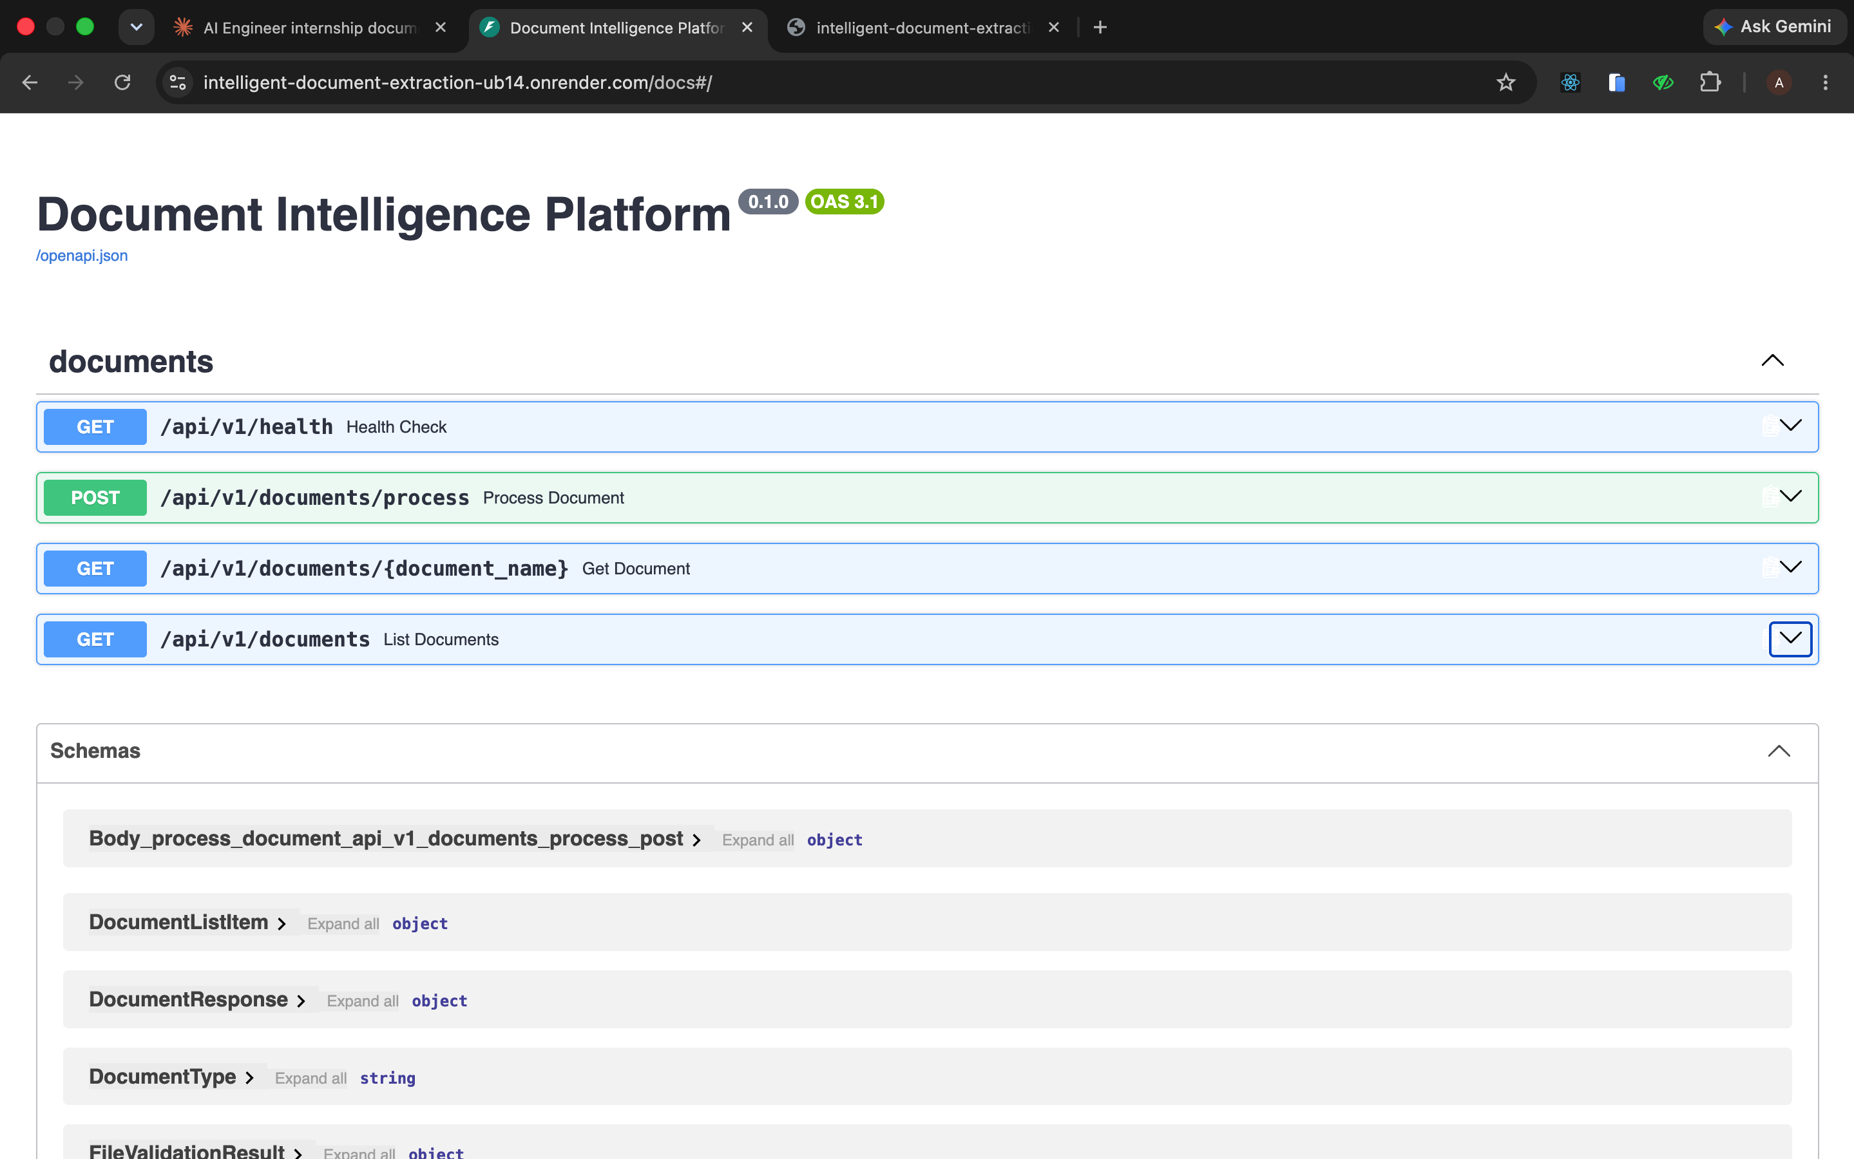
REST API
Documented, structured, and consistent
POST
/api/v1/documents/process
Upload + process a document (multipart)
GET
/api/v1/documents/{document_name}
Latest stored result by name
GET
/api/v1/documents
List all processed documents
GET
/api/v1/health
Health check
Response JSON always includes: document name, document type, file validation, complete extracted data, financial validations, processing status and processing metadata.

Slide 10
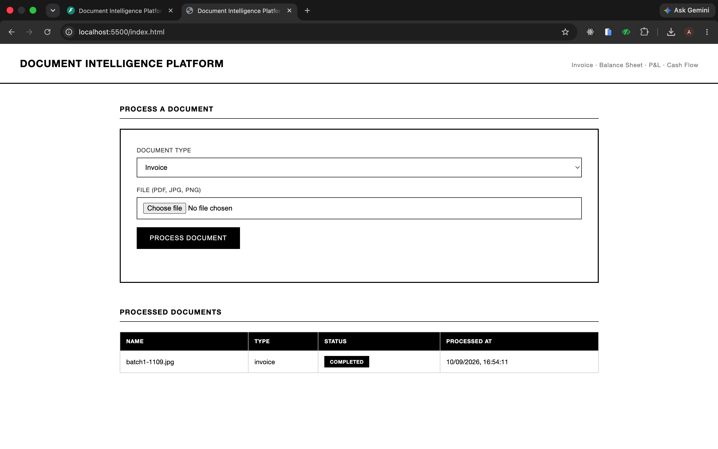
FRONTEND DASHBOARD
Simple, functional, and connected to a live database
Document-type selection + file upload control
Dashboard lists every processed document with status and time
Click through to view extracted fields, line items and validation results
Missing fields and failed validations are clearly highlighted
Raw JSON view for full transparency
Backed by PostgreSQL — results persist across sessions

Slide 11
TESTING COVERAGE
Demonstrated per the assignment's required scenarios
✓
All 4 document types processed
✓
Scanned/image-based document
Invoice, Balance Sheet, P&L and Cash Flow each tested end-to-end
JPG receipt processed via Tesseract OCR + LLM extraction
✓
Validation-failure scenario
✓
Unsupported file scenario
Real invoice with a subtotal/line-item mismatch, correctly flagged FAIL
Non-PDF/JPG/PNG upload rejected gracefully with a clear error
✓
Sample JSON outputs saved
✓
Automated tests
Representative outputs stored in sample_outputs/ for each type
pytest coverage for file validation, financial calculations, and an API flow

Slide 12
DEPLOYMENT
Live, public, and fully wired end-to-end
FRONTEND
BACKEND API
DATABASE
Vercel
Render (Docker)
Neon (Postgres)
Static HTML/CSS/JS, zero build step, instant global CDN
FastAPI + Uvicorn, Tesseract installed via Dockerfile
Free serverless Postgres, persists across sessions
Live Links
Frontend: intelligent-document-extraction.vercel.app
Backend API: intelligent-document-extraction-ub14.onrender.com
Swagger Docs: .../docs
GitHub: github.com/princebhandarii/Intelligent-Document-Extraction

Slide 13
Thank You
Happy to walk through the code, extraction logic, or any design decision in detail.
Prince Bhandari · github.com/princebhandarii/Intelligent-Document-Extraction

