Slide 1
Predicting Diabetes based on
several medical predictors.
Prince Bose (pkb44)
Ashwin Channakeshava (ak1645)
Sarthak Vengurlekar (sv555)

Slide 2
DATASET

Slide 3
Dataset
High Risk Population: The Pima Indian tribes of Arizona and Mexico
Research: In 1965 and 1991, Pima Indians from Arizona and Mexico were investigated and surveyed for Type 2 Diabetes and Obesity.
Result: Crucial role in scientific advances in type 2 diabetes and obesity. Independent roles of genes versus environment.
Size:769 entries of Women above 21 years, Belonging to Pima Indian Heritage.
Features: Seven Independent Medical Predictors and one Dependent Target Variable accounted for.
Notes:
The Pimas of Arizona and Mexico have played a crucial role in scientific advances in type 2 diabetes and obesity. In conjunction, the two groups have provided a unique opportunity to understand the independent roles of genes versus environment because they are genetically-related populations living in dramatically different environments yet presenting with significant differences in diabetes and obesity prevalence. These studies provided compelling evidence of the impact of environment and the protective role of a traditional lifestyle.

Slide 4
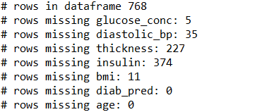
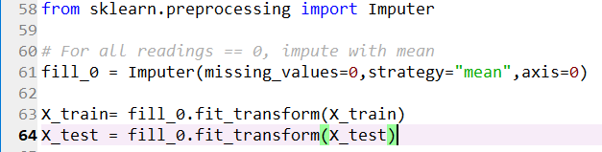
Inconsistencies in the Data
How to deal with missing values?
Ignore them (Not feasible)
Delete them (Data Wasted)
Imputing Values
Impute with Mean
Replace with computed value (Expert Knowledge)
Notes:
The Pimas of Arizona and Mexico have played a crucial role in scientific advances in type 2 diabetes and obesity. In conjunction, the two groups have provided a unique opportunity to understand the independent roles of genes versus environment because they are genetically-related populations living in dramatically different environments yet presenting with significant differences in diabetes and obesity prevalence. These studies provided compelling evidence of the impact of environment and the protective role of a traditional lifestyle.

Slide 5
STEPS

Slide 6
How to get to an Outcome?
Major Steps:
Data Preprocessing
Splitting the dataset into Training and Testing Data
Build a Random Forest Classification Model using Training Data
Implement the Model on the Testing Data
Vary number of estimators and random state of model to optimize accuracy
Notes:
Data Preprocessing (Finding missing values and Imputing Values with Mean)

Slide 7
ALGORITHM

Slide 8
Decision Tree (CART)
Basic Machine Learning Algorithm
Multiple Branched if conditions that lead to the outcome
Supervised
Basic building block for Random Forest Algorithm

Slide 9
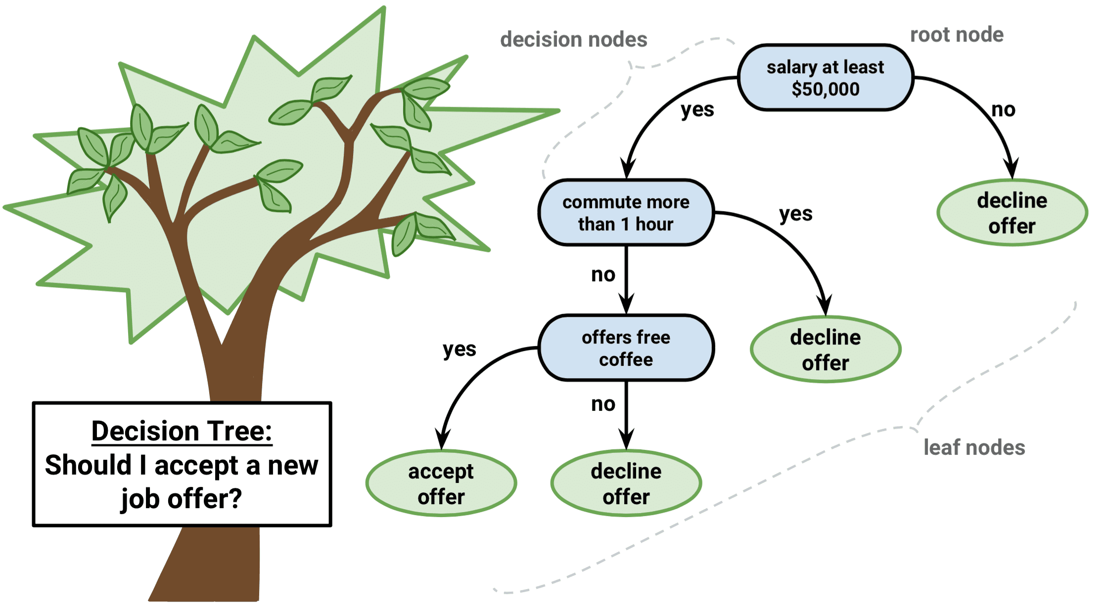
Decision Tree

Slide 10
Random Forest Algorithm
Sophisticated and advanced algorithm
Supervised and Flexible
Creates a forest of many binary decision trees
Each test entry traveses till terminal node of each tree
Voting at terminal Node
Proportion of “Yes”(1) to total votes (“Yes”(1) + “No”(0)) determines the Outcome

Slide 11
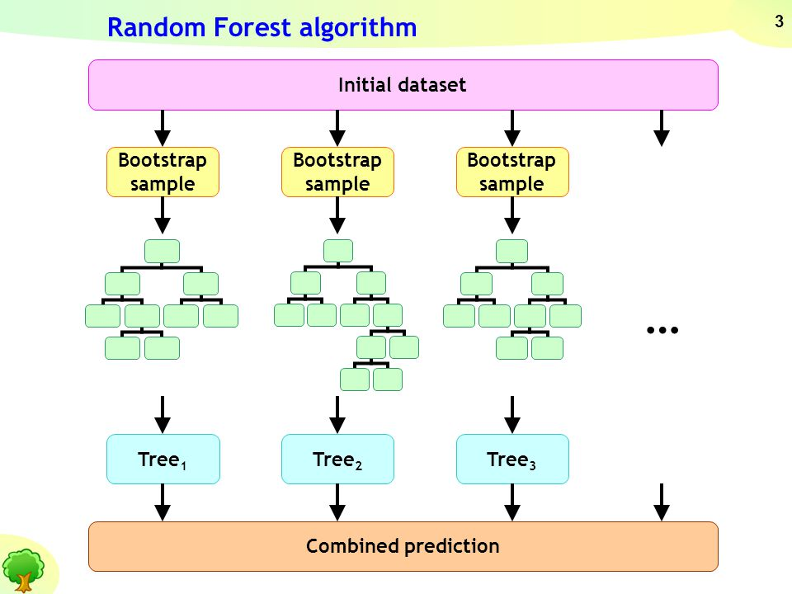

Slide 12
Precision and Recall
Precision:
Fraction of relevant instances from the retrieved instances.
Positive predictive value
Recall:
Fraction of relevant instances that have been retrieved over the total amount of relevant instances.
Sensitivity
Both Characteristics are based on Relevance.

Slide 13
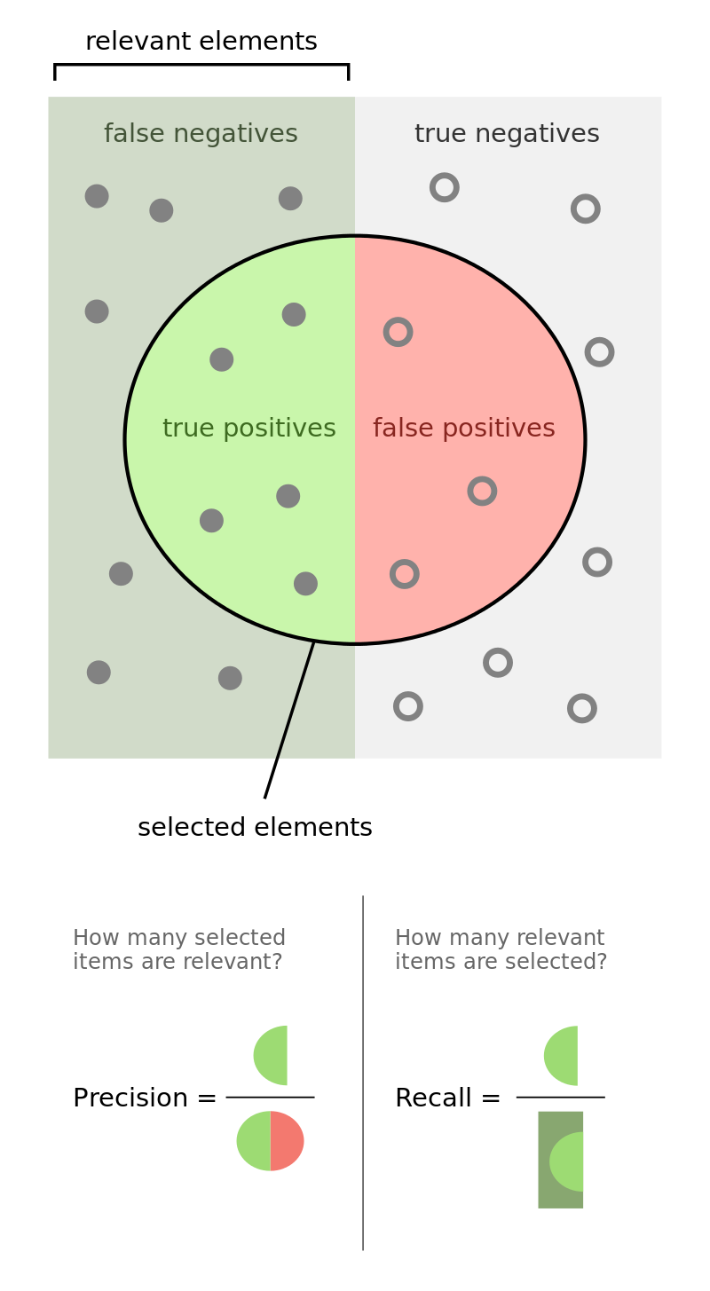

Slide 14
Complexity
For one Tree,
Time Complexity: O(N) = log₂N
For Random Forest Algorithm with N trees for one feature,
Time Complexity: O(N) = N * log₂N
For k features,
Time Complexity: O(N) = k * N * log₂N

Slide 15
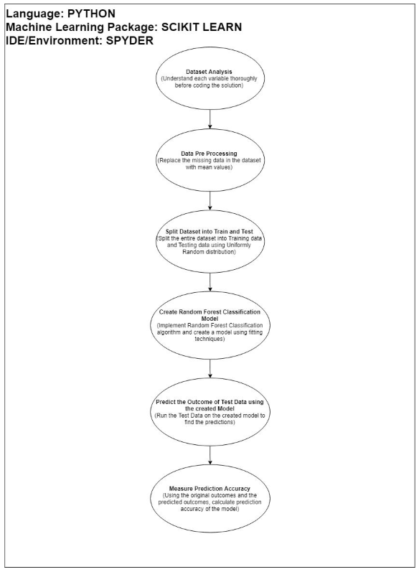
Experimental Configuration

Slide 16
ANALYSIS

Slide 17
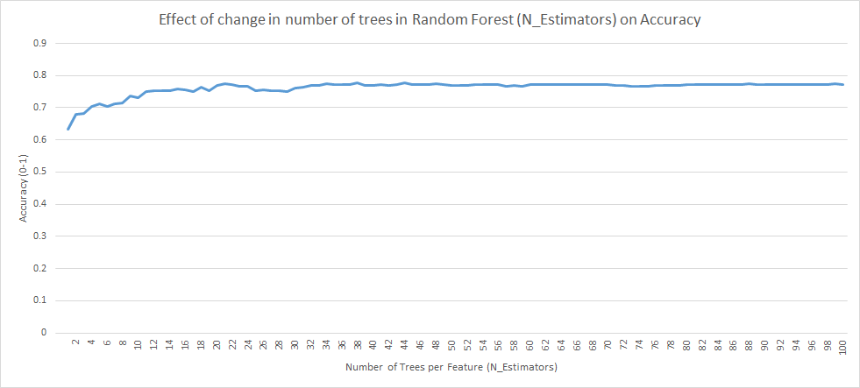
Effect of change in Number of total decision trees in the Random Forest (N_Estimators) over Accuracy

Slide 18
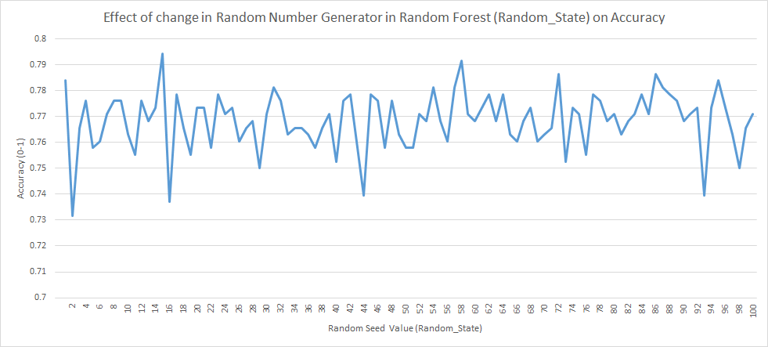
Effect of change in Random Seed of the Random Forest over Accuracy

Slide 19
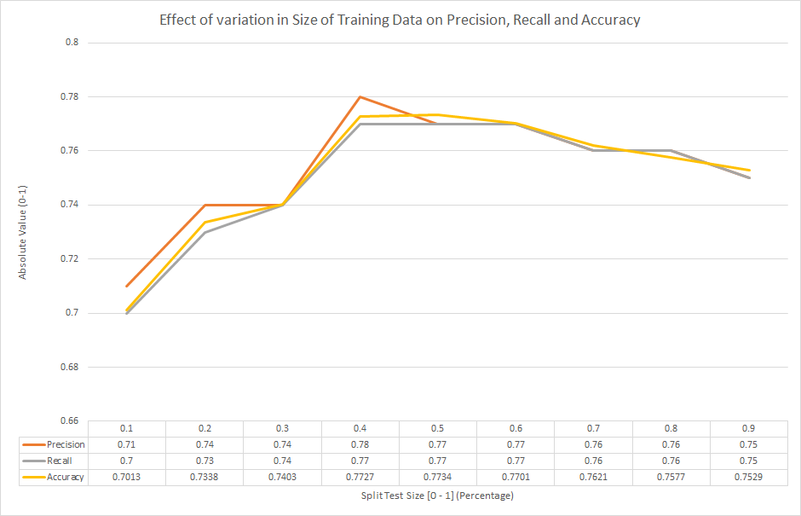

Slide 20
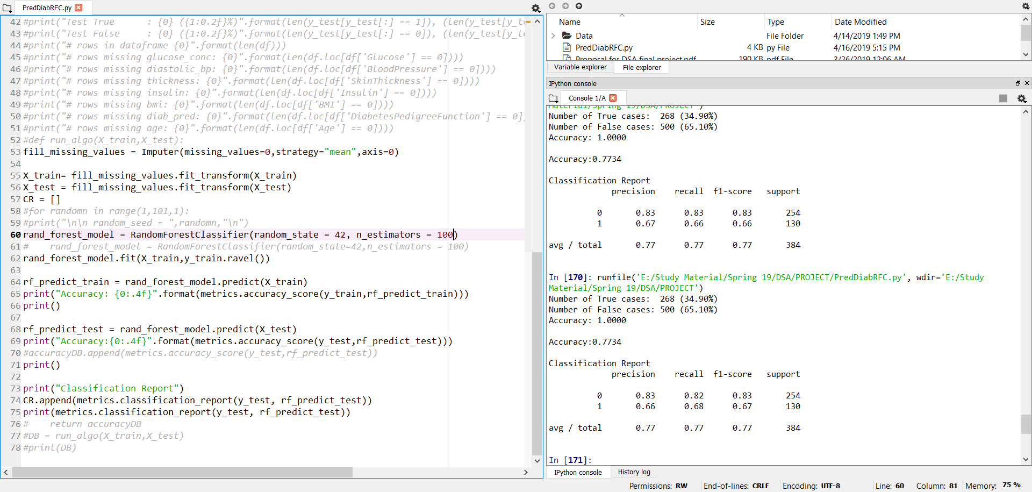
Prediction Results with Optimized Model

Slide 21

Result
We obtain best results for Split Size = 0.4, i.e. 40% -> Testing Data and 60% -> Training Data
N_Estimators had best accuracy for value = 100
Random_State was optimized to 42
We obtained an overall of 77.86% accuracy on the Testing Dataset, and 100 percent accuracy on the Training Dataset
These results can be improved by using Logistic Regression with Cross Validation.

Slide 22


