Slide 1

Chinook’s Analysis
By
Prince Kumar Singh

Slide 2
Problem Statement
To facilitate data-driven growth, our analysis will focus on key music store trends, including customer demographics, purchasing patterns, and churn rates.
At Chinook, my objective is to extract valuable insights from music sales data by solving Objective and Subjective questions that are given, and also guiding strategic initiatives in the physical music market.

Slide 3
Agenda
Introduction
Data Cleaning in Chinook’s Database.
Customer Distribution with different factors(Geographical, Genre, Artist, Sales, Album and year)
Employee’s factor on sales
Insight’s with the analyzed data
Summary
Conclusion

Slide 4
Introduction
Chinook is a platform to purchase album’s and is present with its stores all over the world.
I will be acting as a data analyst to take some insight from the present data to expand there selling and focusing on customer retention and adding customer by guided promotion or advertisement.

Slide 5
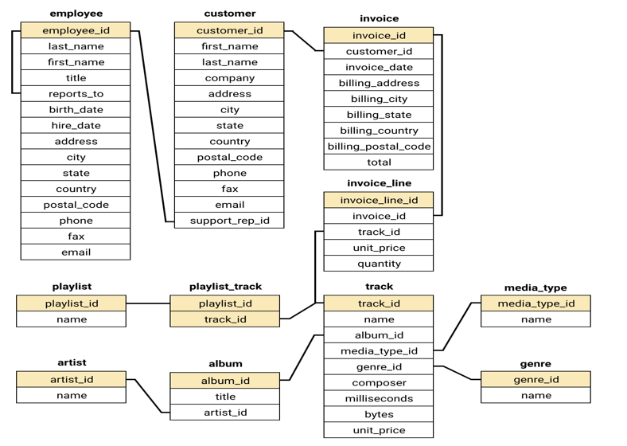
Chinook’s Schema
We will be following this schema to analyze data and taking insights from it

Slide 6
Data Cleaning
Query used to find duplicate rows are :
SELECT Track_id, count(Track_id)
FROM Track
GROUP BY Track_id
HAVING COUNT(Track_id) > 1
Query used to null values
SELECT *from Track
WHERE in (“column_names”) IS NULL
We can use the syntax above queries on every table with its column name to find Duplicate Values and Null values, and later handling them by removing and replacing the values.

Slide 7
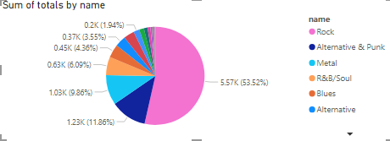
Customer Distribution by Genre
Rock Genre is mostly liked by customers followed by Alternative and Metal Genre

Slide 8
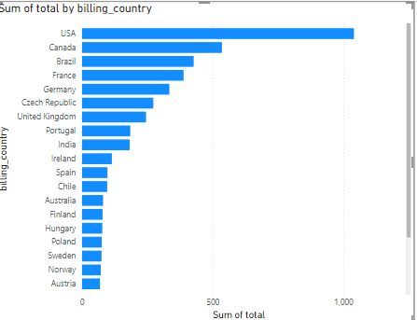
Geographical Distribution of sales
USA’s contribution is unmatchable in terms of sales
Followed by Canada and Brazil with there similar sales distribution

Slide 9
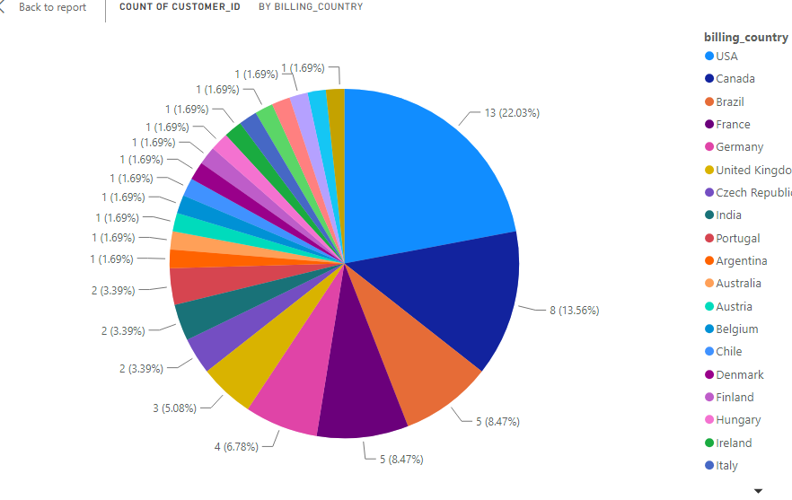
Geographical Distribution of Customer
Most customers are from USA, resulting with their high sales.
Followed by Canada and Brazil.

Slide 10
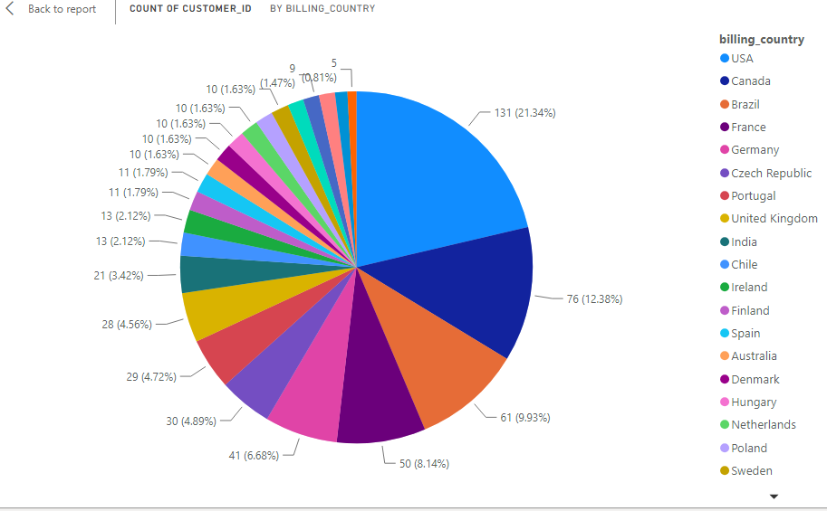
Geographical Distribution of Customer in Sales
USA’s contribution in sales quantity is also high
Followed by Canada and Brazil.

Slide 11
Insights
With the above references we can conclude that:
Countries to get more Customers are USA, Canada, Brazil, France and Germany as these five countries itself has more that 50% of the total sales.
Further Italy and USA are the countries contributing to the most sold volumes by quantity.
Genre to promote more is Rock and Alternative, as they contribute more that 60% of sales.

Slide 12
Summary
In this Presentation, we came to know about:
Data preparation with SQL.
Analyzed different Genres and there contribution in sales using Pie chart.
Analyzed Geographical factors on sales and customers using Pie chart.
Used Stacked bar chart to see distribution of overall sales by year.
Found Insights using the Chart.

Slide 13
Conclusion
With the Analysis of Chinook’s database, we can work on the Advertisements and Promotion of a narrowed Genre base in a particular country, so that we can gain new customers and with a good customer retention.

