Slide 1
PRDA-01
PROFIT ANALYSIS
PROJECT
Regression Analysis • Power BI Visualization • Business Recommendations
Prepared by: Prince Rajwar
Dataset: 50 records | 5 features

Slide 2
01 | Problem Understanding
Business objective and analytical questions
Business problem
Project objectives
Understand how spending patterns and state-level differences relate to startup profitability.
Analyze Profit against R&D, Administration and Marketing spending.
Compare average Profit across Florida, New York and California.
Build a regression model to estimate Profit for new spending inputs.
Create a Power BI dashboard and recommend evidence-based actions.
KEY QUESTION
Which spending factors are most associated with Profit?
02

Slide 3
02 | Dataset & Methodology
From raw data to business insights
RECORDS
FEATURES
MISSING VALUES
STATES
50
5
0
3
Rows in dataset
Columns analyzed
As checked in SQL
Florida, New York, California
Features included
Workflow
RD_Spend
Administration
Marketing_Spend
State
Profit
MySQL
→
Excel
→
Power BI
→
Report
Explore data
Regression
Dashboard
Insights
Data types and missing values were checked before analysis.
03

Slide 4
03 | State-wise Profit Analysis
Average Profit from SQL analysis
Florida
118,774.02
New York
113,756.45
California
103,905.18
Insight: Florida has the highest average Profit; California has the lowest among the three states.
04

Slide 5
04 | Regression Analysis
Profit is the target variable in multiple linear regression
R-SQUARED
SIGNIFICANCE F
95.07%
4.53 × 10⁻³⁰
Variation explained in this dataset
Overall model is statistically significant
Individual predictor results
Predictor | Coefficient | P-value | At 5% level
RD_Spend | 0.8057 | 2.63 × 10⁻²² | Significant
Administration | −0.0268 | 0.6018 | Not significant
Marketing_Spend | 0.0272 | 0.1047 | Not significant
RD_Spend is significant at α = 0.05. Administration and Marketing_Spend are not individually significant at this threshold.
05

Slide 6
05 | Profit Prediction
Model estimates for two supplied spending combinations
Predicted Profit = 50,122.19299 + 0.80571505(RD_Spend) − 0.026815968(Administration) + 0.027228065(Marketing_Spend)
Input | RD_Spend | Administration | Marketing_Spend | Predicted Profit
1 | 21,892.92 | 81,910.77 | 164,270.70 | 70,037.90
2 | 23,940.93 | 96,489.63 | 137,001.10 | 70,554.57
06

Slide 7
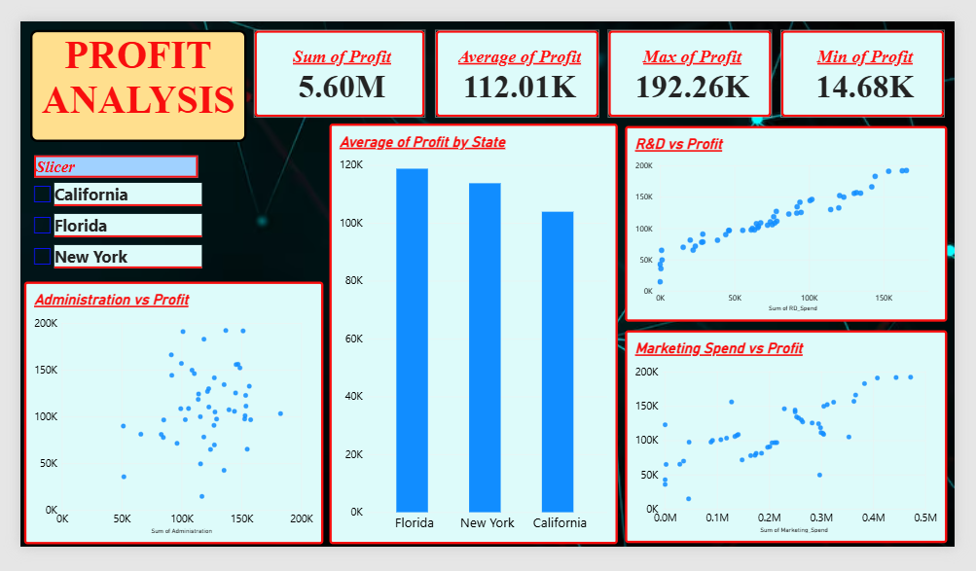
06 | Power BI Visualizations
Replace the placeholder with your actual dashboard screenshot
STATE SLICER
Florida
New York
Scatter charts
California
07

Slide 8
07 | Business Insights & Recommendations
Practical actions based on the analysis
Review R&D returns
RD_Spend is a significant predictor in this dataset. Track project-level costs and realized returns before changing budgets.
1
Compare state performance
Investigate cost structure, demand and operating conditions behind Florida's higher average Profit.
2
Measure marketing ROI
Compare campaign spending with attributable revenue and profit; a non-significant p-value does not mean marketing is ineffective.
3
Improve cost visibility
Review administrative expenses and process efficiency without automatically cutting necessary operations.
4
08

Slide 9
CONCLUSION
Turning spending data into
better business decisions
The dataset contains 50 records across three states.
Florida has the highest average Profit in the analysis.
The regression model explains about 95.07% of observed Profit variation in this dataset.
Use the dashboard to monitor performance and validate predictions against actual results.
THANK YOU
Prepared by: Prince Rajwar

