Slide 1

PARK AND REC ADULT SPORTING
Data Duo:
Sanam, Prince David
Ellundhula, Jeethendrinee
CAPSTONE PROJECT
Instructor: Dr. Yan, Fujian CS896 , Fall-2023

Slide 2
OBJECTIVE
To determine the highest demand times for adult sports activities and to evaluate the seasonality of these activities.
Locating and assessing outside elements that might have impacted the demand for and acceptance of adult sports.
To identify the periods of highest demand and assess the seasonal patterns of adult sports participation.
These goals are the focus of the research, which intends to offer useful insights into the dynamics of adult sports popularity.

Slide 3
Problem Statement
The current challenge involves examining the changes in the popularity of adult sports and ascertaining whether identifiable external elements have significantly influenced the demand for sports.
Furthermore, we seek to explore the possibility of establishing an ideal seasonal schedule for adult sports events, considering the varying demand patterns influenced by a range of factors.

Slide 4
Importance of the Study
To understand which sports are gaining or losing popularity. This helps organizations to invest in sports that are on the rise and consider adjustments for those in decline.
It can guide product development, marketing strategies, and inventory management for sports-related products.
The sports industry has a significant economic impact, from ticket sales to merchandise to tourism. Understanding which sports are growing in popularity can help regions and businesses capitalize on economic opportunities.

Slide 5

Importance of the Study
The demand for sports facilities and infrastructure can change based on the popularity of sports. Understanding these shifts can guide investments in sports facilities and the development of new Arenas.
Companies and sponsors often invest in sports events and teams. Knowing which sports are gaining popularity can guide their sponsorship decisions and marketing strategies to reach a wider and more engaged audience.
Changes in sports popularity can influence the types of sports programs and educational opportunities available to individuals.

Slide 6
Key Variables for Analysis
Max Count(Feature Variable)(INT)
Maximum number of registrations available
Enrollment(Feature Variable)(INT)
Actual number of registrations
Unnamed: 9(Adult_Sports) (Target Variable)(Object)
Variety of Adult Seasonal Sports

Slide 7
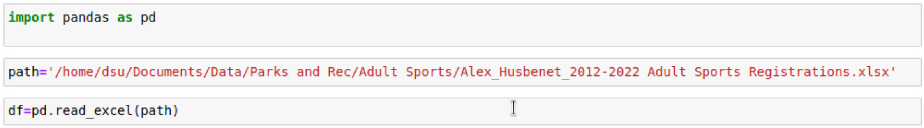
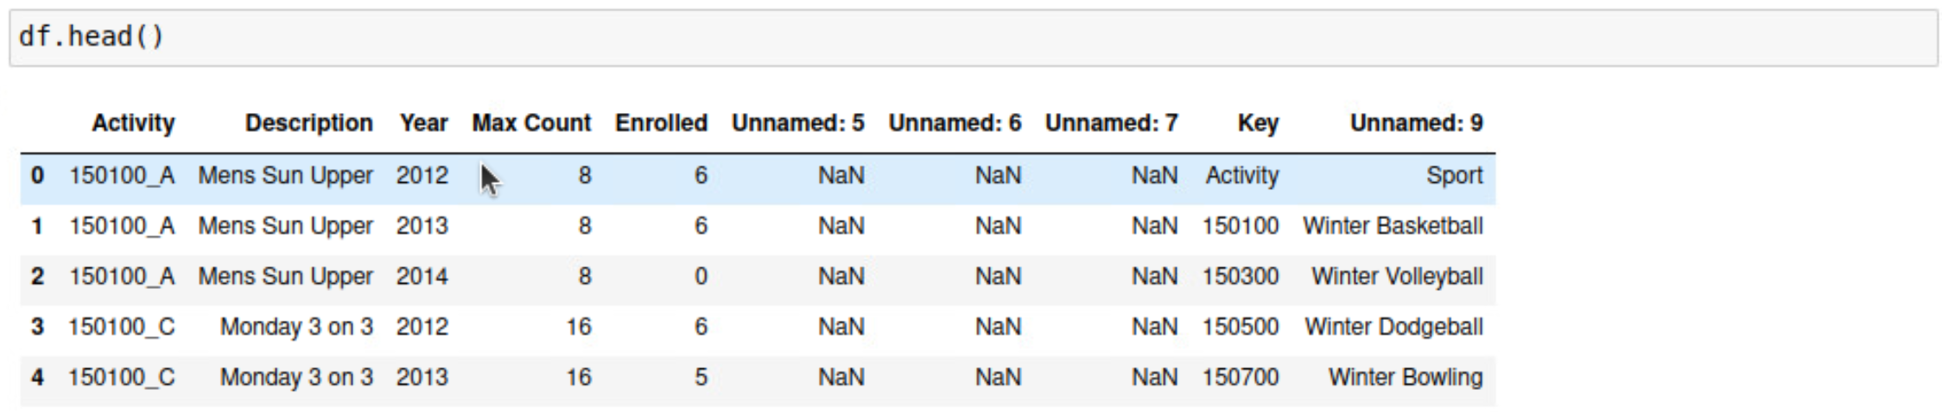
Data Set
Read:
Head:

Slide 8
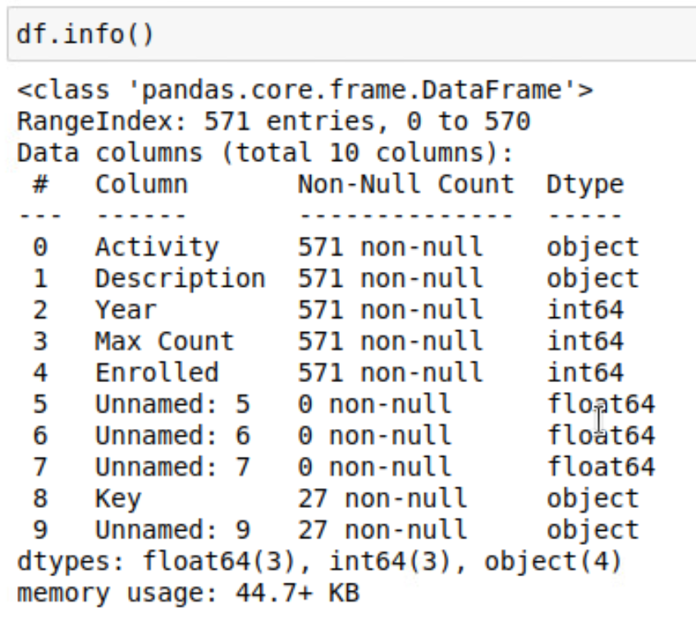
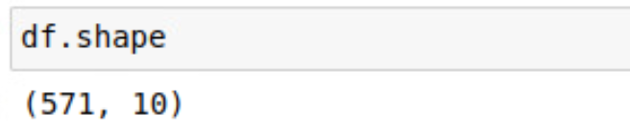
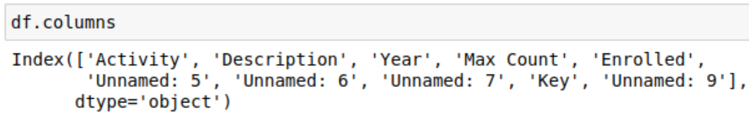
Info:
Shape:
Columns:

Slide 9
Methodology
Classification
We can classify the data based on the popularity metrics such as Highly popular, moderately popular and Low popular.
Regression
We can predict the popularity(Max_Count) of each sport depending on external factors(Seasons).

Slide 10
Hypothesis
The popularity of adult sports varies by season, with certain sports being more popular in specific seasons.

Slide 11
Tools & Softwares
Python
VS Code
Jupyter Notebook
Power BI

Slide 12
Proposed Solution
We will create a model that can predict the popularity of adult sports and look if we can give an optimal schedule for the sports based on the seasons.

Slide 13
Challenges Faced
Understanding the Dataset
Identifying & Replacing the missing values
Model selection

Slide 14
Expected Outcomes
The created model will be used to obtain the popularity of the adult sports.
Create a dashboard showing the Max_Count and Enrollment for the sport for the given years.
Predict an optimal schedule for sports based on seasons.

Slide 15
Conclusion
The developed model can be used to understand and forecast the trends of sports participation. The dashboard can be useful for the stakeholders to quickly access the trends which helps in decision making. If provided, a sports scheduling system that is optimized would represent a data-driven strategy for enhancing adult sports programs.

Slide 16
THANK YOU

