Slide 1
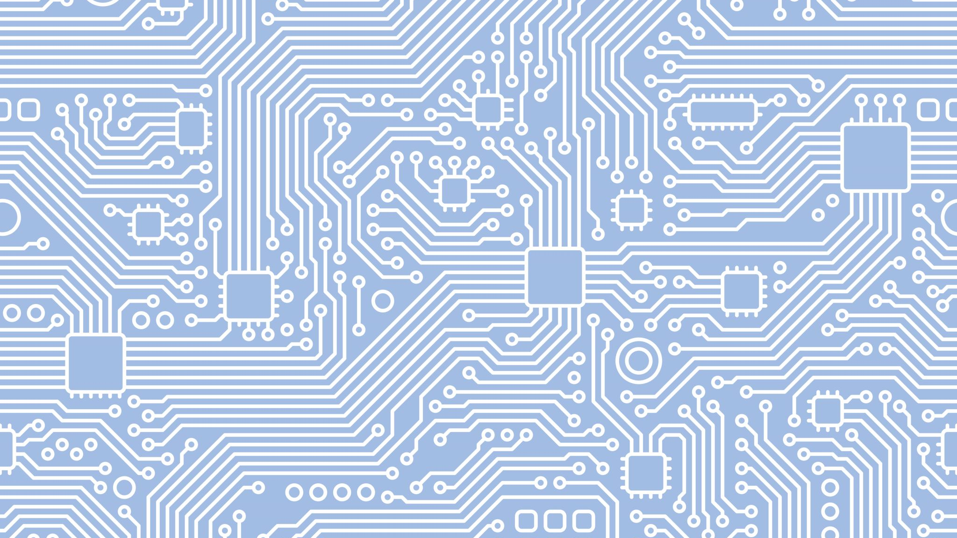
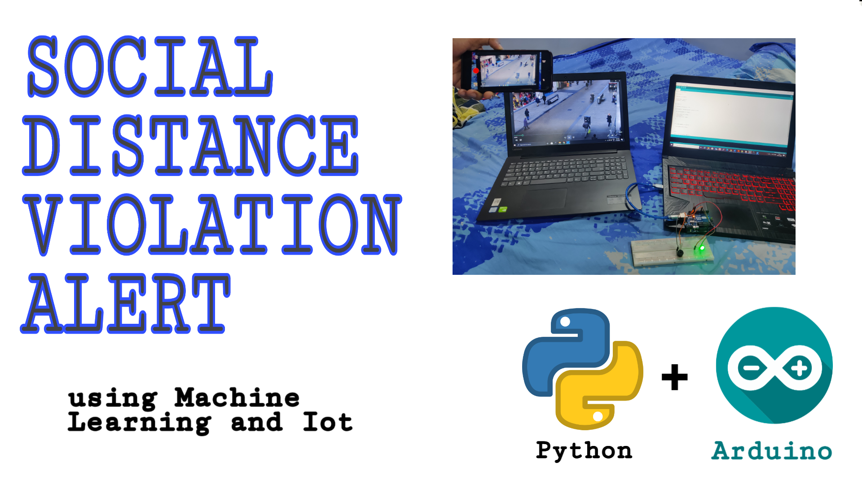
Social Distance violation Alert
1.PRINCE DMELLO
2.SaNIL RODRIGUES
3.SELVIN TUSCANO
Youtube link
https://youtu.be/Fd-FuLAufm8

Slide 2
INTRODUCTION
We are a team of 3 students studying B.E in Computer Science at Fr.Conceicao Rodrigues College of Engineering .We got to know about this Sigmathon from social media .
One major step during this period is the Social Distancing.
We propose to you a digital solution using Machine learning technique which would alert them as soon as the violation of the social distancing is detected
A video stream will be captured from the CCTV camera, with the help of YOLO and CV model we are detecting the humans and keeping a track of the number of humans present in the given live video stream

Slide 3
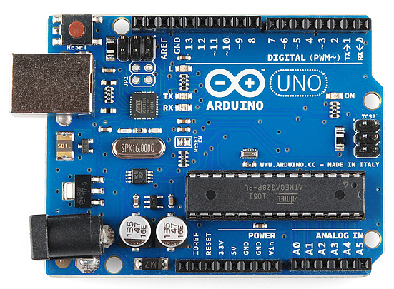
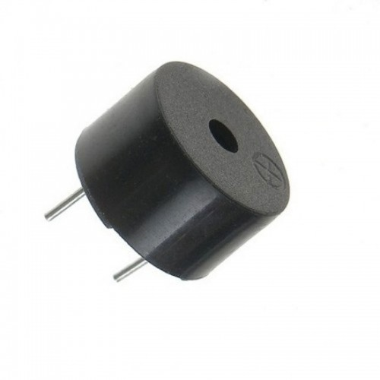

Hardware Requirements
Arduino
Led
Buzzer
Jumper wires

Slide 4


Software Reqirements
Arduino ide
Idle(Python)
Ipweb cam

Slide 5
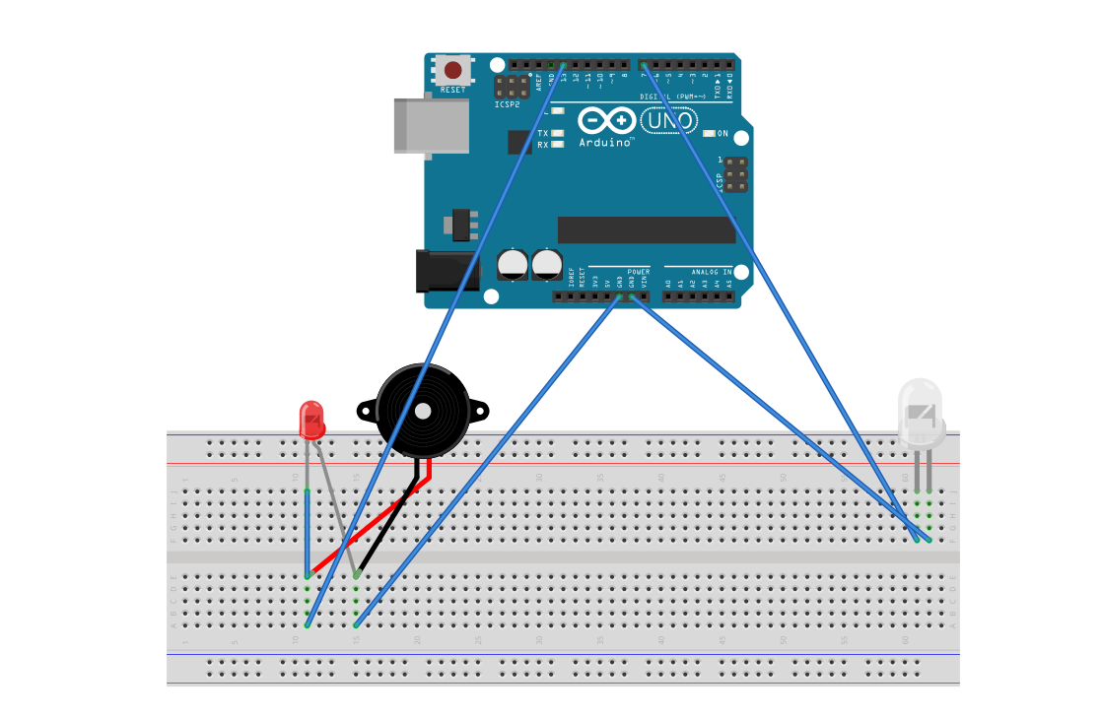
Circuit Diagram
1. we will connect positive of green Led to pin 13 on board and negative to GND.
2. we will connect positive of red Led and Buzzer to pin 7 on board and negative to GND.

Slide 6

How to Run?
Setting up arduino
open social.ino in arduino application.
Compile the sketch.
upload it to the board.
Command line
go to the social folder by eg(cd desktop\social\)
run: pip install -r requirements.txt
python social_distance_detector.py --input pedestrians.mp4 -- output output.avi --display 1
Output frame will be saved in output.avi

Slide 7
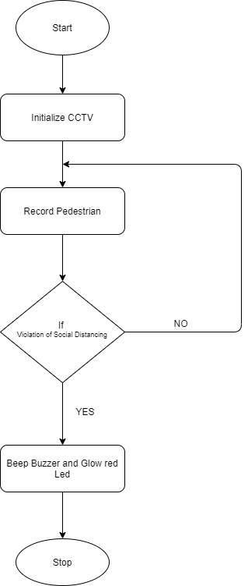


Working

Slide 8
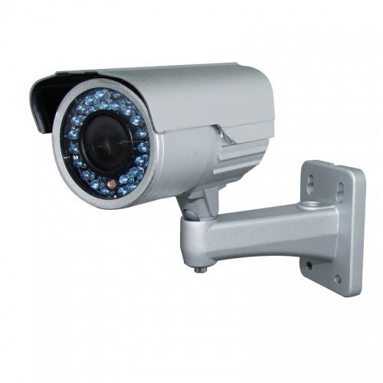
Scaling it in real life
As government can't be everywhere to warn violators of social distancing so here is a hack for this , Social distance Violation alert
Cctv can be used in areas where queues are there ,so the cctv will be connected to a gpu device from where it will render people on its own, if someone violates the 3 feet distance the buzzer will buzz with a red light to alert the people to maintain a safe distance .
This will be very helpful in maintaining social distance and a small step against the spread of corona virus

Slide 9
Scaling it in real life
Have to install CCTV outside shops, streets and inside malls.
We need one system with good graphics processing unit(GPU) .
Once all configuration is done our system will start detecting people in frame.
If many people are violating social distancing rules buzzer will beep and led will glow so that people can follow social distancing .

Slide 10
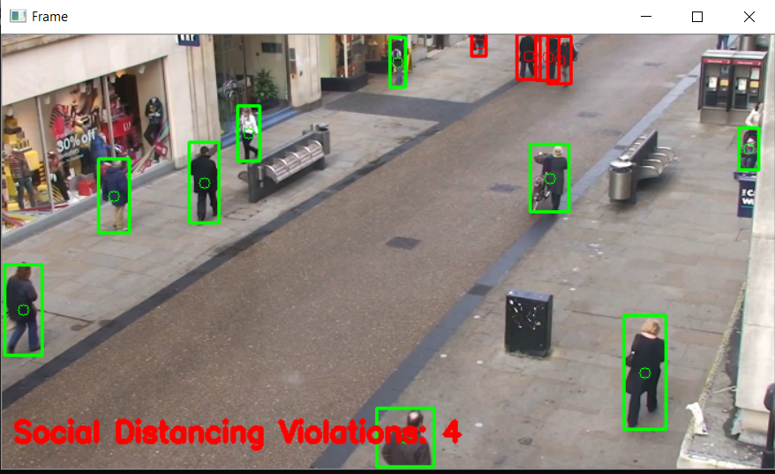
Output-1

Slide 11
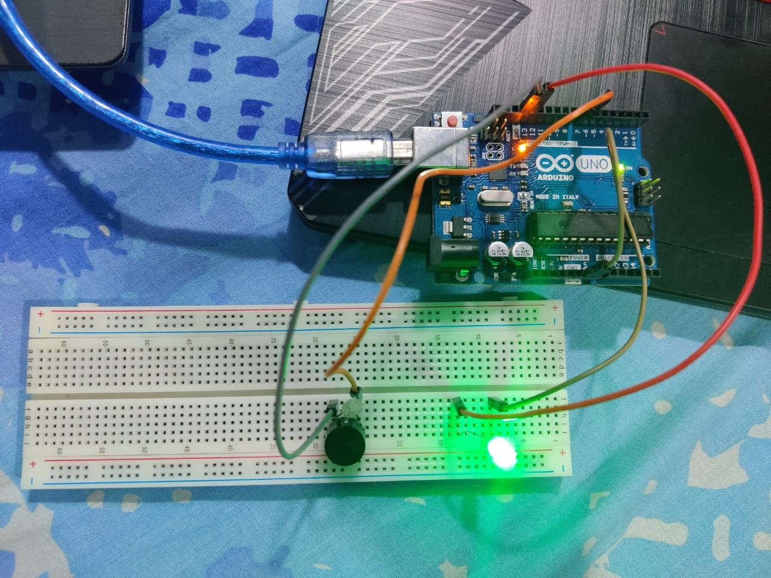
Output-2

Slide 12
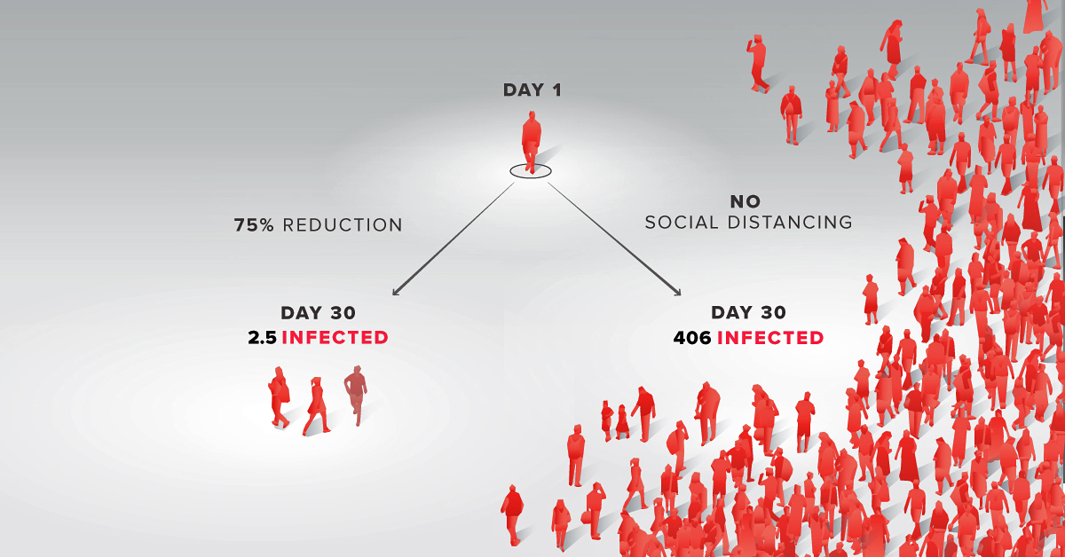
Why social distance violation alert ?
Allows you to manage crowd in areas where social distancing is difficult to practice.
Alerts the authority so that valid actions can be taken.
We can lower the rate of spread of COVID-19 virus.

Slide 13
Thank You…!!!

