Slide 1



FalureAnalysisDashboard
View in Power BI
Last data refresh:
25/08/2025 11:07:02 UTC
Downloaded at:
28/08/2025 15:51:49 UTC

Slide 2
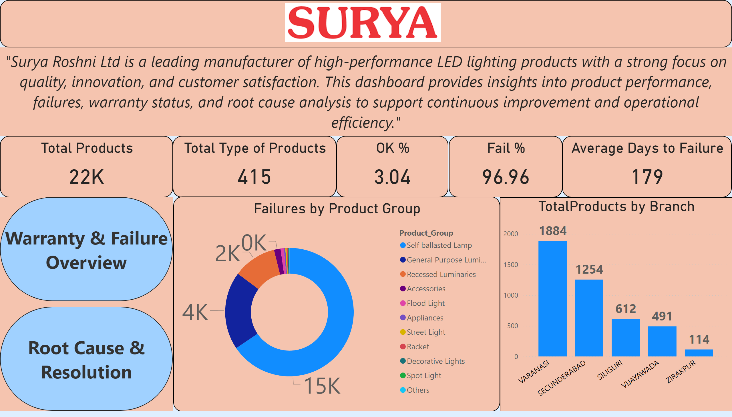
Home
Notes:
textbox
No alt text provided
Total Type of Products
No alt text provided
slicer
No alt text provided
Failures by Product Group
No alt text provided
image
No alt text provided
textbox
No alt text provided
columnChart
No alt text provided
Average Days to Failure
No alt text provided
Total Products
No alt text provided
pageNavigator
No alt text provided
OK %
No alt text provided
Fail %
No alt text provided

Slide 3
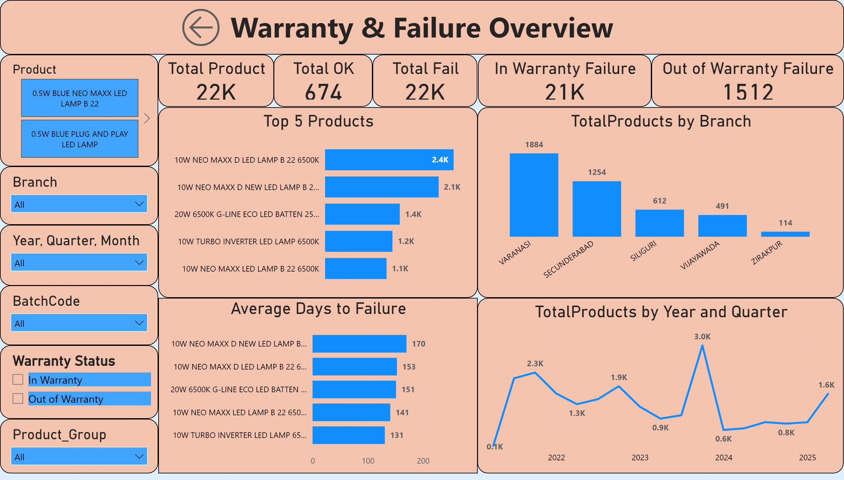
Warranty & Failure Overview
Notes:
textbox
No alt text provided
Total Product
No alt text provided
In Warranty Failure
No alt text provided
Out of Warranty Failure
No alt text provided
Top 5 Products
No alt text provided
columnChart
No alt text provided
Average Days to Failure
No alt text provided
lineChart
No alt text provided
slicer
No alt text provided
slicer
No alt text provided
slicer
No alt text provided
slicer
No alt text provided
slicer
No alt text provided
slicer
No alt text provided
actionButton
No alt text provided
slicer
No alt text provided
Total OK
No alt text provided
Total Fail
No alt text provided

Slide 4
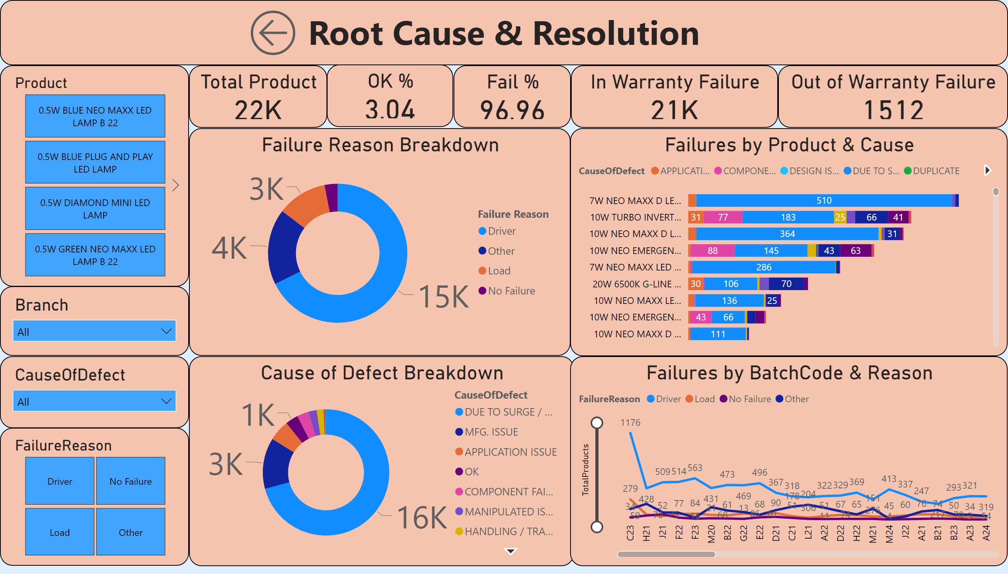
Root Cause & Resolution
Notes:
Failures by BatchCode & Reason
No alt text provided
slicer
No alt text provided
slicer
No alt text provided
slicer
No alt text provided
slicer
No alt text provided
slicer
No alt text provided
actionButton
No alt text provided
Fail %
No alt text provided
OK %
No alt text provided
Cause of Defect Breakdown
No alt text provided
Failures by Product & Cause
No alt text provided
Failure Reason Breakdown
No alt text provided
Out of Warranty Failure
No alt text provided
In Warranty Failure
No alt text provided
Total Product
No alt text provided
textbox
No alt text provided

