Slide 1
SOLANA VALUATION INTERFACE
Pricing that anyone
can recompute.
The value of a protocol asset, computed on-chain from verified accounts and written to a public account — so nobody has to trust an API doing hidden math.
A design-partner proposal for Hylo
Prince · SVI · September 2026
01
Notes:
Framing: this is a partnership ask, not a fundraise. The ask is five technical answers, a name, and a co-announcement — no engineering resource from Hylo.

Slide 2
THE PROBLEM, IN YOUR WORDS
“
honestly an accepted smart contract interface for pricing onchain assets would be amazing — bc pyth wants us to read our own protocol by RPC and give them data by an API — it leaves all sorts of unimaginable security holes
◎ Plish | Hylo · 28 August 2026
You identified it, unprompted.
You were right about the risk.
It is not a hypothetical.
This deck is the thing you described, built — with Hylo as the first adapter.
That pipeline has five trusted hops and no way for a consumer to check any of them.
Four lenders have already lost money to exactly this class of failure.
02
Notes:
Open by handing the framing back to Plish. He diagnosed this himself in August; we are not selling him a problem, we are answering one he raised.

Slide 3
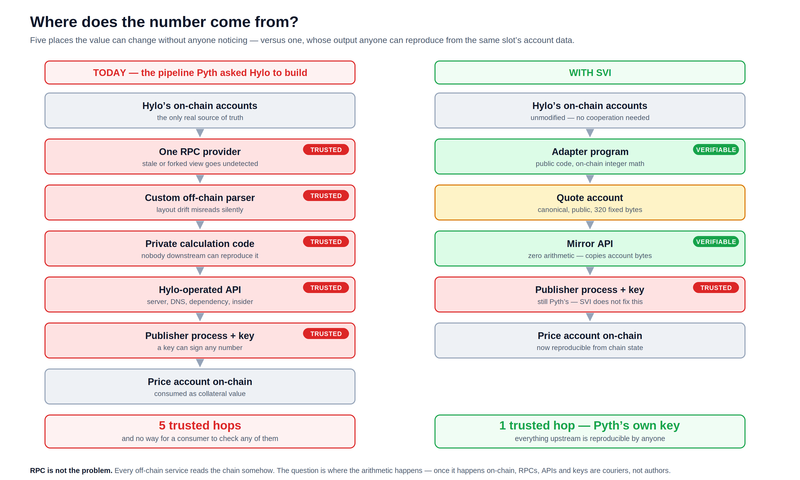
03
Notes:
Left is what Pyth asked Hylo to build. Right is the same pipeline with the arithmetic moved on-chain. Be explicit that the publisher key is still trusted — we do not fix that, and saying so buys credibility for everything else.

Slide 4
EVIDENCE
This failure class already has a body count
In every case below, no on-chain account was ever wrong. The loss came entirely from the valuation layer between true state and the consumer.
$5.8M
$1.8M
1.06→1.7
$10.2M
Loopscale
Moonwell
wUSDM / Venus
YieldBlox
Apr 2025 · Solana
2025 · bad debt
Feb 2026
Feb 2026
The lender's own pricing of RateX PT tokens was wrong. Undercollateralised loans drained 12% of TVL — two weeks after launch.
A config change priced cbETH via cbETH/ETH only, dropping the ETH/USD leg. It read $1.12 instead of ~$2,200. Bots did the rest.
A donation attack moved the ERC-4626 share exchange rate itself, then self-liquidated against it. The rate was the attack surface.
Thin-liquidity VWAP oracle on a tokenised-treasury pair inflated collateral value enough to over-borrow.
$137M+
lost across DeFi exploits in Q1 2026 alone; over $1B cumulatively in 2026.
Loopscale currently lists hyUSD. A lender that hand-rolls valuation for every protocol asset it accepts will eventually hand-roll one wrong.
04
Notes:
Do not oversell these as identical to Hylo's situation — they are the same class, not the same protocol. The Loopscale one is the sharpest: on Solana, and they list hyUSD today.

Slide 5
THE IDEA
Move the arithmetic on-chain.
Then RPCs, APIs and keys become couriers —
not authors — of the number.
Computed
Published
Reproducible
by a Solana program, from accounts it verifies itself
to a canonical 320-byte account anyone can read
byte-for-byte by any third party, from the same slot
05
Notes:
The pivot slide. Everything before is problem, everything after is how.

Slide 6
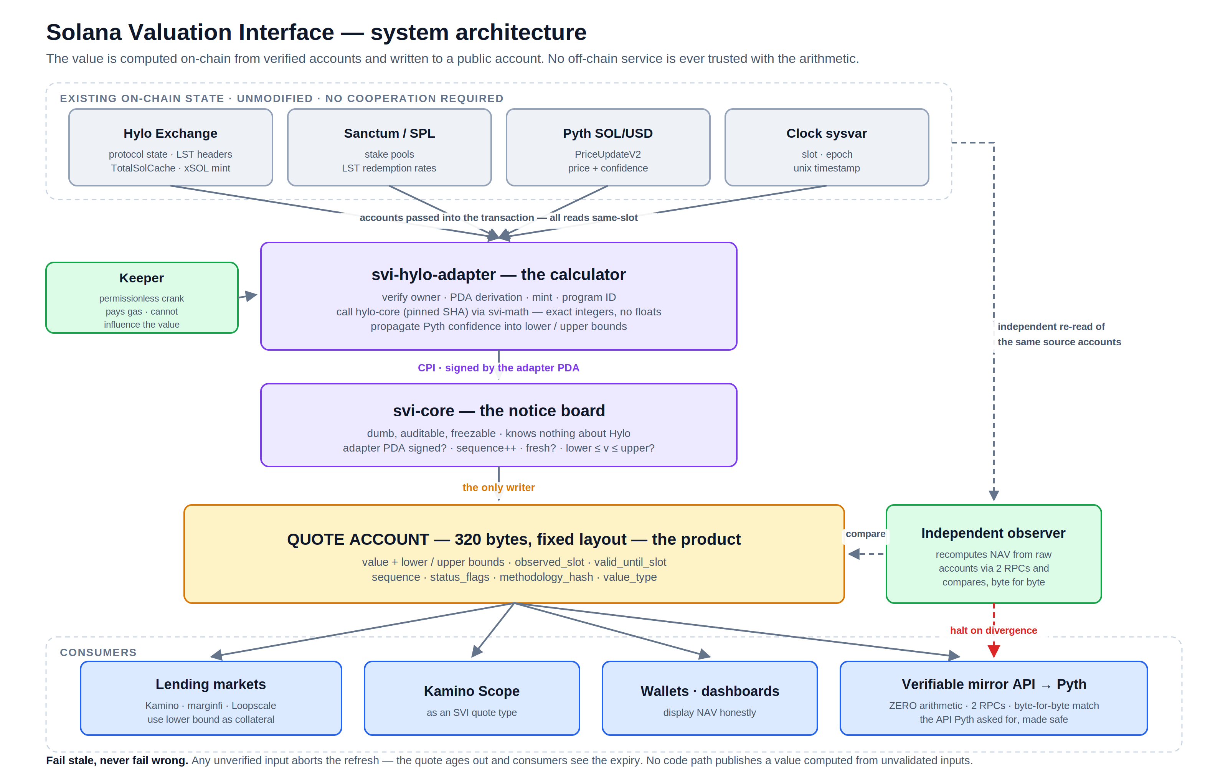
06
Notes:
Grey = exists already, we touch nothing. Purple = we deploy. Amber = the product. Green = operations. Blue = consumers. Emphasise: the keeper pays gas but cannot influence the value.

Slide 7
ARCHITECTURE
Five pieces, and what each one is for
1
Adapter the calculator
One per protocol. Reads the protocol's public account bytes, verifies owner / PDA / mint / program ID, and calls the protocol's own math library. Reimplements nothing.
2
Core the notice board
Tiny, protocol-agnostic, auditable — and one day freezable. Only a registered adapter's PDA may write. Sequence monotonic, freshness enforced, bounds checked.
3
Quote account the product
320 fixed bytes: value, lower/upper bounds, observed_slot, valid_until_slot, sequence, status_flags, methodology_hash, value_type.
4
Keeper rings the bell
Permissionless — anyone can crank. Pays gas; cannot influence the value. If nobody cranks, the quote expires visibly. It fails loud; it never lies.
5
Observer the second accountant
Recomputes from raw accounts through independent RPCs. A divergence of even one unit alerts and halts the mirror API.
The principle it all reduces to: there is no point in the pipeline where a human or a hackable server chooses the number.
07

Slide 8
MECHANICS
One transaction, all reads from the same slot
1
2
3
4
5
Crank
Verify
Compute
Authorise
Publish
Anyone sends the refresh transaction, passing in Hylo's accounts, the stake pools, Pyth SOL/USD and the quote account.
→
Owner, PDA re-derivation, mint allowlist, Pyth program + feed ID — for every account. Any mismatch aborts with no write.
→
hylo-core at a pinned SHA. Integer only. Pyth's confidence interval becomes the lower and upper bounds.
→
CPI into svi-core, signed by the adapter's PDA. That signature is the entire security model.
→
Core checks the rules, writes the quote, increments the sequence, emits QuotePublished.
Permissionless, yet uninfluenceable
Epoch boundaries, handled
Anyone can send this transaction. Nobody can change what it writes — the value is computed by adapter code from verified accounts, and only the adapter's PDA can authorise the write. The keeper is paying for gas. If our bot dies, anyone else's bot cranks it.
When TotalSolCache is an epoch behind, the refresh bundles Hylo's own update_lst_prices crank — permissionless, payer-only signer — then re-reads and proceeds, flagging EPOCH_BOUNDARY_CPI. If that CPI won't fit, we abort rather than publish a stale NAV.
08

Slide 9
THE DESIGN RULE
Fail stale, never fail wrong.
No code path may publish a value computed from unvalidated inputs. A visibly-expired quote is always preferable to a plausible wrong one.
Condition | Behaviour | What the consumer sees
Everything healthy | Publish, sequence++ | Fresh quote, flags clear
New epoch, LST crank not run | Bundle Hylo's permissionless crank, then publish | EPOCH_BOUNDARY_CPI set
…and that CPI won't fit | Abort — no write | Quote ages past valid_until_slot
CR < 100% (Destabilized) | Publish 0 with halt flags | DESTABILIZED — collateral value zero, not a dip to buy
Pyth stale / wrong feed / out of Hylo's own tolerance | Abort — no write | Stale quote, expiry visible
xSOL supply == 0 | NAV = exactly 1.000000000 | ZERO_SUPPLY_DEFAULT
Target program upgraded (layout drift) | Abort until reviewed | Stale quote, expiry visible
Observer disagrees with chain | Alert + halt the mirror API | Mirror stops; the account is still readable
SVI imposes no oracle tolerance of its own — it reads Hylo's on-chain OracleConfig fresh on every refresh, so the feed reflects exactly what the protocol itself would accept for a real redemption.
09
Notes:
This is the slide a risk person cares about most. The point is not that failures don't happen — it's that every failure mode is visible and none of them produces a plausible wrong number.

Slide 10
INTEGRATION
Three ways to consume it, one of them dominant
A
Read the note
B
Call the calculator live
C
The verified mirror
99% of usage
high-stakes only
off-chain consumers
Pass the quote account into your own instruction
Check valid_until_slot and status_flags
Check value_type is what you onboarded
Use the lower bound for collateral
Include the adapter's compute in your own transaction
Value derived from this exact slot's state, atomically
More accounts, more compute units
Zero staleness
Fetch the account through two independent RPCs
Require byte-for-byte agreement
Decode and serve JSON with full provenance
Serve an error when stale — never a last-known-good value
One account read. Fixed 320-byte layout, asserted at compile time.
For liquidators who cannot accept a 60-second-old quote. Most integrators never need this.
A photocopier. It cannot lie about the price, because anyone can compare its output to the account.
Compute-budget reality: an xSOL NAV computation costs tens of thousands of CU. That is fine in a dedicated keeper transaction and often not fine inside a liquidation. Mode A is the default read path, which is why the stored quote account — not the atomic preview — is the product.
10

Slide 11
WHAT THIS COSTS HYLO
Zero changes to your programs. Ever.
Solana programs have no view functions
The one CPI needs no permission either
— and none are needed. Account data is public bytes. The adapter is handed your accounts as transaction inputs and deserializes them itself, verifying owner, PDA derivation, mint and program ID before touching a single field. All reads inside one transaction are same-slot consistent by construction.
The only thing SVI calls into Hylo is update_lst_prices, at epoch boundaries, to accrue state that is stale until cranked. It takes a payer-only signer — it is already permissionless. So even the single CPI in the design requires nothing from you.
NOT ASKED FOR
THE ENTIRE ASK
A program upgrade
An engineering sprint
Integration work
Infrastructure to run
Funding
Exclusivity
Five technical answers
Permission to name Hylo as design partner
A co-announcement at launch
Roughly one engineer-afternoon in total.
11

Slide 12
CORRECTNESS
We reimplement none of your math
The adapter depends on hylo-core, pinned to an exact git SHA recorded on-chain in the adapter config. Your redemption math and SVI's published value cannot diverge, because they are the same code.
Quantity | hylo-core function | Rounding, taken from your source | SVI field
xSOL NAV, redeem side | exchange_math::next_levercoin_redeem_nav | mul_div_floor × price.lower | quote_amount and lower_quote_amount
xSOL NAV, mint side | exchange_math::next_levercoin_mint_nav | mul_div_ceil × price.upper | upper_quote_amount
Collateral ratio | exchange_math::collateral_ratio | mul_div_floor, price.lower | status_flags zone bits
hyUSD NAV if depegged | exchange_math::depeg_stablecoin_nav | mul_div_floor | hylo-hyusd-backing-v1
Why the headline number is the redeem side
Fixed-point domain
Hylo already prices NAV as a range and always takes the side favourable to the protocol — mint uses ceil math with Pyth's upper bound, redeem uses floor with the lower. A holder liquidating xSOL realises the redeem side, so redeem NAV is the defensible collateral value. Publishing the full range preserves the information for consumers with other needs. That is your convention, not ours.
UFix64<N9> for NAV and prices, UFix64<N6> for supplies — per hylo-core convention.
No floating point anywhere in SVI, by design. u128 intermediates, every function total.
12
Notes:
This is the slide that earns technical credibility with Plish. The mapping came from reading hylo-core, not from the docs.

Slide 13
STATUS
This is not a pitch for something that might exist
Component | State | What it is
crates/svi-math | DONE | Exact integer math. u128 intermediates, mandatory explicit rounding, no_std, arithmetic side effects denied, every function total, property-tested.
programs/svi-core | DONE | Descriptor + 320-byte zero-copy Quote, layout asserted at compile time. publish_quote enforces: feed active, adapter PDA signed, bounds coherent, observation fresh and strictly newer.
programs/svi-mock-adapter | DONE | Exercises the CPI and authority path end to end.
hylo-xsol-nav-v1 spec | DRAFT v0.9 | Accounts, formulas, rounding, edge cases, failure states, output mapping, update policy, verification procedure.
programs/svi-hylo-adapter | BLOCKED | Scaffolded. Waiting on five answers — not on engineering time.
Keeper · mirror API · observer | PHASE 2 | Built once the methodology is frozen.
The critical path is not engineering capacity. It is five answers from Hylo.
13

Slide 14
VALUE TO HYLO
What Hylo gets for an afternoon
✓
✓
✓
Zero engineering cost
The Pyth request answered
Liability moved off your team
No program changes, no integration, no infrastructure to run or be paged for.
Pyth gets exactly the API shape they asked for — minus the security objection you raised.
The valuation code is public, reproducible, and not yours to operate or be blamed for.
✓
✓
✓
A feed lenders can underwrite
V2 scales down this path
A public artifact for Hylo
Conservative redemption-anchored value, explicit bounds, freshness stamp, and a DESTABILIZED flag that unambiguously means zero.
The xAsset Engine turns 4 feeds into 4 × N. A methodology-per-asset framework absorbs that; a hand-rolled API does not.
hylo-xsol-nav-v1 is a rigorous public specification of Hylo's valuation semantics — useful documentation in its own right.
14

Slide 15
MARKET
The asset class is NAV-shaped, and it is growing fast
$3.7B
~$15B
~$3.5B
2,800+
tokenised RWA on Solana,
up 4× in six months
Solana LST supply —
every unit a formula, not a trade
lending TVL carrying this
valuation risk today
Pyth feeds — built for
observed market prices
Why now
The honest version
A design partner has the problem today, with a deadline — Pyth has already asked.
Hylo V2's xAsset Engine multiplies 4 feeds into 4 × N.
Solana RWA quadrupled in six months, and it is NAV-priced by definition.
The Foundation is standardising the neighbouring layer (sRFC 40) right now.
Colosseum runs 28 Sep – 2 Nov 2026.
Standards do not monetise. Realistic year-one revenue is low six figures at best, from services beside a permanently free standard — custom adapters, managed keeper infrastructure, reviews. There is no token and there will not be one.
The return here is position, not revenue: authoring the valuation interface Solana adopts, with live feeds and a named partner, while the Foundation is standardising next door. Cost to find out: under $500 to deploy and $50–150 a month to run.
15
Notes:
Sources: Solana RWA $3.7B (Jul 2026, blockchain.news); LST supply approaching $15B (May 2026, Sanctum); lending TVL Kamino ~$2.1B + marginfi ~$700M + Save ~$400M + Drift spot ~$300M. Say the honest-version box out loud — it is what makes the rest believable.

Slide 16
LANDSCAPE
Nobody does this as an open interface
Player | What it is | Why SVI is not redundant
Pyth | Push/pull oracle, 2,800+ feeds, 128 publishers | Customer, not competitor. Built for observed market prices — it has no mechanism for reproducible protocol NAV, which is why it is asking Hylo for an API.
Switchboard | Permissionless custom feeds, TEE-executed jobs | Real overlap, but the math still runs off-chain in an enclave. You trade 'trust the API' for 'trust the enclave and the job definition'.
Kamino Scope | Oracle aggregator, ~40 asset-specific valuation types | Closest analogue and proof the adapter model works — but it is Kamino's internal component, curated by and for Kamino. A consumer target, not a rival.
Blueshift Doppler | Ultra-efficient price publishing primitive | Transport, not semantics. It makes writing a number cheap; it says nothing about where the number came from.
sRFC 40 | Foundation + Exo vault standard, NAV-settled flows | The one genuine strategic risk. Response is to contribute into it, not compete — and to cover what vaults don't: leveraged tokens, backing NAV, redemption, receipt tokens.
Chainlink NAV | Brings off-chain fund NAV on-chain for RWAs | Opposite direction: it transports NAV computed off-chain by a fund administrator. SVI computes NAV from on-chain state.
The honest read: there is no one doing exactly this, and that is not because it is hard — it is because it does not obviously monetise. Kamino, Switchboard and Blueshift could each build it in weeks. The defensible assets are methodology specs, audits, track record and partner relationships — not code.
16

Slide 17
GO-TO-MARKET
Six stages, each with a gate before the next
0
Spec, co-signed
Hylo answers Q1–Q5. Methodology frozen and hashed.
NOW — the entire ask
1
Devnet
Adapter live. Differential test vs hylo-core over 1,000+ randomised states.
~3 weeks
2
Mainnet + mirror
4 feeds live. Mirror serves Pyth's schema and does zero arithmetic.
~6 weeks
3
First consumer
One protocol reads a quote account in production.
Q4 26 – Q1 27
4
Adapter #2
A second protocol ships with zero changes to core or math.
Q1 2027
5
Into the sRFC
Submitted aligned with sRFC 40, not parallel to it.
Q1–Q2 2027
Stages 0–2 are within our control and only prove competence. Stages 3 and 4 are the real test — until a second protocol adopts it, SVI is a Hylo wrapper, and we say so.
17

Slide 18
THE ASK
Five answers, a name, and a retweet
Q1
V1 vs V2 layout, and timing
The equations doc describes V2, the addresses page lists V1 programs, and the SDK has cbBTC / exo machinery. Which layout is live on mainnet today, and is any account structure changing before November?
Q2
update_lst_prices via CPI
Any constraint preventing invocation from a third-party program — LUT requirements, remaining-accounts size? This decides whether the epoch-boundary path bundles your crank or degrades for a window.
Q3
Pyth's exact request
Which feeds, what cadence, what response schema? Highest-value answer of the five: it defines the mirror contract. A forwarded message is enough.
Q4
SDK release pinning
Will Hylo tag SDK releases aligned to program deployments, so the adapter can pin hylo-core to the deployed program version?
Q5
Design-partner blessing
May SVI name Hylo as design partner for the spec and the Colosseum submission, and would Hylo co-announce at launch?
Deadline that matters: Colosseum runs 28 Sep – 2 Nov 2026. Answers by mid-September make a mainnet-live submission with Hylo named as design partner realistic.
18
Notes:
Land Q3 hardest — it is the one that unblocks the best adoption story, and it costs Plish a forwarded screenshot.

Slide 19
PILOT
Six weeks from spec freeze to Pyth evaluating
Phase | Duration | What ships | Hylo's involvement
0 · Spec freeze | 1 week | Q1–Q5 folded in; methodology hashed and frozen at v1.0 | One review pass
1 · Devnet | 2 weeks | Adapter computes xSOL NAV; differential test vs hylo-core; failure paths tested | None
2 · Observer parity | 1 week | Zero divergence over 72h continuous; compute budget under 200k CU | None
3 · Mainnet feeds | 1 week | xsol-nav, hyusd-backing, ehyusd-rate, xsol-leverage live; keeper up | Optional: co-run a keeper
4 · Mirror + Pyth | 1 week | Mirror API in Pyth's schema, zero arithmetic; conformance suite public | An intro to Pyth, if willing
5 · Co-announce | — | Public launch | A retweet
Hylo's cumulative time across all six phases is measured in hours.
Exit conditions: if Hylo wants the feeds retired we deprecate them publicly and immediately; the adapter is open source and yours to fork or take over; nothing here creates exclusivity in either direction.
19

Slide 20
CANDOUR
The objections worth raising, answered
“This makes SVI a dependency for our asset pricing.”
“What if your adapter is wrong and someone gets liquidated?”
It doesn't, and that is deliberate. Cranking is permissionless — Hylo can run a keeper. The adapter is open source, the quote account is readable with no SVI infrastructure involved, and the methodology is a public document. If SVI disappears tomorrow, everything except the mirror keeps working — and the mirror is the piece that does no math.
A real risk. Hence: call hylo-core rather than reimplement it; an independent observer that halts on a one-unit divergence; abort rather than publish on any unverified input; and no real-collateral use until a third-party audit. Until that audit, our own position is that no lending market should underwrite against these feeds.
“Is this a hackathon project that dies in November?”
“What's in it for you?”
Partly — that is what the funding path is for. Mitigations that hold regardless: everything open source, the keeper permissionless, the core small enough to freeze, and the methodology spec standing on its own as documentation of Hylo's valuation semantics even if every line of SVI code were abandoned.
Reputation, a Colosseum submission with a real design partner, and a shot at authoring a Solana standard. Not revenue — the standard and SDKs are permanently free and there is no token. Worth being blunt about, because an unexplained motivation is its own kind of risk.
20

Slide 21
WHAT HAPPENS NEXT
1
You
Answer Q1–Q5. Telegram, a call, or comments on the spec — whichever is least effort.
2
Us
Fold them in, freeze hylo-xsol-nav-v1 at v1.0, publish the hash.
3
Us
Build, test, ship to devnet, run the observer to parity.
4
You
One review pass on the frozen spec, and a yes or no on being named.
5
Us
Mainnet feeds, mirror API, Pyth intro.
6
Both
Co-announce.
The methodology spec is complete except for those five answers. Reading §§2–6 takes about fifteen minutes and is the fastest way to check whether we have understood Hylo's math correctly — which, if we haven't, is the most valuable thing you could tell us.
Fail stale, never fail wrong.
github.com/princedotrs/solana-valuation-interface
21

