Slide 1
Network Policy
Propane FE
Rewriting Rules +
Well-Formedness
RIR
Topology
PGIR
Safety Analysis
Config Generation + Minimization
ABGP
Quagga
Cisco
…

Slide 2
Routing Policy
$ Contracts
Traffic Stats
Optimizer
Refined Policy[i]
Compute Delta
Policy Delta [i]

Slide 3
Propane FE
Network Policy
RIR
Topology
PGIR
Decision
Procedure
PGIR
Topology
Quagga
ABGP

Slide 4
PGIR
Custom
Decision
Procedure
PGIR
Butane
Quagga
ABGP
Logic
SMT
Solver
Logic

Slide 5
Common
Rep.
Decision
Procedure
Common
Rep.
Quagga
ABGP
PGIR
Butane

Slide 6
Network Policy
Propane FE
Rewriting Rules +
Well-Formedness
RIR
BGP Control Graph
Safety Analysis
Topology
PGIR
Config Generation + Minimization
ABGP
Cisco
Juniper

Slide 7
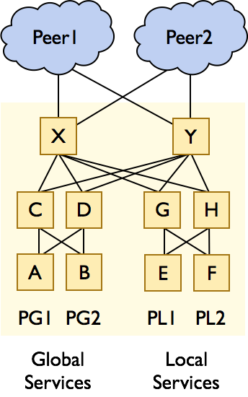

Slide 8
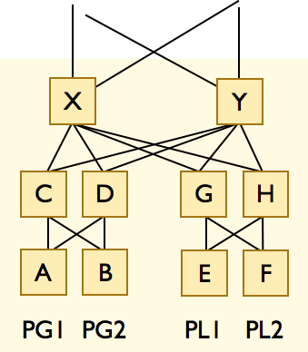
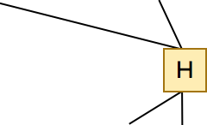
H

Slide 10
