Slide 1
Network Policy
Propane FE
Rewriting Rules +
Well-Formedness
RIR
Topology
PGIR
Safety Analysis
Config Generation + Minimization
ABGP
Quagga
Cisco
…

Slide 2
Propane FE
Network Policy
RIR
Topology
PGIR
Decision
Procedure
PGIR
Topology
Quagga
ABGP

Slide 3
Network Policy
Propane FE
Rewriting Rules +
Well-Formedness
RIR
BGP Control Graph
Safety Analysis
Topology
PGIR
Config Generation + Minimization
ABGP
Cisco
Juniper

Slide 4
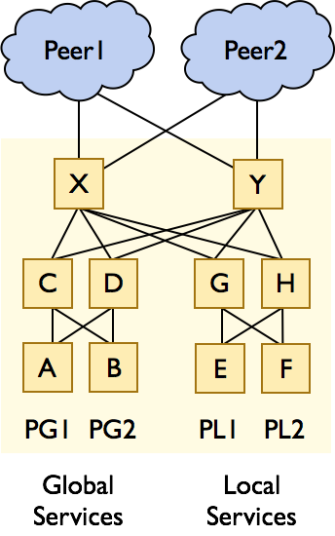

Slide 5
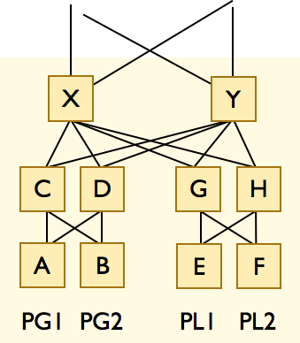
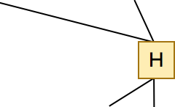
H

Slide 7
