Slide 1
Network Policy
Propane FE
Rewriting Rules +
Well-Formedness
RIR
Topology
PGIR
Safety Analysis
Config Generation + Minimization
ABGP
Quagga
Cisco
…

Slide 2
Propane FE
Network Policy
RIR
Topology
PGIR
Decision
Procedure
PGIR
Topology
Quagga
ABGP

Slide 3
PGIR
Custom
Decision
Procedure
PGIR
Butane
Quagga
ABGP
Logic
SMT
Solver
Logic

Slide 4
Common
Rep.
Decision
Procedure
Common
Rep.
Quagga
ABGP
PGIR
Butane

Slide 5
Network Policy
Propane FE
Rewriting Rules +
Well-Formedness
RIR
BGP Control Graph
Safety Analysis
Topology
PGIR
Config Generation + Minimization
ABGP
Cisco
Juniper

Slide 6
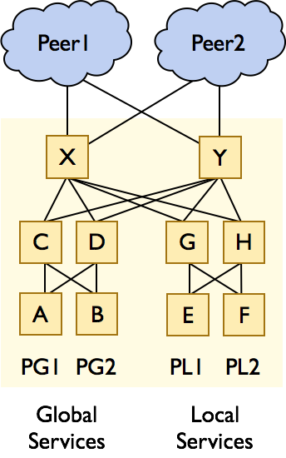

Slide 7
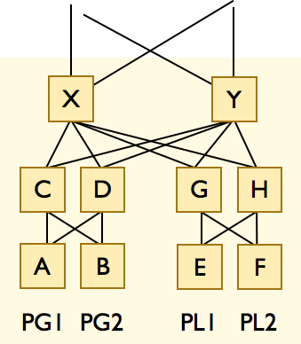
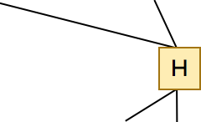
H

Slide 9
