Slide 1


PHYSICS 4
COMPUTING
MUTABLE AND
IMMUTABLE DATA TYPES IN PYTHON
GROUP MEMBERS
JOEL KWAKYE OWUSU BOATENG --4275320
PRINCE EDISON DZAKPASU --4237220
McFAYA ADU FORSON --4267520
ODURO-TWUM EVANGEL --4278420

Slide 2
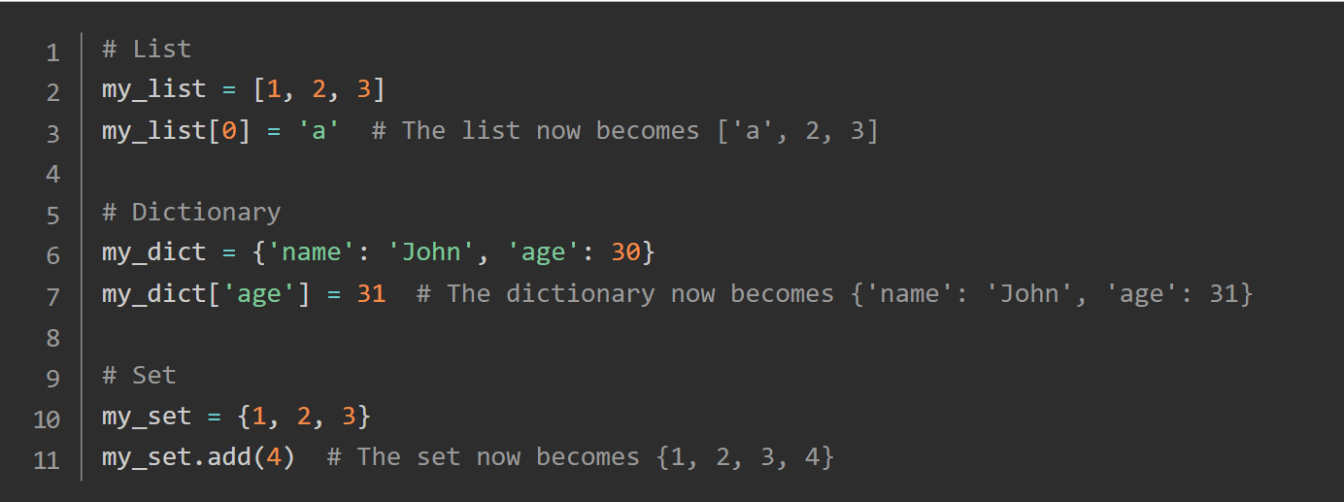

MUTABLE AND IMMUTABLE OBJECTS
A mutable object is an entity whose value can be altered after its creation. In Python, mutable objects are liken to chameleons in the coding ecosystem, adapting and transforming as required. Mutable objects are incredibly versatile and find application in a wide range of real-world scenarios. For instance, lists are frequently employed to store data that needs manipulation, like a list of usernames on a website, while dictionaries are ideal for storing key-value pairs, akin to a phone book.
Python passes mutable objects by reference, not by value. This means that if you modify a mutable object inside a function, those changes can affect the original object outside the function.

Slide 3
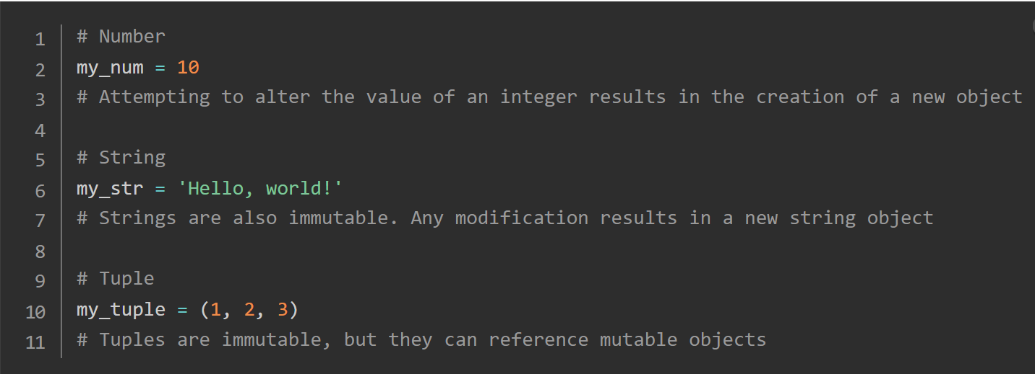
On the contrary, an immutable object is an entity whose value remains constant after its creation. In Python, an immutable object is akin to a written contract—it’s binding and cannot be altered once it’s been established. This unchangeable nature of immutable objects is what makes them so reliable. You can trust that once you’ve created an immutable object, its value will remain constant throughout its lifetime.
Some reasons strings and ints are immutable:
they are commonly passed to functions with the expectation of the function not modifying them.
they are typically small, and less frequently modified than data types like dictionaries.

Slide 4
Thank's For Watching

