Slide 1

Scanner Identification Using Sensor Pattern Noise
Group 28
Course Instructor: Dr. Nitin Khanna
Course TA: Dheeraj Biswas
Group Members
Prince - 12341640
Pratik Raj - 12341620
Ayush Kumar - 12340440

Slide 2
Introduction & Objective
Problem: Digitally scanned images can originate from multiple scanner devices. Verifying which scanner produced a given image is critical for forensic authentication and document integrity.
Objective: Identify the source scanner of a scanned image using the scanner's inherent noise pattern as a unique device fingerprint.
Core Approach: Extract noise residuals using wavelet denoising, build per-scanner reference patterns, and classify using 2D correlation, 1D row correlation, and an SVM classifier.
Dataset: 4 real flatbed scanners (Epson 4490, HP ScanJet 6300c ×2, HP ScanJet 8250), 160 images at 1200 DPI, and 24,270 total patches.
Outcome: SVM accuracy reached 88.44%, while the 2D baseline achieved 67.19% and the 1D row-correlation baseline achieved 70.31%.
DIP Project - Slide 1

Slide 3
Proposed Identification Pipeline
Dataset Loading: Traverse scanner_dataset/scanner_name/dpi/ folders to collect TIFF paths with scanner labels (s1–s4) and keep only the 1200 DPI images used in the main experiment.
Patch Extraction: Extract non-overlapping 1024×768 patches from each valid TIFF scan to obtain 24,270 patches in total.
Wavelet Denoising: Apply 4-level db8 wavelet denoising with soft thresholding and MAD-based noise estimation.
Residual Extraction: Subtract the denoised patch from the original patch to isolate the sensor noise residual.
Feature Extraction: Build a 16-dimensional feature vector from row-pattern and correlation statistics.
Classification: Use group-aware train/test splitting, GroupKFold cross-validation, and an RBF-kernel SVM, with 2D and 1D correlation baselines for comparison.
DIP Project - Slide 2

Slide 4
Dataset & Sample Images
Scanners Used: s1_epson_4490, s2_hp_scanjet_6300c_1_SG9CO270W5, s3_hp_scanjet_6300c_2, s4_hp_scanjet_8250.
Format: High-resolution TIFF images scanned at native DPI, stored under per-scanner folders.
Total Images Used: 160 images at 1200 DPI for the main experiment, selected from a larger collection of 1,583 TIFF files.
Total Patches: 24,270 non-overlapping sub-images of size 1024×768 pixels.
Class Note: The two HP 6300c units are the hardest pair because they are physically very similar.
Sample Image: The sample TIFF shown here is the raw grayscale scan used to verify loading and display.
DIP Project - Slide 3

Slide 5
Residual Extraction — Patch / Denoised / Noise
Patch: Non-overlapping 1024×768 grayscale region from the original TIFF scan.
Denoised: Output of 4-level db8 wavelet denoising, which suppresses most scene content while preserving structured residual behavior.
Noise Residual: Appears as a low-amplitude but structured residual; this is the scanner fingerprint used for later classification.
Mathematical Step: Noise(x, y) = Patch(x, y) - Denoised(x, y)
Processing Stats: All 24,270 patches were processed successfully with 0 skipped.
Observation: Even visually flat residuals retain stable device-specific structure when averaged statistically.
noise = patch.astype(np.float32) - denoised.astype(np.float32)
# Visualized with: plt.imshow(noise, cmap='gray', vmin=-20, vmax=20)
DIP Project - Slide 4

Slide 6
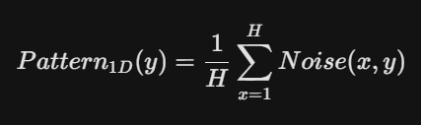
1D Row Noise Pattern
Method: Average all rows of the noise residual along axis=0 to produce a 1D signal of length equal to the number of columns (768).
Mathematical Step: row_pattern = np.mean(noise, axis=0)
Plot (Index 20): The row noise pattern shows rapid fluctuations around zero, with scanner-specific column structure.
Observation: The signal is not visually clean, but its statistical pattern is repeatable across patches from the same scanner.
Stability: Averaging more patches makes the fixed component stronger while the random component cancels out.
DIP Project - Slide 5
def get_row_pattern(noise):
return np.mean(noise, axis=0) # shape: (768,)

Slide 7
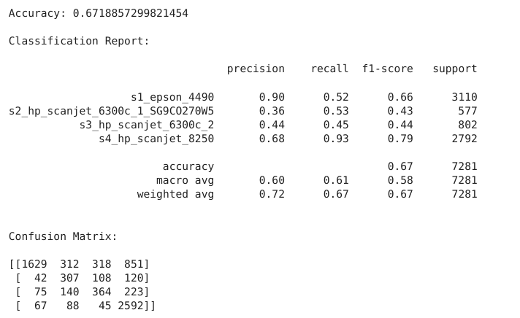
Experiment 1 — 2D Reference Pattern (Baseline)
Method: Average all training noise patches pixel-by-pixel per scanner to create a 2D fingerprint, then classify test patches via Pearson correlation.
Train/Test Split: Group-aware split with a separate held-out test set.
Overall Accuracy: 67.19%.
Interpretation: The 2D baseline works, but it is weaker than the feature-based SVM because the raw pixel fingerprint is sensitive to image content and local variation.
DIP Project - Slide 6

Slide 8
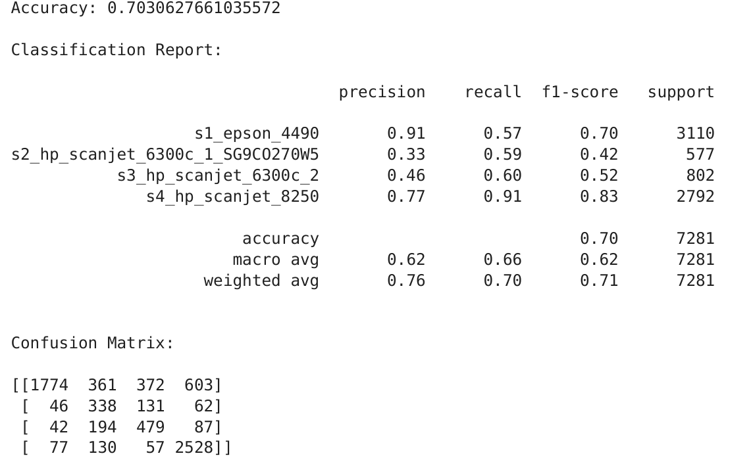
Experiment 2 — 1D Row Reference Pattern
Method: Collapse each noise patch to a 1D column-wise average, build a per-scanner row reference, and classify using 1D correlation.
Train/Test Split: Same group-aware evaluation strategy used across the report.
Overall Accuracy: 70.31%.
Interpretation: The 1D row reference is stronger than the 2D baseline because it reduces scene dependence and emphasizes the scanner's stable column-wise signature.
DIP Project - Slide 7

Slide 9
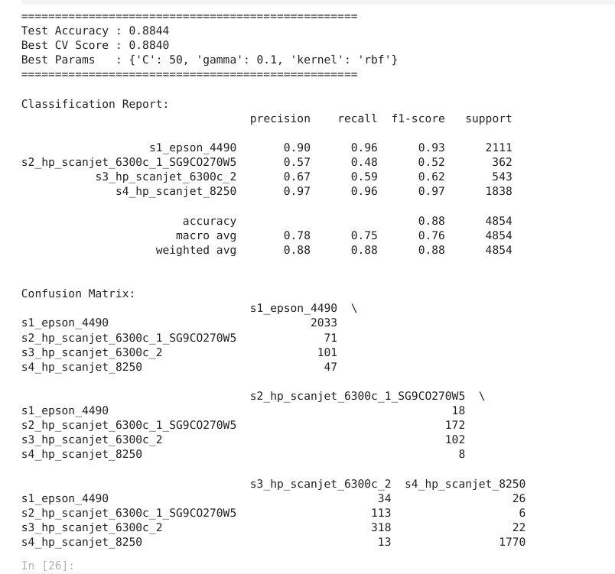
Experiment 3 — 16-D Feature SVM Classifier
Method: Extract 16 statistical features from each residual patch, standardize them, and train an RBF-kernel SVM with group-aware cross-validation.
Train/Test Split: GroupShuffleSplit for hold-out testing and GroupKFold for hyperparameter search.
Overall Accuracy: 88.44%.
Interpretation: This is the best-performing model in the project because the feature vector captures both row-pattern statistics and correlation structure.
DIP Project - Slide 8

Slide 10
Results Comparison — All Three Experiments
Experiment 1 (2D Correlation): 67.19% accuracy; weakest on the two HP 6300c units.
Experiment 2 (1D Row Correlation): 70.31% accuracy; better than the 2D baseline and more robust to scene variation.
Experiment 3 (16-D SVM Classifier): 88.44% accuracy; strongest and most balanced overall.
Hardest Pair: s2 and s3, because both are HP ScanJet 6300c units and are very similar at the hardware level.
Key Takeaway: The feature-based SVM is substantially better than direct correlation baselines on this real, imbalanced dataset.
DIP Project - Slide 9

Slide 11
Technical Stack
PIL / Pillow: Safe loading of large TIFF files with Image.MAX_IMAGE_PIXELS = None.
OpenCV: Grayscale image loading and patch handling where needed.
PyWavelets: 4-level db8 wavelet denoising with soft thresholding.
NumPy + SciPy: Residual computation, row averaging, correlations, and summary statistics.
Scikit-learn: Label encoding, scaling, GroupShuffleSplit, GroupKFold, GridSearchCV, and SVM classification.
Pandas / Matplotlib: Result logging, preview tables, and visualisation of patches, noise residuals, and feature plots.
DIP Project - Slide 10

Slide 12
References
Khanna, Mikkilineni, Chiu, Allebach, Delp, "Scanner Identification Using Sensor Pattern Noise," SPIE Vol. 6505, 65051K, 2007.
Lukas, Fridrich, Goljan, "Determining Digital Image Origin Using Sensor Imperfections," SPIE Vol. 5685, 2005.
Foi, Katkovnik, Egiazarian, Astola, "A Novel Local Polynomial Estimator Based on Directional Multiscale Optimizations," IMA Signal Processing, 2004.
OpenCV Documentation: https://opencv.org
Scikit-learn Documentation: https://scikit-learn.org
DIP Project - Slide 11

