Slide 1
AIONOS AGENTIC AI FACTORY · ASSIGNMENT 2: INTERNAL SERVICE AGENT
Veridian IT Service Agent
An internal IT support agent that's grounded, cites its sources, and can be audited. It understands the issue, finds the policy, asks only the follow-ups that matter, resolves or escalates, and logs every step.
15 / 15
4
2 + 5
0
data-pack requests triaged
active queue tickets assessed
policy conflicts / status corrections caught
invented policies
Live demo: https://princegarg001.github.io/veridian-it-service-agent/
GitHub: https://github.com/princegarg001/veridian-it-service-agent
Prince Garg

Slide 2
PROBLEM & SCOPE
The problem and what the brief requires
Veridian Corp IT receives messy, ambiguous requests. Some are risky (phishing, admin access), some conflict with policy (laptop refresh), and some statuses in the queue are wrong. The agent has to act only on the supplied policies.
✓ Understand the issue
✓ Find policy / resolution
✓ Sensible follow-ups
✓ Resolve simple requests
Hybrid classifier (rules + optional Claude), entity extraction
Policy map + BM25 retrieval + ticket precedents
Slot filling. Asks only when the answer changes the decision
Self-service guidance with citations (Wi-Fi, VPN renewal)
✓ Escalate risky / unclear
✓ Structured ticket
✓ Show source used
✓ Audit trail
Security-first override, ungrounded → human, conflicts → human
JSON: priority, risk, owner, SLA, sources, conflicts, next steps
Clickable KB-xx / TK-xxxx citations on every answer
Hash-chained log of every stage and actor, exportable
2 / 10 · Veridian IT Service Agent

Slide 3
ARCHITECTURE
Architecture of the complete solution
Presentation
Principle: The LLM proposes, the policy engine decides. Every approval, route and escalation is deterministic, testable, and cites its source.
Zero-dependency: static web app on GitHub Pages. Works offline in Rules mode, and hybrid mode adds Claude.
Portable: the engine is a pure function, so it can sit behind Teams/Slack, ServiceNow, or an API with no rewrite.
Safe fallback: if the LLM fails or disagrees on a security or privileged intent, the rules result wins.
index.html · app.js: Agent Chat, Triage Console, Tickets, Audit, KB, Architecture tabs
Orchestration
engine.run(): intake → understand → retrieve → reason → guardrails → act + slot-filling loop
Understanding
Weighted intent classifier + entity extractor. Optional Claude (llm.js) returns schema-checked JSON
Knowledge & retrieval
data.js: KB-01…10 + Asset Mgmt Policy + ticket history. Policy map + BM25 + precedent lookup
Policy & guardrails
12 deterministic handlers · risk · conflict detection · ungrounded → escalate · status checks
Records
Structured JSON tickets · hash-chained audit trail · localStorage · JSON export
3 / 10 · Veridian IT Service Agent

Slide 4
PROCESS FLOW
Process flow: from message to action
1 Intake
2 Understand
3 Retrieve
4 Reason
5 Guardrails
6 Act
chat or queue item + requester + date
intent, confidence, entities
KB policy + BM25 + precedent
policy handler checks slots
risk, conflict, ungrounded
decision + ticket + audit
↺ If a slot that changes the decision is missing (lockout attempts, laptop age, contractor or full-time, asset tag), the agent asks ONE targeted follow-up and loops back. After 2 failed clarifications it hands over to a human.
RESOLVED
IT_TICKET
ROUTED
ESCALATED
NEEDS_INFO
Self-service with citation
REQ-02 guest Wi-Fi
REQ-05 VPN renewal
REQ-09 archive mail
IT must act
REQ-03 manual unlock
REQ-13 laptop diagnosis
Other owner
REQ-07 manager → Finance → IT
REQ-11 contractor VPN form
Risk / no authority / conflict
REQ-01, 04, 08, 10, 14
Targeted question
REQ-06 printer
REQ-12 expense
REQ-15 vague
4 / 10 · Veridian IT Service Agent

Slide 5
INPUTS & ASSUMPTIONS
Inputs, sources and assumptions
Inputs used (only these)
Dates: simulation week Mon 21 to Fri 25 Sep 2026. SLAs in business days (no holiday calendar given).
Catalog: the approved software list isn't supplied, so unconfirmed software is treated as non-catalog (safe default).
Policy conflict: KB-03 (3 yrs) vs Asset Policy (4 yrs + Finance sign-off) is surfaced to humans, not auto-resolved.
No policy = no action: admin/privileged access has no KB entry, so escalate with TK-1050 precedent.
REQ-11: requester treated as the contractor's manager, and this is stated in the reply.
Priority model: P1 security · P2 employee blocked · P3 standard · P4 informational.
Out of scope: identity verification, real ITSM/email integration. Tickets are simulated JSON records.
• Assignment brief: Agentic AI Factory
• Data pack Section 1: KB-01 to KB-10 + Asset Management Policy extract (Finance, Q2 2026)
• Section 2: 15 employee requests REQ-01…15 with recorded status
• Section 3: 10 queue tickets TK-1042…1051 (4 active, 6 closed as precedent)
• No external or invented policy
5 / 10 · Veridian IT Service Agent

Slide 6
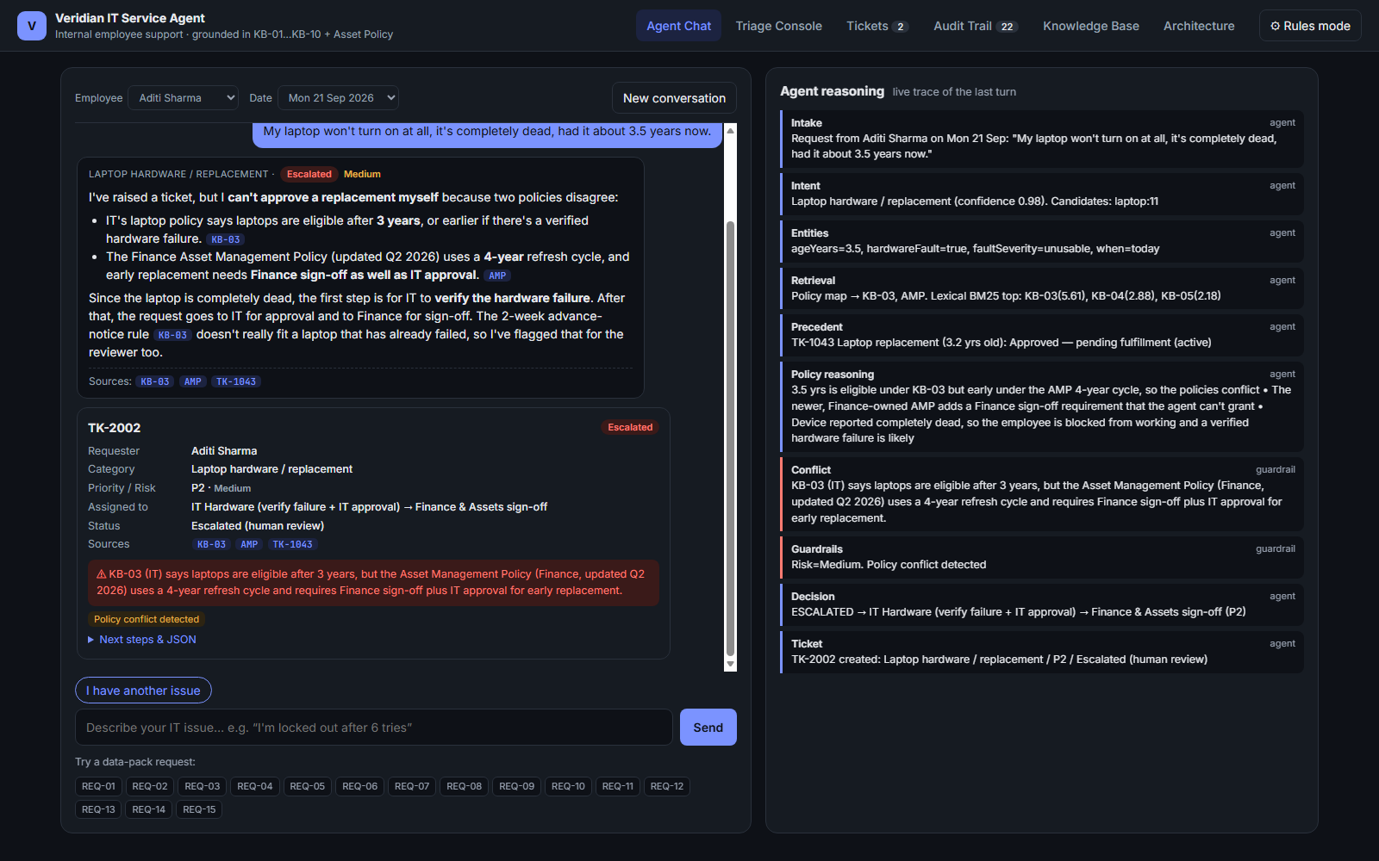
DEMO · AGENT CHAT
Working agent: grounded conversation
REQ-01: 3.5-yr dead laptop
Conflict found: KB-03 says eligible, the Asset Policy says early (needs Finance sign-off)
Doesn't approve: escalates to IT verification → IT approval → Finance sign-off
Flags edge case: the 2-week notice rule doesn't fit a laptop that has already failed
Trace panel: intake, intent, entities, retrieval scores, precedent TK-1043, guardrails, decision, ticket
6 / 10 · Veridian IT Service Agent

Slide 7
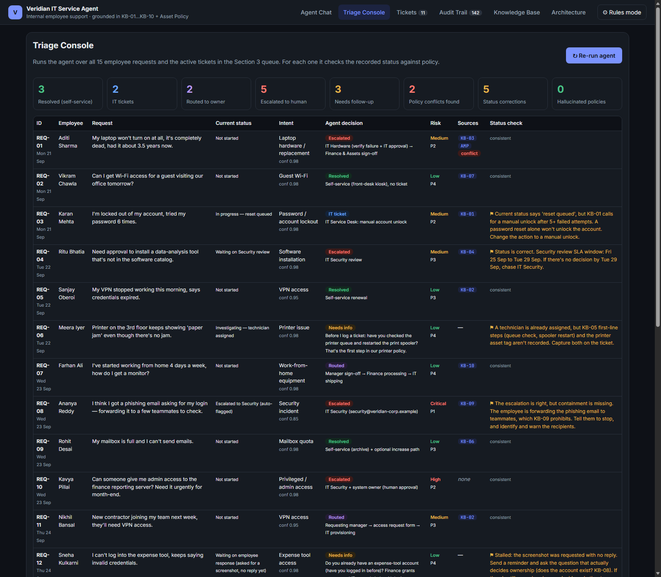
DEMO · TRIAGE & STATUS RECONCILIATION
Triage Console: whole queue in one click
REQ-03: 'reset queued' is wrong. KB-01 requires a manual unlock
REQ-08: escalated, but the employee is forwarding the phishing email. Contain it
REQ-04: SLA window Fri 25 to Tue 29 Sep computed
REQ-06 / REQ-12: missing asset tag / stalled reply
TK-1043: HOLD fulfilment. 3.2 yrs approved without Finance sign-off
TK-1048: link to REQ-08 as a possible same campaign
7 / 10 · Veridian IT Service Agent

Slide 8
SAFETY & GOVERNANCE
Guardrails, escalation and audit trail
REQ-08 · Phishing (P1 Critical)
REQ-10 · Urgent admin access
REQ-14 · Tracking extension
Security-first override. Tells the employee to stop forwarding (KB-09 violation), report to security@veridian-corp.example, warn recipients, and correlate with TK-1048.
No KB policy, so the agent won't act. Urgency pressure flagged. Asks for business justification and manager approval. Precedent TK-1050 was rejected for lack of justification.
Non-catalog, so IT Security review (3–5 business days). Marked HIGH risk as a monitoring tool with privacy exposure.
Audit trail
Structured ticket
Every stage is logged: timestamp, session, actor (employee / agent / LLM / guardrail), stage, detail. Each entry is hash-chained to the previous one, so edits are detectable. Export as JSON.
id · requester · category · decision · priority · risk · assignedTo · status · SLA · kbSources · precedents · policyConflicts · flags · nextSteps · extracted slots. Export as JSON.
8 / 10 · Veridian IT Service Agent

Slide 9
AI TOOLS
AI tools used and how
Claude Code (Claude Opus) · Build partner
Claude API (Sonnet), optional · Runtime NLU
Parsed the docx and PDF data pack into structured data, designed the pipeline and decision model, wrote the engine, UI, and Node test harness, captured screenshots, generated this deck (python-pptx), and wrote the README. Every rule was checked by hand against the data-pack wording.
Hybrid mode (⚙ settings): converts messy employee text into schema-validated {intent, confidence, slots}. Allow-listed slots only. It never approves, routes or escalates, and falls back to rules on failure.
Deterministic policy engine · Decision layer
Node.js scripted evaluation · Verification
12 policy handlers, BM25 retrieval, risk and conflict guardrails. Chosen deliberately over LLM decisions so outcomes are consistent, testable and auditable.
Replayed all 15 requests and multi-turn dialogues (vague → VPN → contractor, laptop age follow-up, phishing with credentials entered) and fixed a misrouting bug where security must outrank password.
9 / 10 · Veridian IT Service Agent

Slide 10
OUTCOME
Results, limitations and next steps
Results
Limitations
Next steps
• 15/15 requests handled with a cited decision or a targeted question
• 5 escalations, all justified (risk, conflict, no policy)
• 5 status corrections on the existing queue
• 2 policy conflicts surfaced (REQ-01, TK-1043)
• 0 invented policies. Ungrounded requests go to humans
• Runs with one command or the live link
• Keyword classifier is tuned to this domain (the LLM layer covers messy phrasing)
• Tickets and audit are in browser storage, not ITSM
• No identity verification or SSO
• No holiday calendar for SLAs
• Catalog contents unknown
• ServiceNow/Jira + Teams integration
• Embedding retrieval + eval set
• Policy-owner workflow to reconcile KB-03 vs AMP
• WORM audit store, PII redaction
• Human-in-the-loop approval inbox
Live: https://princegarg001.github.io/veridian-it-service-agent/
Code: https://github.com/princegarg001/veridian-it-service-agent
10 / 10 · Veridian IT Service Agent

