Slide 1

Customer Shopping Behavior Analysis
A data-driven case study exploring transactional patterns, customer segments, and strategic insights from 3,900 purchases.

Slide 2

Project Overview
This project analyzes customer shopping behavior using transactional data from 3,900 purchases across various product categories. The goal is to uncover insights into spending patterns, customer segments, product preferences, and subscription behavior to guide strategic business decisions.

Slide 3
Dataset Summary
Scale
Missing Data
Customer Demographics
3,900 Rows · 18 Columns
37 values in Review Rating column
Age, Gender, Location, Subscription Status
Purchase Details
Item Purchased, Category, Purchase Amount, Season, Size, Color
Shopping Behavior
Discount Applied, Promo Code Used, Previous Purchases, Frequency, Review Rating, Shipping Type

Slide 4
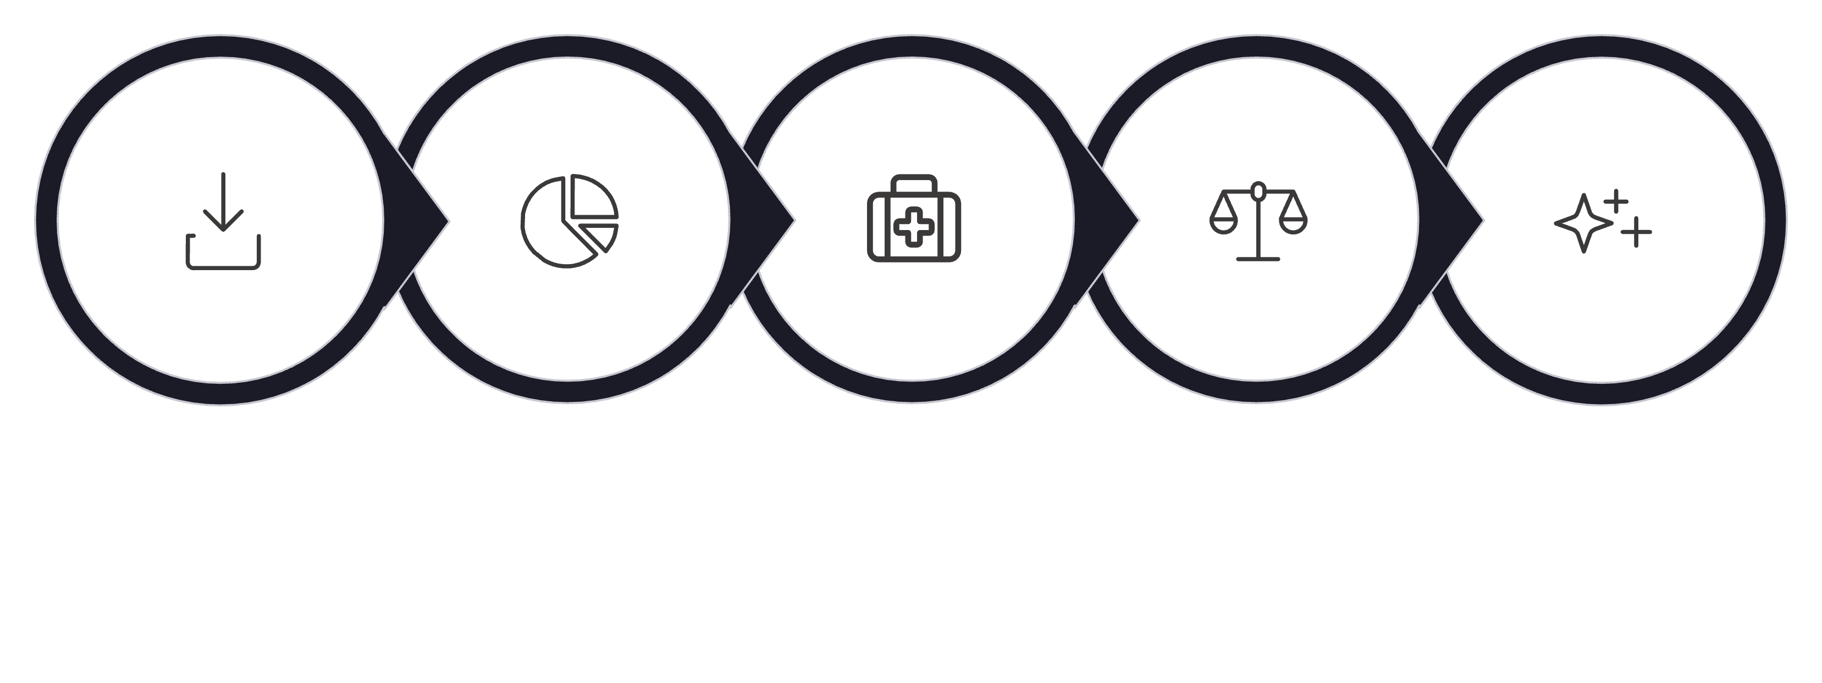
Exploratory Data Analysis using Python
Data Load
Explore
Handle Missing
Standardize
Feature Eng
The cleaned DataFrame was connected to PostgreSQL via Python for downstream SQL analysis. Key steps included imputing missing Review Ratings with category-level medians, binning ages into groups, and dropping the redundant promo_code_used column.

Slide 5
Data Analysis using SQL (Business Transactions)
$157K
839
3,116
Male Revenue
High-Spend Discount Users
Loyal Customers
vs. $75K from Female customers
Spent above average despite using discounts
vs. 701 Returning · 83 New
Key SQL Findings
Top 5 Products by Rating: Gloves (3.86), Sandals (3.84), Boots (3.82), Hat (3.80), Skirt (3.78)
Shipping Comparison: Express avg. $60.48 vs. Standard avg. $58.46
Subscribers: 1,053 (avg. $59.49) vs. Non-Subscribers: 2,847 (avg. $59.87)
Discount-Dependent Products: Hat (50%), Sneakers (49.66%), Coat (49.07%), Sweater (48.17%), Pants (47.37%)
Revenue by Age Group: Young Adult ($62,143) leads, followed by Middle-aged ($59,197), Adult ($55,978), Senior ($55,763)

Slide 6
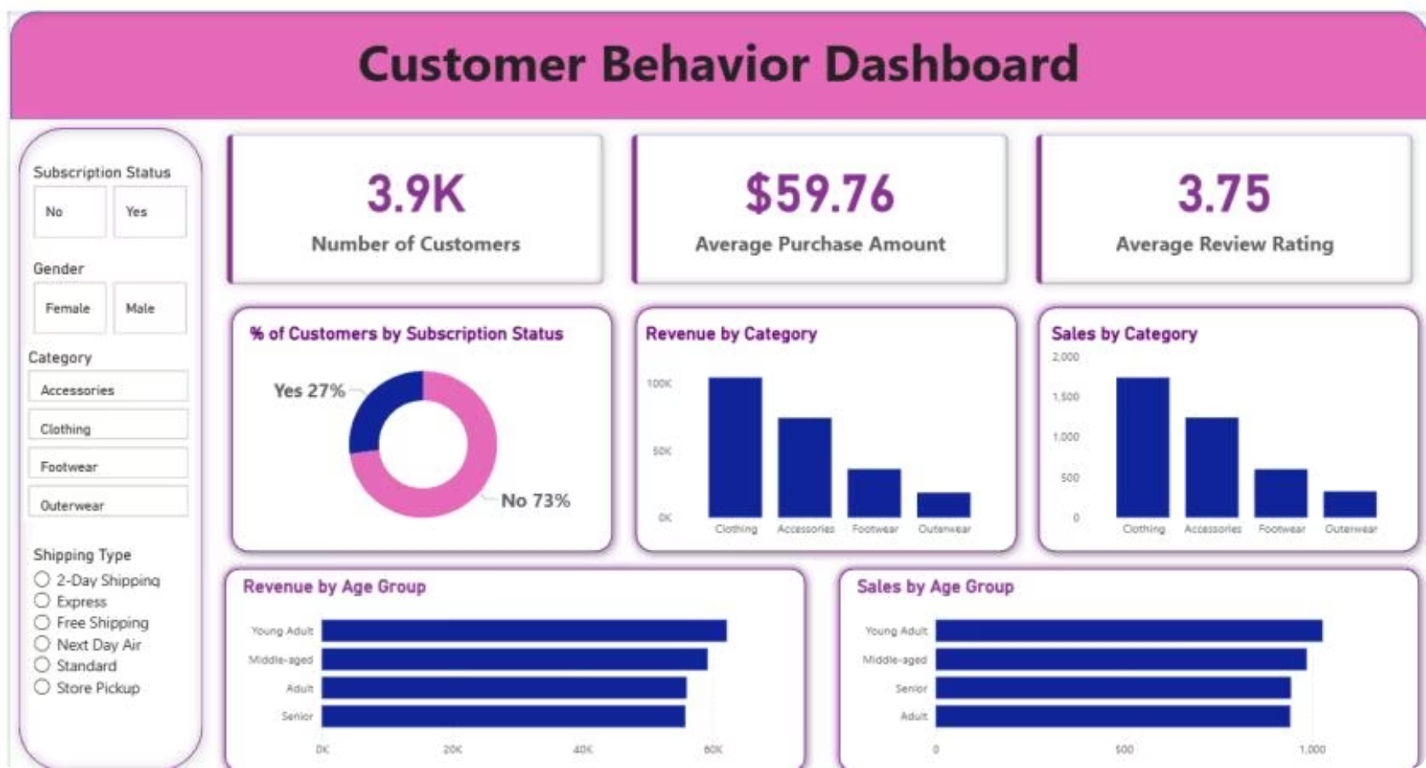
Dashboard in Power BI
An interactive dashboard was built in Power BI to present insights visually, featuring key KPIs and breakdowns by category, age group, and subscription status.
1
3.9K Customers
Avg. purchase $59.76 · Avg. rating 3.75
2
Subscription Split
27% Subscribers · 73% Non-Subscribers
3
Revenue by Category
Clothing ~$90K · Accessories ~$60K · Footwear ~$30K · Outerwear ~$15K
4
Revenue by Age Group
Young Adult leads, followed by Middle-aged, Adult, and Senior

Slide 7
Business Recommendations
Boost Subscriptions
Customer Loyalty Programs
Review Discount Policy
Promote exclusive benefits for subscribers to grow the 27% subscriber base.
Balance sales boosts with margin control — especially for Hat, Sneakers, and Coat.
Reward repeat buyers to move them into the "Loyal" segment and reduce churn.
Targeted Marketing
Product Positioning
Focus efforts on high-revenue age groups (Young Adults) and express-shipping users.
Highlight top-rated and best-selling products (Gloves, Sandals, Boots) in campaigns.

