Slide 1
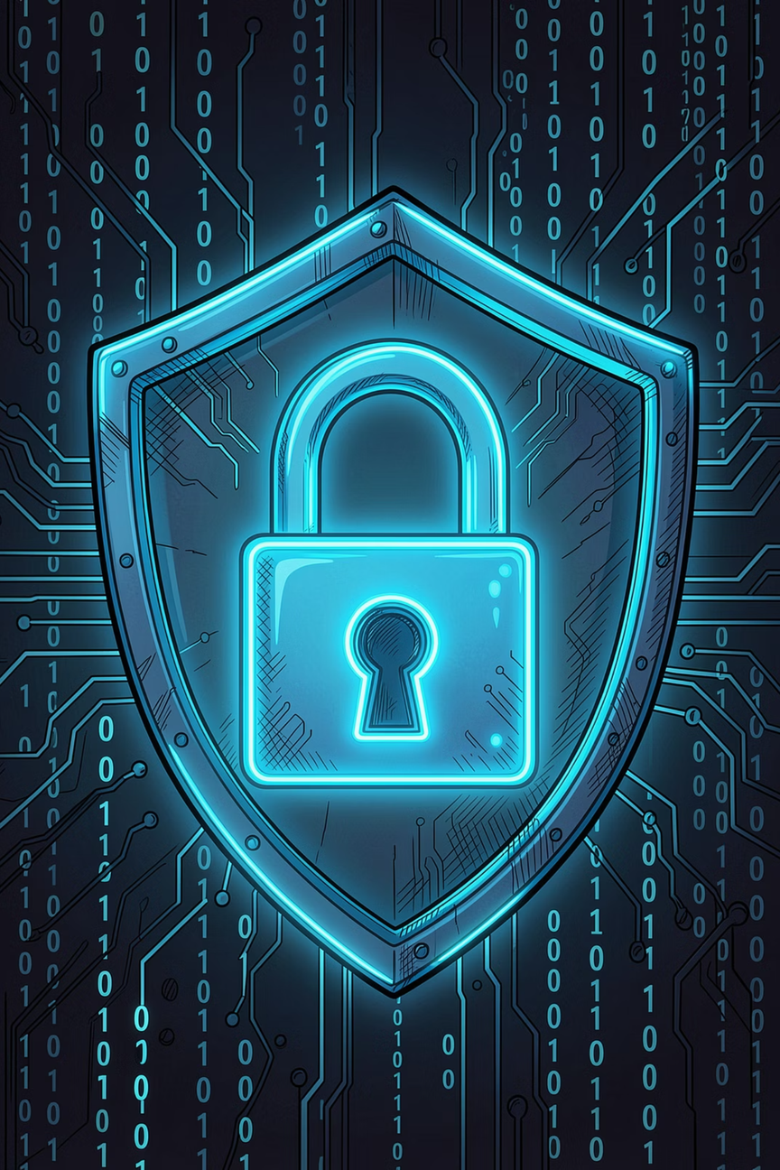

CODEALPHA CYBER SECURITY INTERNSHIP
Phishing Awareness Training
Presenter: Prince Halpara · CodeAlpha Cyber Security Internship
Notes:
1

Slide 2
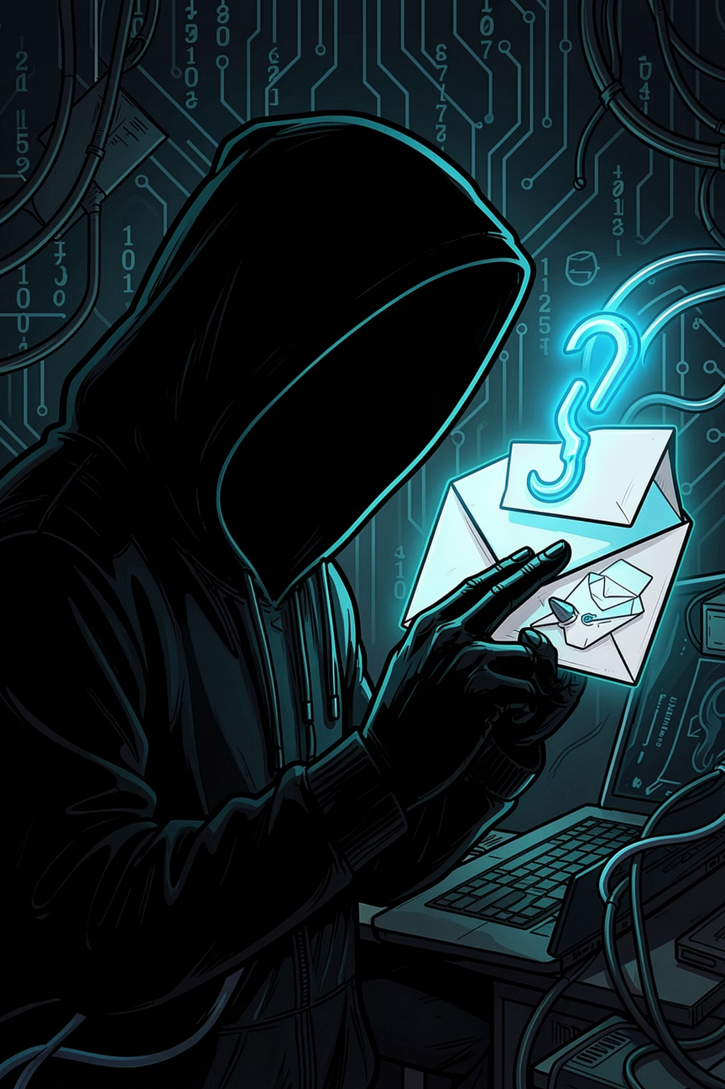

CHAPTER 1
What Is Phishing?
Phishing is a cyberattack where attackers disguise themselves as trusted entities to trick victims into revealing sensitive information — passwords, financial data, or login credentials.
🎣 The Hook
🎯 The Target
Fake emails, texts, or calls that appear legitimate
Individuals, employees, or entire organizations
💸 The Goal
Steal data, money, or access to systems
Notes:
2

Slide 3

CHAPTER 2
Why Phishing Is Dangerous
Phishing is the #1 entry point for cyberattacks. A single click can trigger a chain reaction of damage.
91%
$4.9M
Of Cyberattacks
Average Breach Cost
Begin with a phishing email
Global average cost per data breach
300K+
1.2M
Phishing Sites
Attacks Per Day
Created every month worldwide
Phishing attempts launched globally each day
Impact areas include financial loss, identity theft, data theft, account compromise, and severe business disruption.
Notes:
3

Slide 4
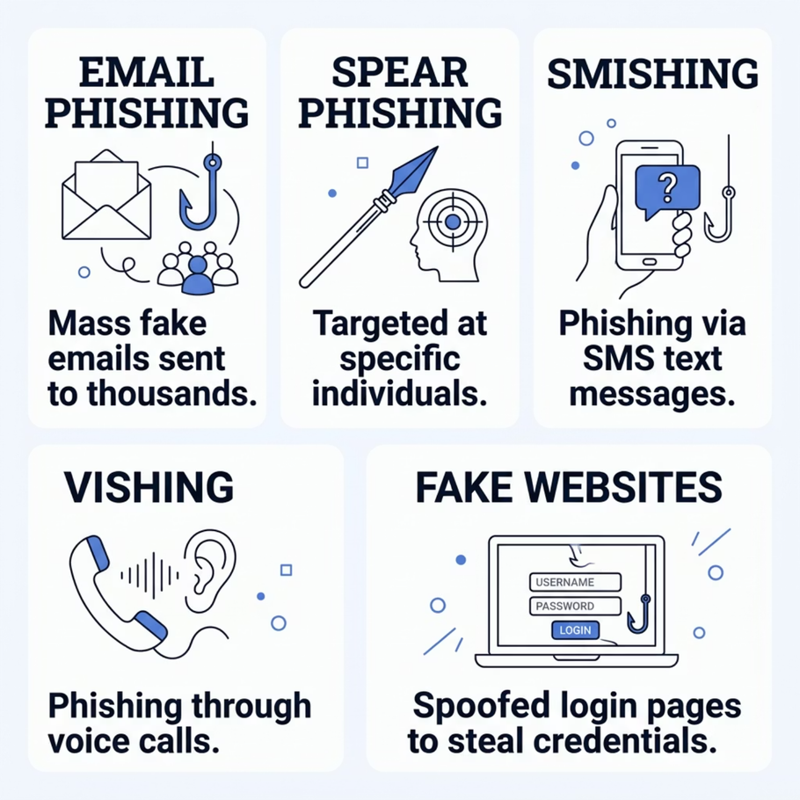

CHAPTER 3
Types of Phishing Attacks
Attackers use many channels to reach you. Knowing each type helps you stay protected across every platform.
Email Phishing — Mass fake emails sent to thousands of victims
Spear Phishing — Targeted attacks aimed at specific individuals
Smishing — Phishing via SMS/text messages
Vishing — Phishing through voice calls
Fake Websites — Spoofed login pages designed to steal credentials
Notes:
4

Slide 5
CHAPTER 4
Recognizing Phishing Emails
Most phishing attempts arrive through email. Train yourself to spot these red flags before you click.
📧 Suspicious Sender Address
⚡ Urgent or Threatening Language
Check the full email — attackers use addresses like support@paypa1.com
"Your account will be suspended in 24 hours" — fear drives impulsive clicks
🔗 Mismatched or Fake Links
📎 Unexpected Attachments
Hover over links to reveal the real URL before clicking
Never open attachments from unknown senders — they may contain malware
Notes:
5

Slide 6
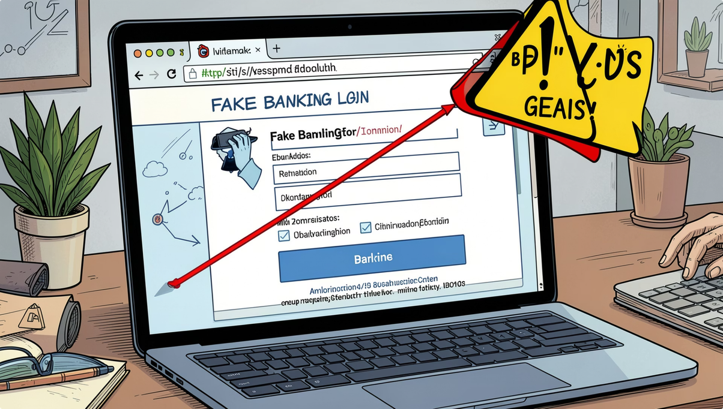
CHAPTER 5
Fake Websites & URL Scams
How URL Spoofing Works
Attackers create websites that look identical to real ones — but the URL tells the truth.
Look for HTTPS — but don't trust it alone; fake sites can have it too
Check the domain name — g00gle.com is not google.com
Verify the certificate — click the padlock icon in your browser
Bookmark official sites — avoid searching or clicking links to log in
Notes:
6

Slide 7
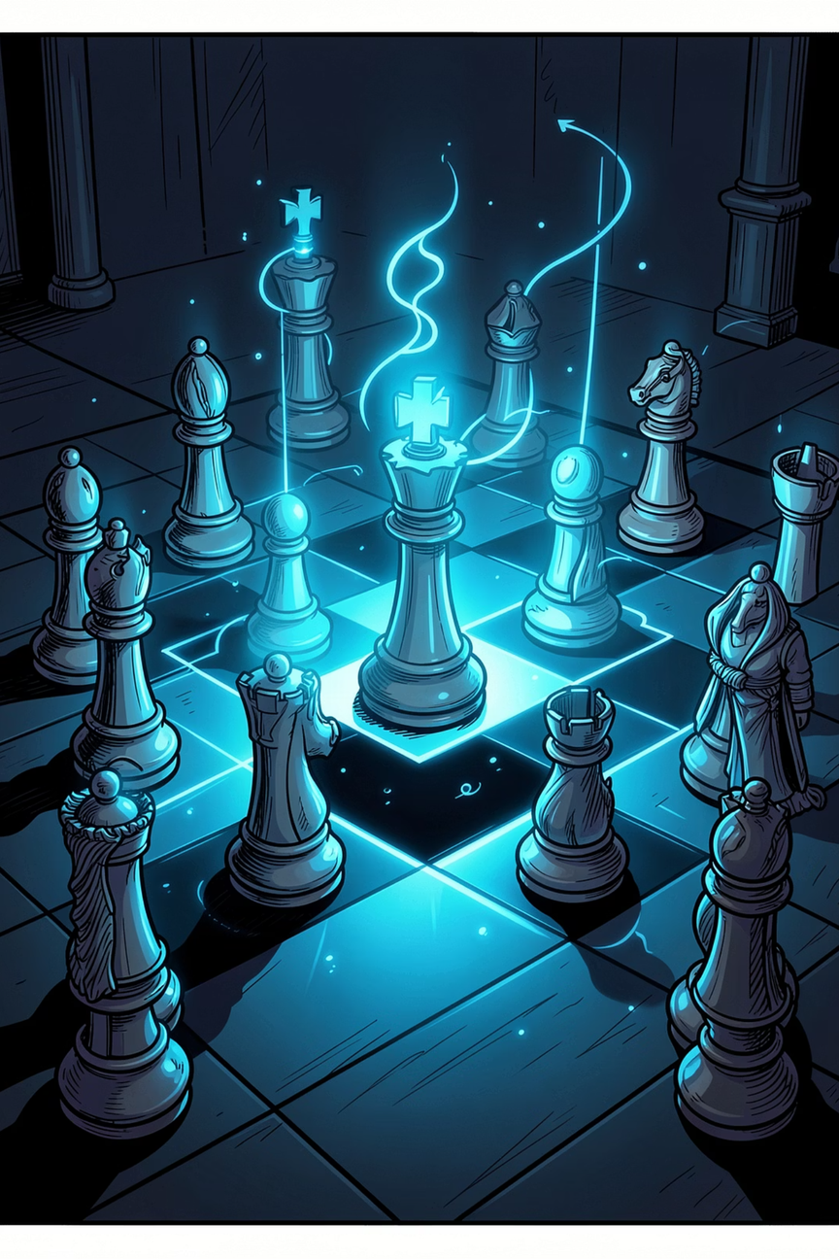




CHAPTER 6
Social Engineering Tactics
Phishing isn't just technical — it's psychological. Attackers exploit human emotions to bypass your defenses.
Fear & Urgency
"Act now or your account will be locked!"
Trust & Authority
Pretending to be IT support, a manager, or a bank
Curiosity & Rewards
"You've won a prize!" — luring victims with false incentives
Helpfulness
Exploiting your desire to assist — "Can you reset my password?"
Notes:
7

Slide 8
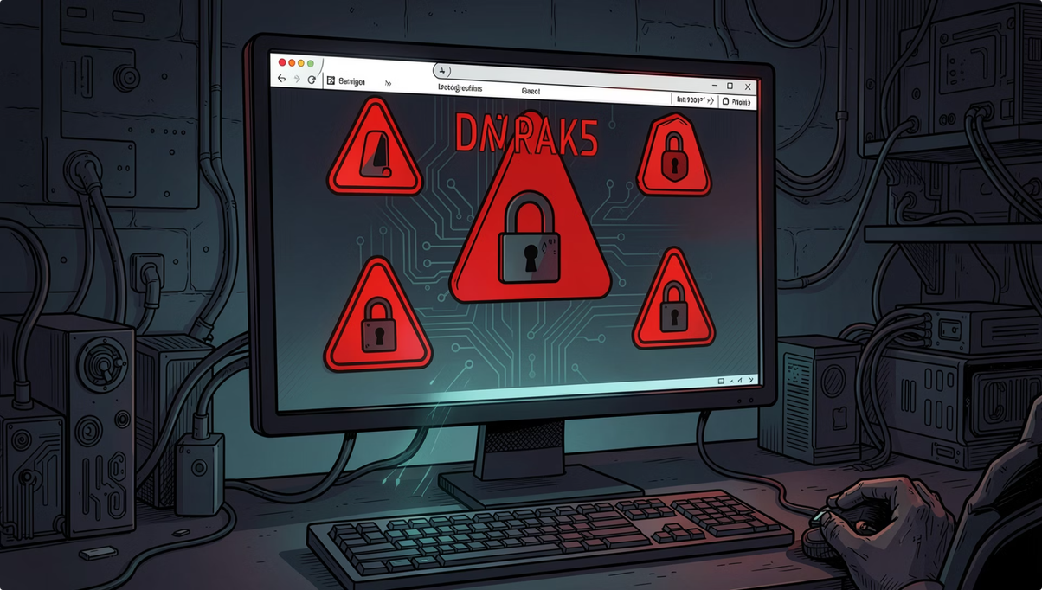
CHAPTER 7 · CASE STUDY
Real-World Phishing Example
The 2016 DNC Email Breach
One of the most impactful phishing attacks in history. Russian attackers sent a single spear-phishing email to a DNC staffer, compromising thousands of emails.
Lesson: One click by one person can compromise an entire organization.
🎯 Target
📩 Method
💥 Impact
Democratic National Committee staff
Spear-phishing email with malicious attachment
20,000+ emails leaked; major political fallout
Notes:
8

Slide 9
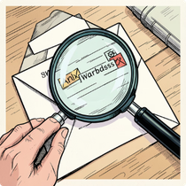
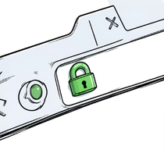
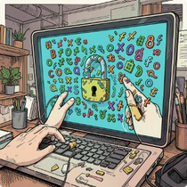
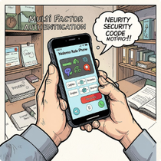
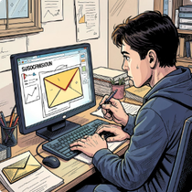
CHAPTER 8
Best Practices & Prevention
Protecting yourself takes just a few consistent habits. Make these your daily cybersecurity routine.
Verify Before You Respond
Check Every URL
Use Strong Passwords
Enable MFA
Double-check sender addresses and question unexpected requests
Hover over links and confirm the domain is legitimate
Unique, long passwords for every account — use a password manager
Multi-Factor Authentication blocks 99% of automated attacks
Report Suspicious Messages
Flag phishing attempts to your IT team or email provider immediately
Notes:
9

Slide 10

KNOWLEDGE CHECK
Quiz & Key Takeaways
🧠 Quick Quiz
✅ Key Takeaways
1
2
Think Before You Click
Pause and question every unexpected message
Most common phishing method?
Check before clicking a link?
Stay Alert, Stay Safe
Email Phishing — accounts for the vast majority of attacks
The URL — always verify the domain name first
Cybersecurity awareness is an ongoing habit
Everyone's Responsibility
3
You are the first line of defense
Extra security feature?
MFA (Multi-Factor Authentication) — adds a critical second layer
Notes:
10

