Slide 1
Mumbai Suburban Rail Network: Strategic Optimization plan

Slide 2
Current State Assessment Network Performance Snapshot
Current State Assessment
High-Density Urban Core
- Western & Central Lines (40 stations each) handle >120 lakh daily passengers
- Efficient spacing (1-3 km) with 3-minute service intervals
- Critical congestion at CSMT, Churchgate, Dadar, Marine Lines
Peripheral Network Gaps
- Underutilized Infrastructure
- 5 km spacing between stations in growing areas
- 20-50 minute intervals on Uran, Neral-Matheran Lines
- Misalignment between population shifts and service quality
Key Metrics
- Strong correlation between station quality and attraction proximity (r=0.75)
- Moderate correlation between footfall and platform count (r=0.57)
- Limited network expansion since 1980s despite population growth

Slide 3
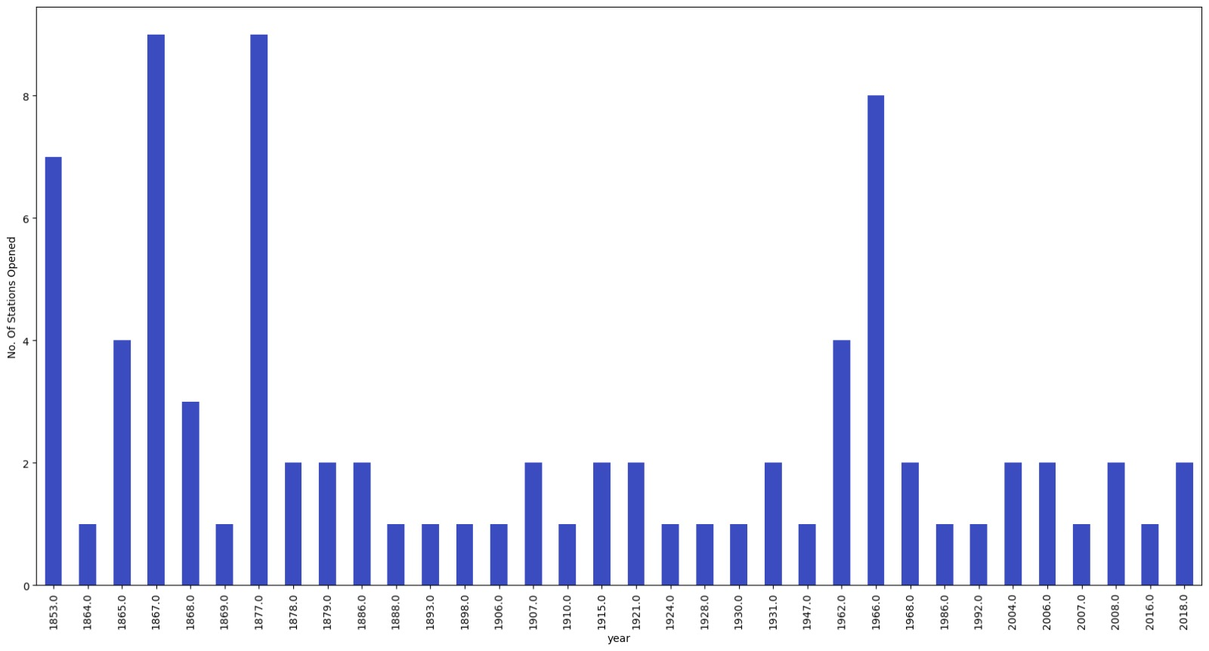
Current State Assessment Network Performance Snapshot

Slide 4
Market Dynamics & Growth Patterns
Demographic Shifts
- Mumbai Metropolitan Region: 22.09M+ residents with 2% annual growth
- Migration toward peripheral areas: Navi Mumbai, Thane (2.69M), Kalyan-Dombivli (1.82M)
- Western Suburbs (Dahisar to Malad), Eastern Suburbs (Chembur, Ghatkopar, Bhandup)
Economic Activity Redistribution
- Andheri-Marol-Saki Naka: IT/manufacturing
- Thane-Belapur: Pharma/IT
- Kalyan-Dombivli-Bhiwandi: Textiles/logistics
- Palghar-Boisar: Heavy industry
Operational Imbalance
- Average station footfall: 2.50 lakh passengers
- Western & Central Lines at capacity, peripheral lines underutilized
- Limited service to growing economic hubs creating transit gaps

Slide 5
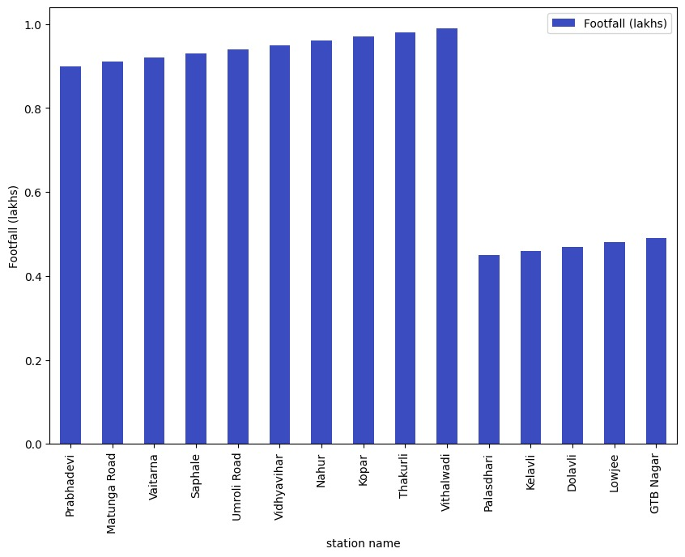
Market Dynamics & Growth Patterns

Slide 6
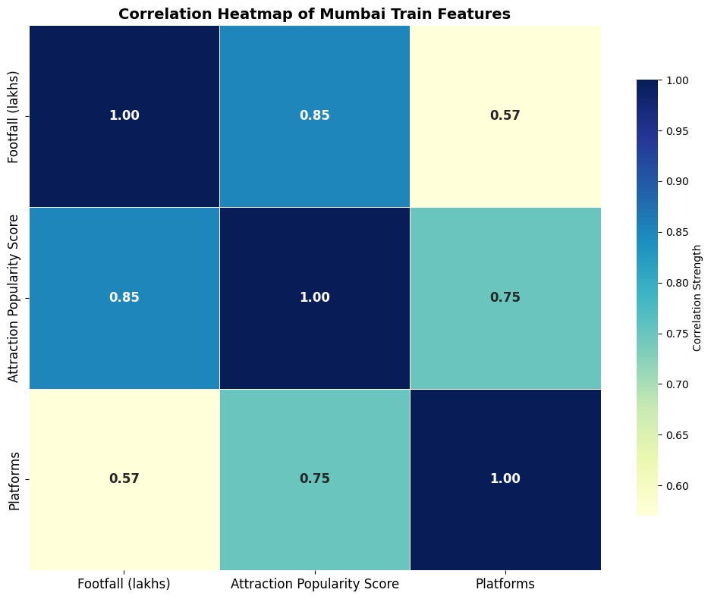
Core Challenges & Opportunities
Critical Pain Points
- Overcrowding at key nodes exceeding capacity
- Peak hour operational strain (6-11 AM, 4-8 PM)
- Service quality deterioration at high-volume stations
Peripheral Connectivity Gaps
- Limited frequency on growth corridors
- Inadequate infrastructure in developing areas
- Last-mile connectivity challenges
Strategic Opportunities
- Growth Corridor Development: Dahanu-Virar-Panvel & Trans Harbour zones
- Tourism potential: Neral-Matheran line
- System Optimization: data-driven service adjustments, strategic investments, tech integration

Slide 7
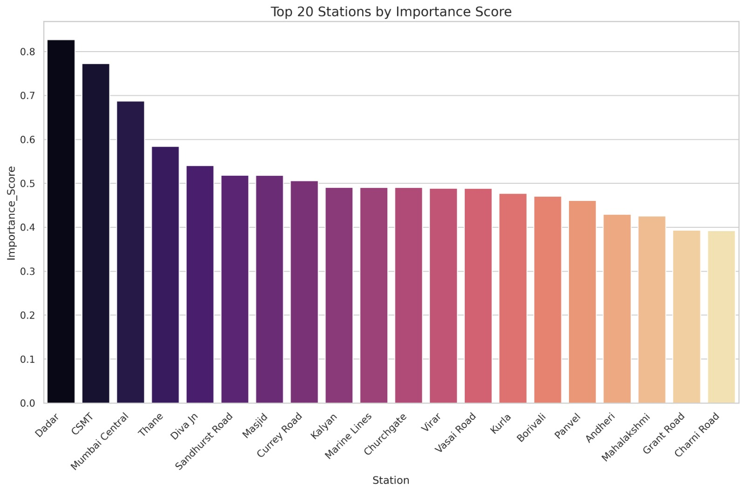
Strategic Recommendations Infrastructure Enhancement
Track Capacity Improvement
- Add dedicated tracks: Borivali-Virar, Thane-Kalyan
- Platform extensions for longer trains
- Junction station upgrades: Dadar, Thane, Kurla, Borivali, Andheri
Service Optimization
- Increase fast trains during peak hours
- Optimized stopping patterns via O-D analysis
- New stations in areas with >5 km gaps
Passenger Experience
- Real-time info and occupancy data
- Intercity train seat reservation system
- Last-mile partnerships and mobility hubs
Development Initiatives
- Mixed-use near peripheral stations
- Plan with industrial zones

Slide 8
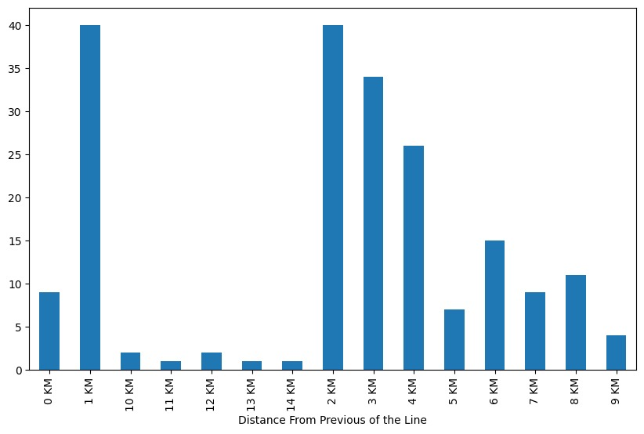
Implementation Roadmap
Phase 1: Immediate Improvements (0-12 months)
- Launch info system & journey tools
- Optimize express service pattern
- Begin platform extensions
- Increase peripheral segment frequency
Phase 2: Core Enhancement (12-36 months)
- Improve signal systems
- Complete initial track expansions
- Develop upgraded junction stations
- Launch seat reservation system
Phase 3: Network Transformation (36-60 months)
- Complete more track projects
- Build new stations in growth areas
- Implement integrated transit platform
- Establish TOD program

Slide 9
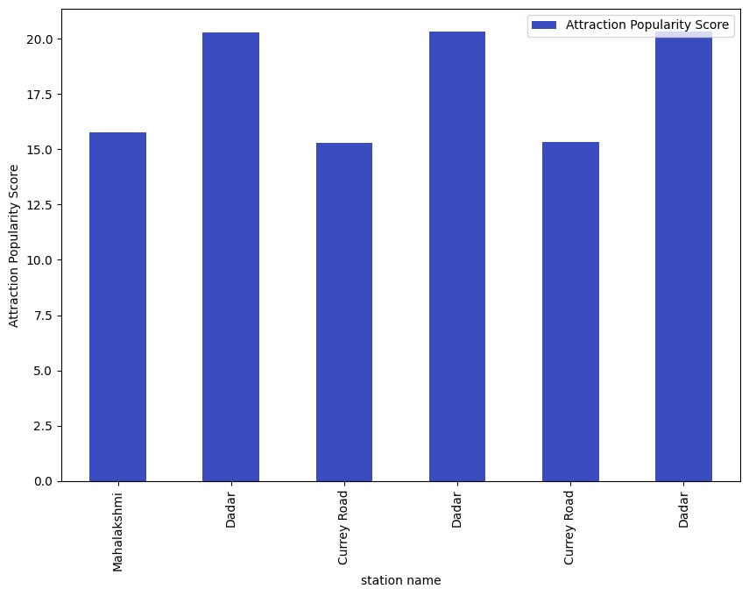
Expected Outcomes & Success Metrics
System Performance
- Higher peak hour capacity
- Reduced long-distance journey times
- Better on-time performance
Passenger Experience
- More travel info and predictability
- Improved station and interchange facilities
- Enhanced last-mile connectivity
Strategic Development
- Balanced urban and peripheral usage
- Aligned infrastructure and population
- Economic support for growth corridors
Long-Term Impact
- Sustainable urban mobility
- Better commuter quality of life
- Balanced metro development

