Slide 1

Boosting
Ensemble

Slide 2
AdaBOOST
It is a boosting algorithm in which weak learner’s errors are conveyed to the subsequent weak learner via weights assignment and cumulative binning sampling.

Slide 3
Algorithm’s Flow
Age | Likes Height | Likes Goats | Climbed Meters
23 | 0 | 0 | 200
31 | 1 | 1 | 700
35 | 1 | 0 | 600
35 | 0 | 0 | 300
42 | 0 | 0 | 200
43 | 1 | 1 | 700
45 | 0 | 1 | 300
46 | 1 | 1 | 700
46 | 1 | 0 | 600
51 | 1 | 1 | 700

Slide 4

Algorithm’s Flow
Age | Likes Height | Likes Goats | Climbed Meters | Weights
23 | 0 | 0 | 200 | 0.1
31 | 1 | 1 | 700 | 0.1
35 | 1 | 0 | 600 | 0.1
35 | 0 | 0 | 300 | 0.1
42 | 0 | 0 | 200 | 0.1
43 | 1 | 1 | 700 | 0.1
45 | 0 | 1 | 300 | 0.1
46 | 1 | 1 | 700 | 0.1
46 | 1 | 0 | 600 | 0.1
51 | 1 | 1 | 700 | 0.1
Weights= $\frac{1}{n}$

Slide 5
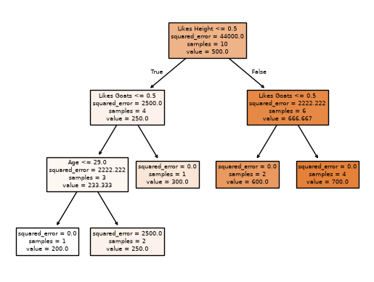
Algorithm’s Flow

Slide 6
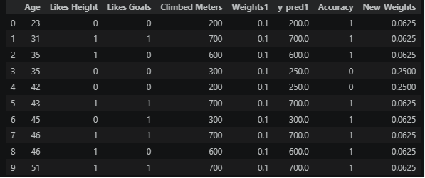
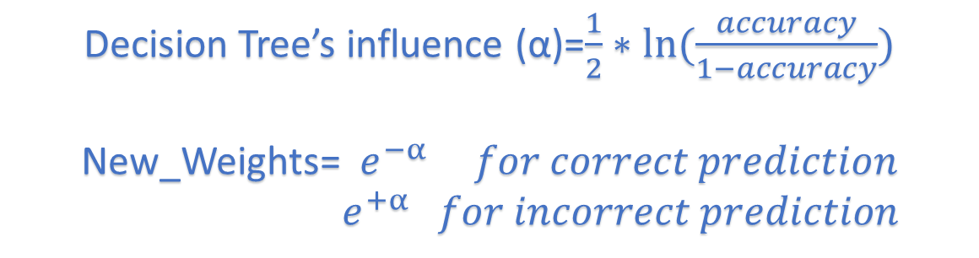
Algorithm’s Flow
Decision Tree’s influence (α)=$\frac{1}{2}∗ln⁡(\frac{accuracy}{1−accuracy})$
New_Weights=$e^{−α} for correct prediction$
$e^{+α} for incorrect prediction$

Slide 7
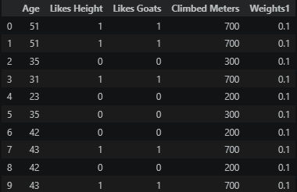
Algorithm’s Flow
Resampling df via Cumulative Weights (or Bins)

Slide 8
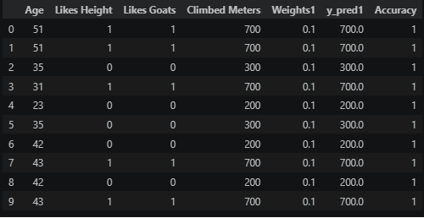
Algorithm’s Flow
Resampling df via Cumulative Weights (or Bins)

Slide 9

Gradient Boosting
It is a boosting algorithm in which a weak learner’s errors are conveyed to the subsequent weak learner via residuals and a learning rate to prevent overfitting.

Slide 10
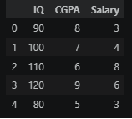
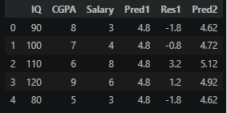
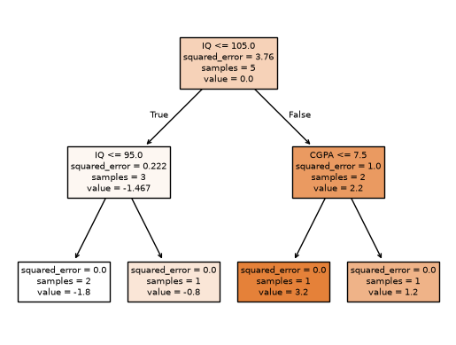
Algorithm’s Flow [Regression]
Predicting the Salaries of Students with Their IQ and CGPA
The first prediction is an average of Salaries = 4.8

Slide 11
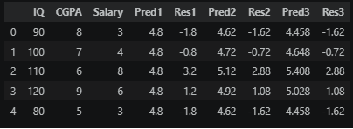
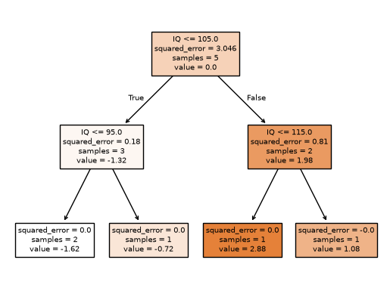
Algorithm’s Flow [Regression]
Training Decision Tree on IQ, CGPA and Res1
The first prediction is an average of Salaries = 4.8

Slide 12
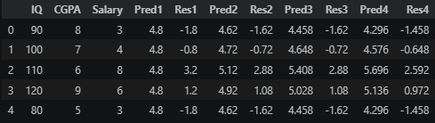
Algorithm’s Flow [Regression]
Training Decision Tree on IQ, CGPA and Res2

Slide 13
Algorithm’s Flow [Regression]
Training Decision Tree on IQ, CGPA and Res2

Slide 14
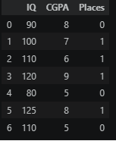
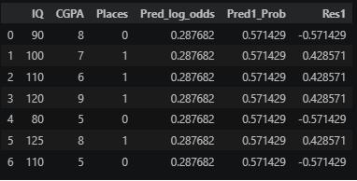
Algorithm’s Flow [Classification]

Slide 15
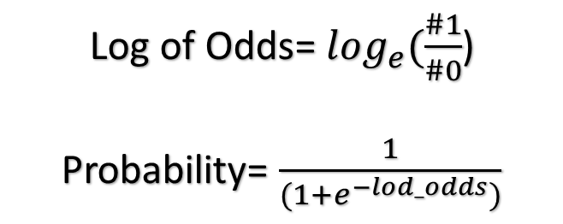
Algorithm’s Flow [Classification]
Log of Odds= $\log_{e}(\frac{\#1}{\#0}$)
Probability= $\frac{1}{(1+e^{−lod_odds})}$

Slide 16
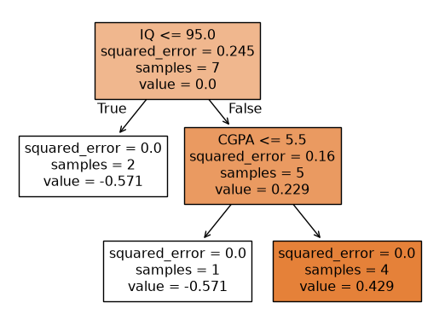
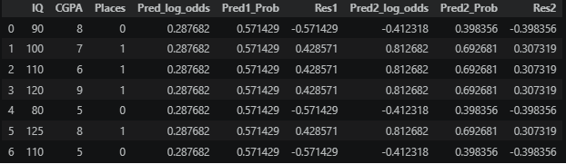
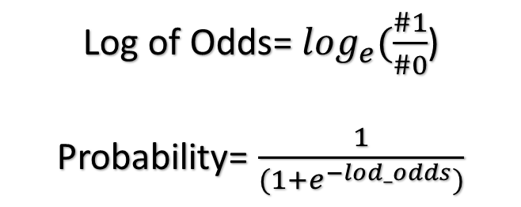
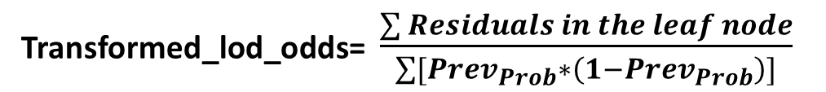
Algorithm’s Flow [Classification]
Log of Odds= $\log_{e}(\frac{\#1}{\#0}$)
Probability= $\frac{1}{(1+e^{−lod_odds})}$
Transformed_lod_odds= $\frac{\sum{Residuals in the leaf node}}{\sum{[Prev_{Prob}∗\left(1−Prev_{Prob}\right)]}}$

Slide 17
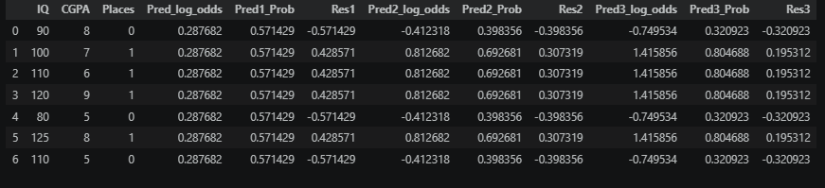
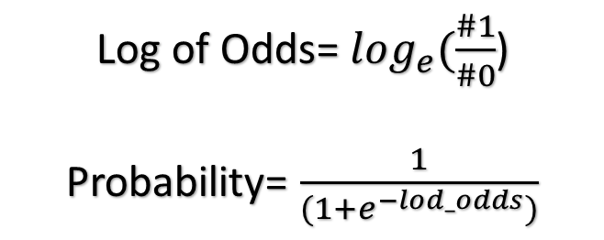
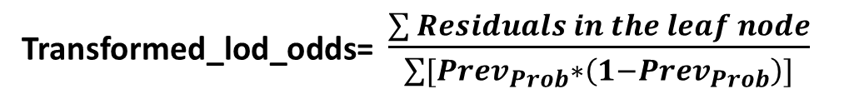
Algorithm’s Flow [Classification]
Log of Odds= $\log_{e}(\frac{\#1}{\#0}$)
Probability= $\frac{1}{(1+e^{−lod_odds})}$
Transformed_lod_odds= $\frac{\sum{Residuals in the leaf node}}{\sum{[Prev_{Prob}∗\left(1−Prev_{Prob}\right)]}}$

Slide 18
Algorithm’s Flow [Classification]

Slide 19
XGBOOST
It is a boosting algorithm in which a weak learner’s errors are conveyed to the subsequent weak learner via residuals and a learning rate to prevent overfitting.
We use ‘Similarity Score’ to decide splitting criteria in Decision Trees.

Slide 20
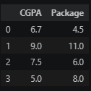
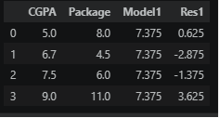
Algorithm’s Flow [Regression]
Model 1 prediction= Average of values in ‘Package’ column

Slide 21
Algorithm’s Flow [Regression]
Model 1 prediction= Average of values in ‘Package’ column

Slide 22
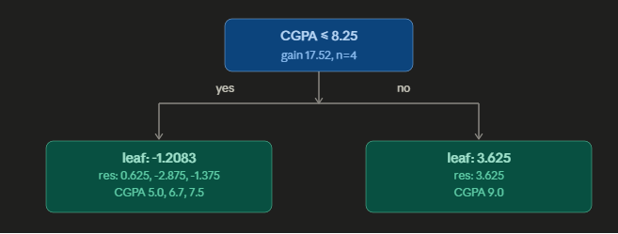
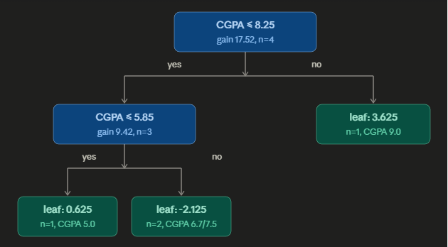
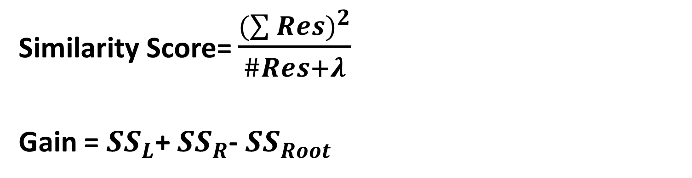
Algorithm’s Flow [Regression]
Decision Tree splitting criteria
Similarity Score= $\frac{{(\sum{Res})}^{2}}{\#Res+λ}$
Gain = ${SS}_{L}$+ ${SS}_{R}$- ${SS}_{Root}$

Slide 23
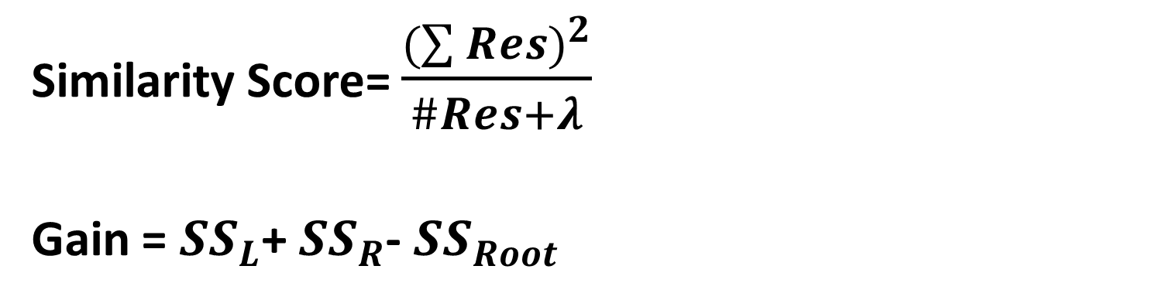
Algorithm’s Flow [Regression]
Decision Tree splitting criteria
Similarity Score= $\frac{{(\sum{Res})}^{2}}{\#Res+λ}$
Gain = ${SS}_{L}$+ ${SS}_{R}$- ${SS}_{Root}$

Slide 24
Algorithm’s Flow [Regression]
Decision Tree splitting criteria
Model2 | Res2
7.5625 | 0.4375
6.7375 | -2.2375
6.7375 | -0.7375
8.4625 | 2.5375
Residuals are approaching zero.

Slide 25
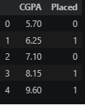
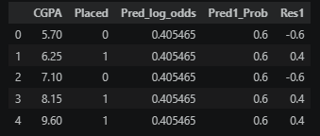
Algorithm’s Flow [Classification]
Model 1 prediction= Log of Odds of ‘Placed’ column

Slide 26
Algorithm’s Flow [Classification]
Model 1 prediction= Log of Odds of ‘Placed’ column

Slide 27
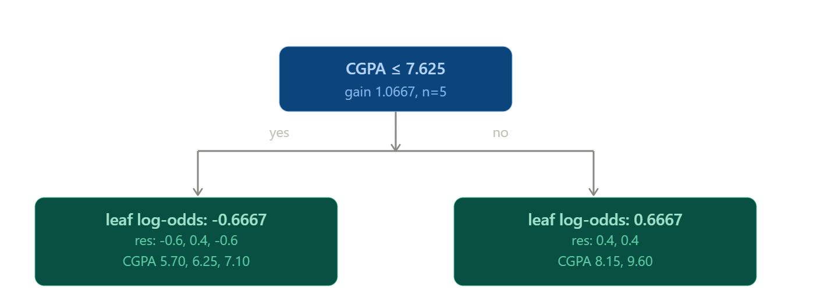
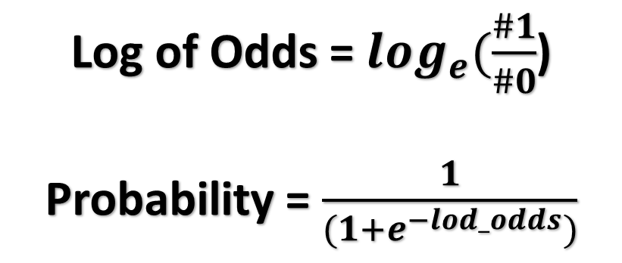
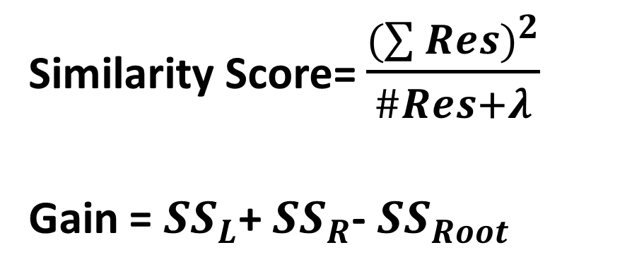
Algorithm’s Flow [Classification]
Decision Tree splitting criteria
Similarity Score= $\frac{{(\sum{Res})}^{2}}{\#Res+λ}$
Gain = ${SS}_{L}$+ ${SS}_{R}$- ${SS}_{Root}$
Log of Odds = $\log_{e}(\frac{\#1}{\#0}$)
Probability = $\frac{1}{(1+e^{−lod_odds})}$

Slide 28
Algorithm’s Flow [Classification]
Decision Tree splitting criteria
Similarity Score= $\frac{{(\sum{Res})}^{2}}{\#Res+λ}$
Gain = ${SS}_{L}$+ ${SS}_{R}$- ${SS}_{Root}$
Pred_log_odds_2 | Pred2_Prob | Res2
0.2054 | 0.5511 | -0.5511
0.2054 | 0.5511 | 0.4489
0.2054 | 0.5511 | -0.5511
0.6054 | 0.6469 | 0.3531
0.6054 | 0.6469 | 0.3531
Residuals approaching zero

Slide 29
Thank You

