Slide 1

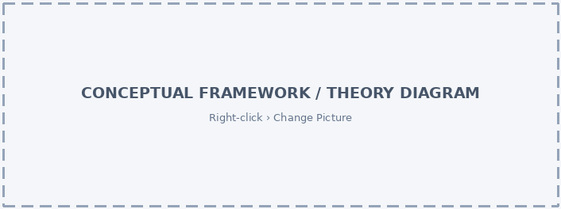
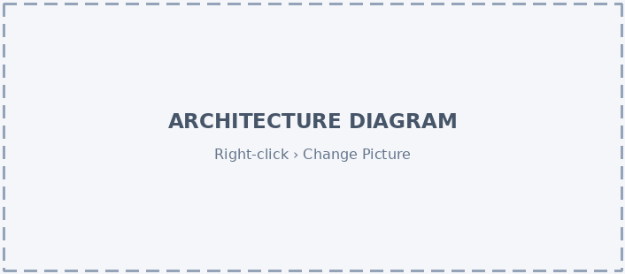
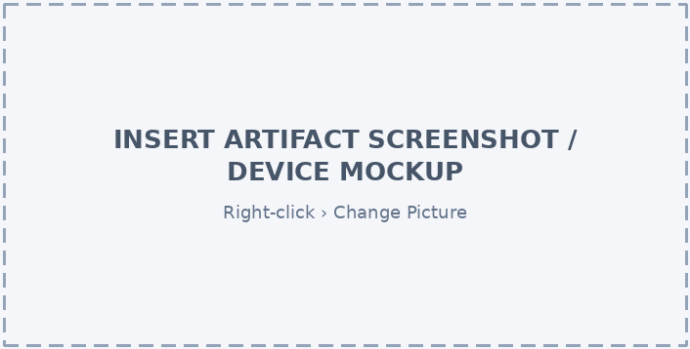
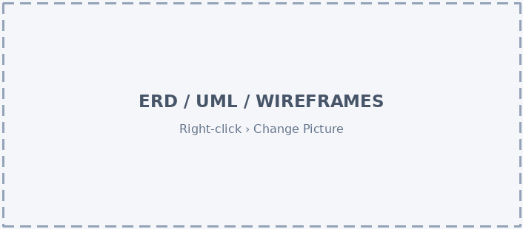


BSBS • SYSTEM DEVELOPMENT PROJECT
PROJECT TITLE
[One-line description: what the artifact does and who it serves]
Group Members: Student 1 | Student 2 | Student 3 | Student 4
Institution Name • [School / Department] • [Academic year]
TECH STACK [e.g. Flutter + Firebase] DURATION [e.g. 12 weeks] SUPERVISOR [Name]
1
INTRODUCTION & PROBLEM STATEMENT
2
LITERATURE REVIEW
Background
Brief context of the problem domain.
Who is affected and why a solution matters.
Problem Statement
Clearly explain the problem the artifact will solve.
Highlight why existing solutions fall short.
Key concepts and theories behind the artifact.
Review of existing systems and related work.
Strengths and limitations of current approaches.
The gap your artifact fills.
Existing work | Strength | Limitation
[Author (Year)] | [ ] | [ ]
[System / App B] | [ ] | [ ]
[Author (Year)] | [ ] | [ ]
Proposed artifact | [How it addresses the gap]
3
SYSTEM DESIGN
Functional and non-functional requirements.
System architecture and main components.
Design models: use-case, class, ERD or wireframes.
Tools, technologies and frameworks used.
Development approach (e.g. Agile, prototyping).
Testing strategy (unit, integration, user).
Users &
Requirements
Interface
Layer
Application
Logic / API
Data
Layer
Figure 1. [Conceptual framework or theory behind the artifact]
Figure 2. [High-level design — replace with your own architecture, UML model or wireframes]
4
RESULTS & DISCUSSION
Demonstrate the working artifact (screenshots, demo link).
Report evaluation results against the requirements.
Discuss how the artifact solves the stated problem.
Figure 3. [System architecture]
Figure 5. [The working artifact in use]
Evaluation criterion | Method | Target | Result
Functionality | Test cases passed | [ ] | [ ]
Usability | User testing / SUS survey | [ ] | [ ]
Performance | Response time, accuracy | [ ] | [ ]
Figure 4. [Data, class or interface design]
5
CONCLUSION
6
RECOMMENDATIONS & FUTURE WORK
Summarise the main findings.
State the artifact's contribution to theory and practice.
Reflect on whether the design requirements were met.
Recommendations for users, organisations or adopters.
Limitations of the artifact and of the evaluation.
Planned improvements, new features or extensions.
REFERENCES
List key references used in the study (e.g. APA 7th style), including every source cited in the literature review.

Slide 2
A1 POSTER LAYOUT, CUSTOMISING & PRINTING GUIDE
Poster D – Colour Coded. Remove this instruction slide before submitting or printing the poster.
POSTER SPECIFICATIONS
Size: A1 portrait, 59.4 cm × 84.1 cm
Outer margins: 2 cm on all four sides
Two columns: 26.9 cm each with 1.6 cm spacing; each section has its own theme accent
Six sections: Introduction & Problem Statement, Literature Review, System Design, Results & Discussion, Conclusion, Recommendations & Future Work
Create all content at the final poster size
CUSTOMISE COLOURS, FONTS AND LAYOUT
Colours: Design › Variants › ▾ More › Colors. Pick a palette or choose Customize Colors. Every shape uses theme colours, so the whole poster changes at once.
Fonts: Design › Variants › ▾ More › Fonts.
Move a section: each section is one group. Click its edge and drag it; sections in the same column share a width, so they swap cleanly.
Edit inside a section: click the group, then click the item. To resize parts, right-click › Group › Ungroup, then regroup (Ctrl/Cmd + G).
Find, hide or reorder sections: Home › Arrange › Selection Pane.
Pictures: right-click a placeholder › Change Picture. Use Crop › Fill if the image looks stretched.
Design diagram: the System Design boxes are ordinary shapes — retype, recolour, add or delete them.
RECOMMENDED FONT SIZES
Title: 48–54 pt | Section headings: 26–28 pt
Group members: 20–24 pt | Body: 18–20 pt
Captions & tables: 14–16 pt | References: 12–14 pt
Screenshots: crop to the relevant screen area so interface text stays readable at 1.5 m
CONTENT CHECKS
Every requirement in System Design should be evaluated in Results & Discussion
Literature review: compare at least three existing works and state the gap your artifact fills
Cite every source from the literature review in the References band (APA 7th)
Use real diagrams (architecture, UML, ERD or wireframes) exported at high resolution (≥ 300 dpi)
Replace every [ ] in the evaluation table with your actual results
Point the QR codes to a working demo video, live system or code repository
POWERPOINT & PRINTING CHECKS
View › Guides: margin and column guides are already set
Keep all content within the poster boundaries
Export to PDF and verify dimensions before printing
Print at 100% / actual size, not Fit to Page

