Slide 1
IBM University Engagement Project Submission
“Exploring the Power of Agentic AI with IBM Granite and IBM Bob”

Slide 2

Project Tile – Agentic AI for Personalized Course Pathways
Domain of Project – Education
Student Name | Recent Passport Photo | Email ID | Mobile number [WhatsApp]
PRINCE KUMAR |  | spksdev@gmail.com | 9304248896
Recommended font style and size:
Font Style: Arial
Font Size (Heading): 28
Font Size (Content): 20

Slide 3
Problem Statement -
Problem Statement No.12 - Agentic AI for Personalized Course Pathways.
The Challenge - Students often struggle to identify the right learning path that aligns with their interests
and long-term goals due to the overwhelming number of online courses and a lack of personalized
guidance. LearnMate aims to solve this by acting as an Agentic AI coach that interacts with students,
understands their interests (like Frontend Development, Cybersecurity, UI/UX Design, etc.), assesses their
current skill level, and dynamically builds a personalized course roadmap that adapts over time based on
progress and preferences.
Technology – Use of IBM Cloud Lite services / IBM Granite is mandatory.
The Objective
Build an Agentic AI-powered personalized learning assistant – LearnMate that provides adaptive course recommendations and personalized learning roadmaps based on each student's interests, skills, goals, and learning progress. The solution should:
• Personalized Learning Path – Create customized course roadmaps based on students' interests and career goals.
• Skill Assessment – Assess the student's current skill level and identify knowledge gaps.
• AI Course Recommendations – Recommend relevant courses and learning resources based on individual needs.
• Adaptive Roadmap – Dynamically update the learning path according to progress, assessment results, and preferences.
• Progress Tracking & Feedback – Track learning progress and provide personalized guidance and feedback.
• Multi-Agent System – Use specialized agents for profile analysis, skill assessment, course recommendation, learning-path generation, and progress tracking.
• Visualization Dashboard – Display the student's roadmap, skills, progress, completed courses, and recommended next steps.

Slide 4
Proposed Solution -
The proposed solution is an Agentic AI-powered Personalized Learning Assistant, LearnMate, built using IBM watsonx.ai, IBM Granite Models, and IBM Cloud services to provide personalized, adaptive learning guidance. The system addresses challenges in course selection, skill assessment, learning-path creation, and progress tracking through an intelligent, modular architecture.
At its core, the solution uses AI-powered reasoning and personalized recommendations to understand a student's interests, career goals, current skill level, and learning progress. Based on this information, LearnMate dynamically generates a suitable course roadmap and adapts it as the student progresses.
The system consists of five key agents:
Profile Analysis Agent understands the student's interests, career goals, existing skills, and learning preferences.
Skill Assessment Agent evaluates the student's current knowledge through assessments and identifies important skill gaps.
Course Recommendation Agent recommends relevant courses and learning resources based on the student's goals, skill level, and identified gaps.
Learning Path Agent creates a structured, personalized roadmap and dynamically updates it according to the student's progress and preferences.
Progress & Feedback Agent monitors completed courses, assessment results, and overall learning progress while providing personalized feedback and suggesting the next learning steps.
The solution includes a user-friendly dashboard built with React that displays the personalized learning roadmap, skill progress, assessments, completed courses, and recommended next steps.
IBM watsonx.ai provides the AI environment, while IBM Granite models power reasoning, natural-language understanding, recommendations, and personalization. IBM Cloud services support the deployment and integration of the AI capabilities.
Overall, LearnMate delivers an end-to-end intelligent learning assistant that helps students make better course decisions, identify skill gaps, and continuously follow a personalized and adaptive learning pathway aligned with their career goals.

Slide 5
Technology Used
• IBM Bob Platform – For designing, developing, and orchestrating the multi-agent LearnMate workflow.
• IBM Granite Model – e.g., ibm/granite-3-8b-instruct – For natural language understanding, reasoning, skill analysis, course recommendations, and personalization.
• IBM Cloud – Provides the secure, reliable, and scalable cloud infrastructure required to build, integrate, and deploy LearnMate.
• IBM watsonx.ai – For AI model integration, prompt engineering, model management, and AI-powered application development.
• Agentic AI / Multi-Agent Architecture – Uses specialized agents for Profile Analysis, Skill Assessment, Course Recommendation, Learning Path Generation, and Progress & Feedback.
• MongoDB – For securely storing student profiles, skills, assessments, course data, learning paths, and progress information.
• React.js – For building the interactive LearnMate dashboard to visualize personalized roadmaps, assessments, recommendations, and learning progress.

Slide 6
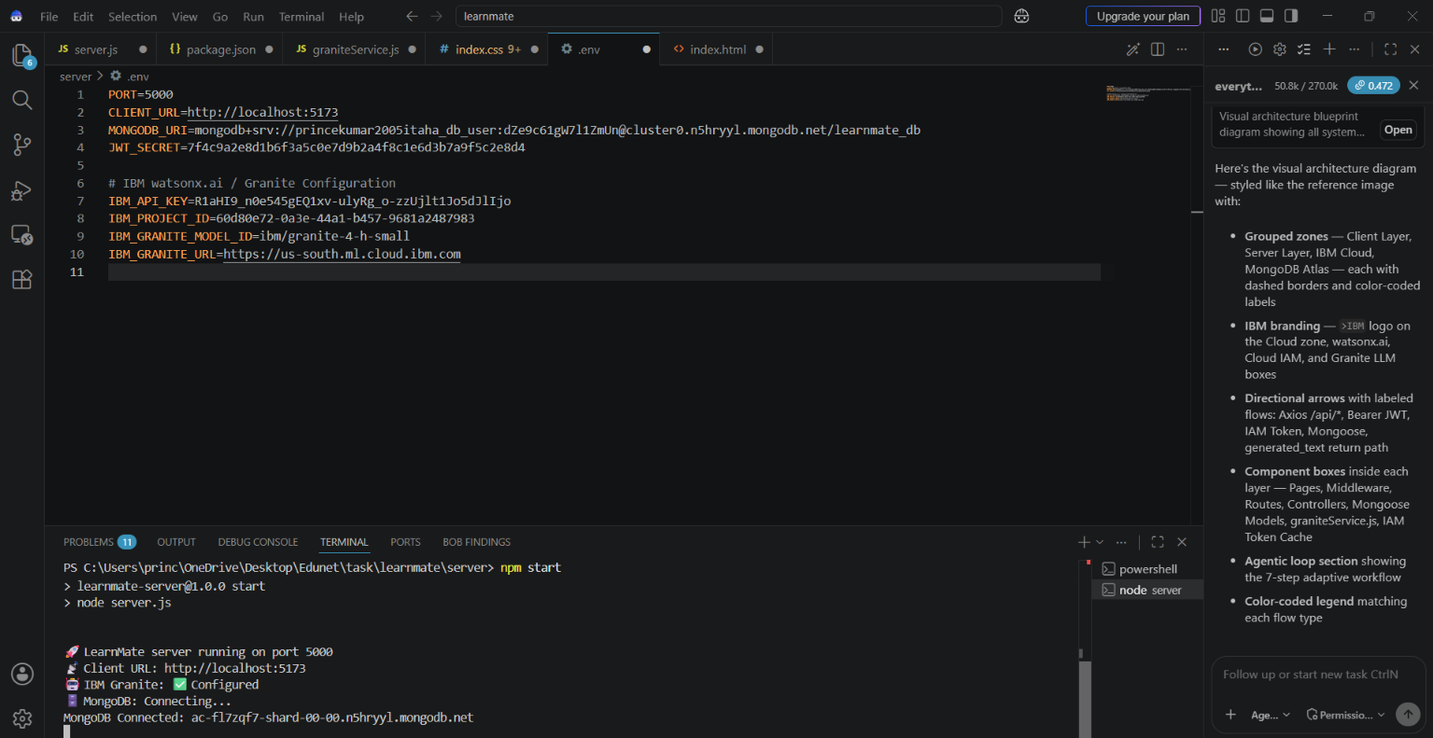
Required Files created using IBM bob -

Slide 7
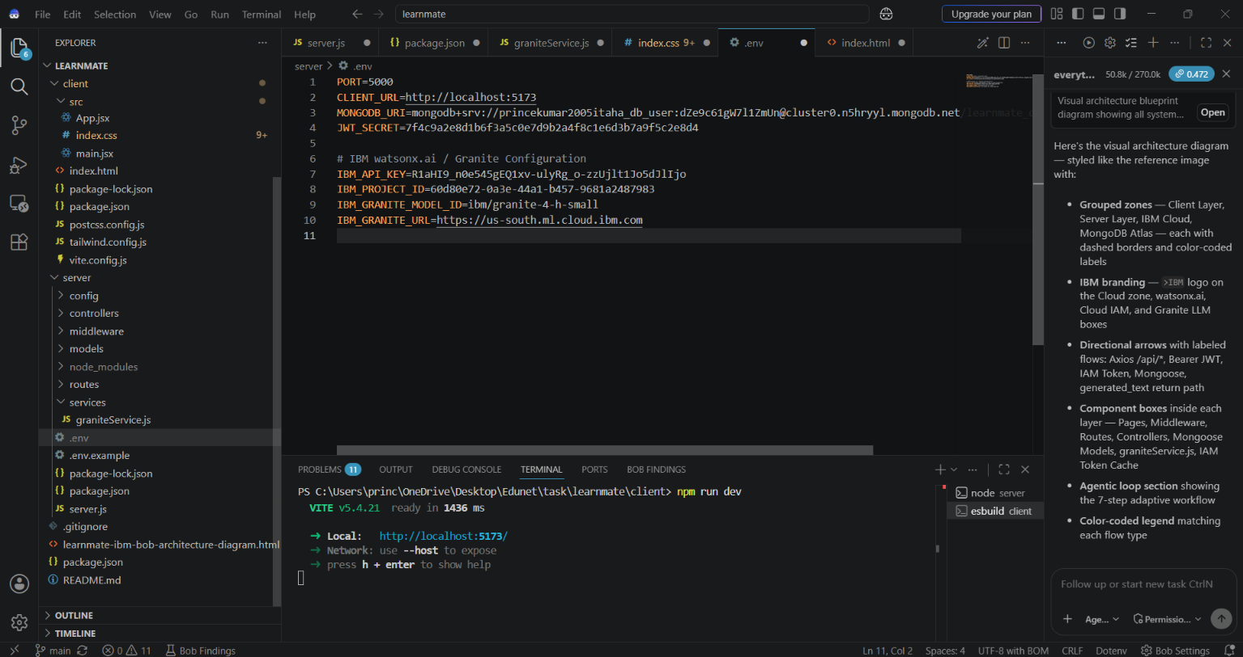
IBM Bob Screenshots:

Slide 8
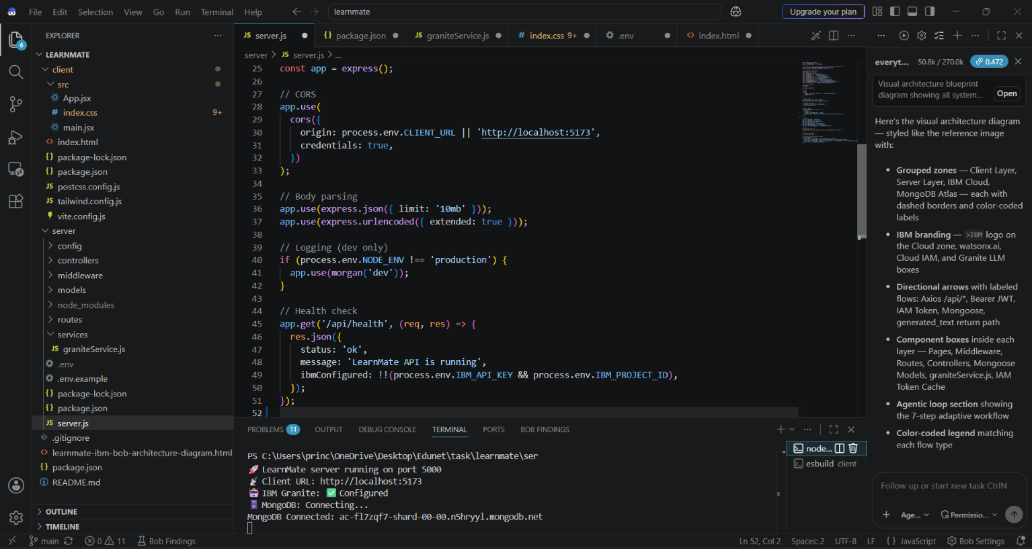

Slide 9
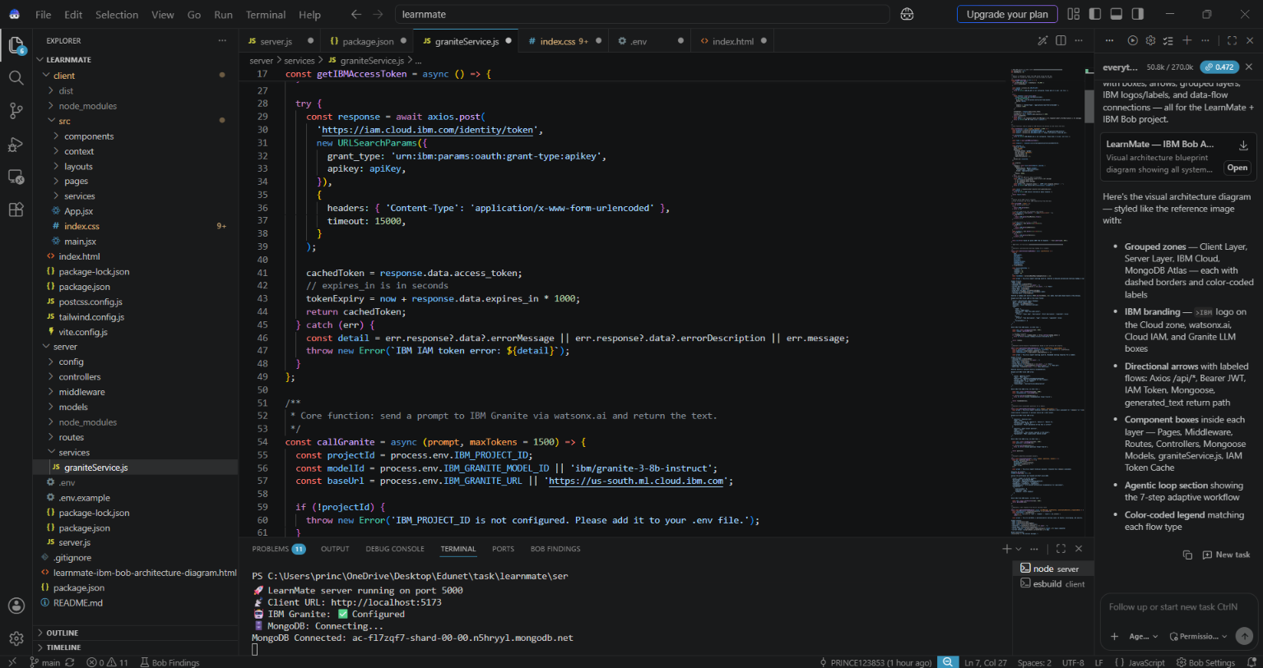

Slide 10
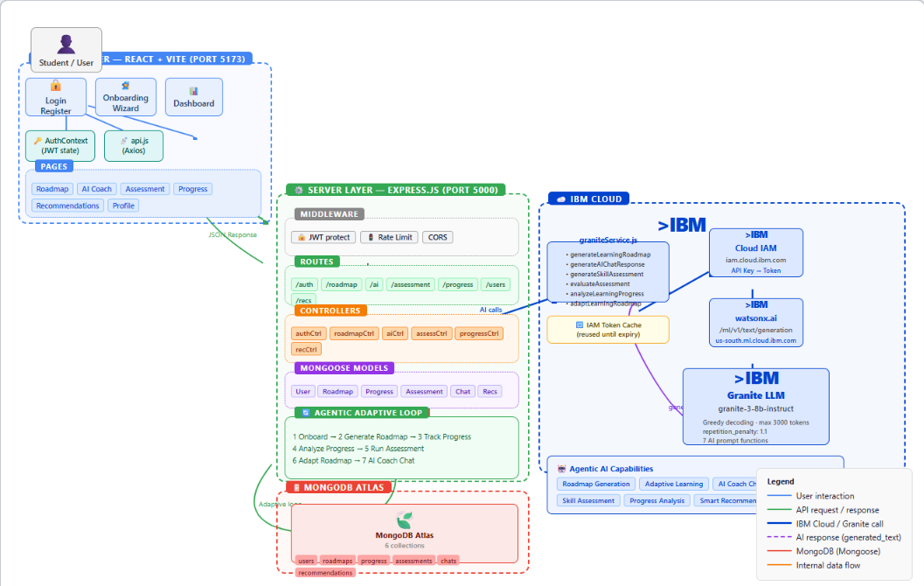
Architecture blueprint for IBM bob:

Slide 11

Role of Agentic AI in the solution
Agentic AI enables LearnMate to function as an intelligent, adaptive learning coach rather than a simple course recommendation system. Using IBM watsonx.ai and IBM Granite, it can analyze student information, reason about learning needs, and generate personalized course pathways.
LearnMate uses multiple specialized agents, each performing a specific role—such as analyzing the student's profile, assessing skills, identifying skill gaps, recommending courses, generating a personalized roadmap, and tracking progress. These agents work together to provide a coordinated and personalized learning experience.
The Agentic AI system provides context awareness by considering information such as the student's interests, career goals, existing skills, learning preferences, assessment results, and progress while making recommendations.
It also supports real-time adaptation. As students complete courses, perform assessments, or update their goals and preferences, LearnMate can adjust their recommended courses and learning roadmap accordingly.
The agents collaborate to improve decision-making—for example, the Skill Assessment Agent identifies gaps, the Course Recommendation Agent suggests suitable resources, and the Learning Path Agent organizes them into a structured roadmap.
Overall, Agentic AI makes LearnMate proactive, personalized, adaptive, and goal-oriented, acting as a smart digital learning coach that helps students choose the right courses and continuously follow a learning path aligned with their career goals.

Slide 12
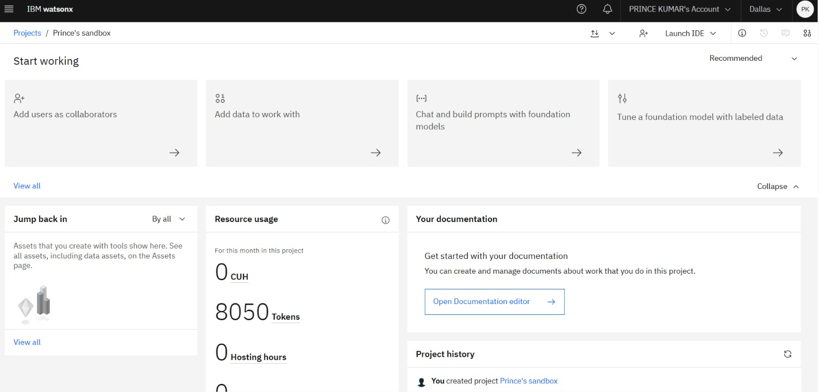
Token Usage
After the Prompt
Before Prompt
Note: I did not take a screenshot of the token usage before starting the project, so the Before Prompt token usage screenshot is not available.
·
·
·

Slide 13
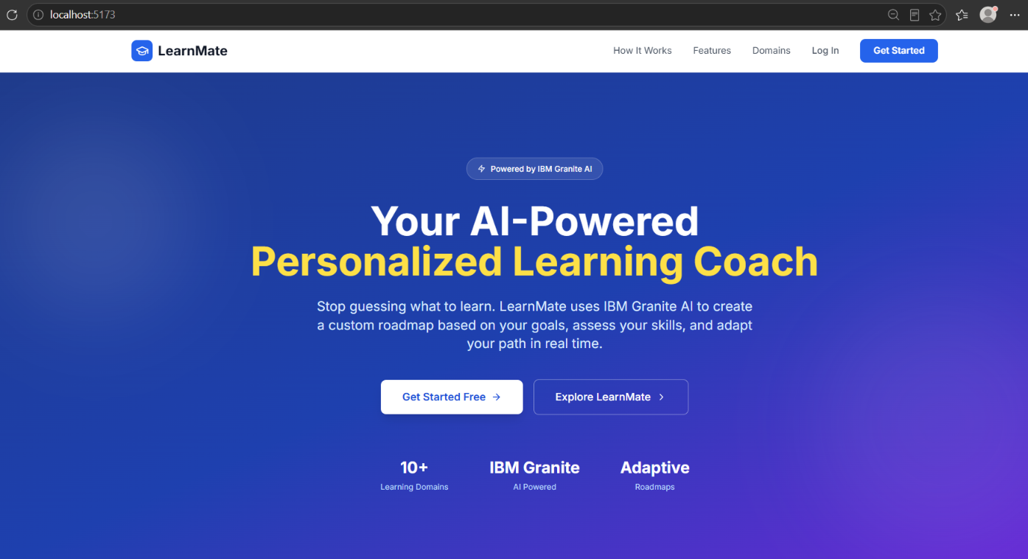
Project Output Screenshot
·
·
·

Slide 14
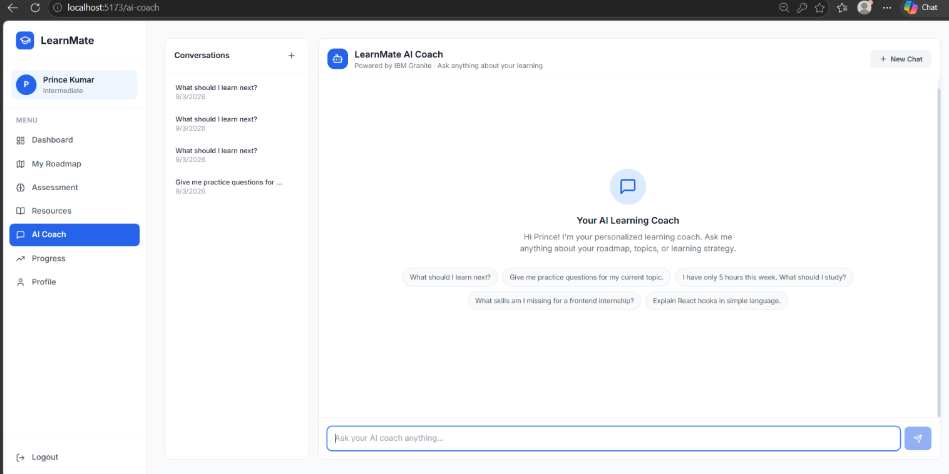
Project Output Screenshot
·
·
·

Slide 15
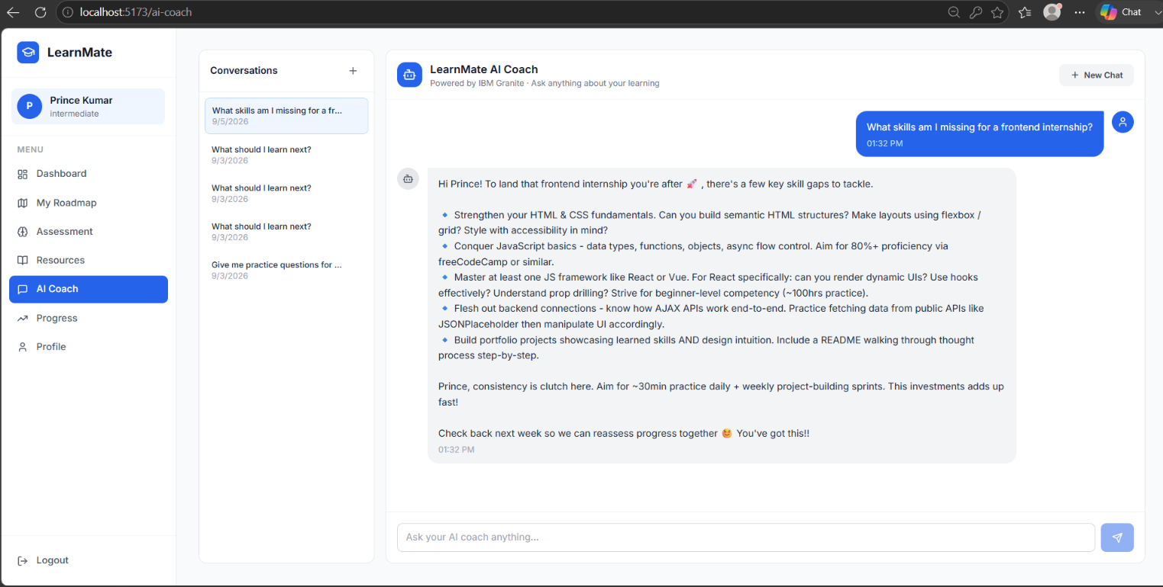
Project Output Screenshot
·
·
·

Slide 16
Novelty and Uniqueness
LearnMate combines Agentic AI, personalization, and adaptive learning to provide intelligent course pathways.
Multi-Agent Intelligence – Uses specialized agents to analyze learner profiles, skills, and goals.
Personalized Learning Paths – Creates customized course pathways according to individual needs.
Skill-Gap Analysis – Identifies missing skills and recommends suitable learning resources.
Adaptive Recommendations – Updates suggestions based on learner progress and assessment results.
AI-Based Assessments – Helps evaluate knowledge and identify areas for improvement.
Goal-Oriented Learning – Connects learning paths with career goals and target skills.
IBM Granite Integration – Uses IBM watsonx.ai and Granite models to provide intelligent AI assistance.
Proactive Learning Support – Suggests the next best learning step instead of simply listing courses.
LearnMate therefore works as a smart, personalized, and proactive learning companion.

Slide 17
Git Hub Link
working Github URL – https://github.com/princekdev/Learnmate
Make sure you have Uploaded following three files into your github repository
1) All Agent relevant files of IBM Cloud , 2) yourproblemstatement.pdf file 3) your projectpresntation.pptx file 4)any other files
·
·
·

Slide 18
Future Scope
Integration with Learning Platforms & Course APIs –
The system can be integrated with online learning platforms and course APIs to provide a wider range of courses, learning resources, and real-time recommendations based on user requirements.
2. AI-Powered Voice Assistant & Multilingual Support –
Adding voice interaction and multiple language support will make LearnMate more accessible. Users will be able to interact naturally in their preferred language and receive personalized learning guidance.
3. Advanced Progress Tracking & Adaptive Learning –
Future versions can continuously analyze learner performance, assessment results, and course progress to automatically improve and adapt personalized learning pathways.
·
·
·

Slide 19
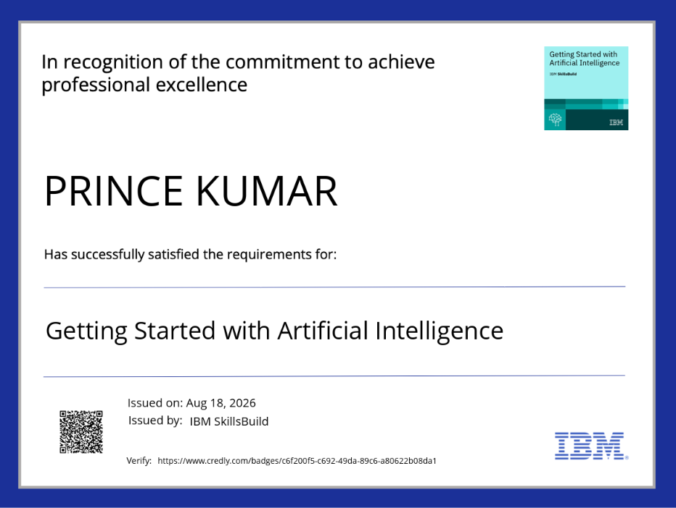
Certificates Earned:
credly certificate(Getting Started with Artificial Intelligence)

Slide 20
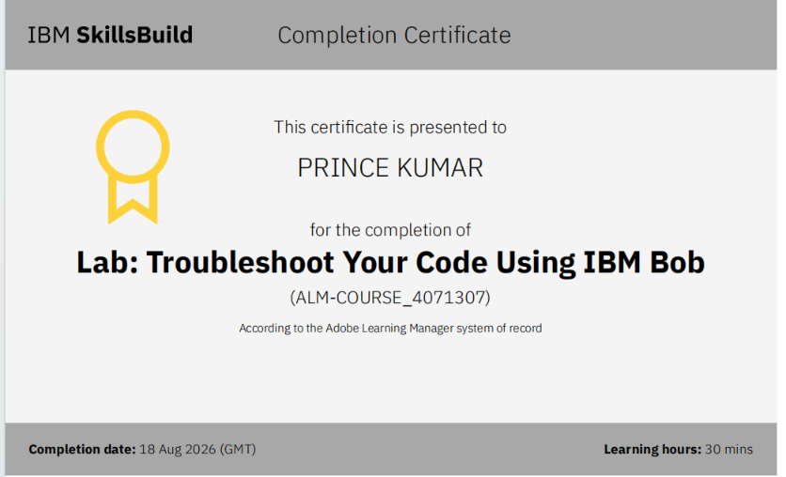
Certificates Earned:​
IBM BOB Certificate

Slide 21


