Slide 1

SDG 12 · RESPONSIBLE CONSUMPTION
EcoSort AI
AI-Powered Waste Segregation & Sustainability Assistant
Understand Waste. Sort Smarter. Build a Sustainable Future.
1M1B AI for Sustainability Virtual Internship In collaboration with IBM SkillsBuild & AICTE
Prince Kumar NIAMT, Ranchi

Slide 2
Problem Statement
Improper waste segregation is a growing challenge for households, students, schools, colleges, offices, and local communities. Many people are unsure about which category a waste item belongs to, whether it can be recycled or reused, and how special waste should be disposed of.
This lack of simple and accessible guidance often results in incorrect segregation, reduced recycling efficiency, increased landfill waste, and environmental pollution.
The key challenge is not just the availability of information, but making waste-management guidance simple, understandable, accessible, and actionable for everyday users.
EcoSort AI addresses this gap by using AI-assisted guidance to help users identify waste, choose appropriate disposal or recycling actions, and develop more responsible and sustainable waste-management habits.
GitHub Repository:
https://github.com/princekdev/eco-sort-ai
Working Demo: https://drive.google.com/file/d/1zlZwqg_tTG6xeGHuO7voHrE9g2Mywr3L/view?usp=sharing

Slide 3
Detailed Solution & AI Elements
EcoSort AI is a web-based AI-powered Waste Segregation and Sustainability Assistant that helps users make better everyday waste-management decisions.
Users enter a waste item in natural language, such as “plastic water bottle.” The system identifies its waste category and provides recommended actions, recycling/reuse guidance, disposal information, and sustainability tips using keyword and fuzzy matching.
Users can ask questions about recycling, composting, e-waste, hazardous waste, sustainable habits, 5 Rs, and SDGs. The system provides structured guidance from a curated sustainability knowledge base.
User Input → AI Understanding → Waste Classification → Recommended Action → Sustainability Guidance
The current prototype operates in AI Demonstration Mode using a curated local knowledge base without external AI APIs.
IBM BOB supported project ideation, development, refinement, testing, and Responsible AI review. The solution emphasizes transparency, privacy, ethical use, uncertainty, and awareness of local waste-management guidelines.
Waste Checker
AI Sustainability Assistant
AI Workflow
IBM BOB & Responsible AI

Slide 4











THE CHALLENGE
The Problem & Target Users
People often don’t know how to correctly manage everyday waste:
THE CONSEQUENCE
Which category does an item belong to?
Can it be recycled or reused?
How should special waste be handled?
Confusion
Incorrect
Segregation
Poor Waste
Management
Environmental
Impact
What sustainable alternative can be chosen?
Left unaddressed, small everyday mistakes compound into a much larger sustainability problem.
TARGET USERS
Students
Households
Schools / Colleges
Offices
Local Communities
EcoSort AI | 1M1B AI for Sustainability Internship
2

Slide 5




GLOBAL GOALS
SDG Alignment
PRIMARY SDG
SDG 11
Sustainable Cities and Communities
SDG 12
Supports cleaner, better-managed local communities through informed waste practices.
Responsible Consumption and Production
EcoSort AI directly advances SDG 12 by helping people build better waste awareness, make smarter segregation choices, and act on reuse and recycling opportunities in their everyday lives.
SDG 13
Climate Action
Builds everyday waste awareness
Reduces environmental impact by lowering avoidable waste and emissions from mismanagement.
Guides responsible disposal decisions
Encourages reuse & recycling habits
EcoSort AI | 1M1B AI for Sustainability Internship
3

Slide 6





THE RATIONALE
Why AI?
A static information page can’t respond to what a person actually has in front of them. AI turns waste guidance into a real conversation.
Understand
Classify
Recommend
Guide
Interpret a user’s waste description in plain language
Identify the most likely waste category
Suggest the appropriate action to take
Answer follow-up sustainability questions
How might we use AI to help people identify, segregate and
responsibly manage everyday waste?
EcoSort AI | 1M1B AI for Sustainability Internship
4

Slide 7






THE SOLUTION
Our Solution — EcoSort AI
An AI-powered sustainability assistant that helps users understand everyday waste, identify appropriate waste categories, receive responsible waste-management guidance, and learn better sustainability habits.
KEY PROTOTYPE FEATURES
Waste Checker
Sustainability AI Assistant
Waste Category Guidance
Look up how to handle a specific waste item
Conversational guidance on sustainable choices
Clear categorization of common waste types
Sustainability Tips
AI Workflow / Prompt Demo
Impact / Awareness
Practical, everyday eco-friendly suggestions
Shows how the assistant reasons and responds
Highlights the value of better waste habits
EcoSort AI | 1M1B AI for Sustainability Internship
5

Slide 8







THE WORKFLOW
How EcoSort AI Works
USER INPUT
AI UNDERSTANDING
WASTE CATEGORY
RECOMMENDED ACTION
SUSTAINABILITY GUIDANCE
“Plastic water bottle”
Interprets the description
Plastic Waste
Recycle / Reuse where appropriate
Practical next-step tip
Local waste-management and recycling rules may vary by city or region.
EcoSort AI | 1M1B AI for Sustainability Internship
6

Slide 9
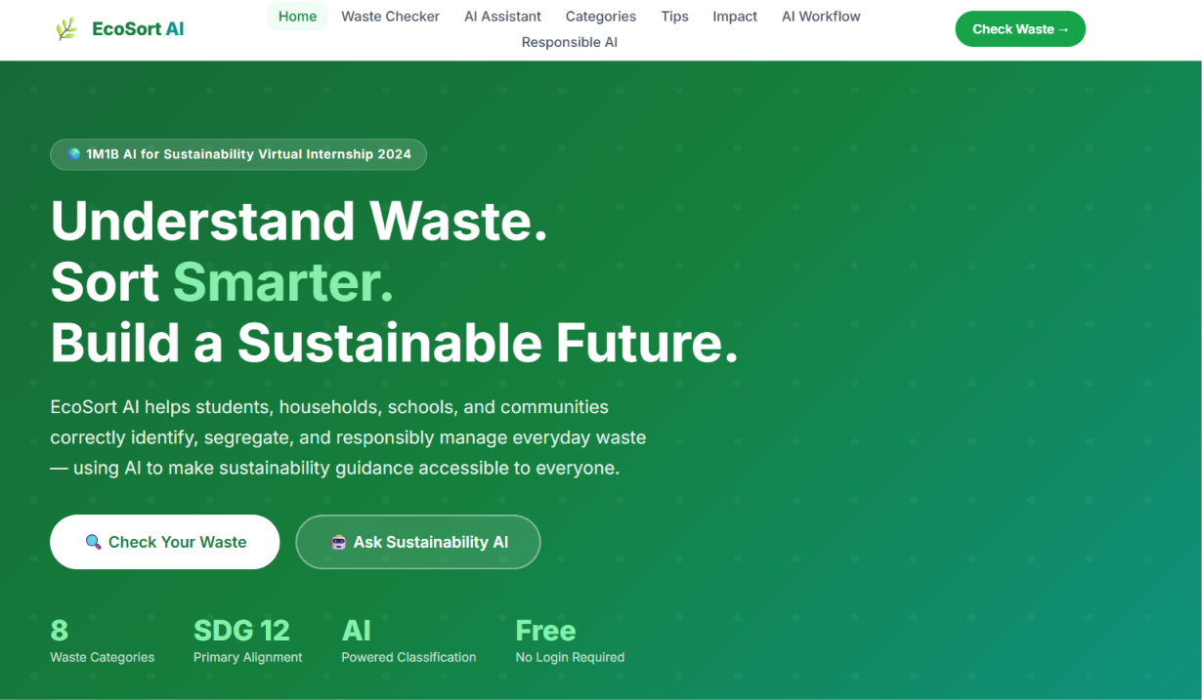
THE PROTOTYPE
Home Page
Prototype — Key Screens
Actual EcoSort AI interface — screenshots to be inserted from the working prototype.
Waste Checker
AI Workflow / Prompt
EcoSort AI | 1M1B AI for Sustainability Internship
7

Slide 10
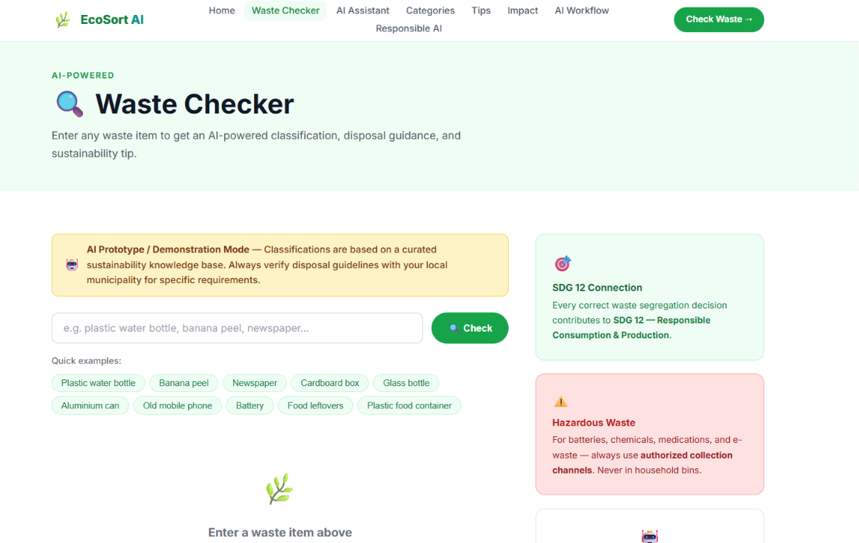
THE PROTOTYPE
Waste Checker
Prototype — Key Screens
Actual EcoSort AI interface — screenshots to be inserted from the working prototype.
Waste Checker
AI Workflow / Prompt
EcoSort AI | 1M1B AI for Sustainability Internship
7

Slide 11
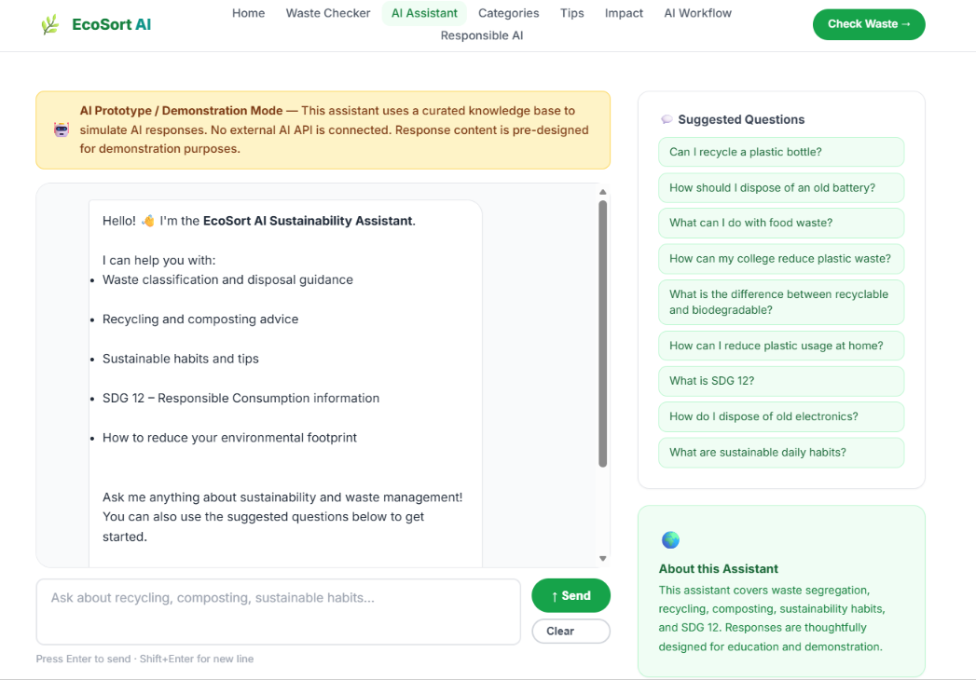
THE PROTOTYPE
AI Sustainability Assistant
Prototype — Key Screens
Actual EcoSort AI interface — screenshots to be inserted from the working prototype.
Waste Checker
AI Workflow / Prompt
EcoSort AI | 1M1B AI for Sustainability Internship
7

Slide 12
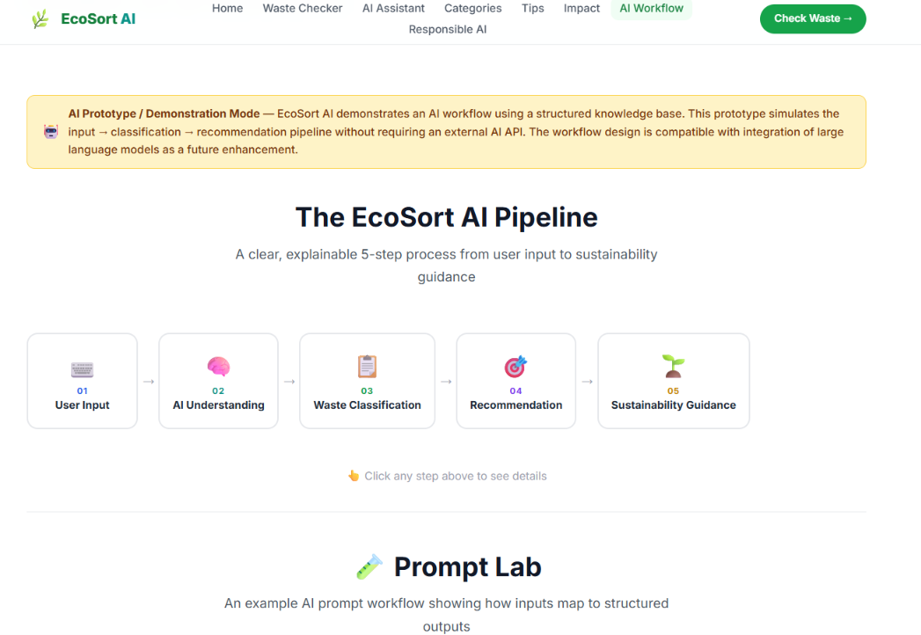
THE PROTOTYPE
AI Workflow / Prompt
Prototype — Key Screens
Actual EcoSort AI interface — screenshots to be inserted from the working prototype.
Waste Checker
AI Workflow / Prompt
EcoSort AI | 1M1B AI for Sustainability Internship
7

Slide 13



UNDER THE HOOD
AI Workflow & Prompting
“I have an empty plastic water bottle. What should I do with it?”
Waste category identified
Recommended action given
Reuse / recycling guidance
Sustainability tip included
Relevant caution noted
Prompt engineering helps make AI responses structured, useful, consistent and responsible.
EcoSort AI | 1M1B AI for Sustainability Internship
8

Slide 14

IBM BOB
IBM BOB was incorporated into the EcoSort AI project development process as an AI-assisted project-building and development tool.
IBM BOB — Contribution & Evidence
Ideation
Project concept and structure
EcoSort AI | 1M1B AI for Sustainability Internship
11

Slide 15


IBM BOB
IBM BOB was incorporated into the EcoSort AI project development process as an AI-assisted project-building and development tool.
IBM BOB — Contribution & Evidence
Development
Building / implementing components
EcoSort AI | 1M1B AI for Sustainability Internship
11

Slide 16


IBM BOB
IBM BOB was incorporated into the EcoSort AI project development process as an AI-assisted project-building and development tool.
IBM BOB — Contribution & Evidence
Refinement
Improving and testing the prototype
EcoSort AI | 1M1B AI for Sustainability Internship
11

Slide 17
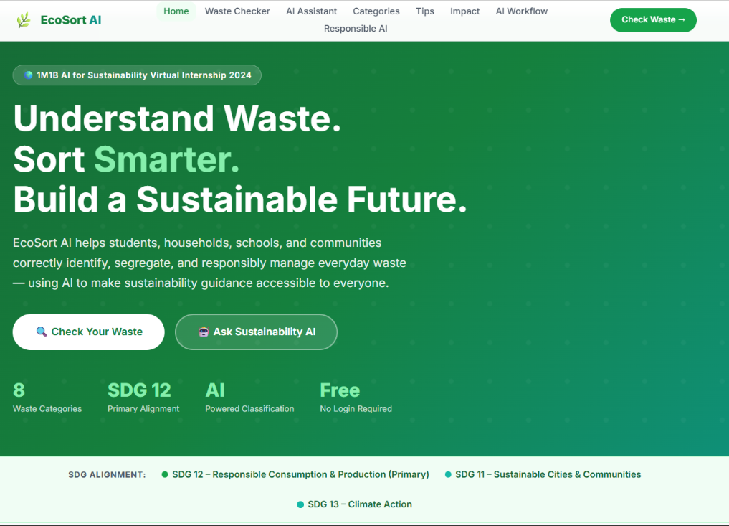
Some Screenshots Of Project

Slide 18
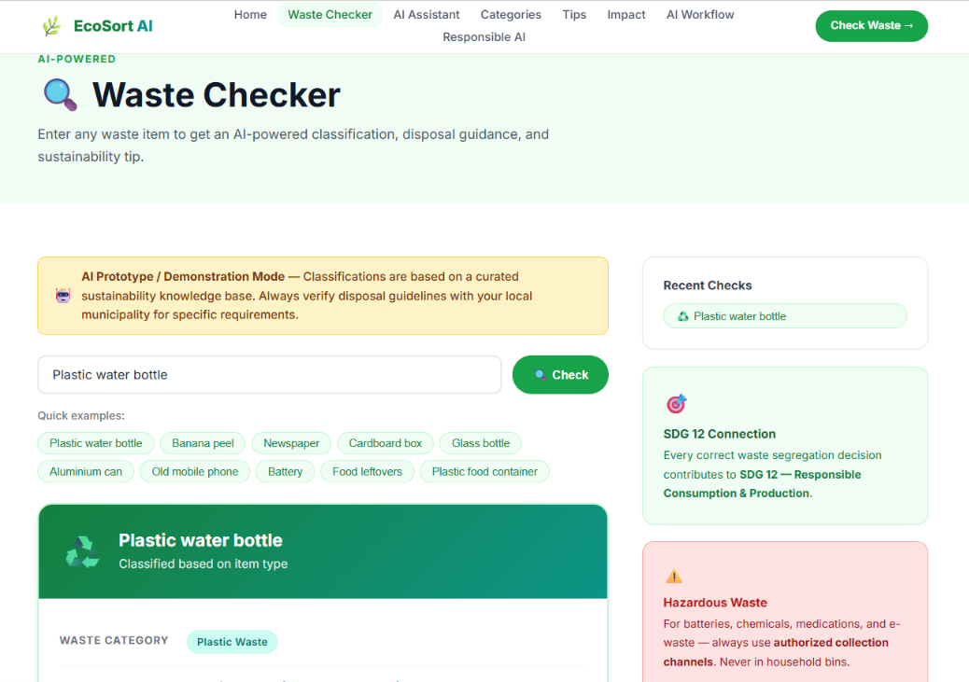
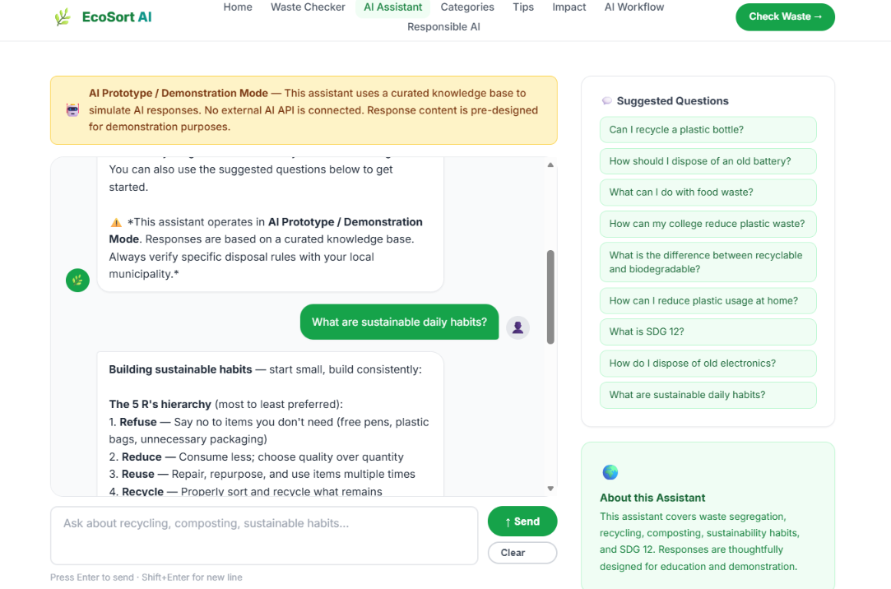

Slide 19
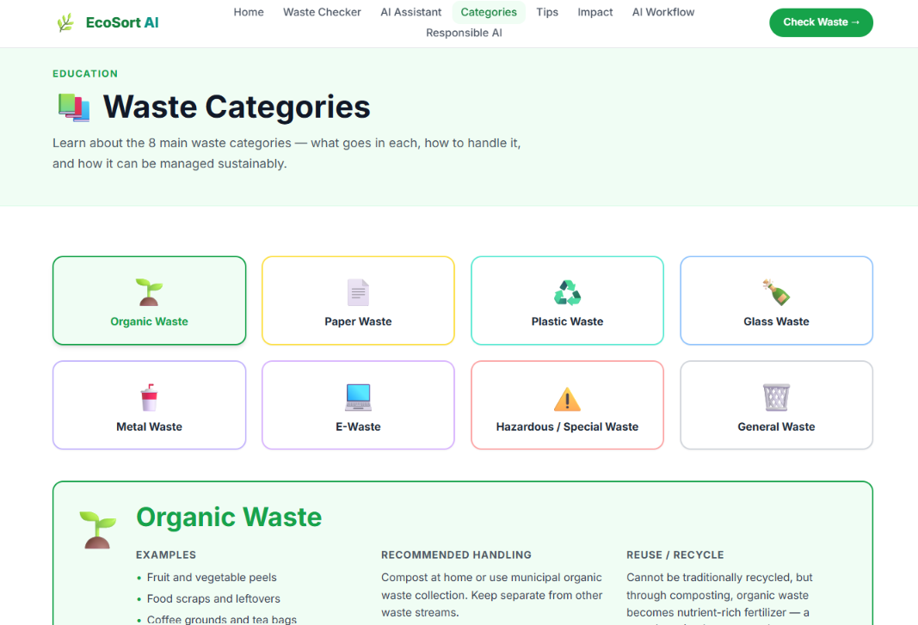

Slide 20
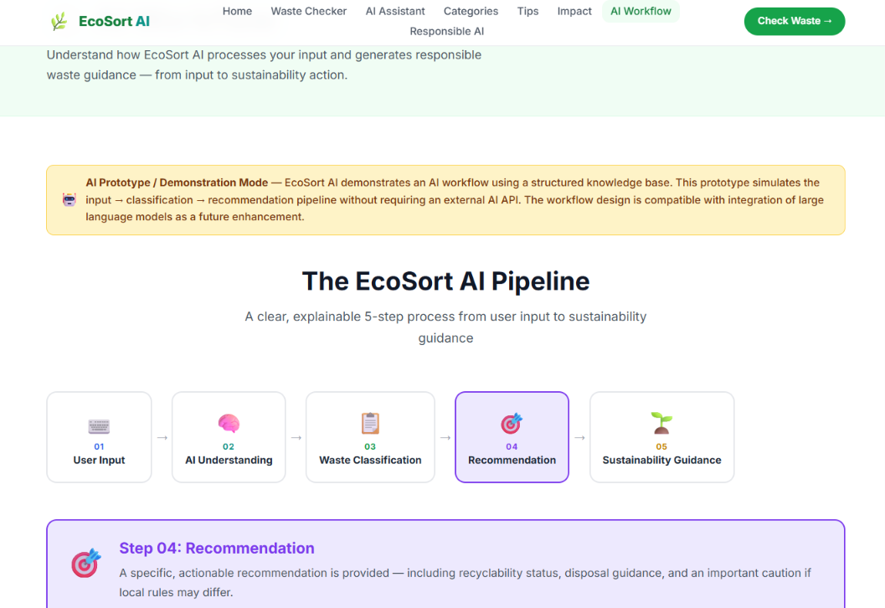

Slide 21








PROCESS & PRINCIPLES
Design Thinking + Responsible AI
DESIGN THINKING
Empathize
Define
Ideate
Prototype
Test & Refine
Understand real waste-handling struggles
Frame the core sustainability problem
Explore AI-assisted solution ideas
Build the EcoSort AI assistant
Improve based on feedback
RESPONSIBLE AI
Fairness
Transparency
Privacy
Ethics
Uncertainty
Avoid biased assumptions
Make AI guidance clear
Avoid unnecessary personal data
Avoid harmful or misleading advice
Note that local rules may differ
EcoSort AI | 1M1B AI for Sustainability Internship
9

Slide 22



LOOKING FORWARD
Potential / Expected Impact
Directional outcomes EcoSort AI aims to support — not measured results.
Environmental
Social
Economic
Better waste-segregation awareness
Accessible sustainability guidance
Encourages resource recovery & reuse
Increased recycling / reuse awareness
Increased awareness among students
Potentially more efficient handling
More responsible waste decisions
Stronger community engagement
Supports circular-economy thinking
EcoSort AI | 1M1B AI for Sustainability Internship
10

Slide 23




CONCLUSION & FUTURE
What EcoSort AI Demonstrates
Real-World Problem
SDG 12
AI-Powered Assistance
Responsible AI
Sustainability Impact
FUTURE SCOPE (not current features)
Image-based waste recognition
Multilingual assistance
Local waste-management guidance
Campus waste analytics
More advanced waste classification
“AI can create meaningful impact by helping people make better everyday sustainability decisions.”
Thank You
Prince Kumar | NIAMT, Ranchi

