Slide 1

G2M Case Study
Virtual Internship
21-Jun-2022

Slide 2
Agenda
Executive Summary
Problem Statement
Approach
EDA
EDA Summary
Recommendations

Slide 3
Background –G2M(cab industry) case study
XYZ is a private equity firm in US. Due to remarkable growth in the Cab Industry in last few years and multiple key players in the market, it is planning for an investment in Cab industry.
Objective : Provide actionable insights to help XYZ firm in identifying the right company for making investment.
The analysis has been divided into four parts:
Data Analysis to get maximum insights from the existing data
Analyzing the pattern of the two companies and their share in the market
Finding the most profitable company
Recommendations for investment in the two companies

Slide 4
Exploring Data
Total Features: 16
Timeframe of the data: 2016-01-31 to 2018-12-31
Total data points: 359392
Assumptions:
No Outlier consideration in the data
Only “Price Charged” and “Cost of Trip” features used to calculate profit.
Users feature of city dataset is treated as number of cab users in the city.
Cab_Data.csv
Customer_ID.csv
Final Cab Data
City.csv
Transaction_ID.csv

Slide 5
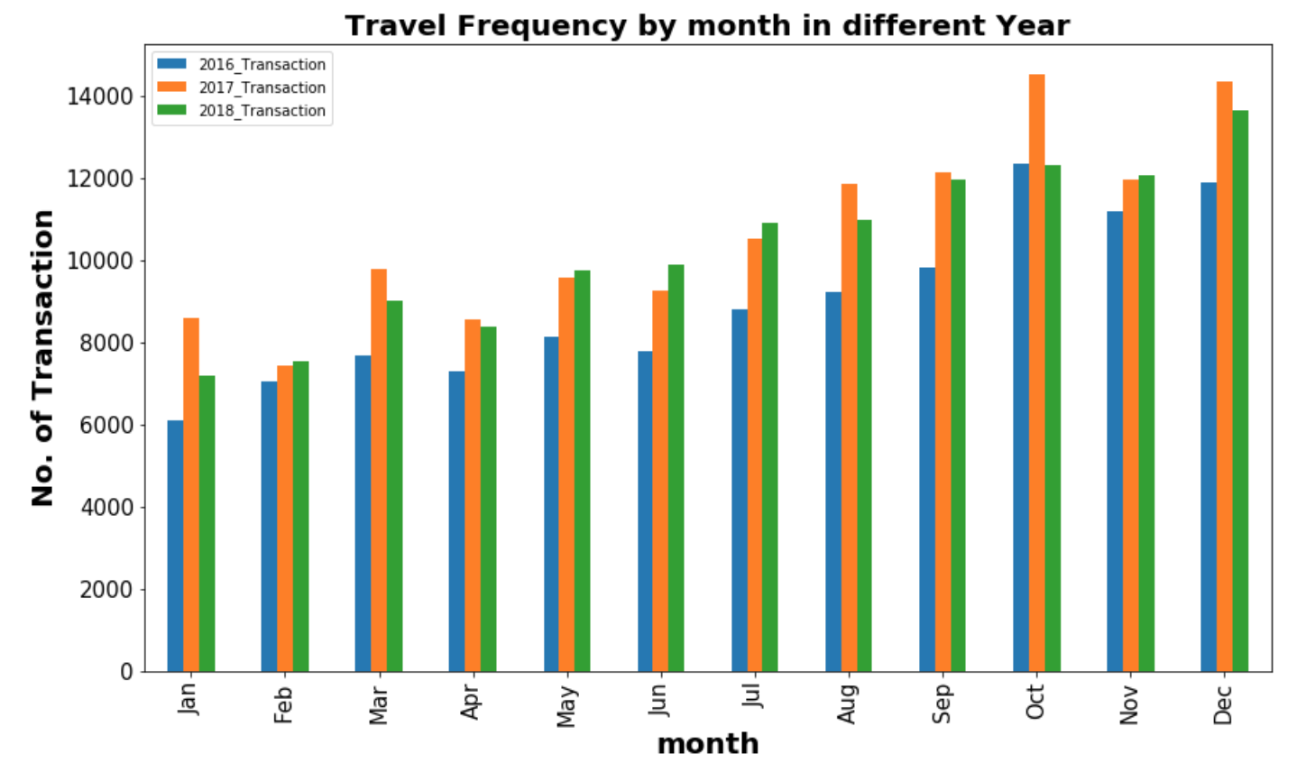
Cab Usage Frequency and Seasonality Pattern

Slide 6
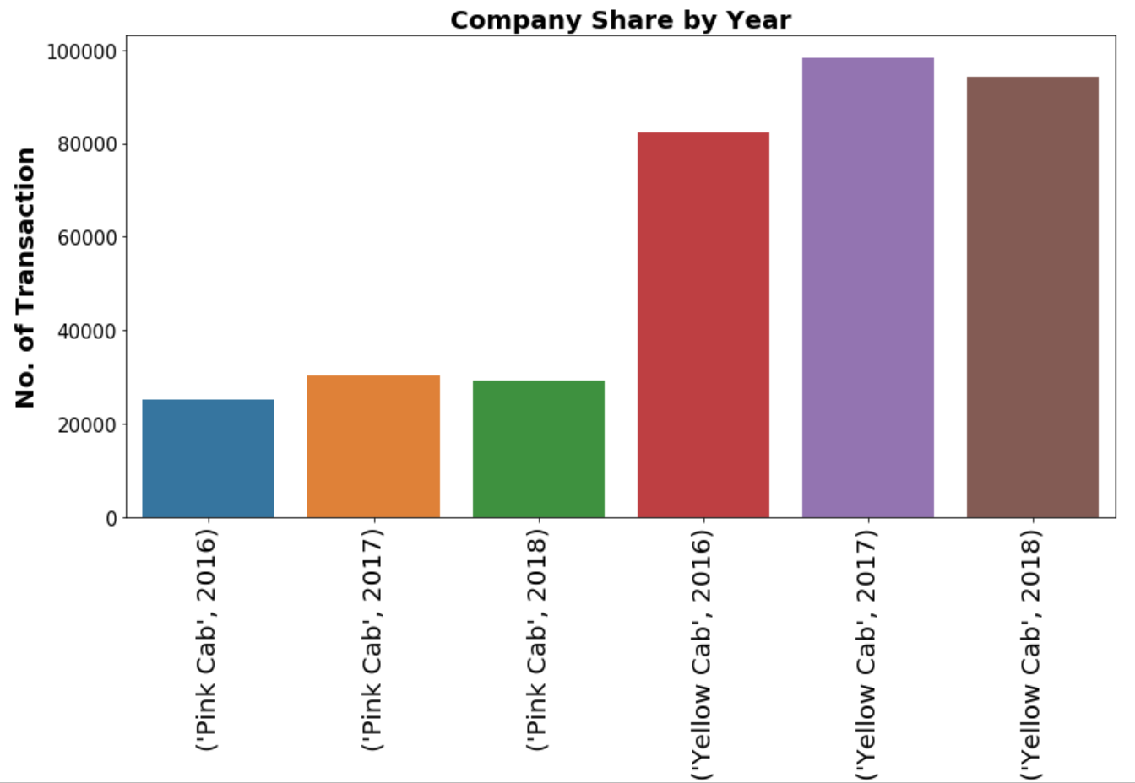
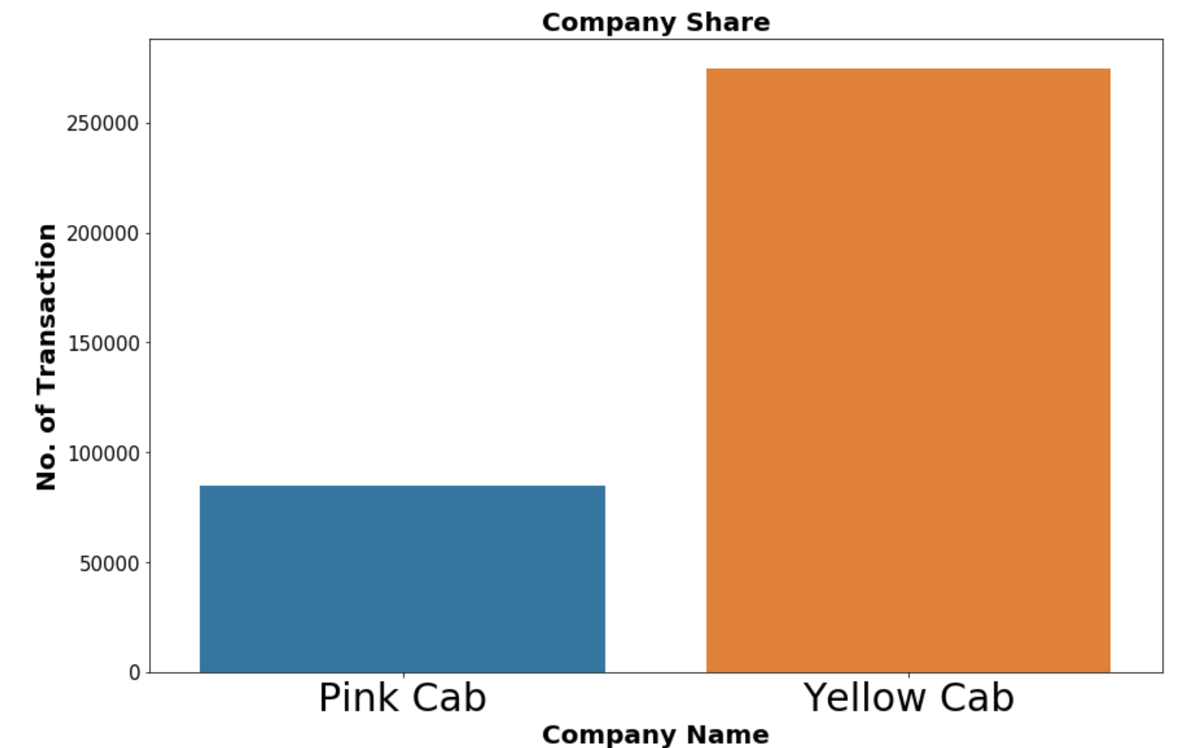
Company Share in Market

Slide 7
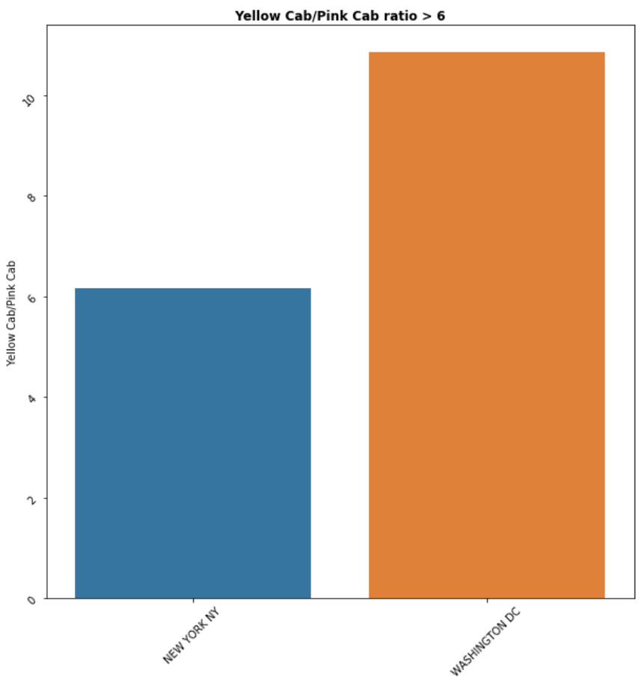
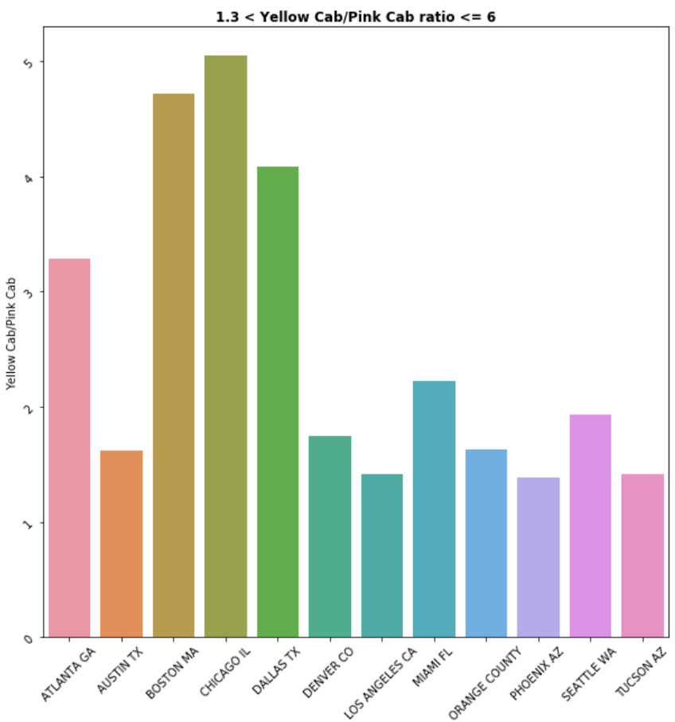
Region Wise Company Share in Market

Slide 8
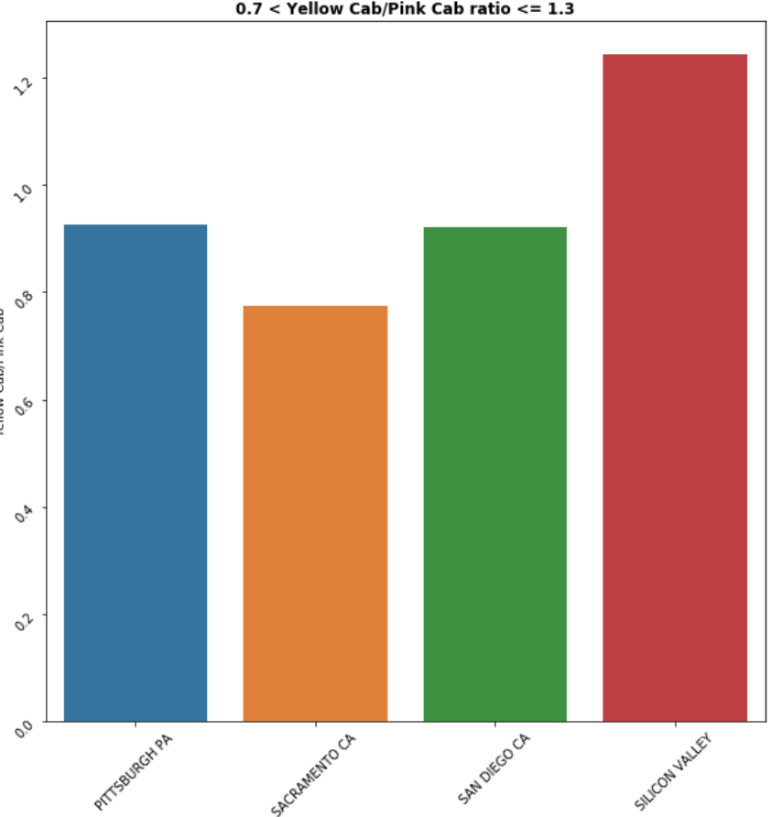
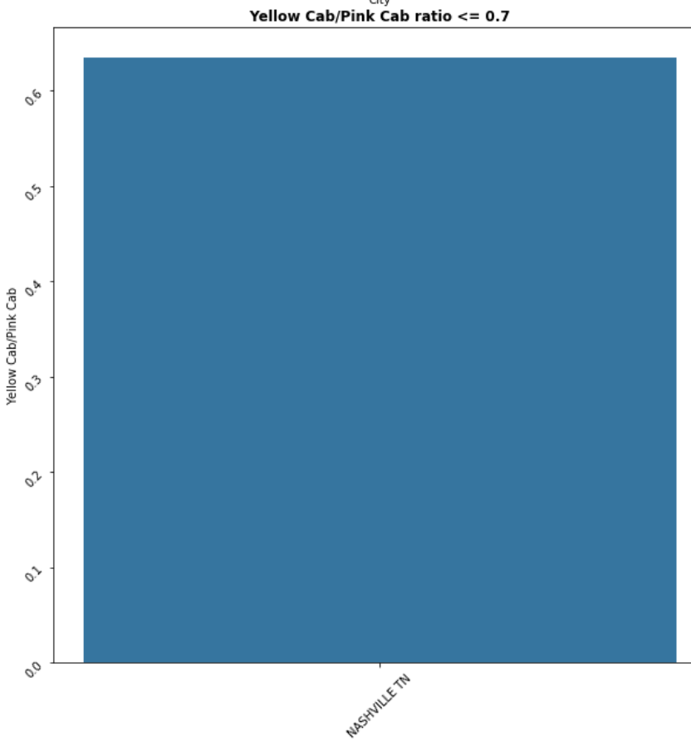
Region Wise Company Share in Market

Slide 9
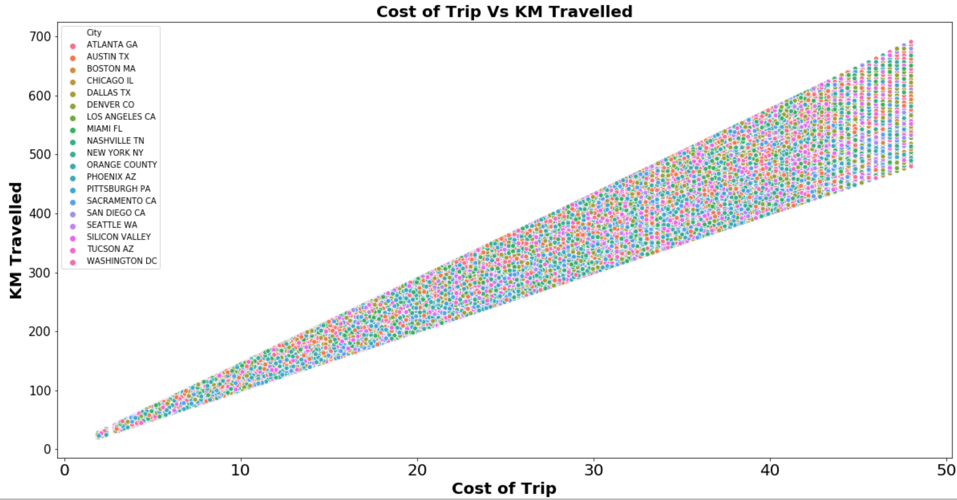
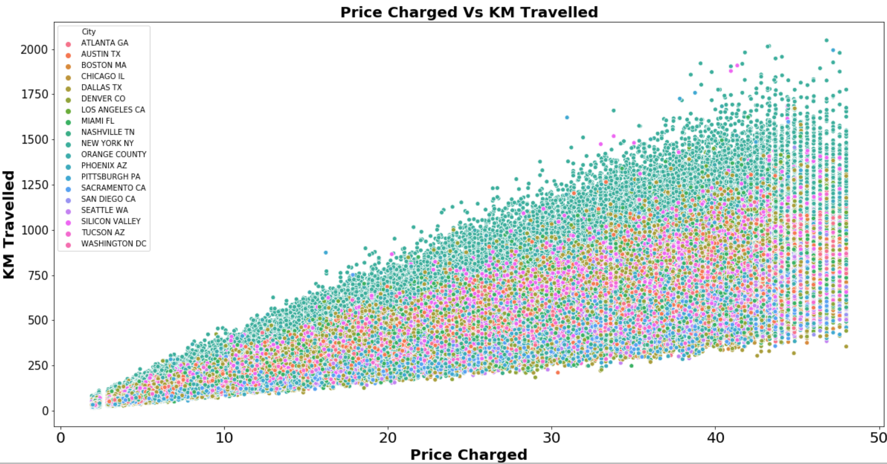
Cost of trip and Price Charged

Slide 10
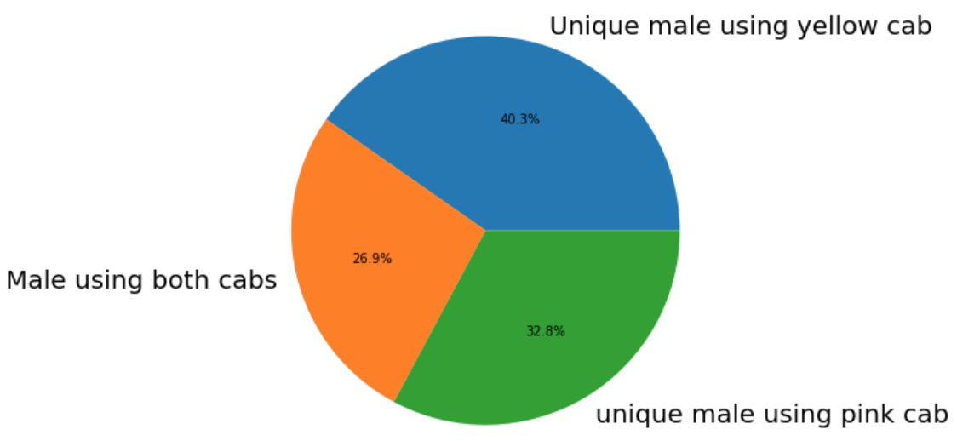
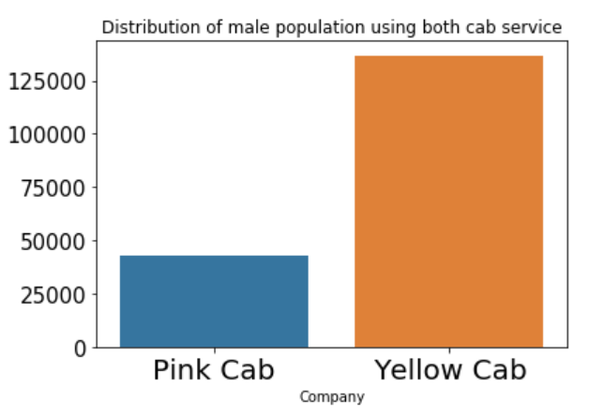
Gender Wise Customer retainment
Male

Slide 11
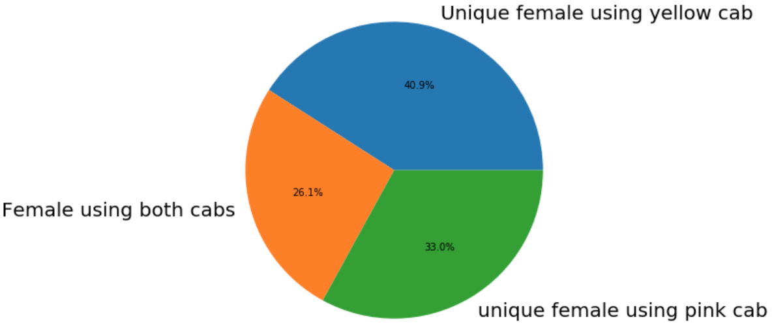
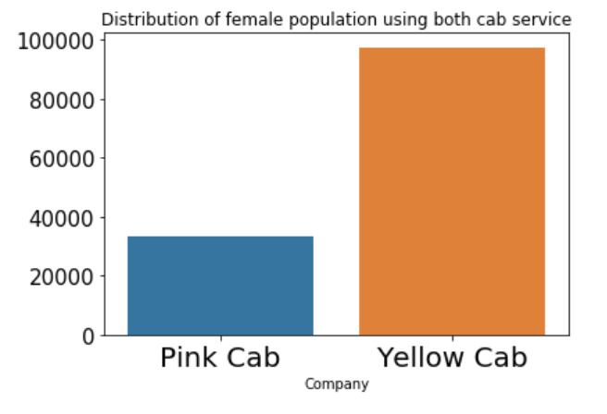
Gender Wise Customer retainment
Female

Slide 12
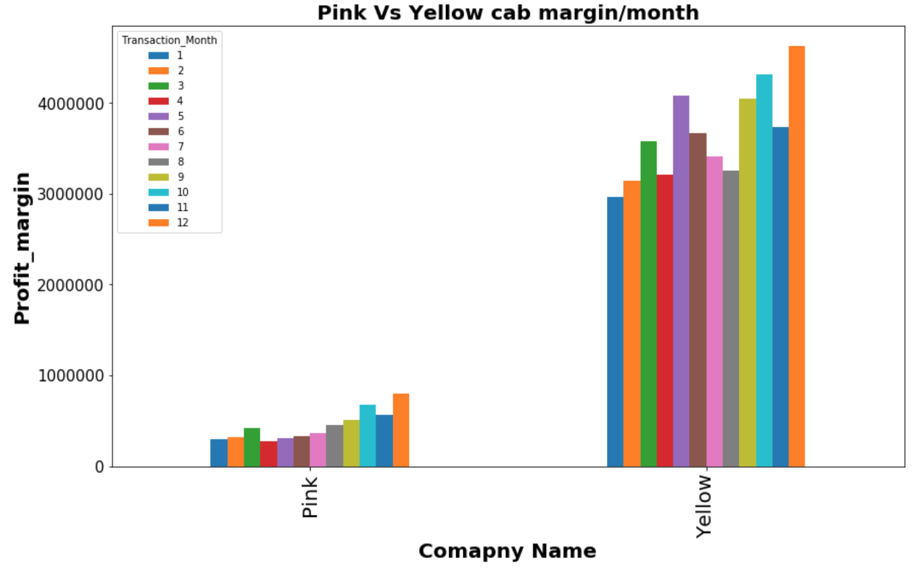
Profit Margin Month Wise

Slide 13
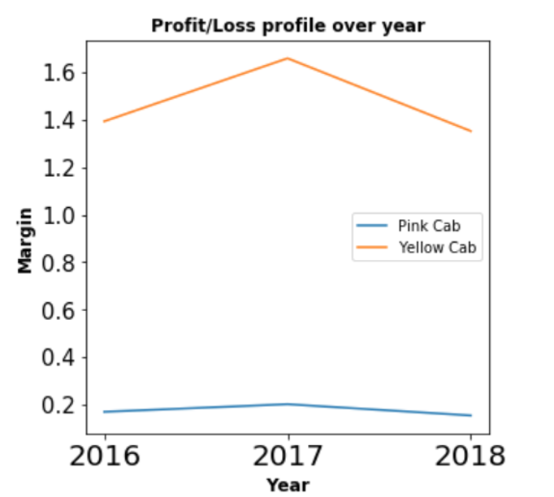
Gain/Loss Profile

Slide 14
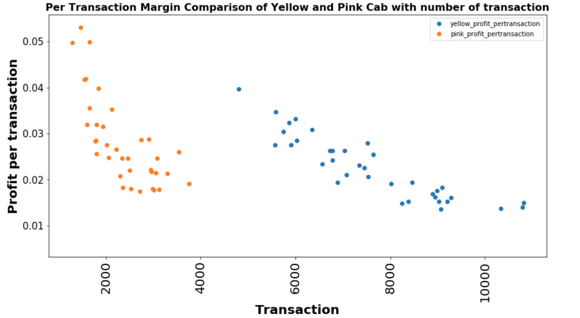
Business Model of Yellow Cabs

Slide 15
Recommendations
I have evaluated the two companies and made the following observations:
Coverage of Customers : Yellow cab has higher customer reach consistently for over three years as compared to pink cab.
Customer Retention: Yellow Cab still maintain its monopoly over the market and is performing better at retaining around 85 % of its customer, losing ~10-15% customer to pink cab.
Age wise Reach : Yellow cab has customer in all age group, and it’s been observed that it’s even popular in 60+ age group as equally as its in 18-25 age group.
Business Model: Yellow Cab has adopted a strong model of increasing its profit by reducing its profit margin when transaction is high and vice-versa.
Overall: Despite "Low-Profit charging" strategy of Pink Cab, It doesn't seem to be a major competitor for Yellow Cab in near future. Pink Cab should give lucrative deal in the cities where it is performing better. However, currently Yellow can is dominating the market with less variance in its market share and profit.
On the basis of above point , I will recommend investment in yellow cabs

Slide 16
Thank You

