Slide 1

AI-Powered Collections Strategy
Leveraging Agentic AI for Scalable, Fair, and Effective Debt Management at Geldium
Tata iQ Forage Simulation | Predictive Analytics Team | October 2026
Notes:
Opening frame: this deck presents an agentic-AI collections system for Geldium. Every claim is grounded in the executed Task 1 EDA (500 customers, 16.0% delinquent) and the executed Task 2 baseline check - we deliberately pilot before we model.

Slide 2
How the System Works
1 · INPUTS
2 · DECISION LOGIC
3 · ACTIONS
4 · LEARNING LOOP
- Customer data: Income, Credit_Score, Credit_Utilization, Debt-to-Income, Loan_Balance, Missed_Payments (12 mo), 6-month payment history, Employment_Status, Tenure
- Data-quality gate first: label clean-up, median imputation + missingness flags (Task 1 cleaning log)
- Rules first: transparent DTI-band risk tiers (low / medium / high)
- Predictive model only after the go/no-go gate (cross-validated PR-AUC must beat the 0.16 no-skill floor)
- Calibrated probability -> risk score + reason codes
- Low risk: automated reminder e-mails / SMS
- Medium risk: proactive hardship or limit-review offer
- High risk or vulnerable: human collections review
- Outcomes tracked: cure rate, roll-rate, complaints, cost per account
- Monthly fairness + drift (PSI) audits
- Rules and models refreshed; kill-switch to manual review
Baseline: 500 customers, 16.0% delinquent - every pipeline step is documented in the Task 1 cleaning log and Task 2 model card.
Notes:
Walk left to right. Emphasise the data-quality gate: Task 1 found 6 label variants in Employment_Status (245 rows fixed), 7.8% missing Income (median imputed + flagged) and 81 tenure-age inconsistencies - the system consumes only cleaned, documented data. Decision logic is rules-first because the executed baseline showed models at the no-skill floor (PR-AUC 0.15-0.17 vs 0.16 base rate).

Slide 3
Role of Agentic AI
AUTONOMOUS (AI acts, no approval needed) | HUMAN OVERSIGHT (approval required)
Nightly segmentation and risk scoring (rules + validated model) | Model go/no-go approval and threshold setting (Task 2 gate)
Reminder e-mails / SMS to low-risk accounts | Hardship and restructuring offers (affordability judgement)
Case routing and priority queues for collectors | Any adverse action: limit cuts, escalation, legal action
Drift / anomaly detection and automatic alerting | Fairness and bias review before any scale-up
Outcome dashboards and standard reporting | Vulnerable-customer exceptions and complaint handling
Principle: AI acts autonomously only where actions are reversible, low-impact and fully explainable; everything affecting a customer's credit terms stays human.
Notes:
Agentic AI here means the system can plan and execute routine steps end-to-end (scoring, messaging, routing, monitoring) without ticket queues. The boundary is deliberate: unemployed customers show the highest observed delinquency (19.4%), so vulnerable or adverse-touching decisions always route to a human officer.

Slide 4
Responsible AI Guardrails
Fairness by design - subgroup audits (Age band, Employment_Status, Location) for equal-opportunity and calibration parity; Location excluded from scoring because it proxies ethnicity and socio-economic status.
Explainability - transparent DTI-band rules today; per-decision reason codes for any future model; predictions communicated as probabilities with uncertainty (executed baseline: no better than chance).
Human-in-the-loop and compliance - no fully automated adverse decisions; adverse-action reason notices; income and debt data minimised to need-to-know; documented model card and full audit trail.
Continuous monitoring - monthly drift (PSI), calibration and complaint-rate reviews; kill-switch back to manual review; fairness re-audit before any scale-up.
Guardrails are build requirements, not afterthoughts - each maps to a Task 2 evaluation metric and a named owner.
Notes:
Two concrete fairness risks drive these guardrails: (1) proxy discrimination via Location / Employment_Status, (2) vulnerable-group impact on unemployed customers (19.4% delinquent). Compliance angle: adverse-action transparency and data minimisation for income/debt fields; 7.8% missing Income is disclosed as a banding limitation.

Slide 5
Expected Business Impact
BUSINESS KPIs | CUSTOMER OUTCOMES
15%+ relative delinquency reduction in the pilot cohort (DTI > 40%, 74 accounts) by day 90 | Supportive offers before punitive action; hardship routing for vulnerable customers
Lower cost per account: automated reminders replace manual dialling | Fewer intrusive contacts for low-risk customers
Higher cure rate and lower 90+ DPD roll-rate in the targeted band | Transparent reason codes (e.g., 'your debts are close to your income')
Collections capacity freed for complex, high-value cases | Fair outcomes audited by age, employment group and region
Near-zero marginal cost as the portfolio scales | Consistent, documented process customers can question and challenge
Impact targets come from the Task 3 SMART pilot - measured against a matched control, with a scale-or-stop decision at day 91.
Notes:
Quantitative targets are pilot commitments, not modelled projections: 15% relative delinquency reduction in the DTI > 40% cohort (18.9% observed vs 9.8% in the lowest band). Qualitative gains - fairness, transparency, scalability - are audited with the same rigor as the KPIs.

Slide 6
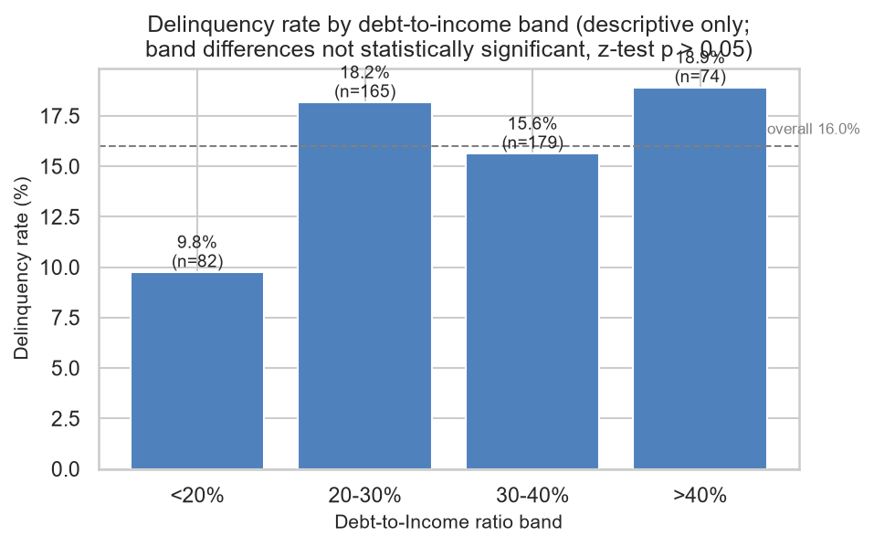
Evidence Base: Why Pilot-First
Base rate: 16.0% delinquent (80 of 500 customers)
Strongest observed gradient: DTI > 40% delinquent at 18.9% vs 9.8% below 20% (~2x)
Executed baseline: logistic regression, boosting and dummy all at PR-AUC 0.15-0.17, i.e. the 0.16 no-skill floor
Implication: no model deployment yet - validate the DTI gradient with a controlled 90-day pilot, then scale what works
Definitions: cross-checked against the official Dataset Description Guide (Missed_Payments = 12-month window; Month_1-6 = 6-month window)
Caveat: segments are descriptive, not statistically validated - the pilot exists to validate before scaling (Task 2 go/no-go gate).
Notes:
This slide keeps us honest: the same EDA that found the DTI gradient found that no predictor beats chance today. Pilot-first is how we capture upside without acting on noise - and every number here is reproducible from the project repository.

