Slide 1
Mining best k Hub locations for Crowd- sourced Taxi based Package Shipment Service
Prince Kumar(2020CSB088)

Slide 2
Statement Explanation
Innovative Model: A proposed crowd-sourced taxi shipment model suggests using regular passenger taxis for package deliveries.
Subscription System: Taxis can subscribe to carry package shipments alongside passengers, ensuring a dual-purpose service.
Delivery Requirement: Packages must be shipped within the city premises within a day.

Slide 3
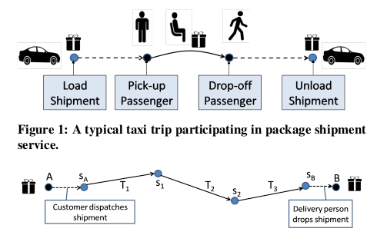
Operational Guidelines: Taxis subscribing to the service should collect shipments from a hub before picking up passengers and drop them off at a hub after passenger drop-offs.
Minimal Disruption: The model aims to seamlessly integrate package deliveries without negatively impacting the passenger trip itinerary.

Slide 4
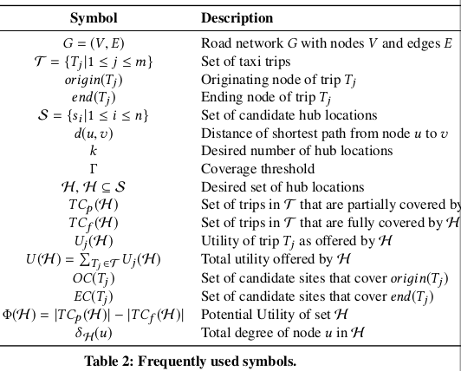
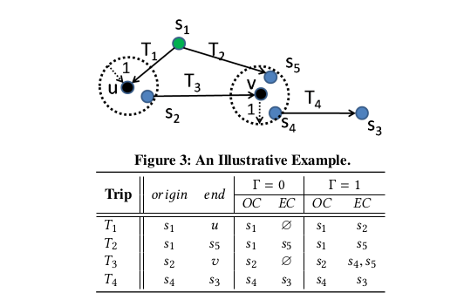

Slide 5
Assumption:-
It is assumed that the trip data is collected
for at least one day duration.
A shipment typically moves through a sequence of hubs before reaching its destination.
Suppose G = {V , E} denotes a road network spread over a geo-graphical region where V denotes the set of road intersections, and E denotes the set of road segments between two neighbouring road intersections. To model the direction of the underlying traffic that passes over a road segment, we use directed edges.

Slide 6
Goal and Aim:-
The goal of the shipment service is to serve maximum number of shipment requests. To address this goal, ideally there should be a hub in each neighbourhood of the city.
The goal of the crowd-sourced taxi based shipment service is to reduce the average shipping time and to maximize the number of shipments that are delivered within the stipulated time, referred to as throughput.
The aim of the Hub Selection query is to determine a set of k new hub locations H ⊆ S, |H | = k, that fully cover maximum number of passenger trips.

Slide 7
The Hub Selection problem is NP Hard.
Problem Complexity: The Hub Selection problem is proven to be NP Hard through a reduction from the clique problem in graph theory.
Reduction Steps: The reduction involves creating a new graph G from an input graph G' by adding nodes and directed edges. Trips in G correspond to edges in G', with specific parameter settings.
Equivalence Claim: A clique of size k in G' corresponds to a set of hub locations in G, with utility U(H) ≥ k(k − 1).
Proof Outline: If G' has a clique of size k, then G has a set of hub locations meeting the utility condition. Conversely, if G has such a set of hub locations, it implies the existence of a clique in G' of the same size.
Conclusion: The reduction establishes the equivalence between the clique problem in G' and the Hub Selection problem in G, providing insights into their computational complexity.

Slide 8
ALGORITHMS FOR THE HUB SELECTION
PROBLEM
Hub Selection Challenge: Hub selection is computationally challenging in the context of the given problem.
Two Rounds of Pruning: Two pruning rounds are implemented to narrow down the solution space: first on the trip space (T) and then on the site space (S).
Trip Pruning Criteria: Trips with empty original or destination coverage (OC or EC) and those shorter than 2Γ are pruned as they are not useful for package shipment.
Site Pruning Criteria: Undesirable hub locations are identified by low total degrees in the Γ-neighbourhood; if below a threshold, the site is pruned from the site space (S).

Slide 9
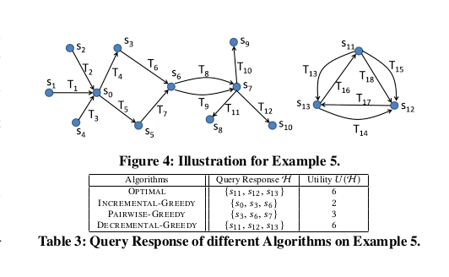

Slide 10
Optimal Algorithm:-
An instance of the Hub Selection problem, where the set of taxi trips is given by T = {T 1, . . . ,T18 } and the set of candidate sites is given by S = {s 0, . . . , s 13 }. For simplicity, assume that the the coverage threshold Γ = 0 and there are no existing hub locations, i.e., H0 = ∅. The trips are shown with black arrows that indicate their direction. As an instance, the trip T1 originates at s 1 and ends at s 0 ; thus oriдin(T1 ) = s 1 and end(T1 ) = s 0 . Givem a set of candidate sites H ⊆ S, since Γ = 0, each trip T j is fully covered by H if and only if both its end nodes, i.e., oriдin(T j ) and end(T j ) are in H . Suppose the goal is to set up k = 3 new hub locations. The optimal solution is {s 11, s 12, s 13 } that fully cover 6 trips namely, T13, . . . ,T18 . The solutions returned bydifferent algorithms, including the optimal

Slide 11
Incremental-Greedy
The algorithm starts with a solution set H = H0 that contains
the set of existing hub locations H0 . Then it runs for k iterations.
In each iteration θ = 1, . . . , k, it selects a site sθ ∈ S \ H such that the utility of the resulting set, U (H ∪ {sθ }) is maximal. If there are multiple such sites, then the tie is broken by choosing the site sθ that maximizes the potential utility of the resulting set, Φ(H ∪ {sθ }). Still, if there are ties, without loss of generality, we pick the site with the lowest index. The chosen site sθ is added to the solution set H . At the end of k iterations, the algorithm reports the desired set of new hub locations H \ H0 .

Slide 12
Pairwise-Greedy
We observe that a trip T j is fully covered if and only if both the ends of the trip are covered.This algorithm considers selecting a set of at most two sites at a time.
The algorithm begins with a solution containing the existing hub
locations, i.e., H = H0 . The available budget b is set to k. In each successive iteration, the algorithm identifies a non-empty set of sites, Hθ ⊆ S\H such that Hθ | ≤ min{b, 2}| and U (H ∪Hθ ) is maximal.In case there are ties, we choose the set Hθ such that the resulting set H ∪ Hθ offers the highest potential utility Φ(H ∪ Hθ ). Still if there are ties, they are broken arbitrarily. The chosen set Hθ is added to the set H and the available budget b is reduced by |Hθ |. The algorithm terminates when there is no more available budget, i.e., b =0. Finally, the algorithm returns the solution set H \ H0 .

Slide 13
Decremental-Greedy
The algorithm begins with H = S = {s 0, . . . , s 13 }.
Since n = 14 and k = 3, the algorithm runs for n − k = 11 itera-
tions. In the first iteration, the algorithm finds that each of the sites,
s 1, s 2, s 4, s 8, s 9 and s 10 have same marginal utility loss of 1. Applying
the tie breaking rules, the algorithm prunes s 10 . In the next 5 iter-
ations, it eliminates s 9, s 8, s 4, s 2 and s 1 , in this order. At this stage,
each of the sites, s 0, s 3, s 5 and s 7 have a marginal loss of 2 and total
degree 2. For all other sites, the marginal utility loss is 4. Thus in the
7th iteration, the algorithm removes s 7 . In the next 4 iterations, it
prunes away s 6 , then s 5 , followed by s 3 and finally s 0 . At the end of
11 iterations, the algorithm reports the set {s 11, s 12, s 13 } that offers a
utility yield of 6. Incidentally, this is the optimal utility.

Slide 14
Future Work:
Algorithmic Analysis: A comprehensive examination of the aforementioned algorithm will be conducted.
Exploration of Alternatives: Concurrently, efforts will be made to devise more efficient and optimal solutions to achieve the desired outcome.
Implementation and Evaluation: Following the conceptualization stage, code will be written and executed to generate outputs.
Result Analysis: The outcomes will be systematically analyzed and observed to draw meaningful insights.

Slide 15
Advantages:
Short delivery time.
Taxi drivers have excellent knowledge of the traffic conditions at different roads at different time, and they are often good at choosing paths with lighter traffic to deliver passengers to their destinations. Hence, it is highly possible that the time cost of packages on roads is short as we rely on the taxis when they are delivering passengers.
Economical and environmental friendly.
Compared to introducing additional transportations that are dedicated to package delivery, we leverage the existing taxis on the street. Moreover, we only assign packages to taxis that are carrying passengers to reduce extra air and noise pollution, making it an economical, green solution.

Slide 16
Disadvantages :
How to ensure the quality of taxi service?
Participating in crowdsourced package express shipping should not impair the quality of passenger delivery service, which is the core business of the taxi industry.
Where to store the package in each hand-off?
Often, a package cannot be arrived at its destination on a single taxi ride. It has to be dropped off at certain “exchange station,” e.g. despatch center, warehouse, or simply safe boxes, and wait for the next ride. The numbers and locations of such hand-off points .may impact the efficiency of the entire express shipping service

Slide 17

Application:-
Supply Chain Optimization:
Distribution Centers: In supply chain logistics, the problem can be adapted to optimize the placement of distribution centers or hubs for efficient product distribution, considering transportation networks and delivery routes.
Waste Collection and Recycling:
Waste Collection Points: Determining the strategic placement of waste collection points or recycling centers to optimize waste management processes and reduce transportation costs.
Tourism and Hospitality:
Tourist Information Centers: Selecting strategic locations for tourist information centers to assist visitors while minimizing disruption to local traffic and services.

Slide 18
THANK YOU

