Slide 1
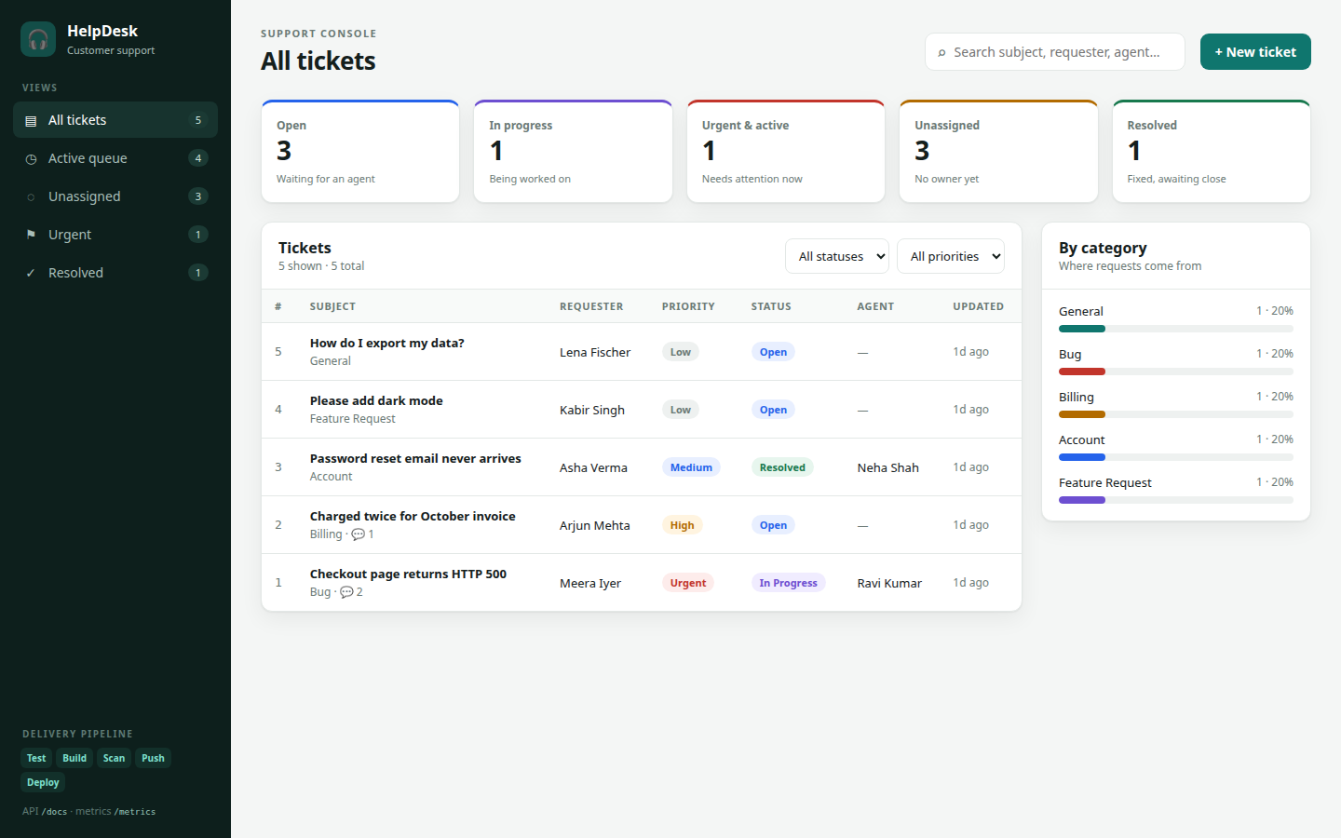
HelpDesk
A support-ticketing app, shipped with a complete DevOps pipeline on AWS
Prince Kumar
Session 21 · DevOps capstone · October 2026
Notes:
Part 1: Introduction. See presentation/SCRIPT.md.

Slide 2
What HelpDesk does
M1
1
Customers raise tickets
Bug, billing, account, feature request or general, with a priority
2
Agents work the queue
Reply to the customer, add internal notes, assign, resolve, close
3
Leads see the big picture
Live counts: open, in progress, urgent, unassigned, by category
Notes:
Part 1 (continued): what the app does.

Slide 3
Architecture
AR
Developer
git push to main
GitHub Actions
Test · Build · Trivy · Push · GitOps commit
GHCR
images tagged with the commit SHA
new image tag in Git → Argo CD syncs
AWS ap-south-1 · VPC, 2 public + 2 private subnets
EKS 1.34 · namespace helpdesk · synced by Argo CD
Terraform
VPC · subnets · NAT
EKS · node group
EBS CSI · metrics-server
GitHub OIDC role
AWS NLB
+ NGINX Ingress
Frontend ×2
React · Nginx
Prometheus → Grafana
ServiceMonitor scrape
Backend ×2–6
FastAPI · HPA
PostgreSQL
StatefulSet · 5 Gi EBS
Users → / and /api
Notes:
Part 2: Architecture.

Slide 4
Ten modules, one pipeline
ALL
M1
M2
M3
M4
M5
Application
Testing
Git & GitHub
Docker
CI/CD
React · FastAPI · Postgres · Alembic
pytest ×19 · ruff · SQLite test DB
public repo · clear commits
multi-stage · non-root · Compose
GitHub Actions · GHCR · SHA tags
M6
M7
M8
M9
M10
DevSecOps
Terraform
Kubernetes
Observability
Demo & docs
Trivy · fail on HIGH/CRITICAL
VPC · EKS · node group · OIDC
Helm · Argo CD · Ingress · HPA
Prometheus · Grafana dashboard
README · live commit → deploy
Notes:
Part 2 (continued): overview of the modules.

Slide 5
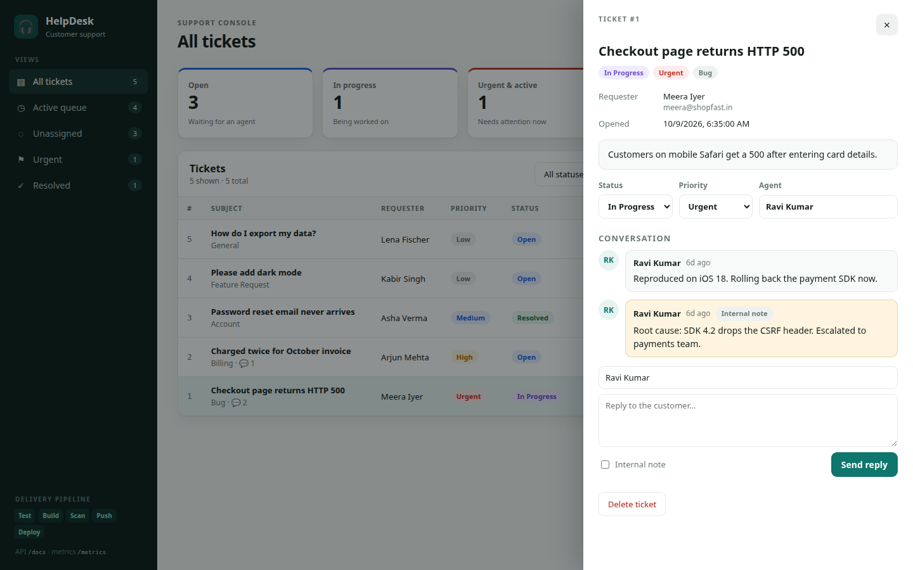
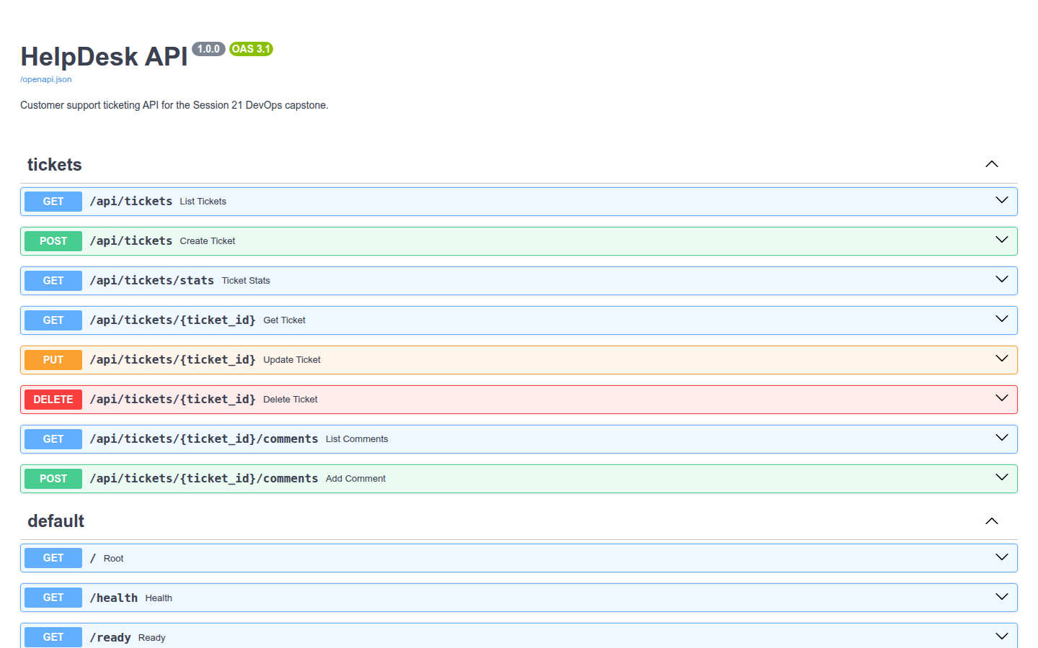
Application and REST API
M1
8
1
/health · /ready · /metrics
REST endpoints (CRUD + stats + comments)
table schema via Alembic migration
probes for Kubernetes and Prometheus
Notes:
Part 3: The application.

Slide 6
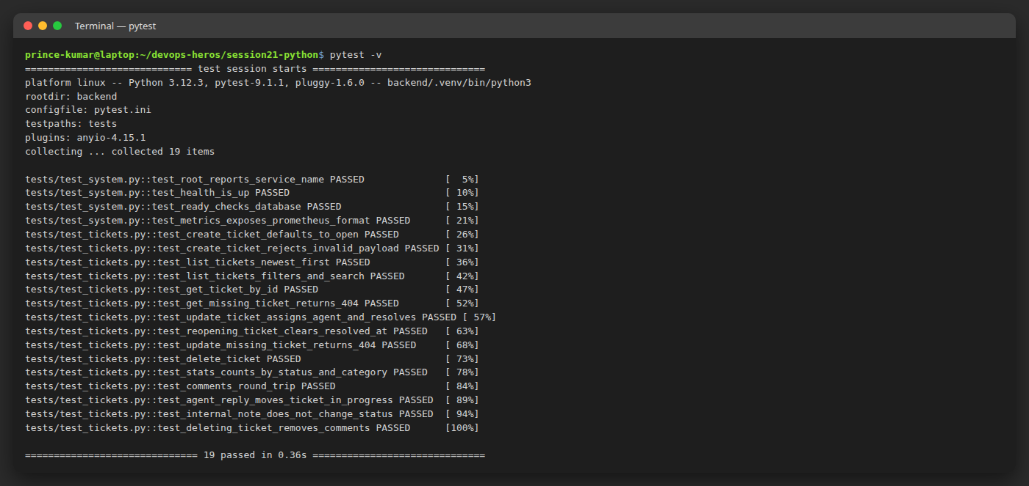
Testing and code quality
M2
19 / 19
pytest cases passing
SQLite
in-memory test DB per test (conftest.py)
ruff
lint gate before any build
Notes:
Part 4: Testing and code quality.

Slide 7
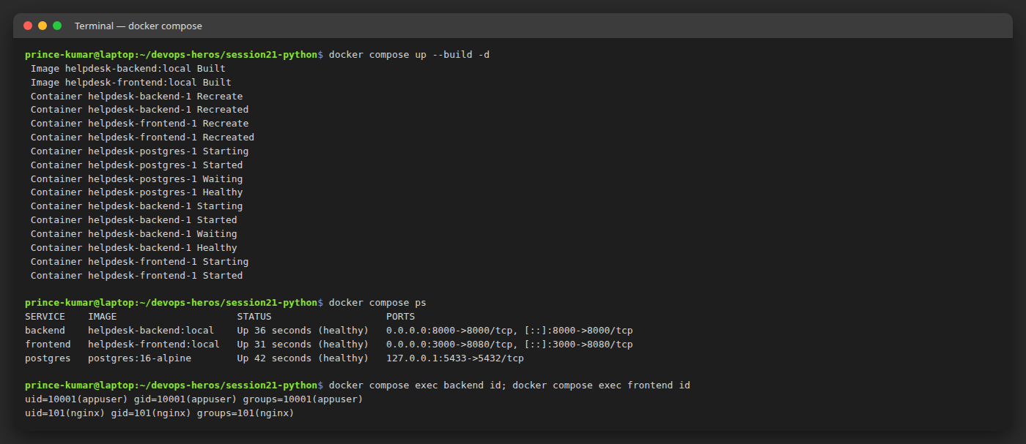
Docker and Compose
M4
Backend: 2-stage build; pip removed from the runtime image
Frontend: Node builds React, Nginx serves it
Non-root: backend uid 10001, frontend uid 101
One command starts frontend, backend and Postgres with health checks
Notes:
Part 5: Docker.

Slide 8
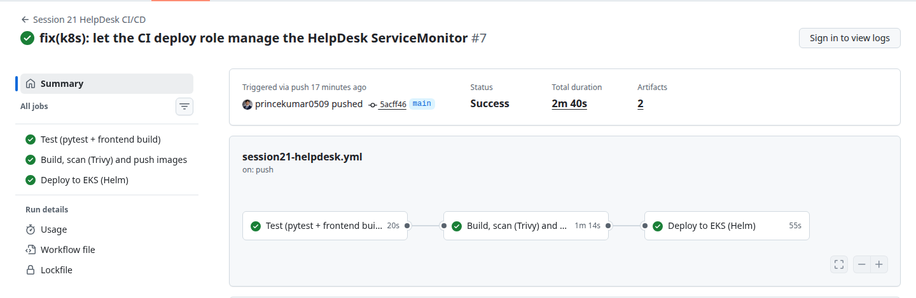
CI/CD with GitHub Actions
M5
1 · Test
ruff · pytest · npm build · helm lint
2 · Build, scan, push
Docker → Trivy → GHCR :sha
3 · GitOps deploy
commit new tag → Argo CD syncs EKS
Notes:
Part 6: CI/CD, the live change.

Slide 9
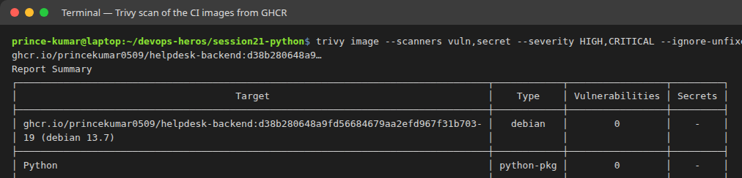
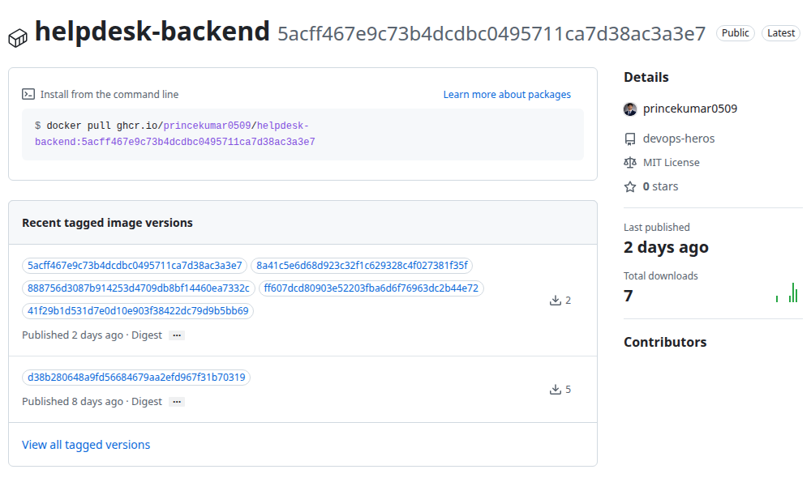
Security scan and registry
M6
0
fixable HIGH / CRITICAL CVEs in either image
exit 1
pipeline fails if Trivy finds any
:sha
every image tagged with its Git commit, never latest
Notes:
Part 7: Trivy and GHCR.

Slide 10
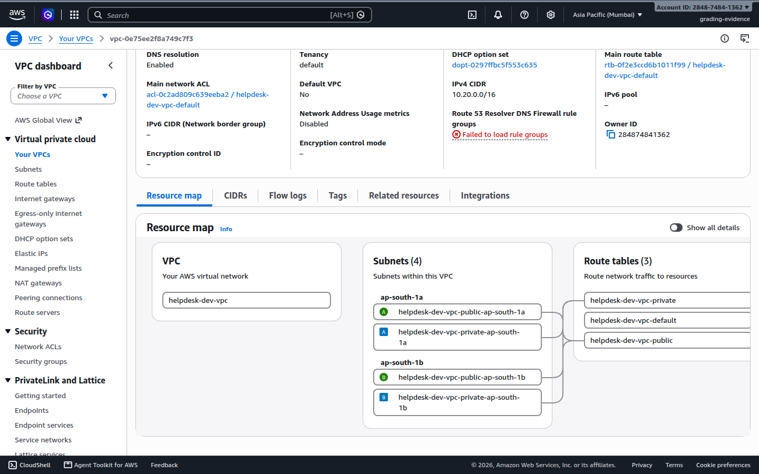
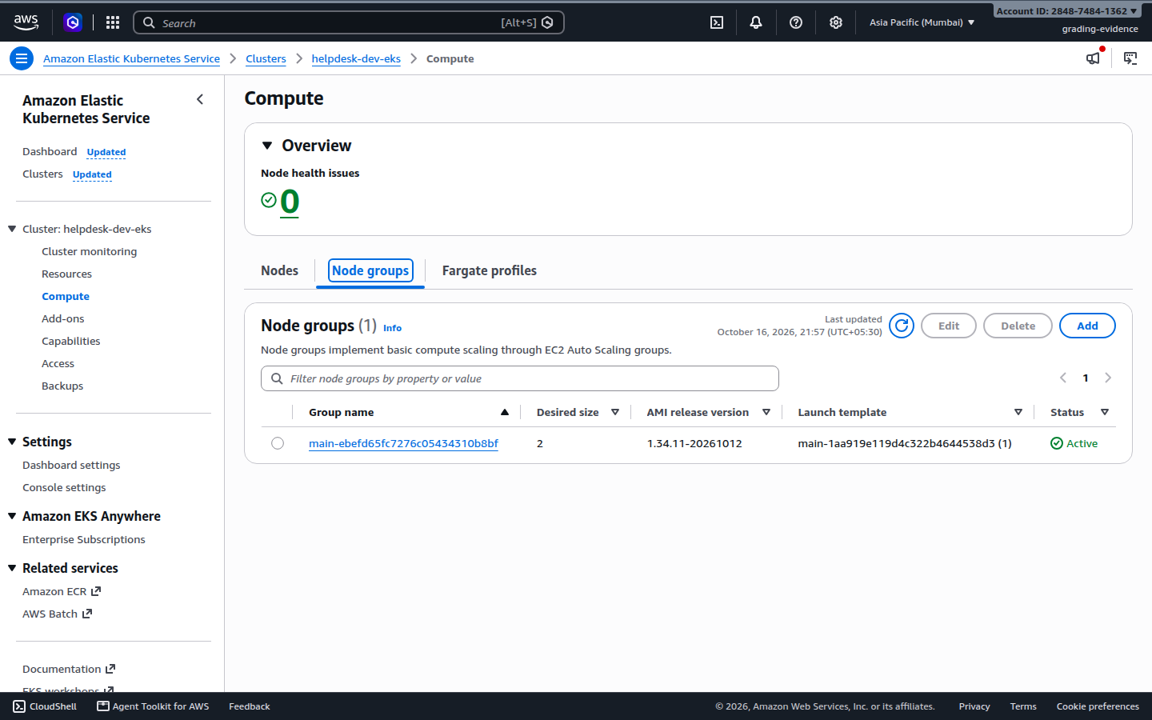
Terraform: VPC and EKS on AWS
M7
65
2 + 2
1.34
2 nodes
resources in one plan
public + private subnets, 2 AZs
EKS, Active
m7i-flex.large (free tier)
Notes:
Part 8: Terraform on AWS.

Slide 11
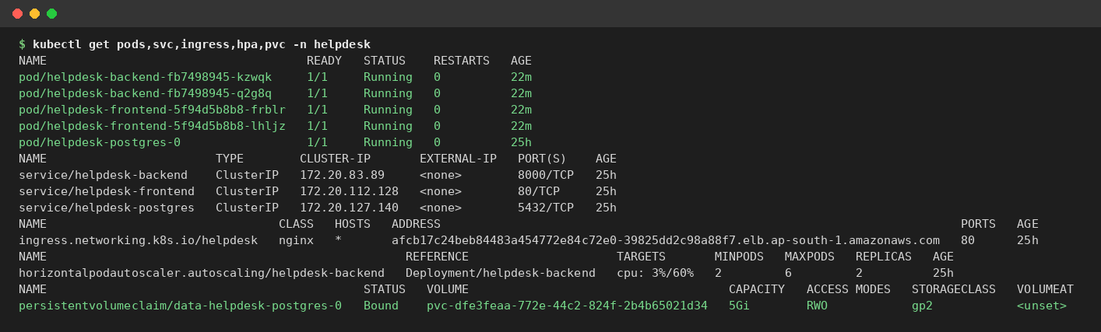
Kubernetes and Helm on EKS
M8
2 backend + 2 frontend pods, all Running; ClusterIP Services
Ingress: / → frontend, /api → backend, behind an AWS NLB
Postgres StatefulSet on a 5 Gi EBS volume
helm history: every release, one-command rollback
Notes:
Part 9: Kubernetes and Helm.

Slide 12
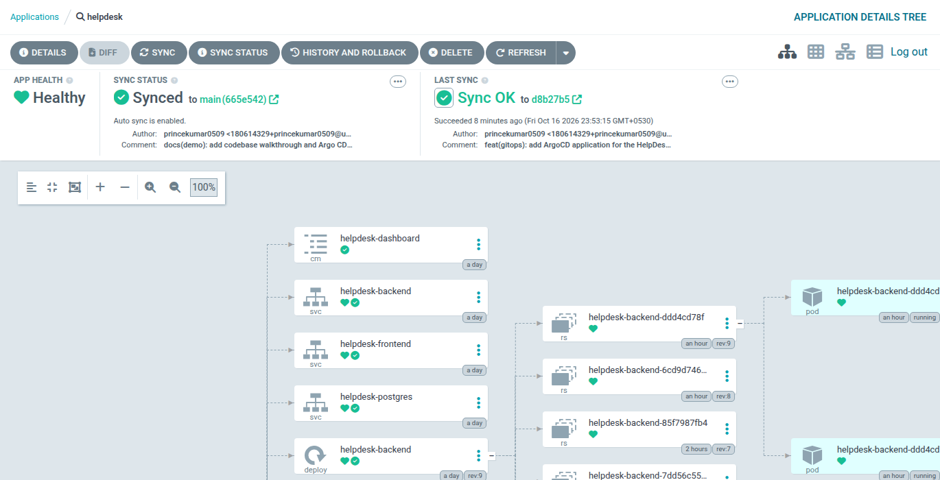
GitOps with Argo CD
M8
Git is the source of truth
Argo CD watches helm/helpdesk on main and keeps the cluster equal to it
CI only commits
after tests + Trivy, CI writes the new SHA to values-image.yaml
Auto-sync + self-heal
manual cluster edits are reverted; rollback = git revert
Notes:
Part 8b: GitOps with Argo CD.

Slide 13
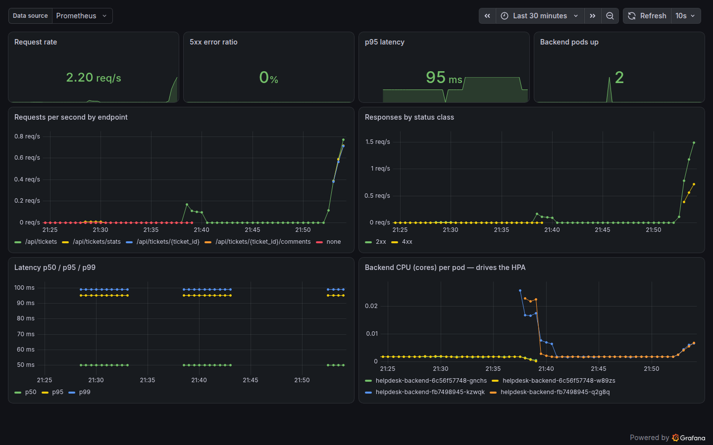
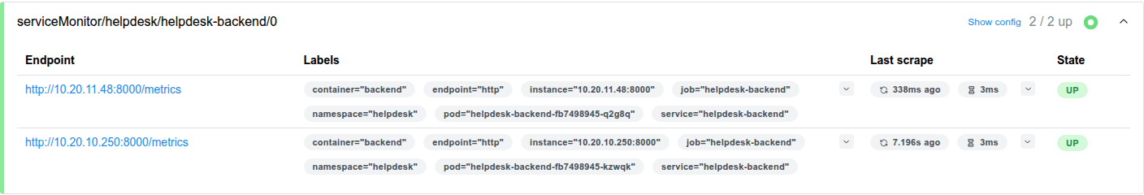
Autoscaling and monitoring
M9
2 / 2
2 → 6
Prometheus targets UP
backend pods via HPA at 60% CPU
0 %
95 ms
5xx error ratio
p95 latency under load
Notes:
Part 10: Autoscaling and monitoring.

Slide 14
Real problems I solved
!
1
AWS account never activated
2
Free plan blocked t3.medium
Health showed "customer verification failed". Opened a new account and verified it properly.
EC2 only allows free-tier types → nodes moved to m7i-flex.large (8 GiB).
3
CI could not assume AWS role
4
Helm denied the ServiceMonitor
GitHub sends an immutable OIDC subject → trust policy accepts it, set in Terraform.
EKS namespace-admin skips CRDs → small RBAC Role, still least privilege.
Notes:
Part 11: Challenges and what I learned.

Slide 15
Thank you
Commit → test → scan → registry → EKS, fully automated and reproducible from code
Code & docs
github.com/princekumar0509/Helpdesk
Evidence
evidence/ folder: screenshots for every module
After grading
helm uninstall + terraform destroy, so no AWS cost is left running
Notes:
Part 12: Cleanup and thank you.

