Slide 1

School of Computing Science and Engineering
Course Code : E1PA106R-PR Course Name: STUDENT GRADE PREDICTION SYSTEM
Program: MCA (2nd)
Course Code: E1PA106R-PR
Course Name: STUDENT GRADE PREDICTION SYSTEM
Name of the Faculty: Dr. Program Name: M.C.A

Slide 2
Content
• Objective.
• System Architecture
• Student Grade Prediction System Process
• Dataset and Preproccessing
• Machine Learning Model
• Implementation
• User Interface
• Result and Predictions
• Conclusion
• Advantage
• Screenshort
• Recommended Books & References
Program Name: M.C.A

Slide 3
UNIT-1
Objective
• Identify and predict student grades based on performance data.
• Use machine learning to provide insights and improve academic support.
• Focus on regression-based predictions to guide student progress.
Program Name: M.C.A

Slide 4
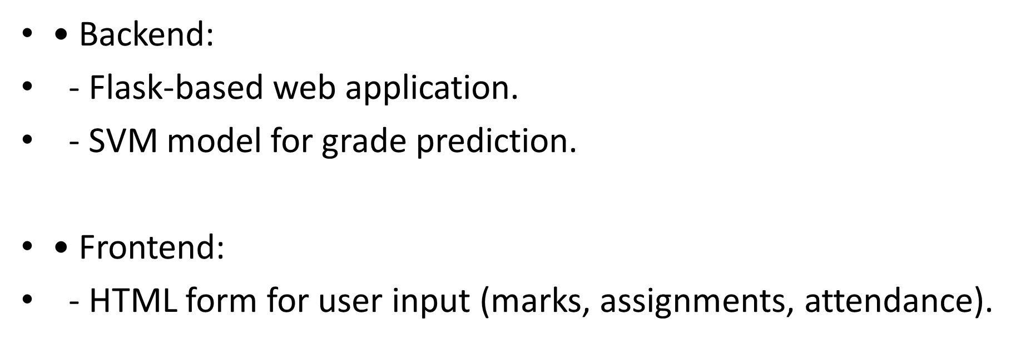
System Architecture
UNIT 2
Program Name: M.C.A

Slide 5
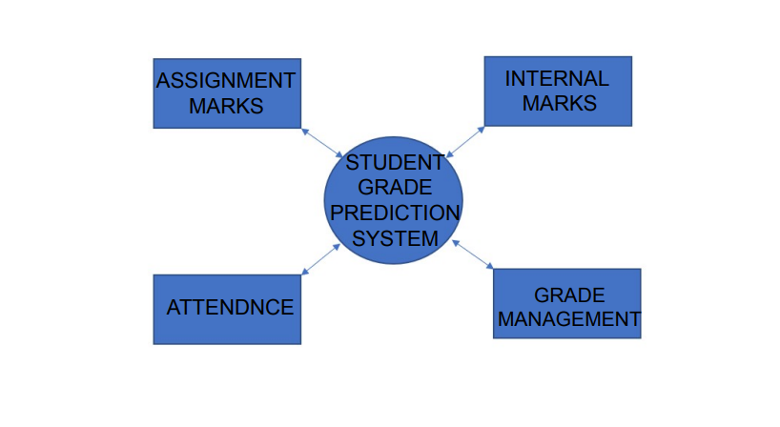
Student Grade Prediction System process
Program Name: M.C.A

Slide 6
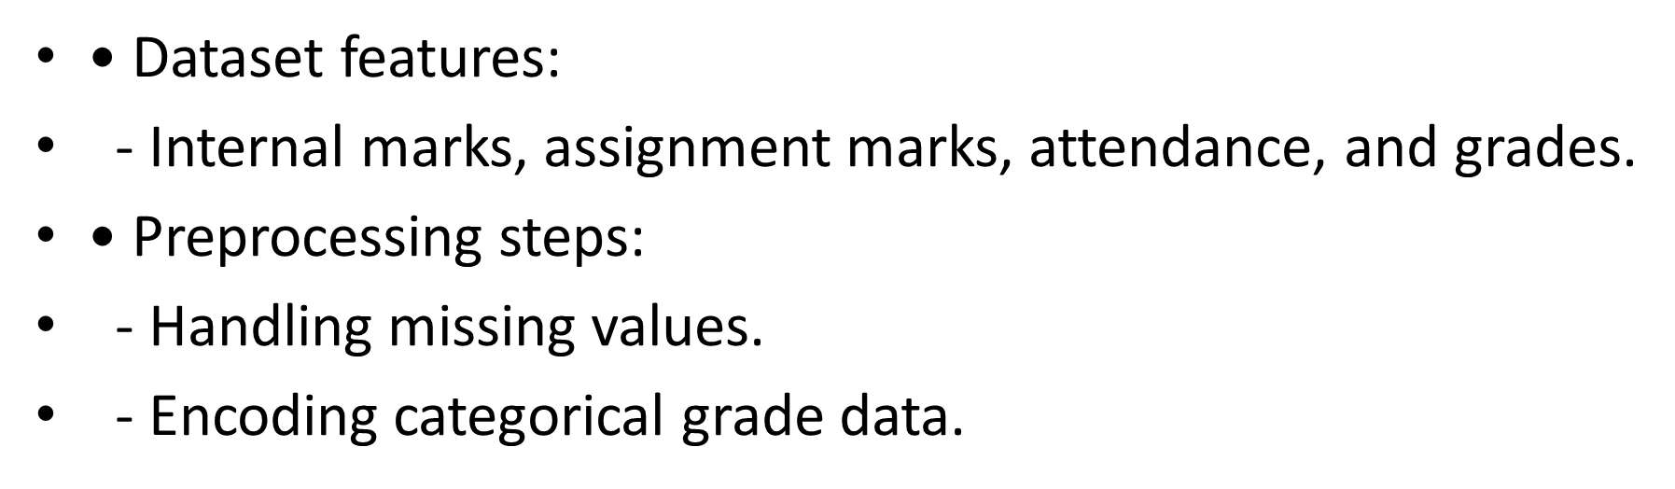
UNIT-3
Dataset and Preprocessing
Program Name: M.C.A

Slide 7
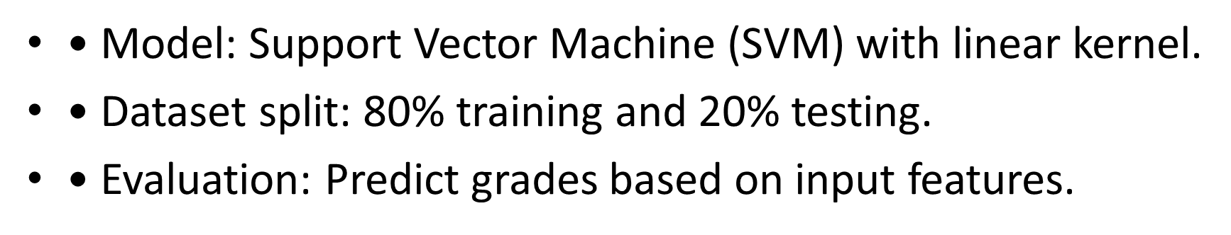
UNIT-4
Machine Learning Model
Program Name: M.C.A

Slide 8

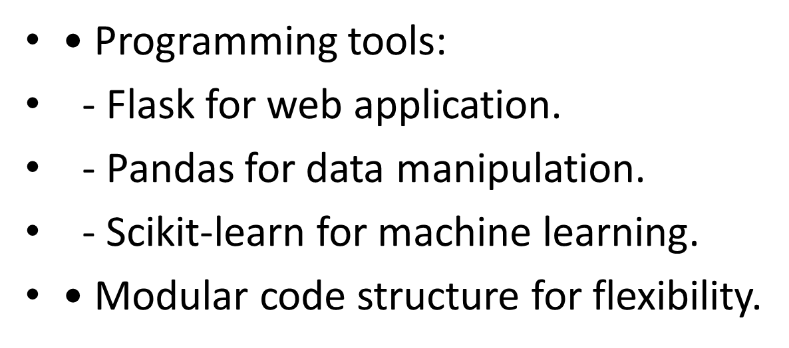
UNIT-5
Program Name: M.C.A

Slide 9

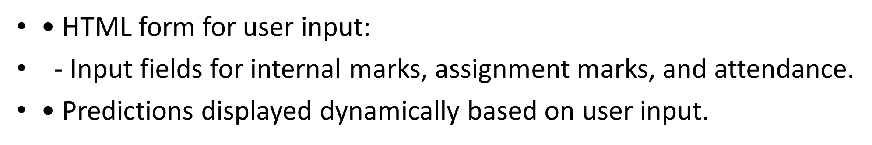
UNIT-6
Program Name: M.C.A

Slide 10

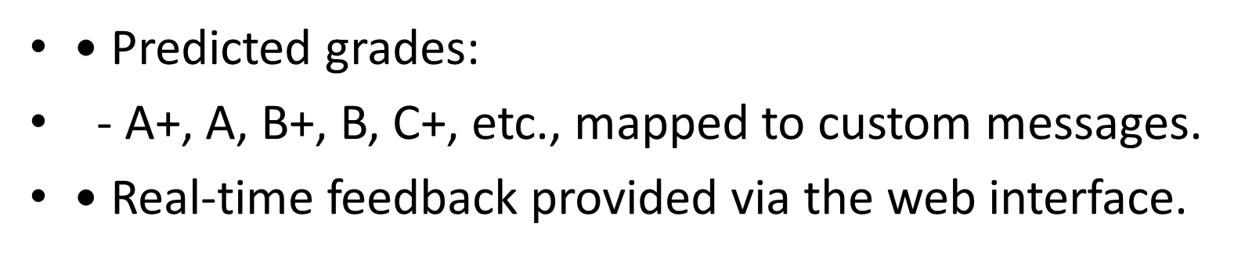
UNIT-7
Program Name: M.C.A

Slide 11

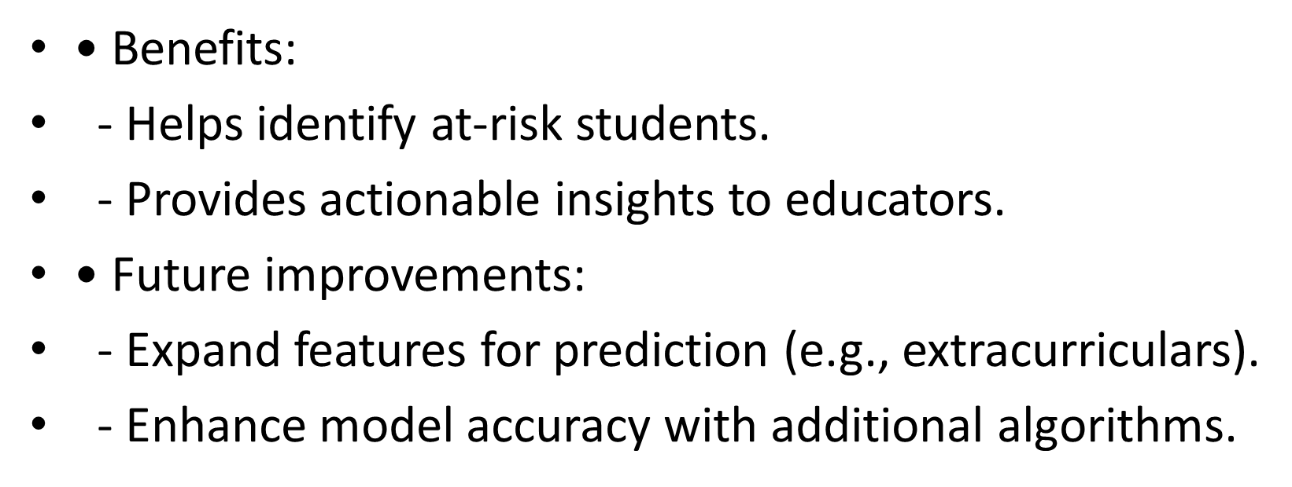
UNIT-8
Program Name: M.C.A

Slide 12
Advantages
Media convergence has proved to be beneficial in the digital era which is filled with content seeking our attention continuously. Here are the most important advantages of Media Convergence:
The instant availability of news and moment-based content is one of the top advantages of media convergence between traditional media and new media.
The content producers can specifically target the best audience or group they are aiming towards by publishing customized content.
With media convergence, the audience has also become the creator themselves. From memes to social media posts, media convergence has truly been beneficial to integrate audience on a global level.
Another important benefit of media convergence that it has broadened the limitations of traditional media by blending it with new media, thus providing instant and latest content on an international level.
With the media convergence between traditional media and new media, the cost of digital marketing has also become economical thus making this process beneficial and affordable.
Program Name: M.C.A

Slide 13
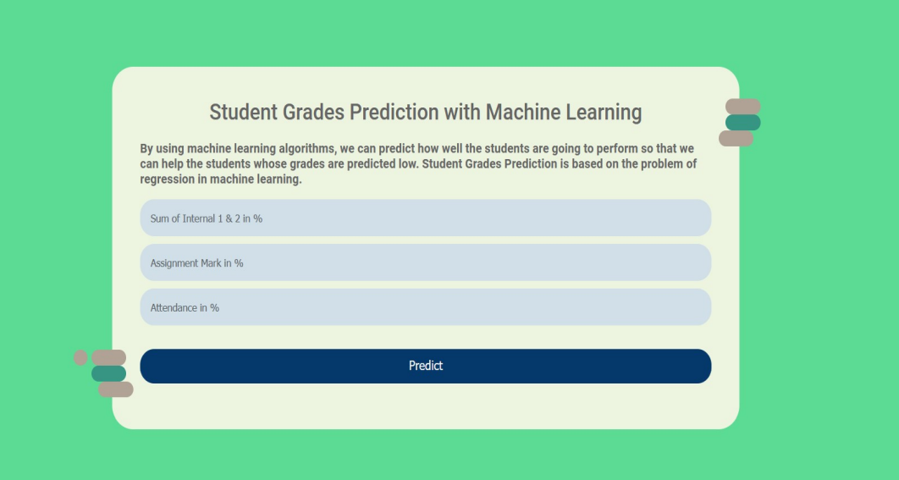
SCREENSHORT
Program Name: M.C.A

Slide 14
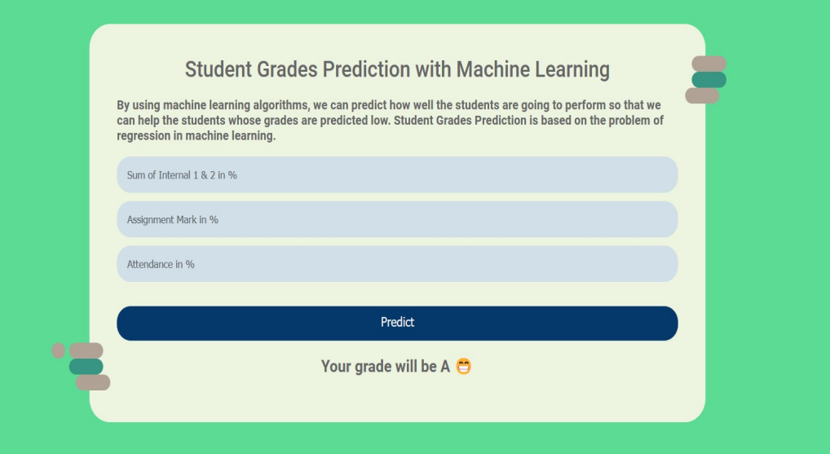
SCREENSHORT
Program Name: M.C.A

Slide 15
Recommended Books & References
Text books:
V. John, N. M. Karunakaran, C. Guo, K. Kidono and S. Mita, "Free Space, Visible and Missing Lane Marker Estimation using the PSINet and Extra Trees Regression," 2018 24th International Conference on Pattern Recognition (ICPR), Beijing, 2018, pp. 189-194, DOI: 10.1109/ICPR.2018.8546108.
2. B. V. Mbuwir, F. Spiessens, and G. Deconinck, "Benchmarking regression methods for function approximation in reinforcement learning: heat pump control," 2019 IEEE PES Innovative Smart Grid Technologies Europe (ISGT-Europe), Bucharest, Romania, 2019, pp. 1-5, DOI: 10.1109/ISGTEurope.2019.8905533.
3. S. S. Arun and G. Neelakanta Iyer, "On the Analysis of COVID19 - Novel Corona Viral Disease Pandemic Spread Data Using Machine Learning Techniques," 2020 4th International Conference on Intelligent Computing and Control Systems (ICICCS), Madurai, In- dia, 2020, pp. 1222-1227, DOI: 10.1109/ICICCS48265.2020.9121027.
Reference Book
Pedregosa, F., et al. (2011). Scikit-learn: Machine Learning in Python.
2. Breiman, L. (2001). Random Forests. Machine Learning Journal.
Program Name: M.C.A

Slide 16


