Slide 1

2-DOF Planar Robotic Arm
Dr B R Ambedkar National Institute of Technology Jalandhar
Department of Mechanical Engineering
Major Project Presentation
Supervisor Evaluation
Project Title:
Group Members:
Supervisor:
Amana Fatima SN 23109011
Dirgha Gupta 23109035
Madhav Kumar 23109064
Prince Kumar 23109079
Tikhade Khushi Anil 23109104
[Prof. Joseph Anand Vaz
Notes:
Presenter 1. Welcome, introduce the group and supervisor, state the project title. Replace the bracketed names before presenting.

Slide 2
Agenda
Presenter 1
Five parts, five presenters
1
Introduction, problem & mechanical design
Slides 1–4
2
Motion, forward kinematics & workspace
Slides 5–7
3
Trajectory planning & inverse kinematics
Slides 8–9
4
Control system & firmware algorithm
Slides 10–12
5
Hardware, plan, applications & conclusion
Slides 13–17
Notes:
[Presenter 1] Here is how our presentation is organised. I will cover the introduction, the problem statement and the mechanical design in slides one to four. My second teammate will explain the controllable parameters, forward kinematics and the workspace. The third will explain trajectory planning and inverse kinematics. The fourth will cover the control system and the firmware algorithm. And the last presenter will close with hardware, the implementation plan, applications, conclusion and future scope, followed by questions.

Slide 3

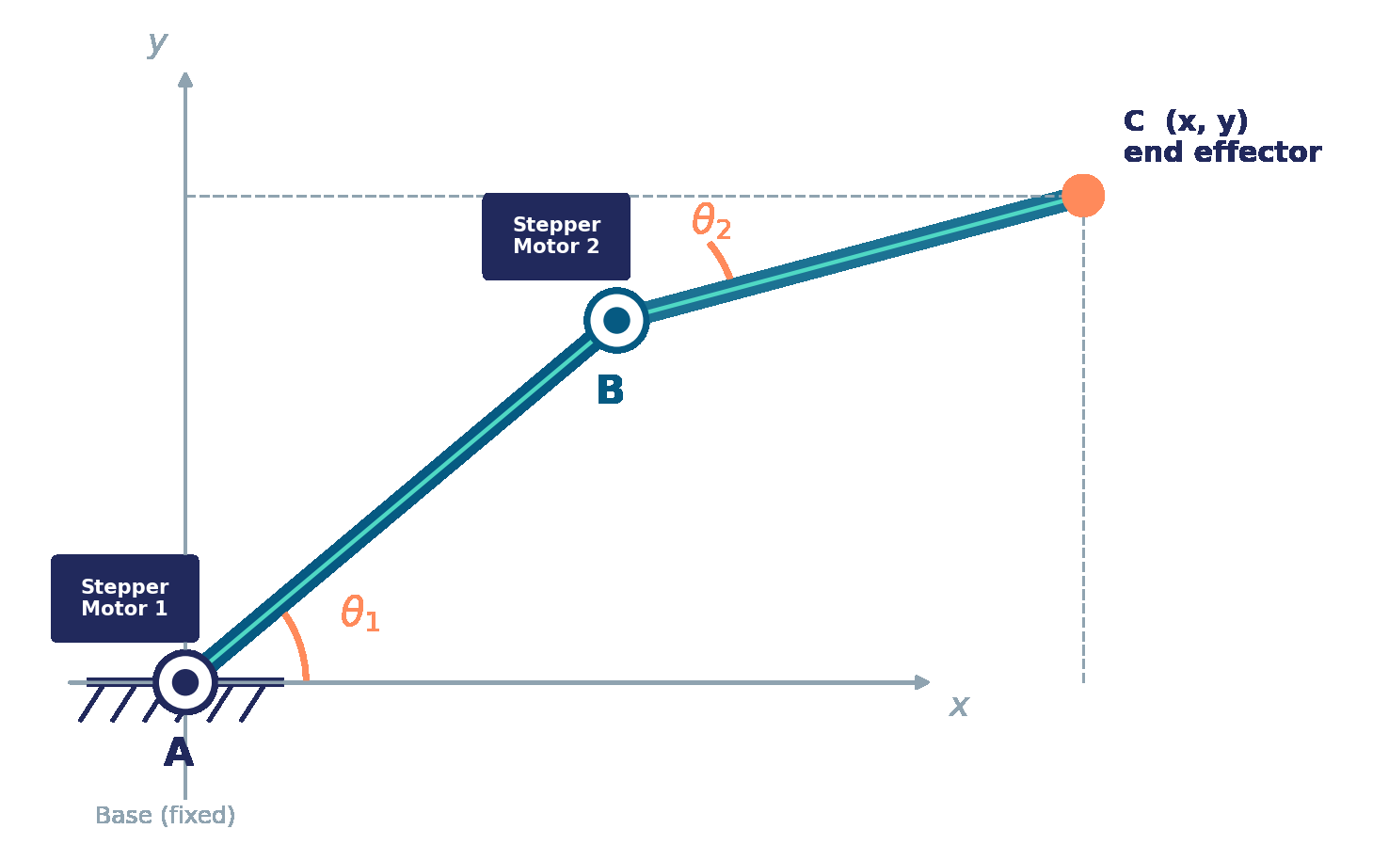


Introduction
A two-link, two-joint planar arm whose end-effector (C) is commanded to follow a path
Link AB
Rotates about fixed joint A (Motor 1 at centre).
Link BC
Rotates about moving joint B (Motor 2 at centre).
Joint A
Fixed base joint; sets arm orientation, angle θ₁.
Joint B
Elbow joint; sets relative bend of link 2, angle θ₂.
Point C
Two-link planar arm: base A, elbow B, end-effector C
End-effector; its (x, y) position is what we control.
Notes:
Presenter 1. Explain the arm: link AB turns about base joint A (Motor 1), link BC turns about elbow B (Motor 2). The end-effector position (x, y) at C is what we ultimately control.

Slide 4

Introduction (contd.)
Motion allowed, controllable parameters and forward kinematics
Motion allowed
Forward kinematics
AB
BC
x = L₁ cos θ₁ + L₂ cos(θ₁ + θ₂)
Circular motion with A as the fixed centre of rotation
Circular motion with B as the (moving) centre of rotation
y = L₁ sin θ₁ + L₂ sin(θ₁ + θ₂)
We can independently control
L₁, L₂: lengths of links AB and BC
θ₁: angle of AB from the base x-axis (Motor 1)
θ₂: angle of BC relative to AB (Motor 2)
A
Direction of rotation
A
Angle of rotation (θ₁)
Predicts exactly where C lands for any commanded pair (θ₁, θ₂).
B
Direction of rotation
B
Angle of rotation (θ₂)
Combined movement: coordinated direction and angle changes at A and B shift C to C′; repeated over waypoints, the same four controls trace a continuous trajectory.
Notes:
Presenter 1. Each link moves on a circle. Direction and angle at A and B are the four controls. Forward kinematics gives (x, y) for any (theta1, theta2).

Slide 5
Literature Survey
(1/3) Foundations: manipulator kinematics, workspace and trajectory generation
J. J. Craig (2005)
Joint space
(θ₁, θ₂)
[1]
Introduction to Robotics: Mechanics and Control
Standard treatment of manipulator kinematics, workspace and trajectory generation.
Forward
M. W. Spong et al. (2006)
Inverse
[2]
Robot Modeling and Control
Forward and inverse kinematics with control of robot manipulators.
Cartesian space
(x, y)
B. Siciliano et al. (2009)
A 2R planar arm has a closed-form inverse solution with two branches (elbow-up / elbow-down).
[3]
Robotics: Modelling, Planning and Control
Kinematics, motion planning and control within one framework.
Notes:
Presenter 2. Standard robotics textbooks [1]-[3] give the kinematic framework we use: forward kinematics, closed-form inverse kinematics for a 2R arm, workspace limits and trajectory generation.

Slide 6

Literature Survey
(2/3) Inverse kinematics and trajectory tracking approaches
Reference | Approach | Robot / validation | Observation
[4] Duka, 2014 | Feed-forward neural network learns the inverse mapping for a circular trajectory | 3-link planar arm; MATLAB model | Simulation only; use on a real manipulator left as future work
[5] Ata & Myo, 2005 | Genetic algorithm + pattern search minimise tracking error on line and circle paths | 3-DOF planar redundant arm; MATLAB simulation | Analytical IK used only as a reference; no hardware
[1]-[3] Textbooks | Closed-form geometric IK solved at every waypoint | General serial manipulators (2R is a special case) | Exact and light to compute; two elbow solutions
Observation: advanced solvers are demonstrated on redundant three-link arms in simulation [4], [5]. For a two-link arm, closed-form IK is sufficient and can be validated directly on hardware.
Notes:
Presenter 2. Published work solves IK with neural networks [4] or genetic algorithm plus pattern search [5] on three-link arms, validated in MATLAB. For a 2-link arm, the closed-form solution from the textbooks is enough.

Slide 7


Literature Survey
(3/3) Stepper actuation: open-loop versus encoder-based closed-loop control
Open-loop (motor only)
Closed-loop (with encoders)
Encoder feedback loop [6]
The encoder samples rotor position, so lost steps are detected and compensated.
Commanded steps assumed = actual steps
Encoder reports the true joint angle
Controller
Driver + Stepper
No knowledge of true joint angle
Controller compares actual vs desired θ
Errors accumulate silently over a path
Error corrected before the next waypoint
Compare
actual vs desired
Encoder
Cheaper and simpler, but drift-prone
Accurate, repeatable trajectory tracking
Notes:
Presenter 2. Open-loop steppers assume every pulse is a step; missed steps go unnoticed. An encoder reports the true angle so the controller can correct before the next waypoint [6].

Slide 8



Research Gaps and Problem Formulation
What the literature leaves open, and the problem this project addresses
Research gaps
Problem formulation
Simulation-only validation
IK and trajectory-tracking studies [4], [5] are validated in MATLAB; hardware realisation is left open.
Make a 2-link, 2-DOF planar arm follow a pre-defined (x, y) path accurately and repeatably.
Heavy solvers for simple geometry
Given
Neural and evolutionary solvers target redundant arms; a 2-link arm has a closed-form solution that suits a microcontroller.
L₁, L₂ and a path of (x, y) waypoints
Find
(θ₁, θ₂) at every waypoint
Open-loop steppers drift
Missed steps accumulate silently along a path unless encoder feedback closes the loop [6].
Subject to
R_{min} ≤ √(x² + y²) ≤ R_{max}
Notes:
Presenter 3. Three gaps: validation mostly in simulation, heavy solvers where closed form suffices, and open-loop stepper drift. Our problem: follow a (x, y) path accurately with closed-form IK and encoder feedback.

Slide 9
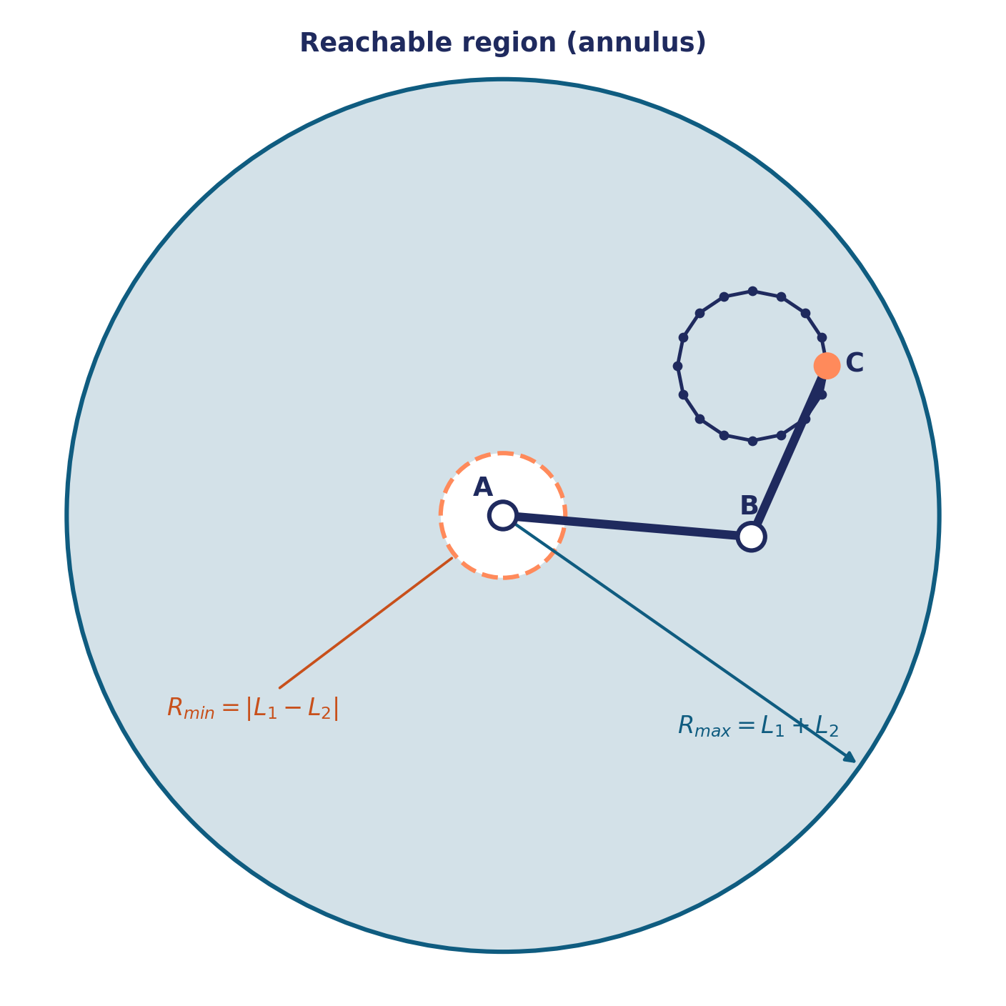
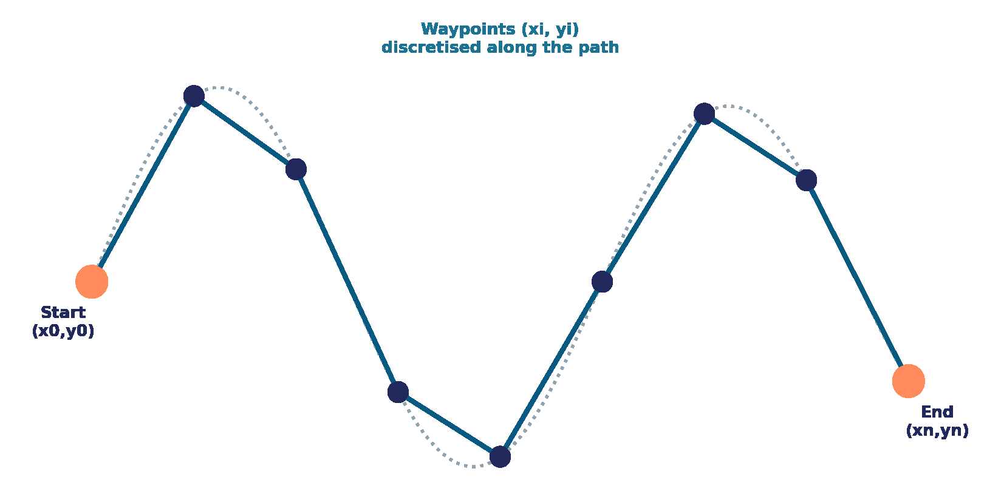
Research Gaps and Problem Formulation (contd.)
Workspace and trajectory: where the end-effector can go, and the path it follows
Path = {(x₁,y₁), …, (xₙ,yₙ)}
Waypoints must lie inside the annulus
IK is solved for each waypoint in turn
Finer spacing gives a smoother trace
Notes:
Presenter 3. Reachable region is an annulus: Rmax = L1 + L2, Rmin = |L1 - L2|. The chart shows the annulus area 4*pi*L1*L2 for L1 + L2 = 35 cm: it is largest when links are equal. Values are illustrative.

Slide 10
Research Gaps and Problem Formulation (contd.)
Inverse kinematics: from a target (x, y) to joint angles (θ₁, θ₂)
1
Elbow angle
cos θ₂ = (x² + y² − L₁² − L₂²) / (2 L₁ L₂)
Two solutions exist: elbow-up and elbow-down.
2
Shoulder angle
θ₁ = atan2(y, x) − atan2(L₂ sin θ₂, L₁ + L₂ cos θ₂)
θ₁ follows once θ₂ is fixed.
3
Reachability check
R_{min} ≤ √(x² + y²) ≤ R_{max}
Reject or clamp targets outside the annulus.
L₁ = 20 cm, L₂ = 15 cm; circle radius 6 cm centred at (20, 12). Computed from the equations on this slide.
Notes:
Presenter 3. Solve theta2 first (two branches), then theta1, after a reachability check. The chart is an illustrative run of these equations on a circular path (L1 = 20 cm, L2 = 15 cm, radius 6 cm centred at (20, 12)), using the sin(theta2) > 0 branch.

Slide 11

Project Objectives
One aim, four objectives
AIM
Design and implement a 2-link, 2-DOF planar robotic arm whose end-effector follows a pre-defined trajectory of (x, y) coordinates with accuracy and repeatability.
Objective 1
Objective 2
Objective 3
Objective 4
Define the workspace
Independent joint actuation
Closed-loop correction
Path following
Determine the full set of reachable (x, y) points for a given pair of link lengths.
Drive each joint with a dedicated stepper motor for precise angular control.
Use a rotary encoder on each joint to correct step loss and drift.
Convert a Cartesian path into joint angles (IK) and drive the arm smoothly along it.
Notes:
Presenter 4. State the aim, then the four objectives: workspace, independent stepper actuation, encoder-based closed loop, and IK-based path following.

Slide 12
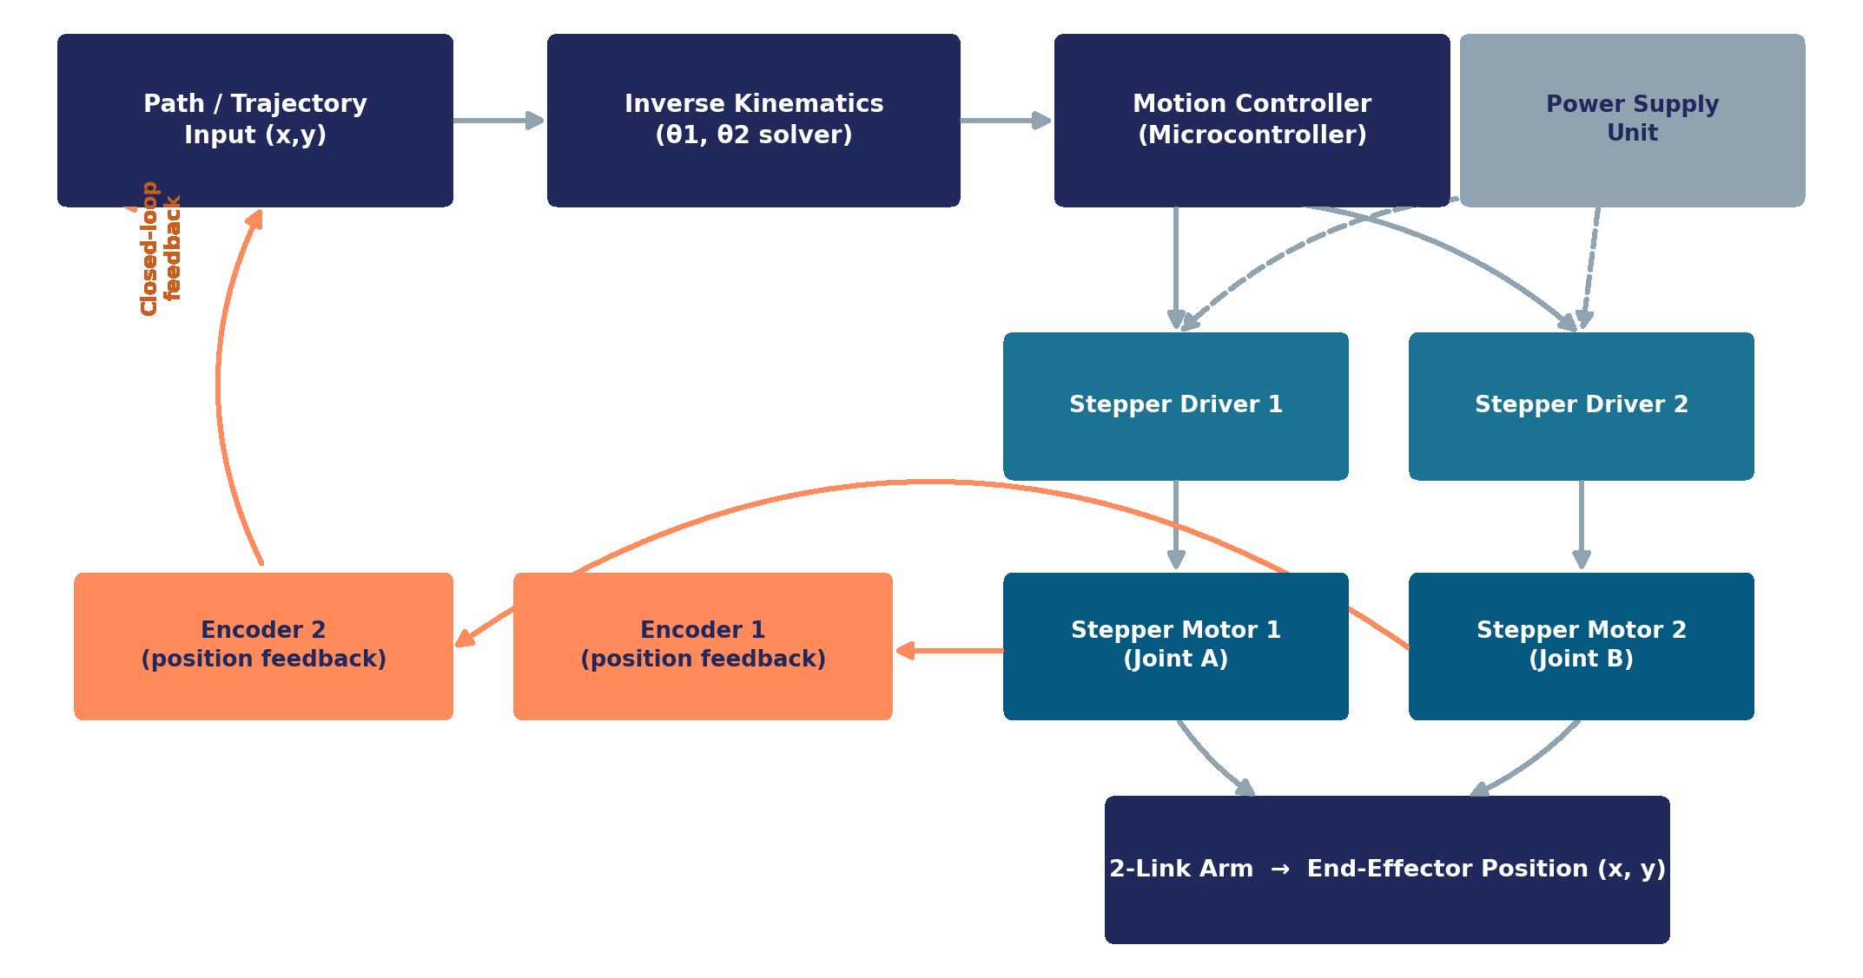

Project Objectives (contd.)
Proposed system architecture
Plan
The Cartesian path is converted to joint angles by the IK solver.
Drive
The controller sends step and direction signals to two stepper drivers.
Correct
Encoders on each joint feed the actual angle back to the controller.
Notes:
Presenter 4. Path goes to the IK solver, then to the motion controller, then to two stepper drivers and motors. Encoders on each joint feed the actual angle back to close the loop.

Slide 13
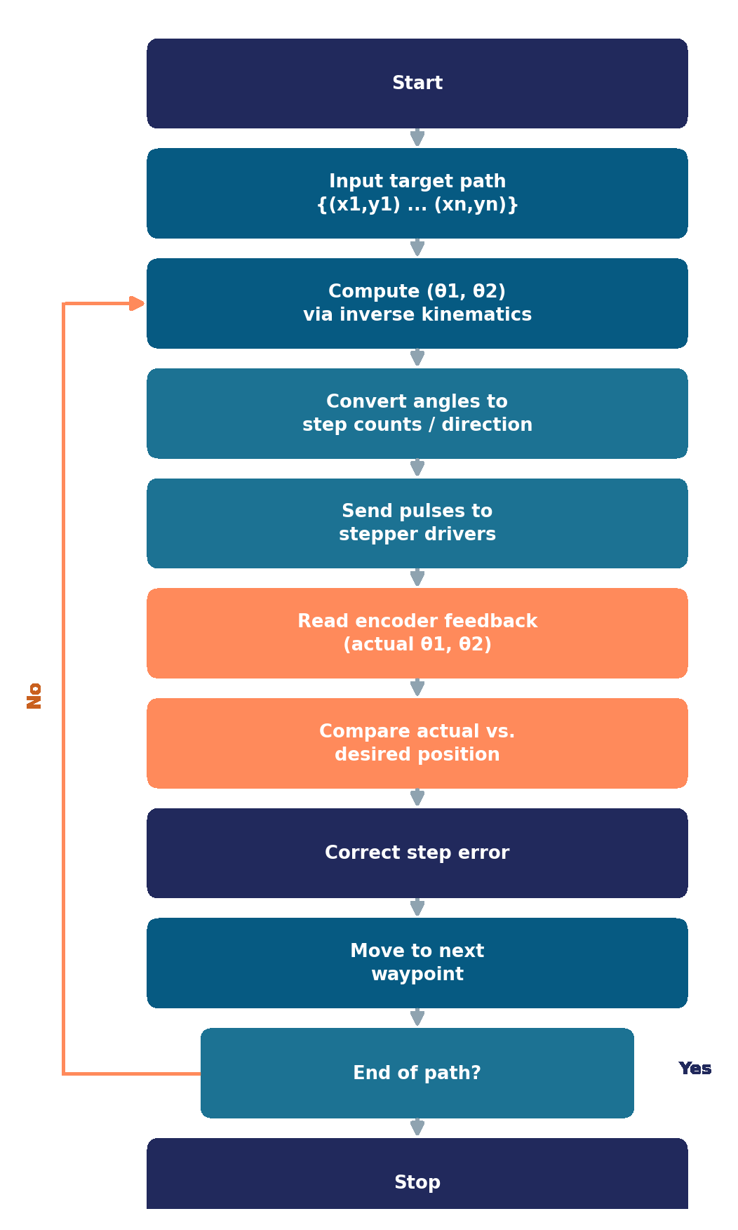
Project Objectives (contd.)
Firmware control algorithm
1
Load the target trajectory as an ordered list of (x, y) points.
2
Inverse kinematics converts each point into a joint-angle pair.
3
Angles are translated into step counts and rotation direction for each driver.
4
After each move, encoders confirm the joints reached the commanded angles.
5
Any discrepancy is corrected before advancing to the next waypoint.
Notes:
Presenter 4. Load the path, solve IK for each point, convert angles to step counts and direction, check with encoders after every move, correct any discrepancy before advancing.

Slide 14
Project Objectives (contd.)
Hardware: bill of materials
Component | Qty | Role in the system
Microcontroller (Arduino / ESP32) | 1 | Runs trajectory logic, inverse kinematics & motor commands
Stepper motors (NEMA-17 or similar) | 2 | Actuate joint A and joint B
Stepper drivers (A4988 / DRV8825) | 2 | Convert step/direction signals into motor phase currents
Rotary encoders | 2 | Measure actual joint angles for closed-loop feedback
Link members (AB, BC) | 2 | Rigid arm segments, aluminium or 3D-printed
Base frame & bearings | 1 set | Mounts joint A, supports structural loads
Power supply unit | 1 | Delivers regulated power to motors & controller
2
Stepper motors
2
Stepper drivers
2
Rotary encoders
Notes:
Presenter 5. Microcontroller, two NEMA-17 class steppers with two drivers, two encoders, links, base with bearings, and a power supply.

Slide 15



Project Objectives (contd.)
Implementation plan in six stages
1
2
3
Mechanical Design
Kinematic Modelling
Electronics & Wiring
Model links, joints & base; select link lengths for the target workspace.
Derive & simulate forward / inverse kinematics; validate reachable area.
Wire stepper drivers, motors, encoders and power supply to the controller.
4
5
6
Firmware Development
Feedback Integration
Trajectory Testing
Implement IK solver, step/direction generation and waypoint sequencing.
Read encoders, close the control loop, calibrate zero positions.
Run test paths, measure tracking error, tune and finalise the system.
Notes:
Presenter 5. Mechanical design, kinematic modelling, electronics, firmware, feedback integration, then trajectory testing and tuning.

Slide 16


Conclusions
What the design achieves, and where it goes next
A 2-link, 2-DOF arm gives a well-defined, calculable workspace from just two link lengths.
Future scope
Add a 3rd joint / gripper for full pick-and-place capability
Independent stepper control at A and B, guided by forward and inverse kinematics, is sufficient to place the end-effector anywhere inside that workspace.
Introduce PID tuning on the feedback loop for faster, smoother correction
Add vision-based feedback for closed-loop position verification
Enable wireless (Bluetooth / Wi-Fi) trajectory upload and control
Encoders close the loop, turning an open-loop stepper system into an accurate trajectory-tracking one.
Optimise link lengths and motor sizing for higher payload capacity
Notes:
Presenter 5. Three conclusions, then future scope: third joint or gripper, PID tuning, vision feedback, wireless upload, and optimising link lengths and motors.

Slide 17






Conclusions (contd.)
Applications of the 2-DOF trajectory-controlled arm
Pick & Place Automation
2D Plotting / Drawing
Educational Robotics
Moving small parts between fixed points on an assembly line.
Tracing shapes, text or CNC-style patterns on a flat surface.
Teaching kinematics, control loops and embedded motor control.
Prototype for Prosthetics
Lab & Assembly Fixtures
Research on Path Tracking
Testbed for lightweight, precisely controlled limb segments.
Repeatable low-cost positioning for inspection or dispensing.
Platform for testing trajectory & control algorithms cheaply.
Notes:
Presenter 5. Pick and place, plotting, education, prosthetics prototype, lab fixtures and path-tracking research.

Slide 18
References
IEEE style
[1]
J. J. Craig, Introduction to Robotics: Mechanics and Control, 3rd ed. Upper Saddle River, NJ, USA: Pearson Prentice Hall, 2005.
[2]
M. W. Spong, S. Hutchinson, and M. Vidyasagar, Robot Modeling and Control. Hoboken, NJ, USA: Wiley, 2006.
[3]
B. Siciliano, L. Sciavicco, L. Villani, and G. Oriolo, Robotics: Modelling, Planning and Control. London, U.K.: Springer, 2009.
[4]
A.-V. Duka, “Neural network based inverse kinematics solution for trajectory tracking of a robotic arm,” Procedia Technol., vol. 12, pp. 20–27, 2014, doi: 10.1016/j.protcy.2013.12.451.
[5]
A. A. Ata and T. R. Myo, “Optimal point-to-point trajectory tracking of redundant manipulators using generalized pattern search,” Int. J. Adv. Robot. Syst., vol. 2, no. 3, pp. 239–244, 2005.
[6]
Analog Devices, “TMC4361A closed-loop motor control for stepper motor drivers,” Application Note AN-032. [Online]. Available: https://www.analog.com/en/resources/app-notes/an-032.html. Accessed: Oct. 5, 2026.
Notes:
Presenter 5. References are in IEEE format. Cited on slides 5-8.

