Slide 1

Title: School Buddy Case Study Analysis
Subtitle: Performance Analysis of Schools (2019-2021) name=prince

Slide 2
Introduction
Objective of the Analysis:
Identify Top Performers: Recognize the best students based on cumulative marks.
Rank Students: Compare 2020’s top 10 students’ marks across schools.
Analyze Improvements: Find students with the highest subject improvement from 2019 to 2021.
Determine Best Schools: Identify top schools for Arts, Science, and Commerce streams.
Analyze Performance Categories: Categorize students by performance and determine the best
schools based on these categories.

Slide 3
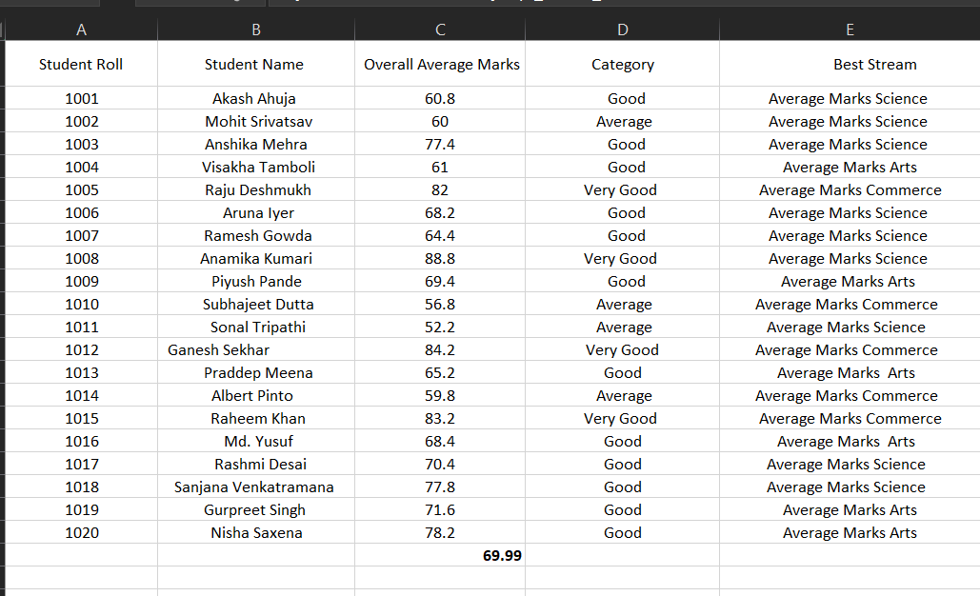
DATA sample OF VIDYA MANDIR 2019

Slide 4
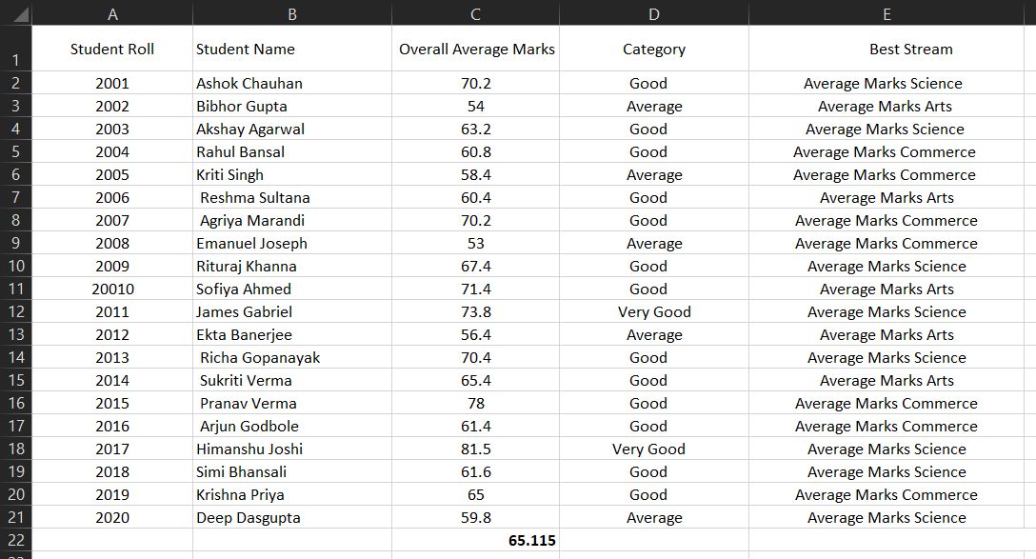
DATA sample OF ST JOSEPH 2019

Slide 5
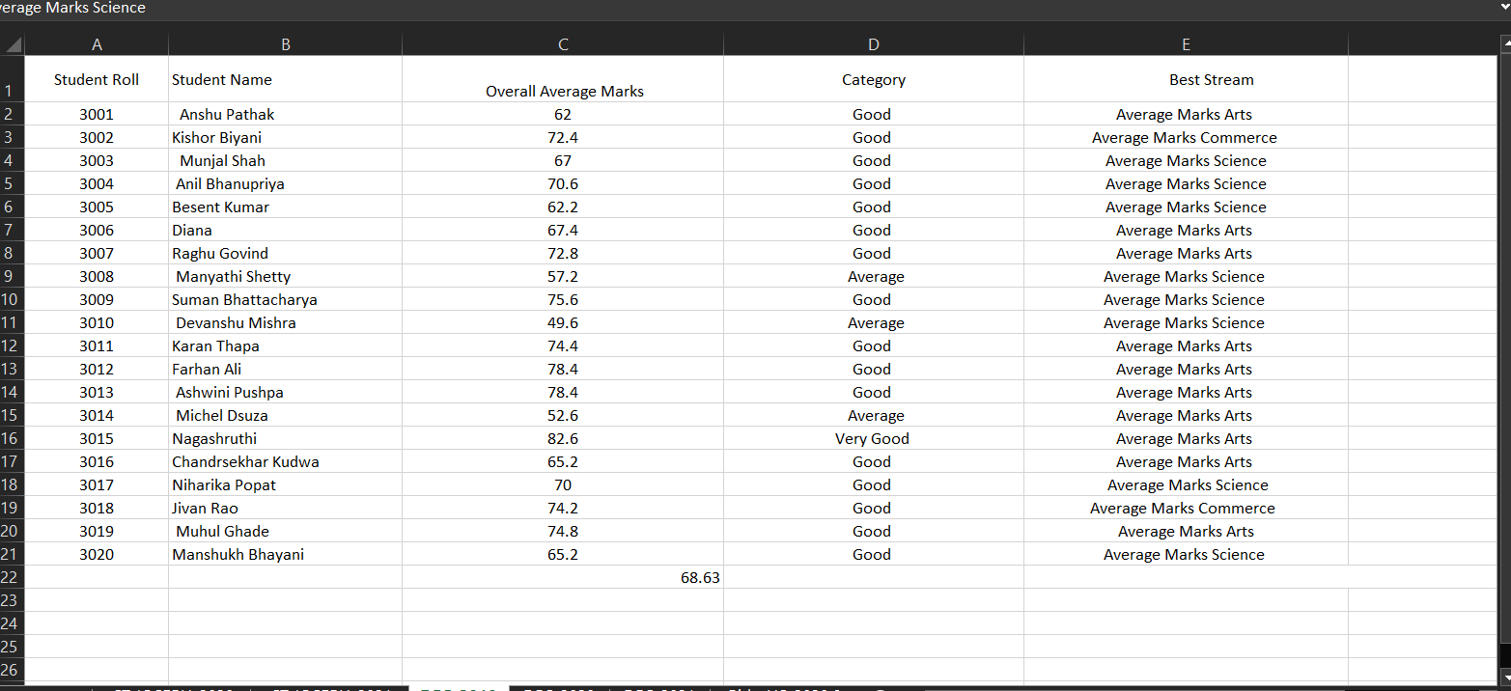
DATA sample OF DPS 2019

Slide 6
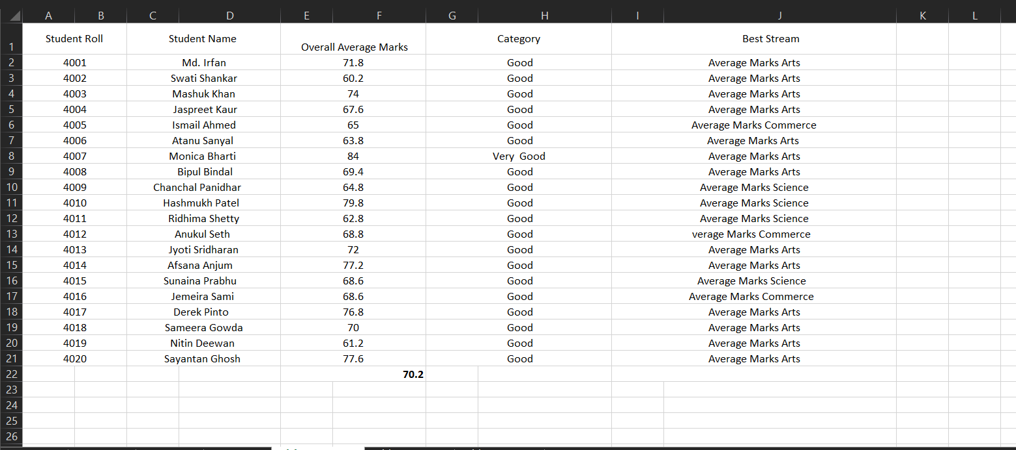
DATA sample OF birla hs 2019

Slide 7
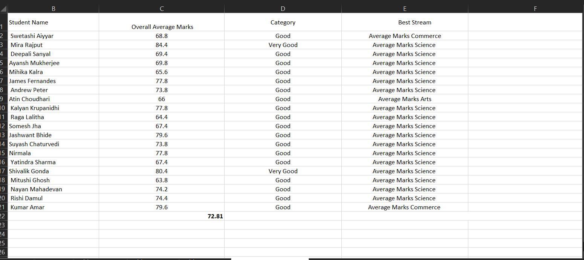
DATA sample OF INTERNATIONAL 2019

Slide 8
The average marks for the school on a yearly basis.
Year | VIDYA MANDIR | ST JOSEPH | DPS | BIRLA_HS | INTERNATIONAL
2019 | 69.69 | 65.115 | 68.63 | 70.2 | 72.81
2020 | 70.77 | 62.94 | 62.13 | 70.88 | 59.69
2021 | 7.11 | 53.94 | 60.13 | 70.21 | 71.685

Slide 9
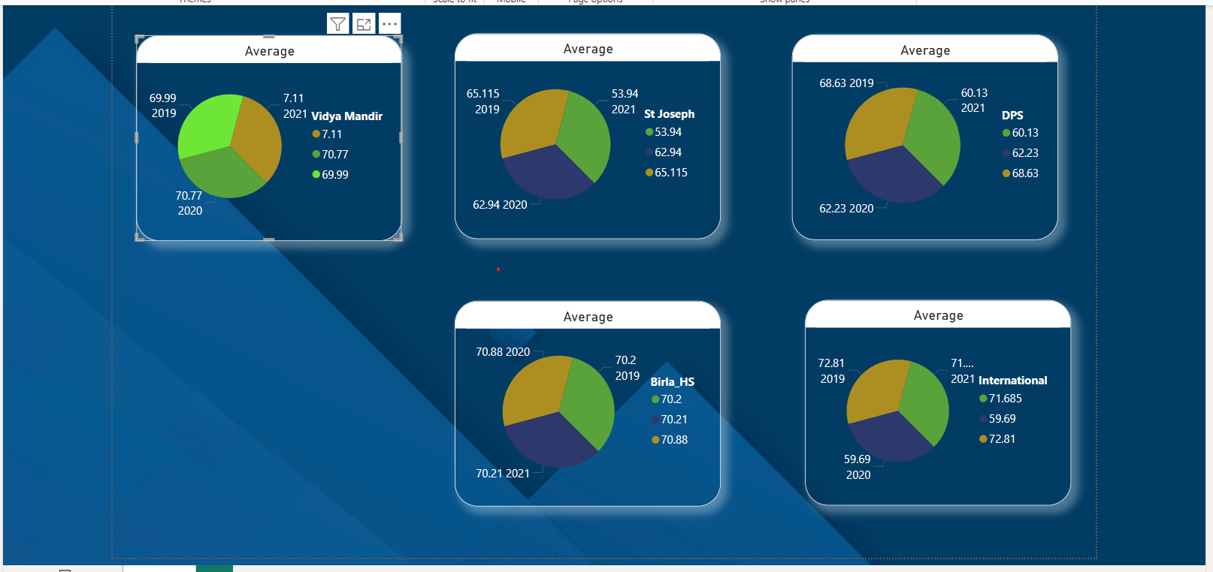
The comprehensive analysis of the average marks of the school on an annual basis.

Slide 10
calculating growth percentages
Percentage Change Calculation:
From 2019 to 2020:
Percentage Change =( Value in 2020 – Value in 2019 / Value in 2019) *100
From 2020 to 2021:
Percentage Change =( Value in 2021– Value in 2020 / Value in 2020 ) *100

Slide 11
Which is the best school for each year 2019, 2020 and 2021 based on highest no. of students in Good and Very Good category.
Ans: The best school for each year are:
2019: International School (72.81)
2020: Birla HS (70.88)
2021: International School (71.685)
Which is the fastest-growing School in Bangalore (Overall and Streamwise)?
Ans: Overall Fastest-Growing School:
2019 to 2020: Birla HS
2020 to 2021: International School

Slide 12
THANK YOU

