Slide 1

Face Recognition with OpenCV, Python, and Deep learning
Kolawole Matthew Oluwadamilare
2787580

Slide 2
Contents:
Introduction
Objectives
Neural Networks in Image Recognition
Practical Applications
Future Scope and Conclusion
References

Slide 3
INTRODUCTION
Computer vision is a field of artificial intelligence that trains computer to interpret and understand the visual world.
A Convolutional Neural Network (CNN) is a Deep Learning algorithm which can take in an input image, assign importance (learnable weights and biases) to various aspects/objects in the image and be able to differentiate one from the other.

Slide 4
Objectives
The objective of this project is :
Face Detection
Face Recognition in images
Face Recognition in real time feed and video from file

Slide 5

Application
Security surveillance
Authentication system
Statistic analysis etc.

Slide 6
In this project In order to run face recognition with OpenCv, knn classifier, cnn, Dlib which contains implementation of “deep metric learning” which is used to construct face embeddings used for the actual recognition process, facial_recognition which wraps around dlib’s facial recognition functionality, making it easier to work with.

Slide 7
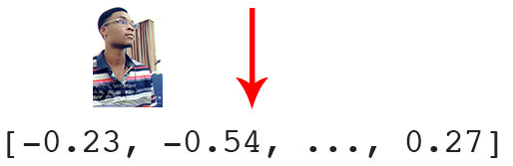
IMPLEMENTATION PROCESS
In this project before recognizing faces in images and videos, the faces in the training set needs to be quantified and there’s need to construct 128-d embeddings .
Facial recognition via deep learning and Python using the face_recognition module method generates a 128-d real-valued number feature vector per face like the example showed below.

Slide 8

IMPLEMENTATION PROCESS
localize the face and compute encodings
Then we dump the names and encoding to disk for future recall
Then save it into a .pickle file
Creating command line arguments that are processed at runtime with argparse
Constructing dict with two keys which are encodings and name

Slide 9

Implementation process
After creating the encoding script the next step is to create the recognition script
loading the pre-computed encodings with face names and then construct the 128-d face encoding for the input image
detect all faces in the input image and compute their 128-d encodings then initialize a list of names for each face that is detected
Then attempt to match each face in the input image (encoding) to our known encodings dataset which returns a list of True/False values, one for each image in our dataset and get the value of the most accurate prediction and it prints the image with the highest most predicted name with a bonding box on the face with name

Slide 10

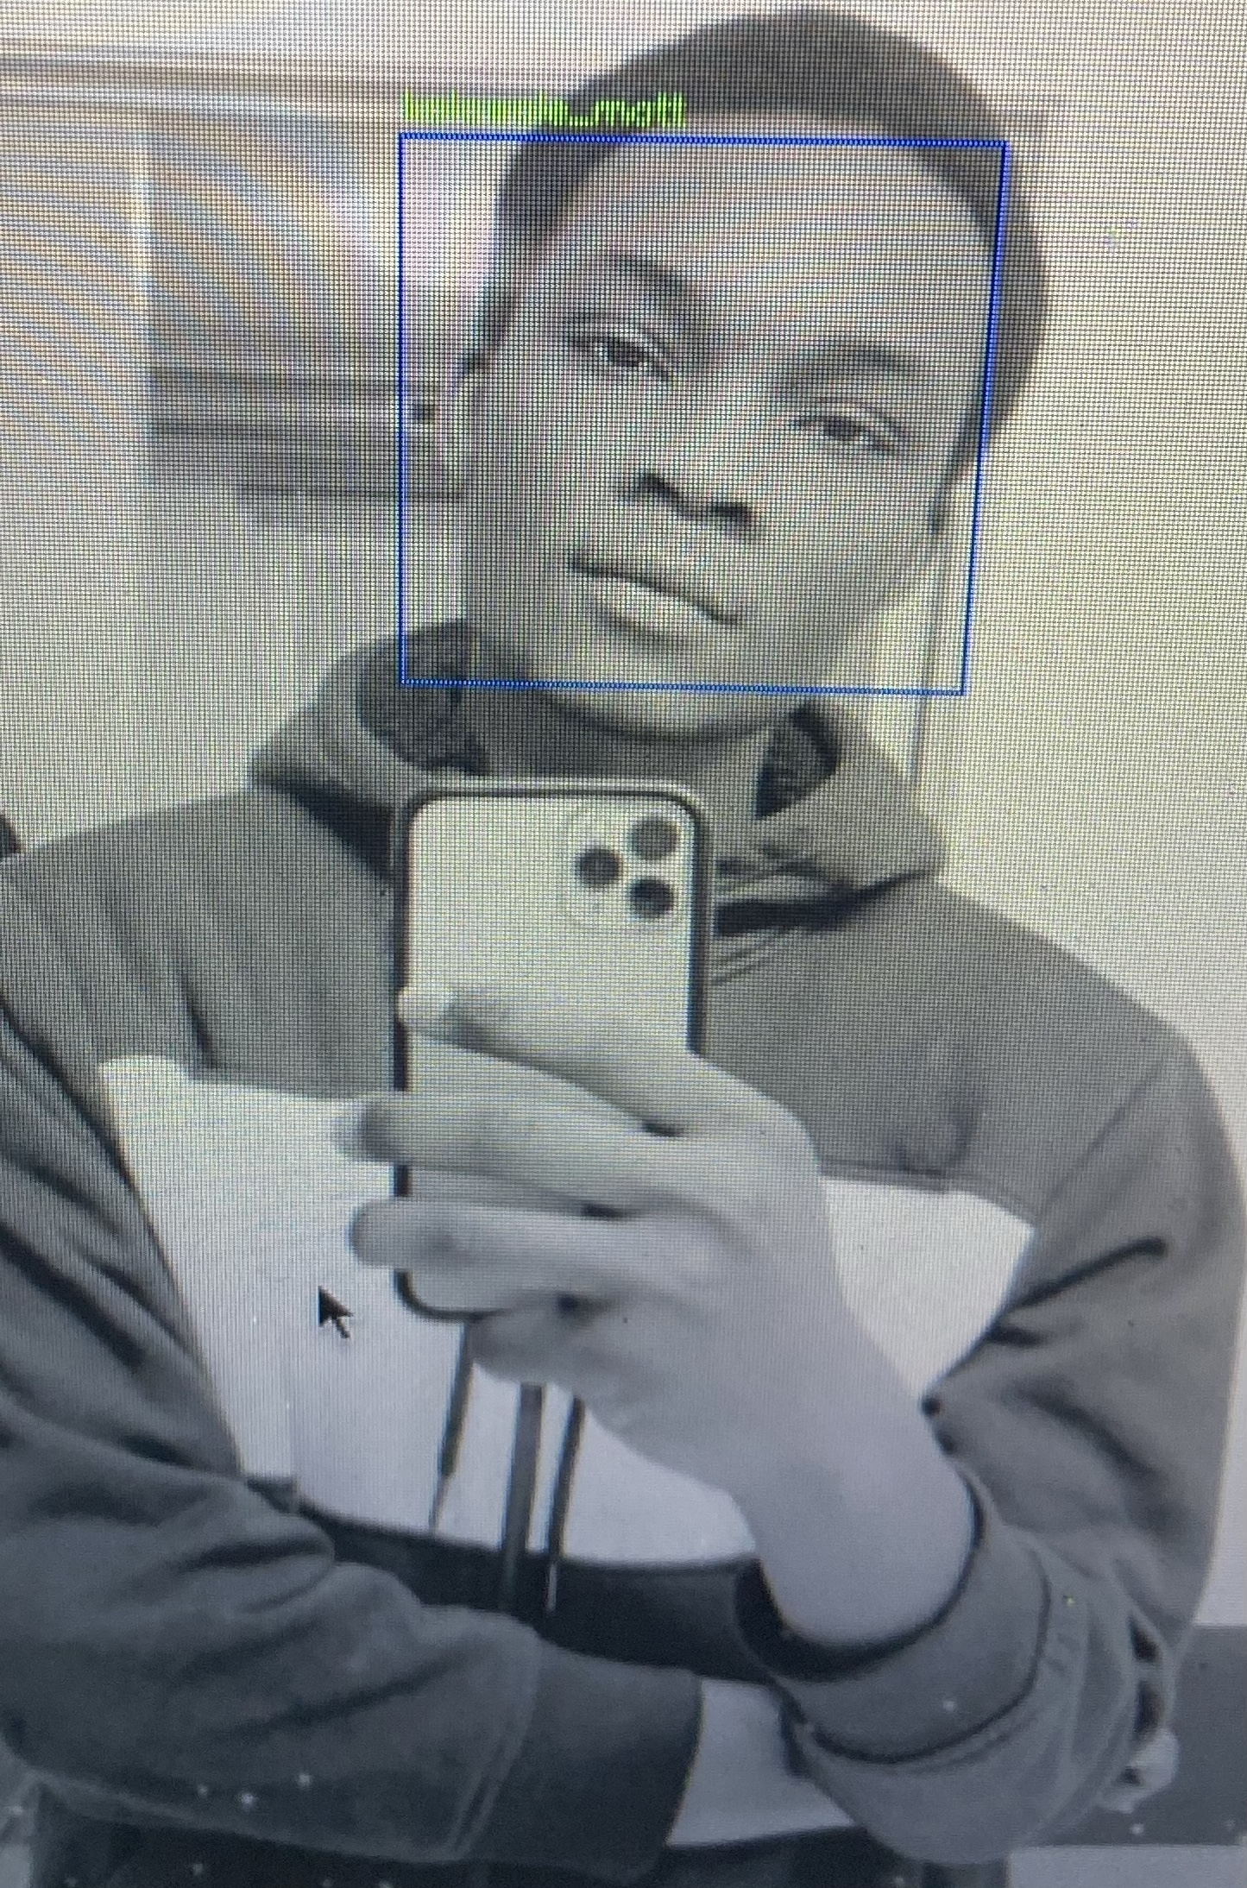
Result for the facial recognition

Slide 11
Recognition in real time live feed
Load the precomputed encodings and start up the live feed
Detect every face in the feed and run the feature extraction
Compare the faces detected at every point in time to the one in the encodings
Create a bounding box on the face with the name as the title after detecting the face and if the features extracted does not match any in the database the system recognize it as unknown.

Slide 12
conclusion
This Facial recognition system detects faces in a images, live feed and videos from file and recognizes them with cnn and can be run in start up and can be used as a security system by sending the picture of of the user using the system if it does not match with the picture on the database.

Slide 13
References
Deep learning for image Recognition paper by He et al
Face recognition modules by Adam Geitgey

