Slide 1
Diversity Inclusion ANALYSIS
Base On Gender

Slide 2
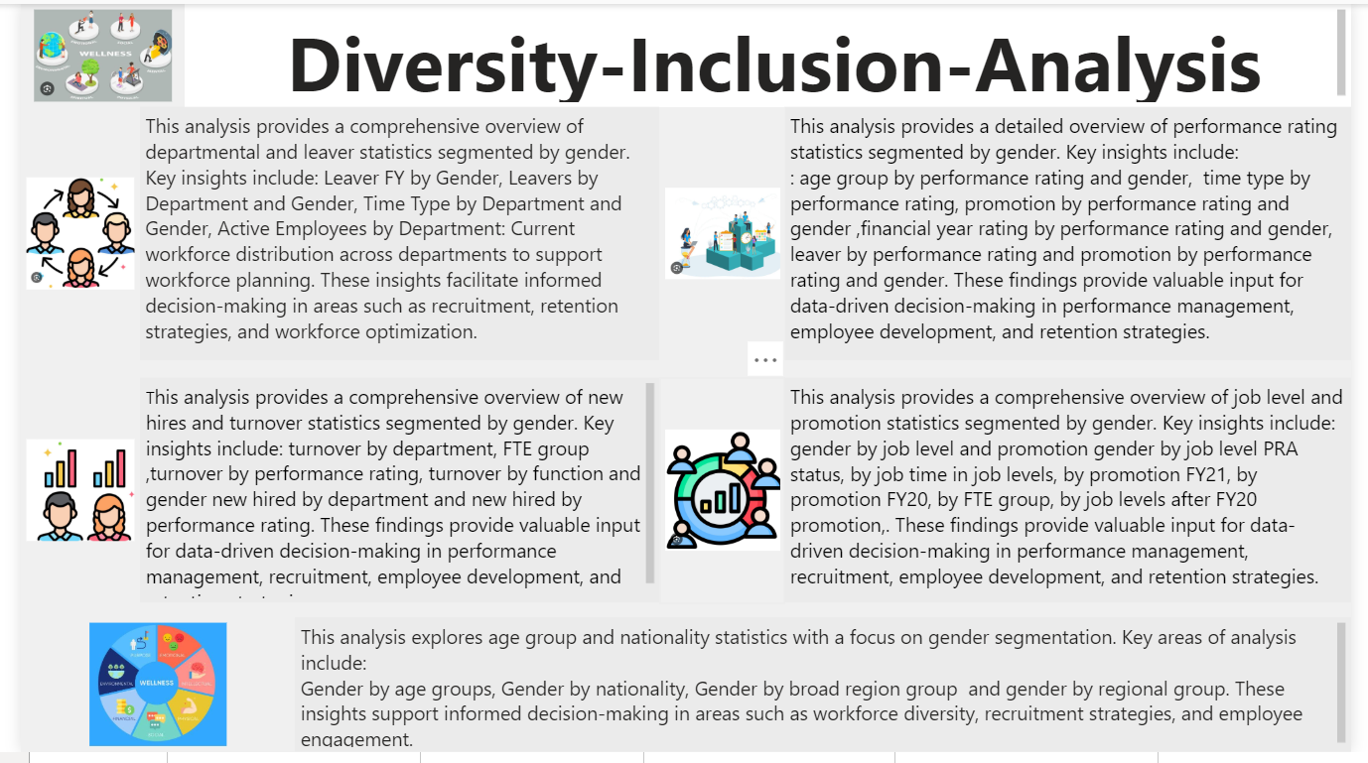

Slide 3
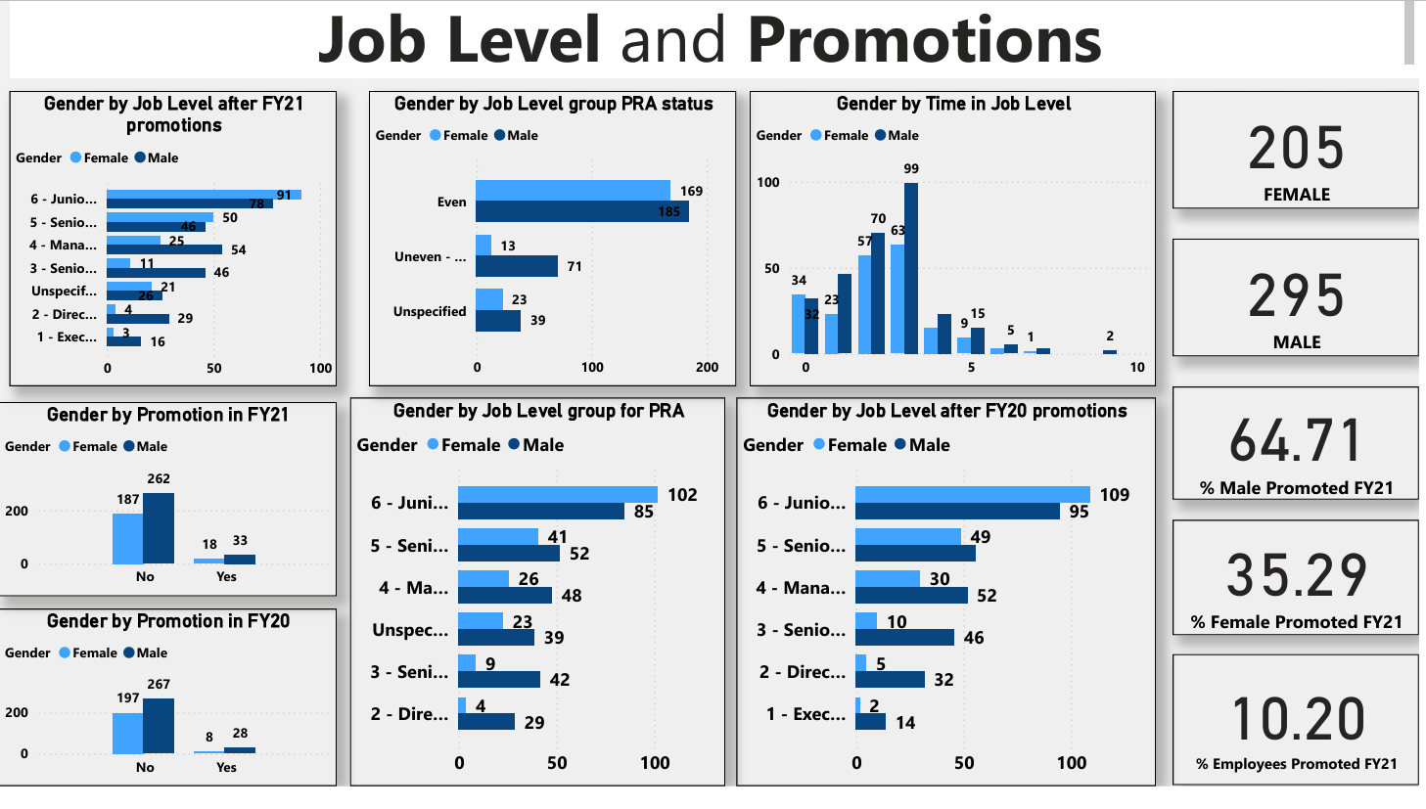

Slide 4
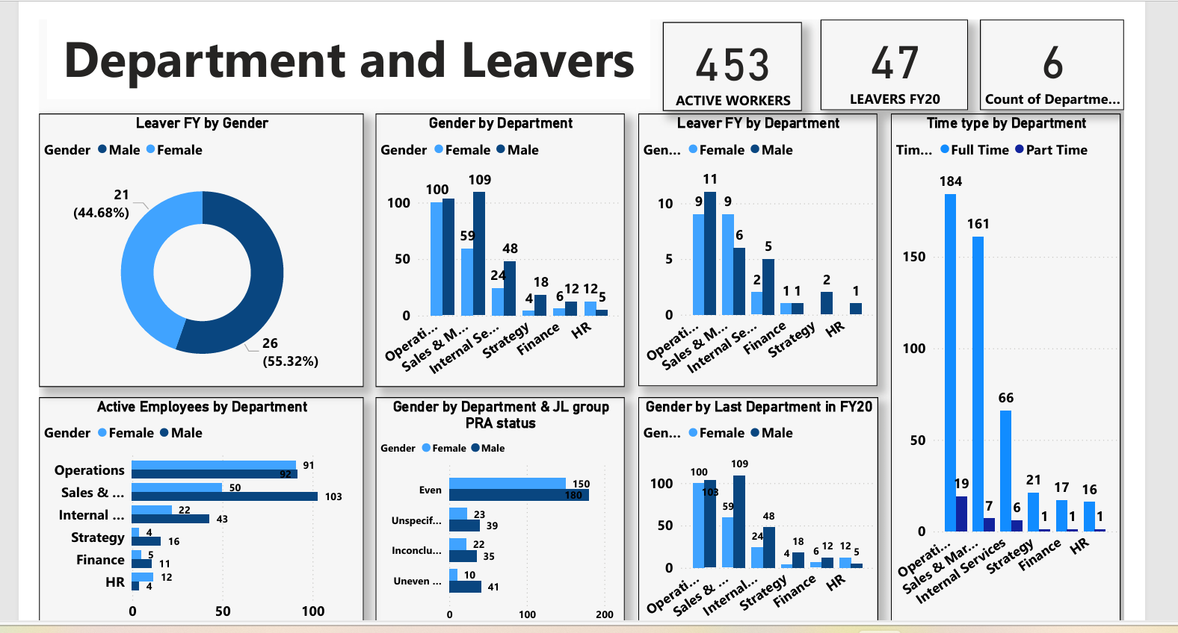

Slide 5
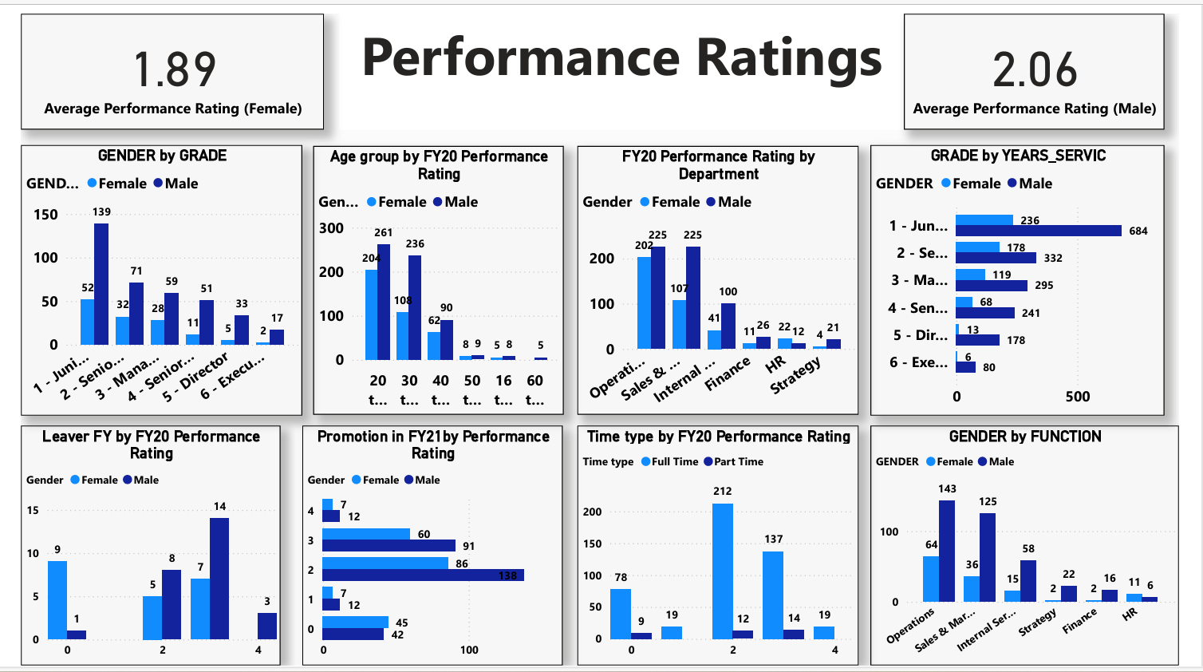

Slide 6
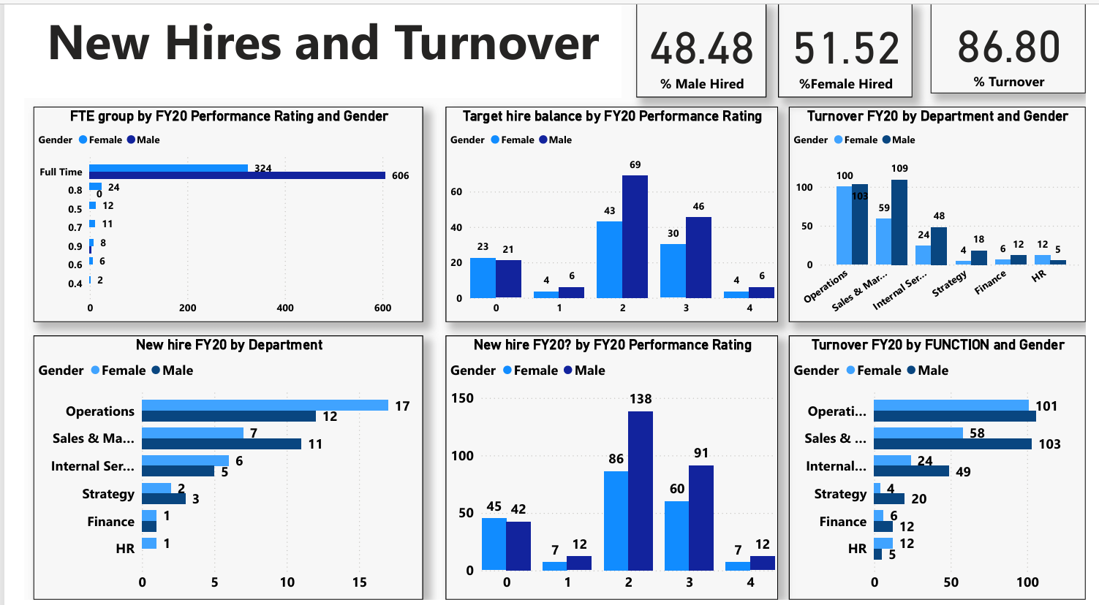

Slide 7
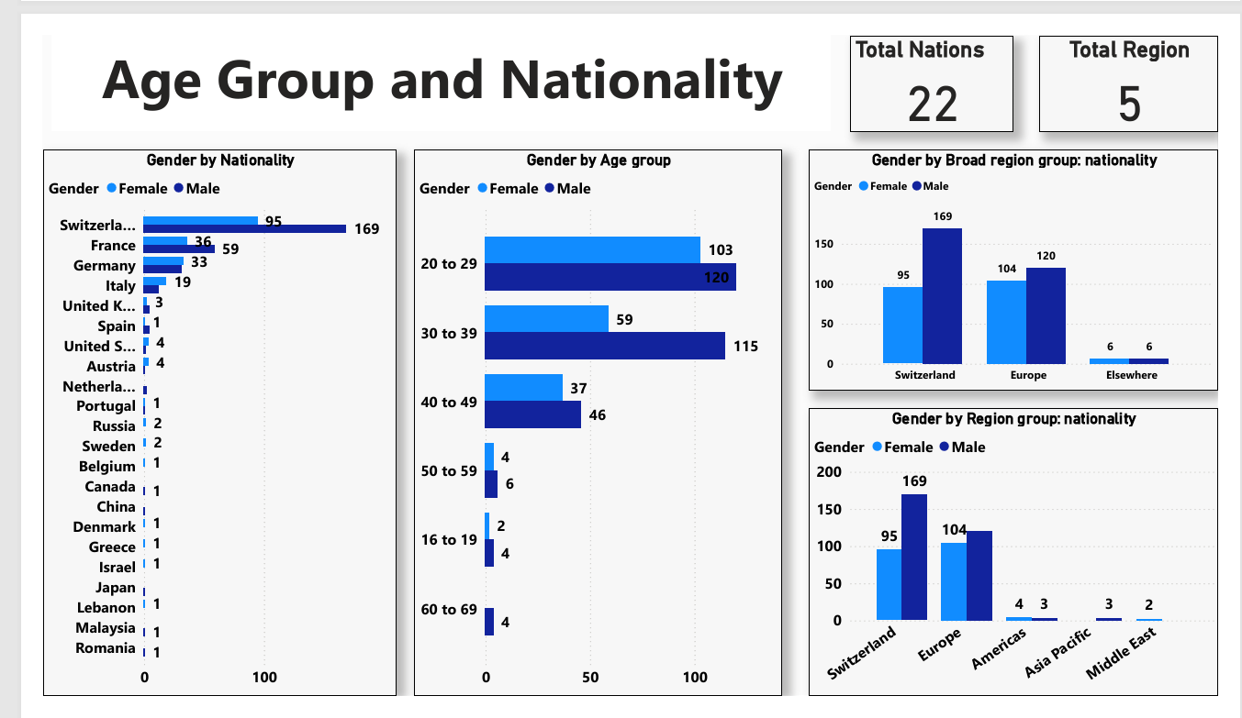

Slide 8
SUMMARY AND RECOMMENDATION
Summary
The organization faces gender disparity in leadership roles, promotions, and departmental representation.
While hiring trends show some improvement, promotions and performance ratings continue to favor males.
Departments with strategic roles (Operations, Sales & Marketing) show a more significant male bias.
Retention and career growth opportunities for females appear limited.
Recommendations
Promotion Equity:
Define clear criteria for promotions, ensuring transparency and fairness.
Use a balanced review panel to minimize bias in promotion decisions.

Slide 9
Gender-Specific Hiring Goals:
Set departmental hiring targets to achieve better gender representation in male-dominated roles.
Use gender-neutral language in job descriptions to attract diverse talent.
Leadership Development for Women:
Introduce mentorship programs pairing female employees with senior leaders.
Offer leadership training sessions specifically for women to bridge skill gaps.
Retention Strategies:
Conduct exit interviews to identify retention challenges for females.
Provide flexible working conditions and career progression plans to improve female retention.
Performance Review Calibration:
Train managers to conduct unbiased performance evaluations. Regularly audit performance ratings to address systemic gender biases.

Slide 10
Regular Gender Equity Audits:
Review promotion, performance, and salary data annually.
Publish gender diversity reports to track progress and hold leadership accountable.
Conclusion
The data clearly shows an imbalance in gender representation, especially in senior positions and promotions.
Proactive efforts in equitable promotions, focused hiring, and mentorship can close the gender gap.
Transparent performance reviews and regular audits will ensure continuous improvement.
By implementing these recommendations, the organization can build a more inclusive, diverse, and equitable workplace, enhancing employee satisfaction and productivity.

