Slide 1

SMART INDIA HACKATHON 2026
TITLE PAGE
Problem Statement ID – SIH26201
Problem Statement Title- Student Innovation-There is a need to design drones and robots that can solve some of the pressing challenges of India such as handling medical emergencies, search and rescue operations, etc.
Theme- Robotics and Drones
PS Category- Software
Team ID- 129300
Team Name (Registered on portal) - @TRINETRA

Slide 2
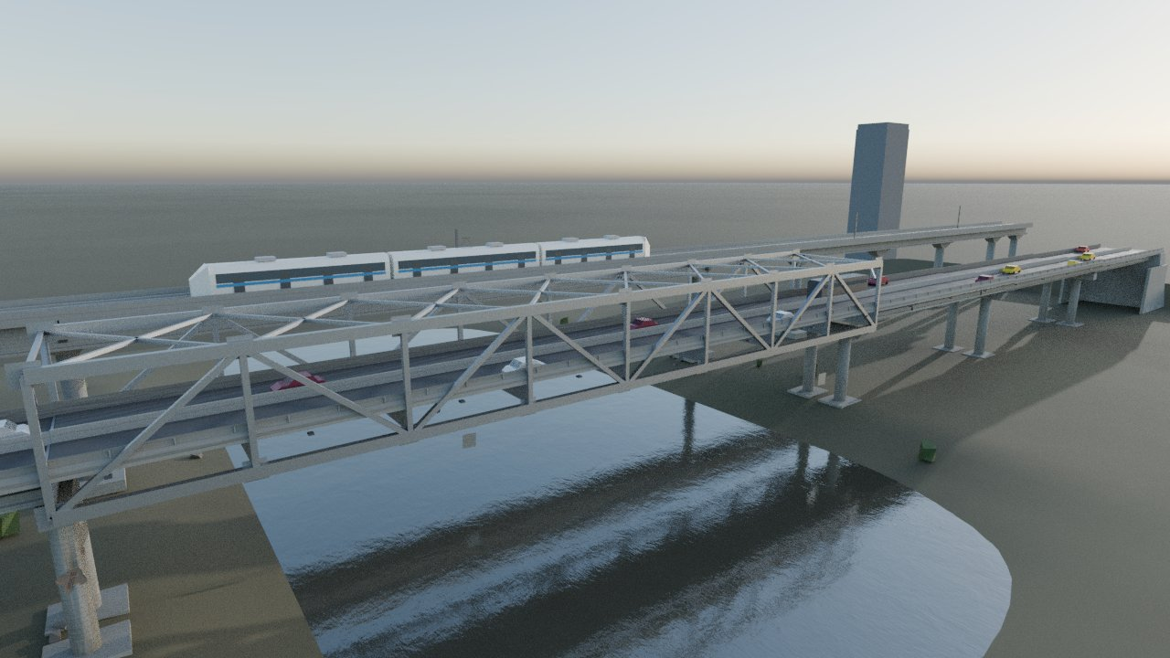
AVIAN: Autonomous Bridge-Inspection Drone
@TRINETRA
Proposed Solution (Describe your Idea/Solution/Prototype)
Detailed explanation of the proposed solution
Plans its own inspection route from the bridge's 3D model — no list of known defects needed
Flies the route autonomously, steering clear of steel and concrete using on-board range sensing
A zoom camera captures millimetre-level detail from a safe 8 m standoff
AI flags cracks, spalling and corrosion and tags each one to the exact bridge member
How it addresses the problem
India's railways alone have 1,47,523 bridges; 37,689 are over 100 years old. They are checked “by visual perception” with ~40% of bridge-staff posts vacant
Every span gets a repeatable, geo-tagged image record instead of one person's judgement
Reaches under-deck and truss zones with no rope access, scaffolding or lane closure
Our digital twin: 360 m road bridge + steel truss + metro viaduct, with 192 measured defects
Innovation and uniqueness of the solution
Route planned from geometry only — code-audited to read zero defect data
“Survey + zoom” instead of flying close: keeps ≥ 3 m from structure, as China's 2026 UAV bridge-inspection guideline requires
Every run is scored against a digital twin with 192 known defects, so results are measured, not claimed
Why now — 9 July 2025
The 40-year-old Gambhira bridge linking Vadodara and Anand districts collapsed into the Mahisagar river, killing 22. Residents had reportedly warned about its condition for years; four engineers were suspended for lapses in maintenance and supervision. (ref. 2)

Slide 3
TECHNICAL APPROACH
@TRINETRA
Technologies to be used (e.g. programming languages, frameworks, hardware)
Digital twin & simulation
Blender: bridge model, 192 measured defects
PyBullet: flight physics
Gazebo + ROS 2 Jazzy: exported world
Autonomy (Python)
Cascade PID flight controller
Coverage planner (greedy set-cover)
Ray-cast range sensor for avoidance
AI defect detection
PyTorch + torchvision Faster R-CNN (MobileNetV3)
BSD-3 licence — free to hand over
Trained on rendered defect images
Target hardware (planned)
PX4 quadcopter + zoom gimbal camera
LiDAR / visual-inertial SLAM
Jetson-class on-board computer
Methodology and process for implementation (Flow Charts/Images/ working prototype)
1
Digital twin
2
Plan coverage
3
Fly & avoid
4
Zoom capture
5
Detect
6
Score
Bridge 3D model → 568 collision shapes
150 viewpoints from geometry only
Ray-cast sensing steers clear of structure
8.7× zoom (9° HFOV) from 8 m, at the achieved pose
Faster R-CNN flags defects in each image
Checked against 192 known defects; report per bridge member
Working prototype today: all six steps run end-to-end in simulation, with measured results on the next slide. Next: run the same stack live in Gazebo + ROS 2, then on PX4 hardware.

Slide 4
FEASIBILITY AND VIABILITY
@TRINETRA
Analysis of the feasibility of the idea
Potential challenges and risks | Strategies for overcoming these challenges
Detection accuracy is the weakest link: 0 detections on 1,000 real bridge photos (precision = recall = 0) — doesn't yet transfer from simulation; on its own mission imagery, unseen-defect recall is 1 of 3 in-scope cases (5 of 20 for all defects, optimistic); false alarms fell from 37.6 to 0.08 per 100 tiles (v1 → v2); loose bolts (~10 px) are below reliable detection at current resolution | Retrain on real bridge datasets (CODEBRIM, dacl10k) on a GPU; higher-resolution capture for bolts; an engineer confirms every flag before it is reported
Collisions in the dense steel truss: stuck/collision rate before → after the Section 4 fix is pending the freeze — see the stat at left | Clearance checks along the whole path, not just at waypoints; slower close-range legs; target under 5% before any field flight
No GPS under the deck; magnetic noise near 25 kV railway overhead lines | Visual-inertial / LiDAR SLAM, as used by Flyability's Elios 3; compass-free heading
Measured in our simulation — not estimated
—
bridge surface coverage — route planned with no defect data (pending freeze)
—
known defects fell inside a settled camera view (pending freeze)
—
flight-log entries show avoidance driven by the sensor, not a map (pending freeze)
—
waypoints with a collision or stall, before vs after sensed avoidance (pending freeze)
0.34
detector mAP@0.5 on 24 held-out defects (synthetic images)
Regulatory path: Drone Rules 2021 R&D exemption at prototype stage → DGCA type certificate through a QCI-approved body (~₹1.5 lakh at NTH) → railway safety permits for any work near live 25 kV lines.

Slide 5
IMPACT AND BENEFITS
@TRINETRA
1,47,523
37,689
≈ 33
railway bridges in India
of them over 100 years old
bridges per bridge-staff member in post (1,47,523 ÷ 4,517)
Source: Standing Committee on Railways, Maintenance of Bridges in Indian Railways (Jan 2019), ref. 1. Inspections rely on the “visual perception” of the inspecting official.
Potential impact on the target audience
Benefits of the solution (social, economic, environmental, etc.)
Indian Railways — fits the Railway Board's drone-inspection circulars and its Bridge Management System (4D BrIM)
NHAI, MoRTH and state PWDs — e.g. Gujarat's Roads & Buildings department after the Gambhira collapse
Metro operators (DMRC) — viaduct inspection without closing lines
Rescue teams — a quick structural check of a flood- or quake-damaged bridge before convoys cross
Social
Earlier warning of failing spans; inspectors off ropes and scaffolds
Economic
No lane closures or snooper trucks; each year's images map onto the same twin, so every defect is tracked over time
Environmental
Battery-electric; fewer heavy access vehicles and fewer emergency rebuilds
Where it fits: between satellite radar, which tracks millimetre movement across whole regions but can't see under a deck, and manual close inspection, which can but is slow, risky and subjective.

Slide 6
RESEARCH AND REFERENCES
@TRINETRA
Details / Links of the reference and research work
The problem in India
1. Standing Committee on Railways (2019). Maintenance of Bridges in Indian Railways – A Review. prsindia.org/policy/report-summaries/maintenance-of-bridges-in-indian-railways-a-review
2. Gambhira Bridge collapse, Vadodara–Anand, 9 July 2025. en.wikipedia.org/wiki/Gambhira_Bridge_collapse
3. Railway Board circular 2021/25/CE-III/BR/BMS/Drone: 4D BrIM inspection of railway bridges using UAS. indianrailways.gov.in → Railway Board → Bridge policy circulars
Regulation and standards
4. Ministry of Transport, China (Feb 2026). UAV highway-bridge inspection technical guideline, 交办公路〔2026〕8号 (3 m minimum standoff). xxgk.mot.gov.cn/jigou/glj/202602/P020260228435553861410.pdf
5. Ministry of Civil Aviation. Drone Rules 2021 and type certification. pib.gov.in/PressReleasePage.aspx?PRID=1833750
Technical basis
6. Wang et al. RCO-YOLOv5 UAV bridge-defect detection, mAP@0.5 = 91.0%. ASCE J. Perform. Constr. Facil. doi.org/10.1061/JPCFEV.CFENG-5441
7. Mundt et al. (CVPR 2019). CODEBRIM concrete bridge-defect dataset. arxiv.org/abs/1904.08486
8. Flotzinger et al. (WACV 2024). dacl10k bridge-damage benchmark. arxiv.org/abs/2309.00460
9. Milillo et al., Nature Communications (2025): fewer than 1 in 5 long-span bridges are monitored. NASA Science summary, 12 Dec 2025
10. Flyability Elios 3: LiDAR-SLAM inspection drone for GPS-denied spaces. flyability.com/elios-3
11. PyTorch torchvision detection models (BSD-3-Clause). pytorch.org/vision/stable/models.html

