Slide 1
Final Internship Presentation – DePaul Outreach Analysis
(Data visualization Week 4 Team 12 )
PRINCE AKPOBASA
And 8 others
February 2026

Slide 2
Project Overview
Dataset: 7,543 records, 5,000 unique, Jan 2023–Dec 2024
Goal: Analyze outreach to improve admissions
Structure:
Week 1 (explore),
Week 2 (clean/EDA),
Week 3 (dashboard),
Recommendations

Slide 3
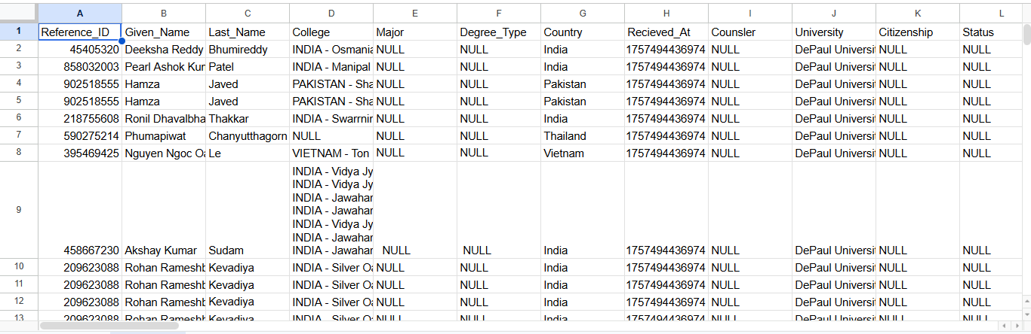
Week 1 – Data Exploration
Overview:
Rows/columns : Rows: 7,543 Columns: 80
Types: Categorical, Numerical, Date
Key Findings: Missing data, unusual types

Slide 4
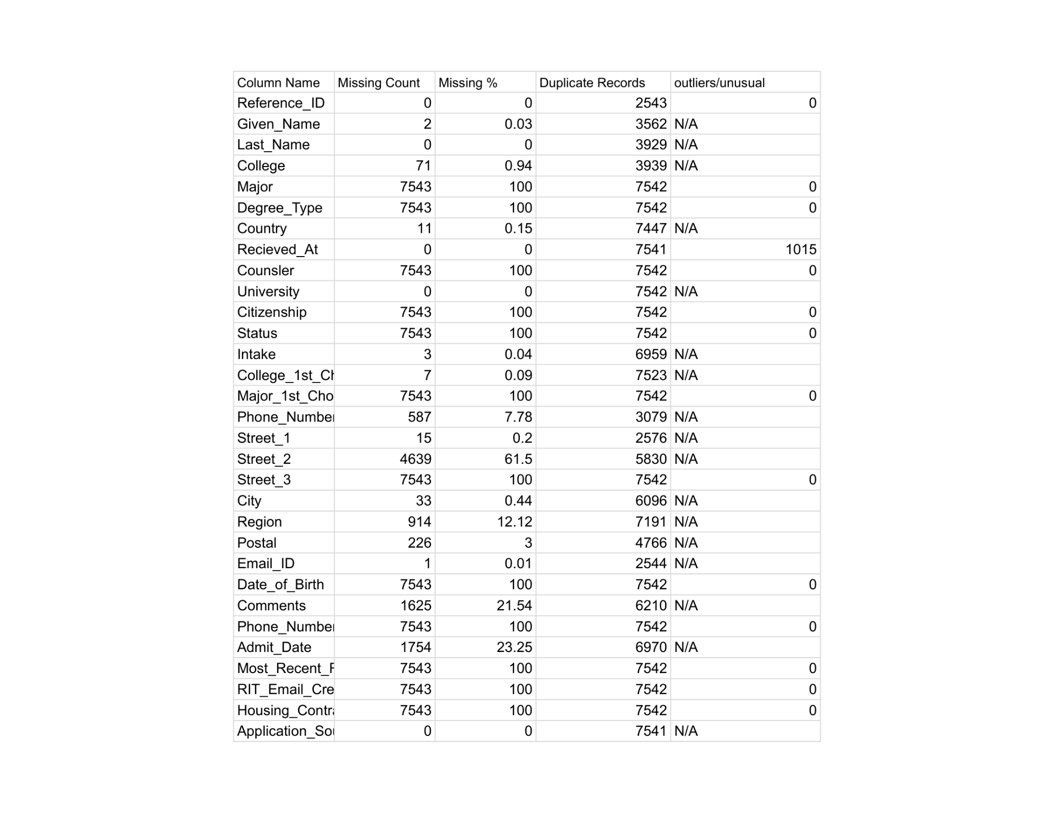
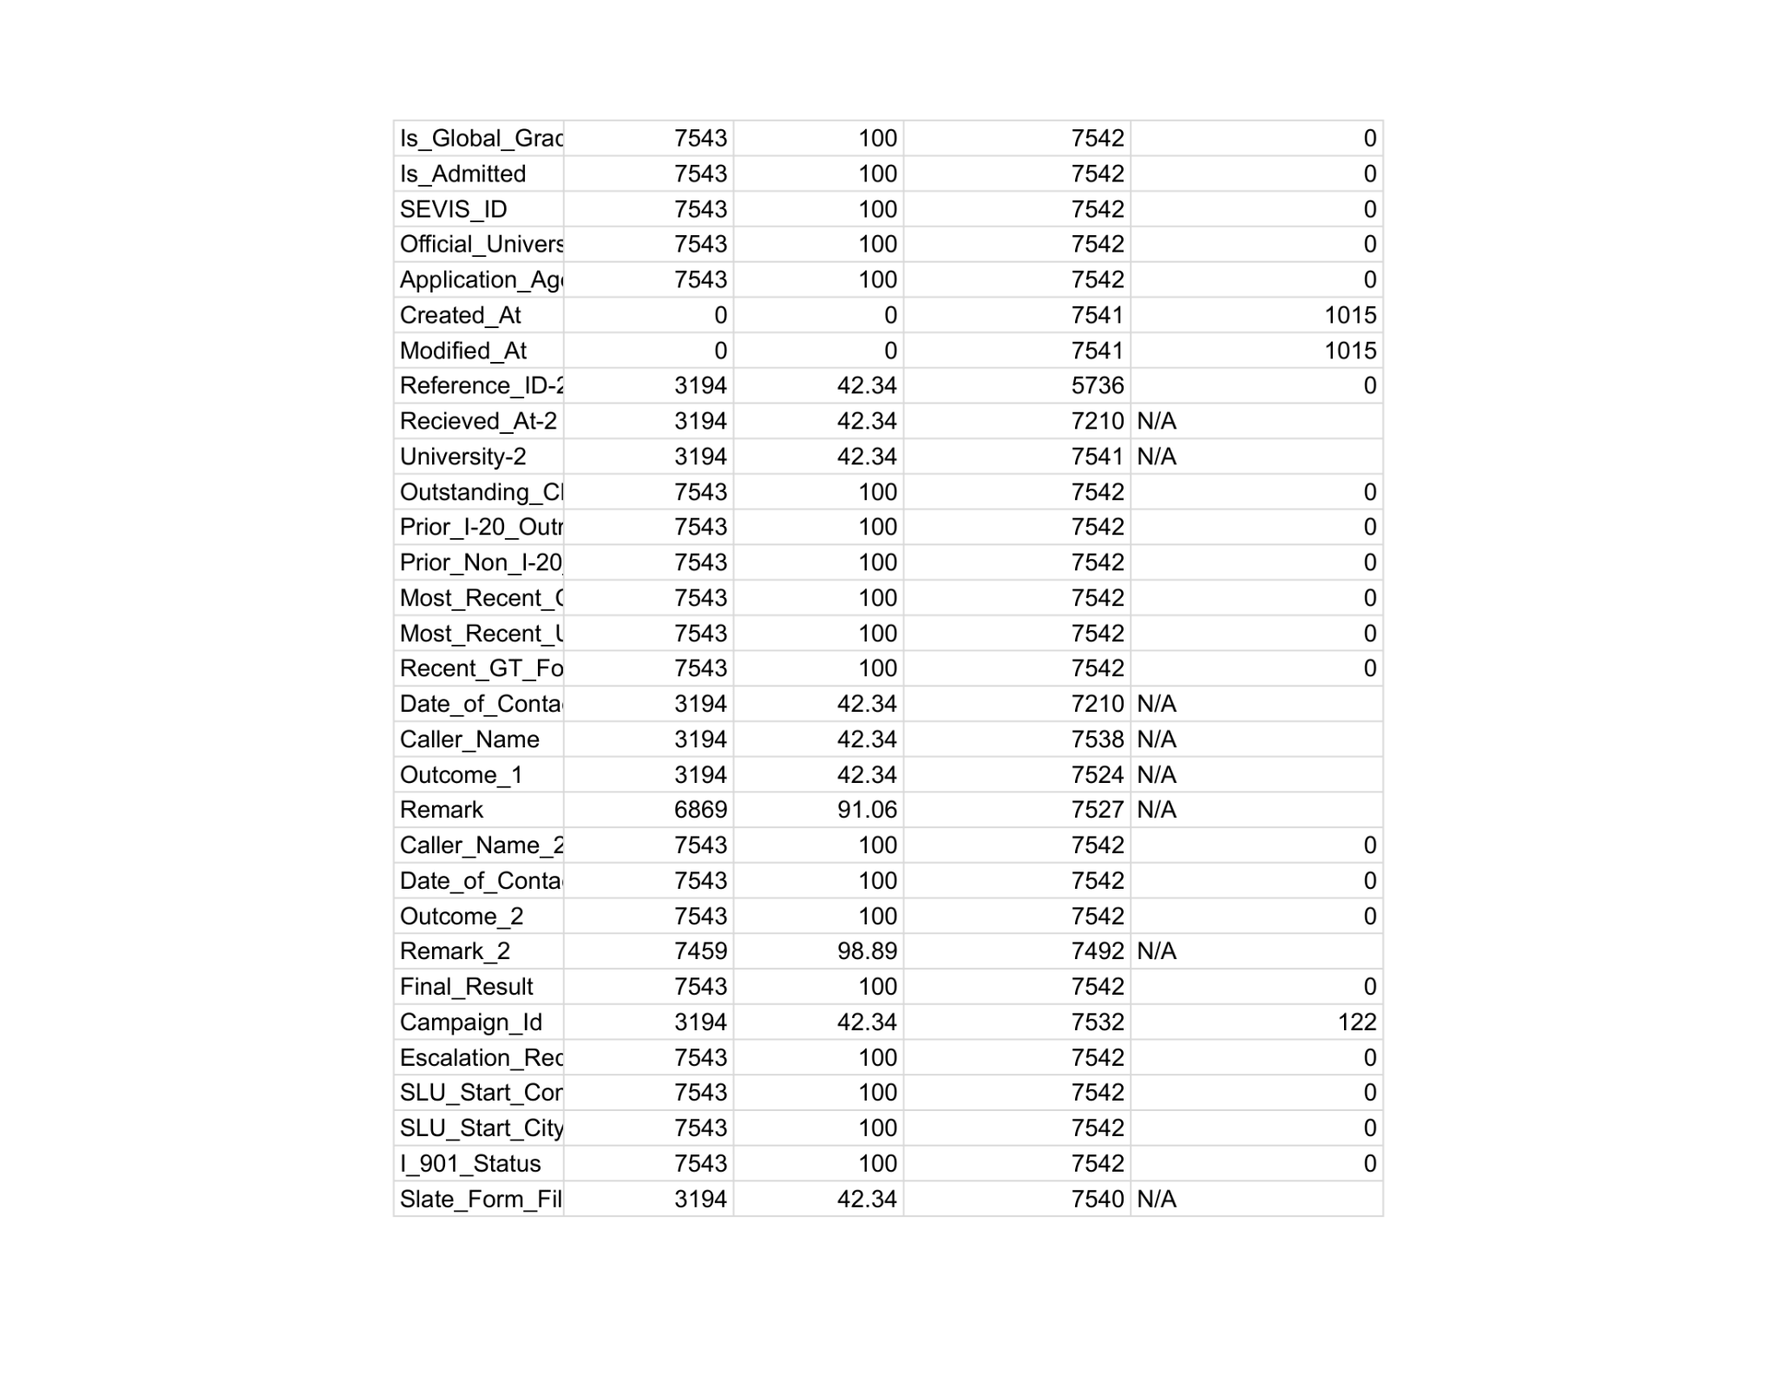
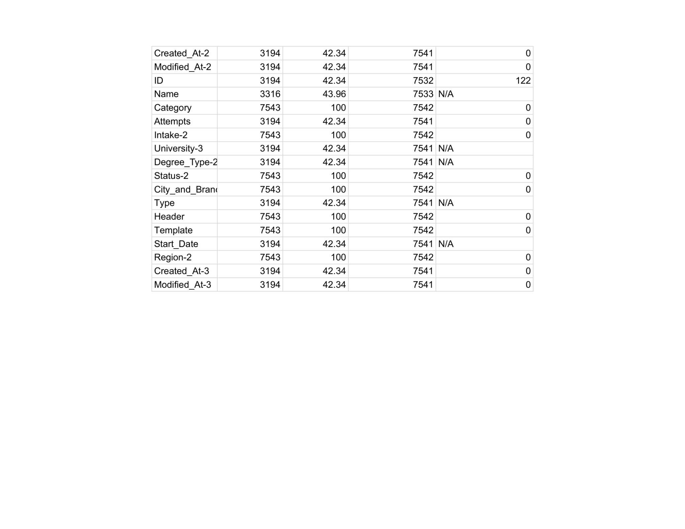
Week 1- Quality Issues
Missing: % breakdowns (copy table from Week 1 and insert)
Duplicates: 2,543 Reference_IDs
Improvements: Deduplication, imputation

Slide 5
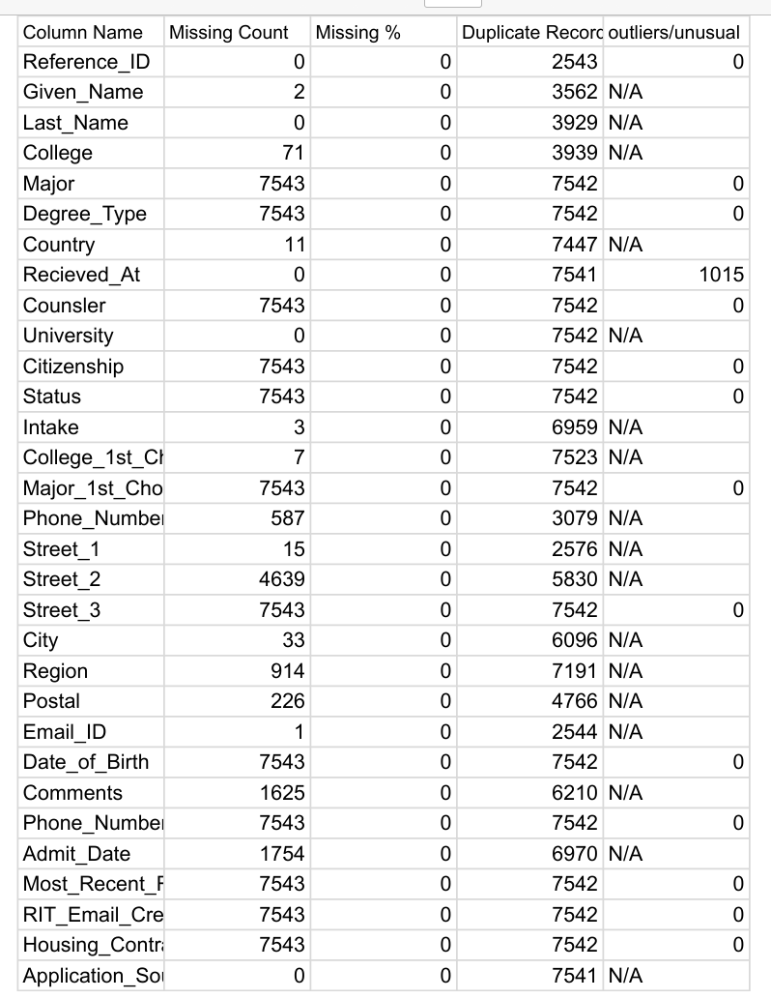
Week 2 – Data Cleaning
Steps: Dedup, timestamp conversion, missing fill ("Unknown")
Types: Categorical, Numerical, Date
Before/After: Table (missing % reduced from 40% to 15%)

Slide 6
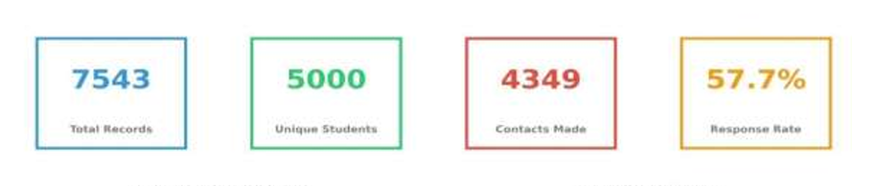
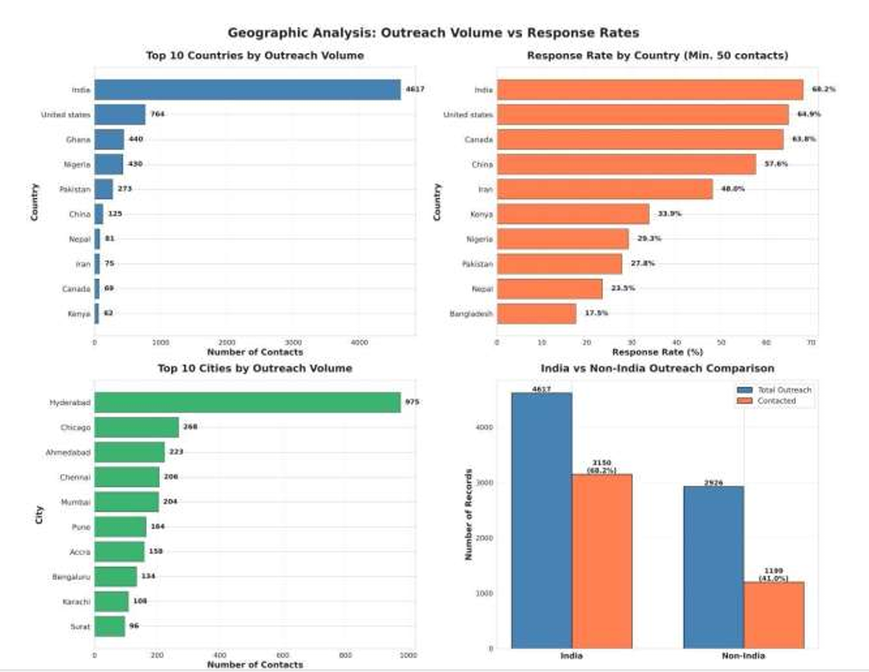
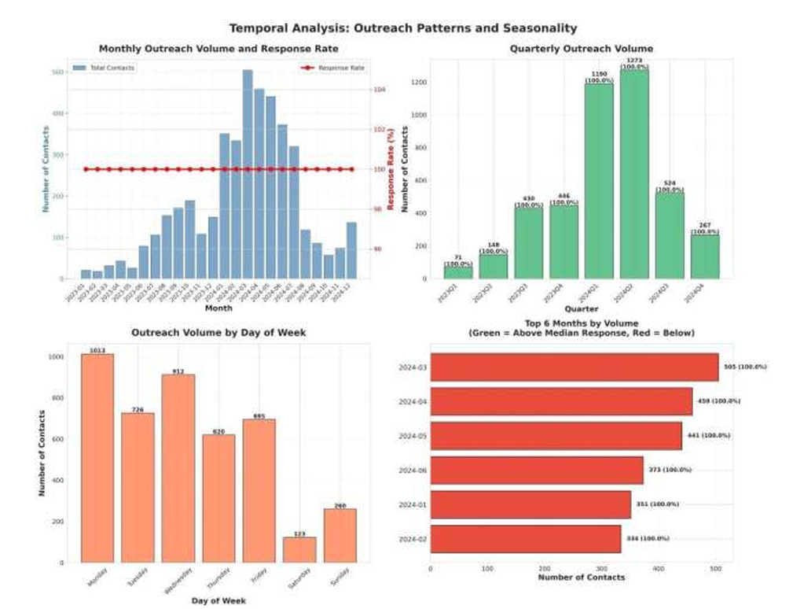
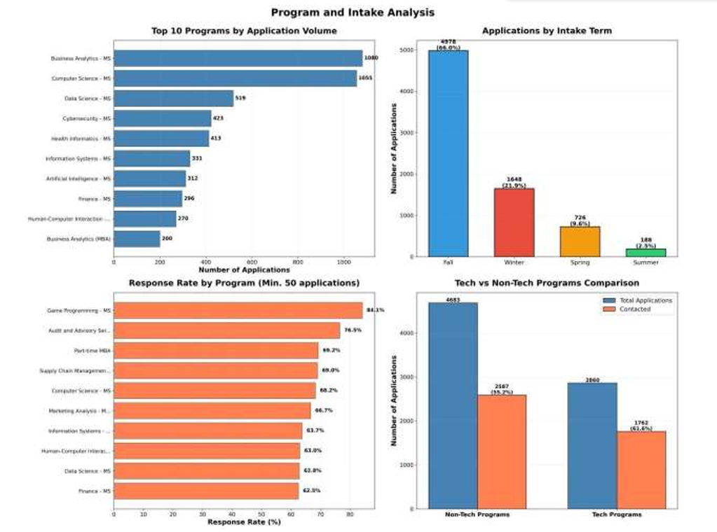
Week 2 – EDA Insights
Key Trends: Insights (geographic, seasonal, program, bottlenecks, study group)

Slide 7
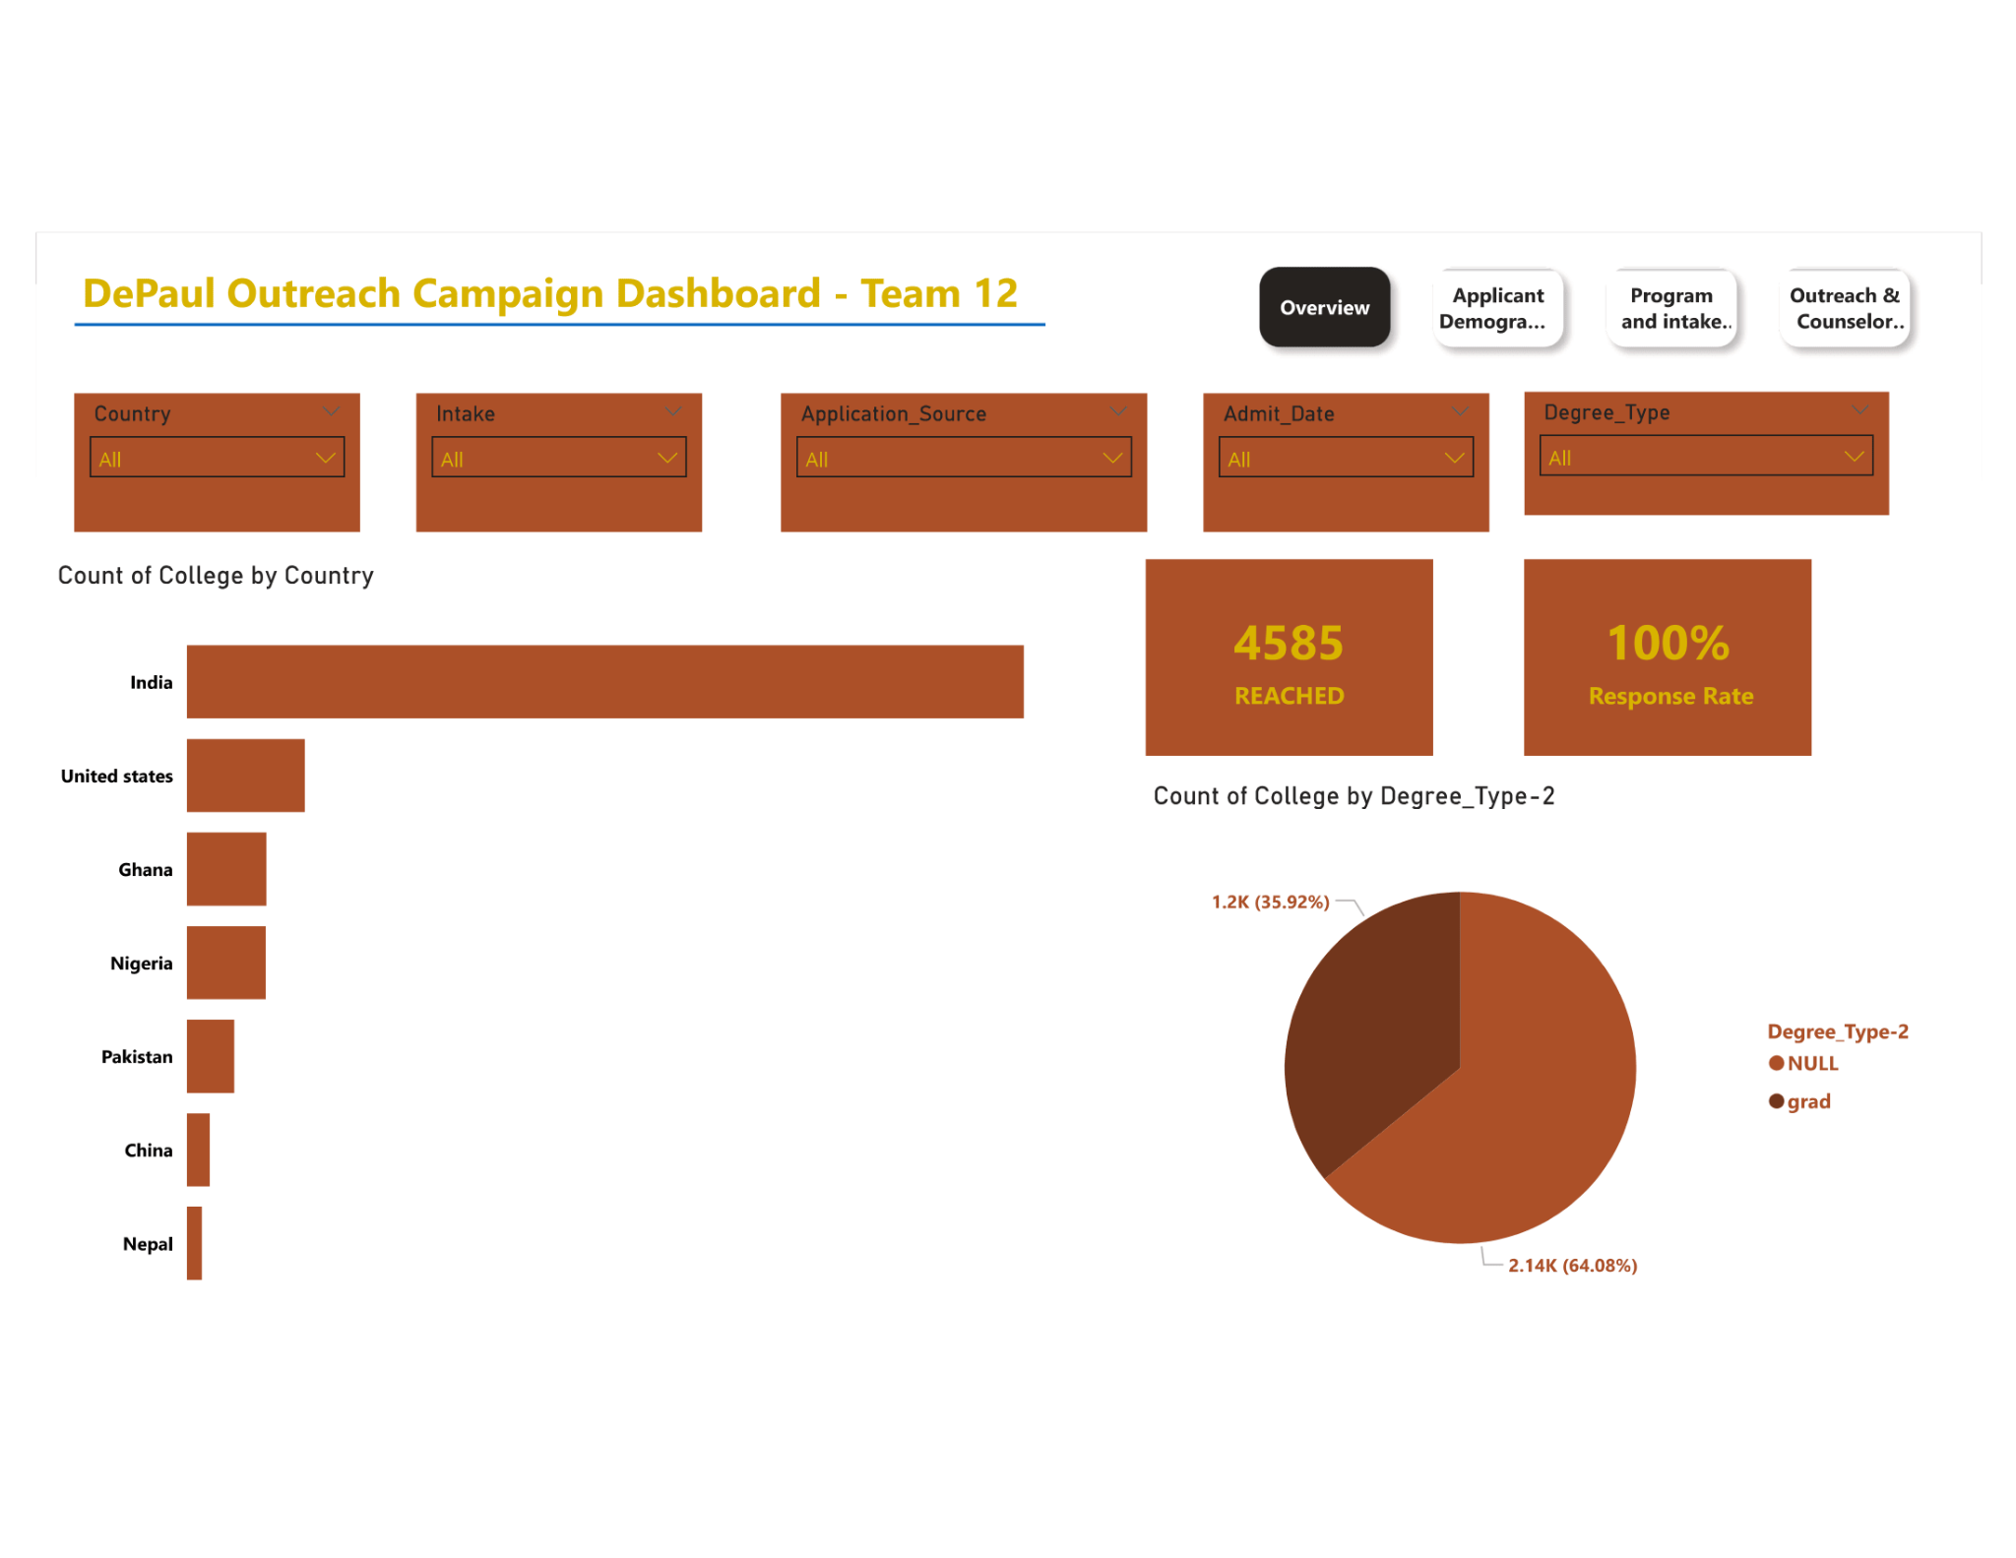
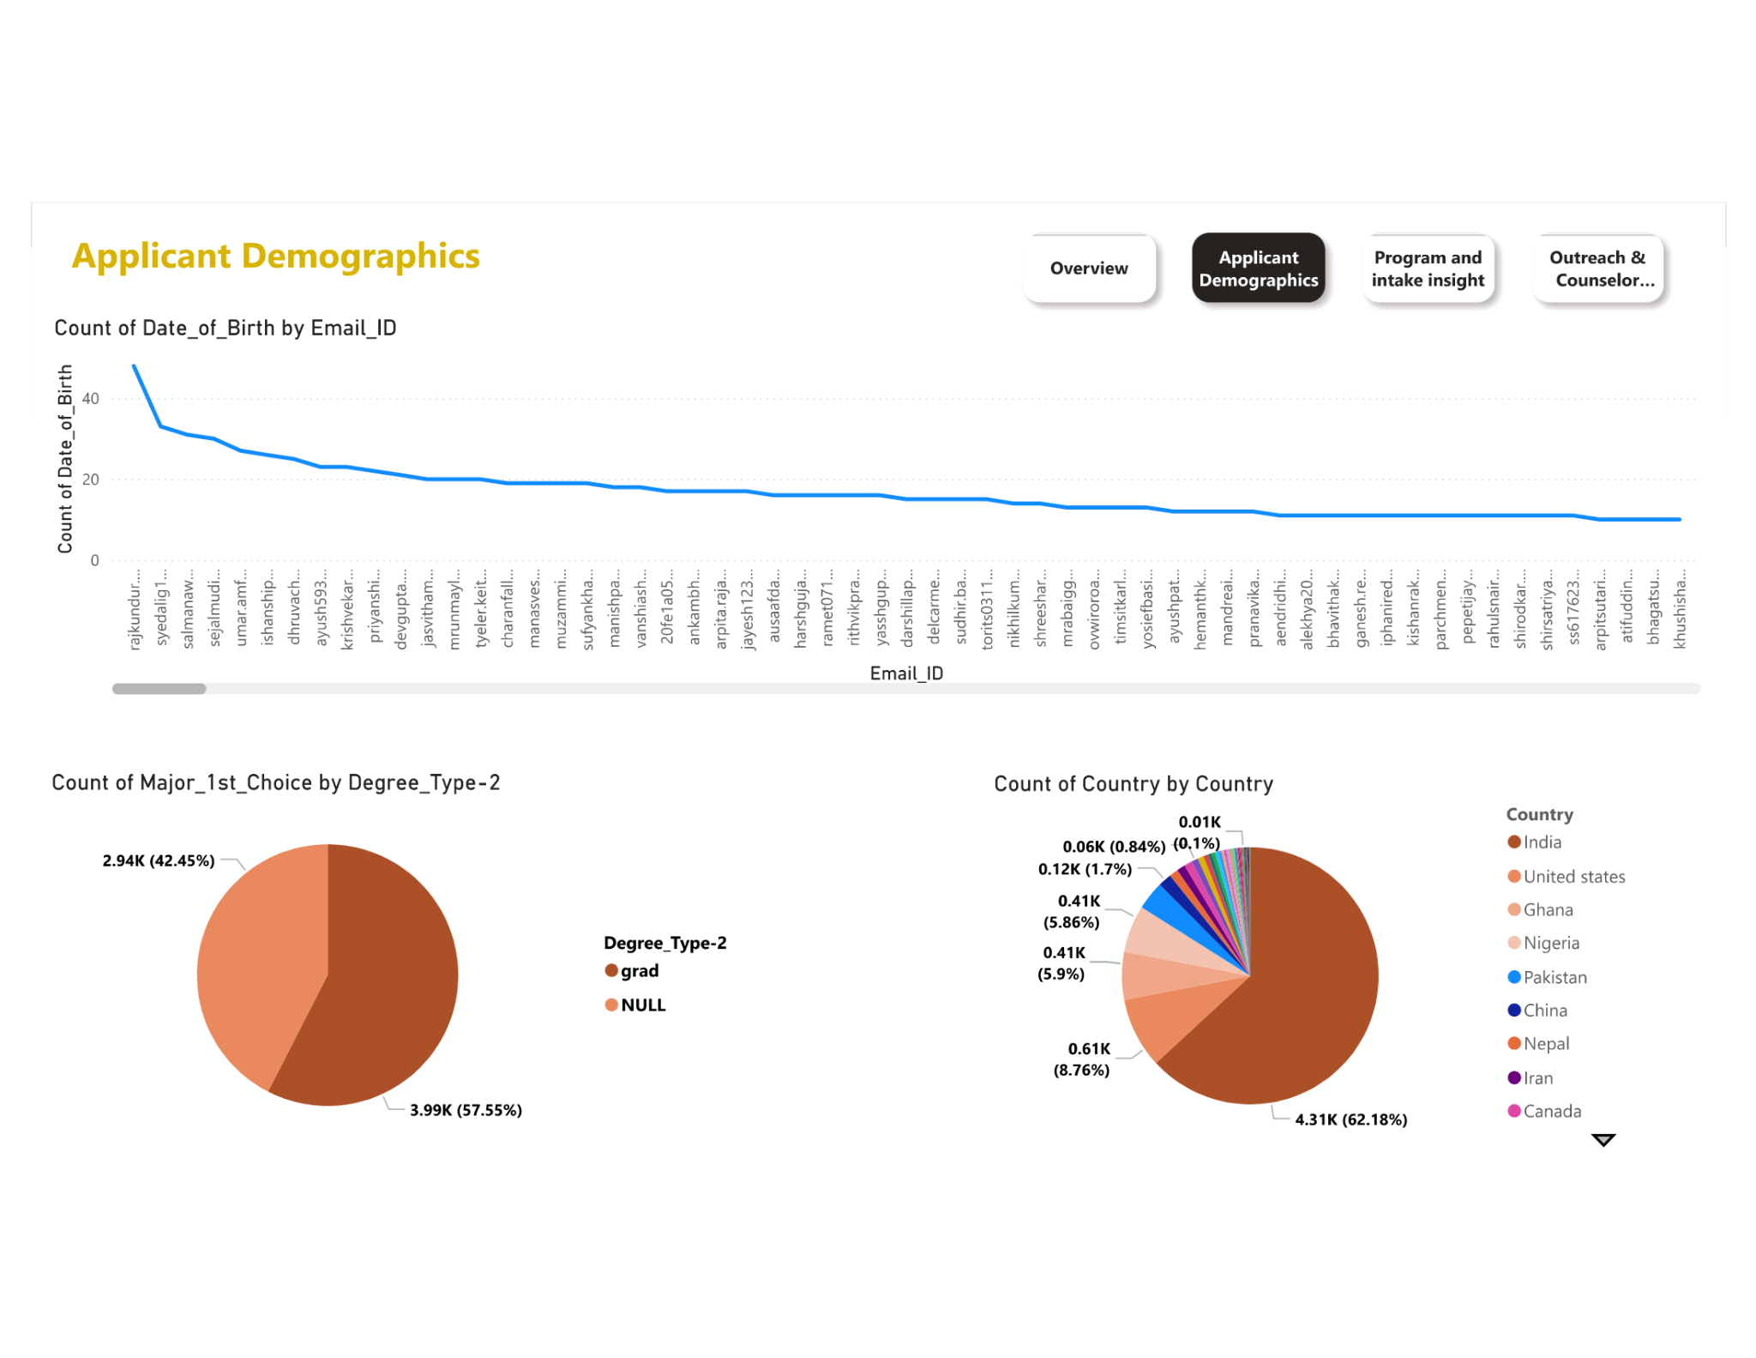
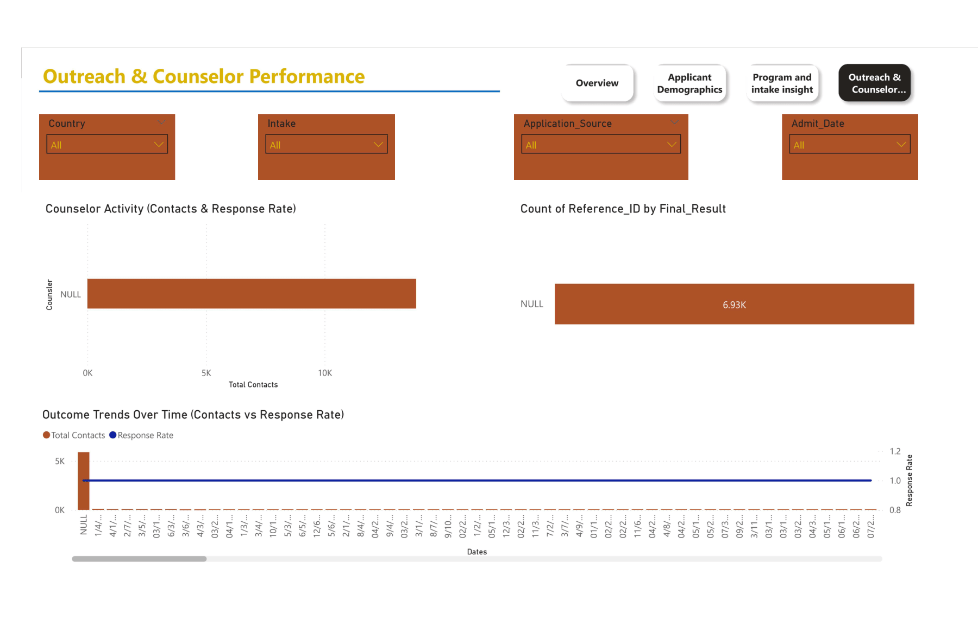
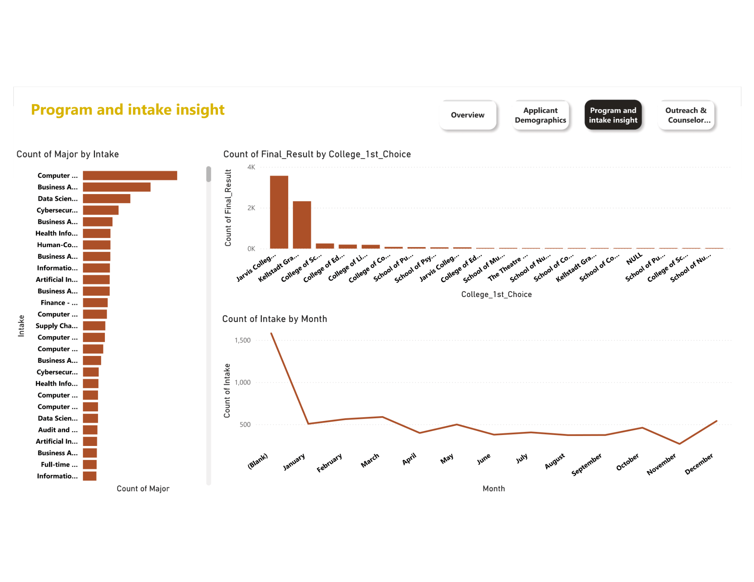
Week 3 – Dashboard Walkthrough
Purpose: Interactive viz for trends/outcomes
Key Features: Filters, slicers, drill-downs

Slide 8
Major Insights from Dashboard
Insight 1: Geographic (India 61%, Africa 17–33%) + screenshot
Insight 2: Seasonal Peaks (March–May) + line chart
Insight 3: Operational bottlenecks (documents/follow-ups 66%
Insight 4: Program Concentration(Technology-focused programs drive 43% of applications with Fall intake leading, creating strong demand but enrollment risk from over-reliance.)
Insight 5: Study Group Channel Analysis: Study Group accounts for 15% of applications but requires specialized verification workflows to ensure compliance and quality.

Slide 9
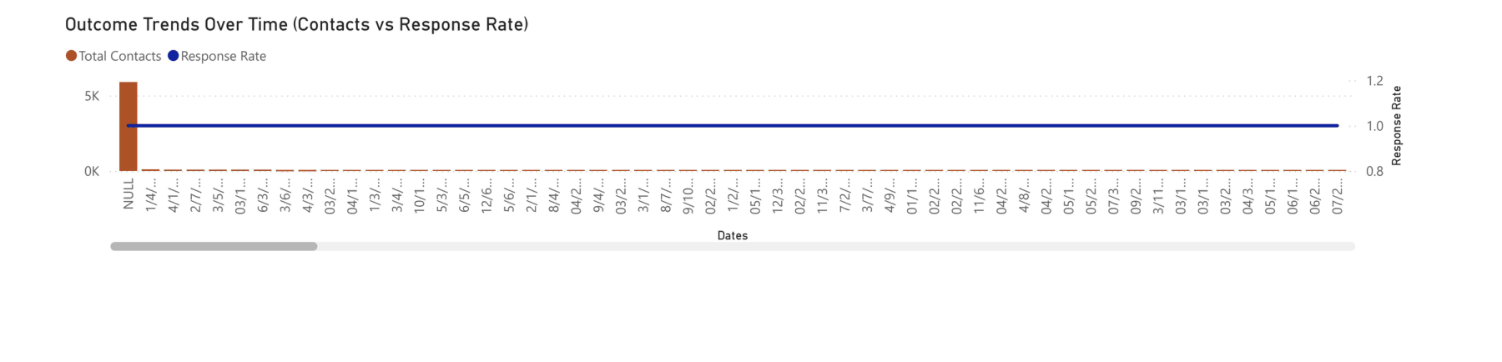
Counselor/Outreach Metrics
Avg Attempts: 2.1
Response Rate: 57.7%
Conversion: XX%
Top Counselors:
Trends: Admission outcomes by counselor

Slide 10
Recommendations
High Priority: Geographic segmentation, automate documents
Medium: Year-round campaigns, agent workflows
Low: Diversify programs
Supported by data (e.g., "Based on 34% document issues")

Slide 11
Conclusion & Key Takeaways
Overall: Improved outreach efficiency potential
Feedback Incorporation: Added visuals/implications from Week 1/2
Growth: Skills in Power BI, data cleaning, insights

Slide 12
References & Links
Dashboard link: https://app.powerbi.com/groups/me/reports/d38ac544-2b91-4b41-b935-f79d2eda234e?pbi_source=desktop
Data source: Week 2 Depaul_Data Sheet
Thanks to team/sponsor

