Slide 1
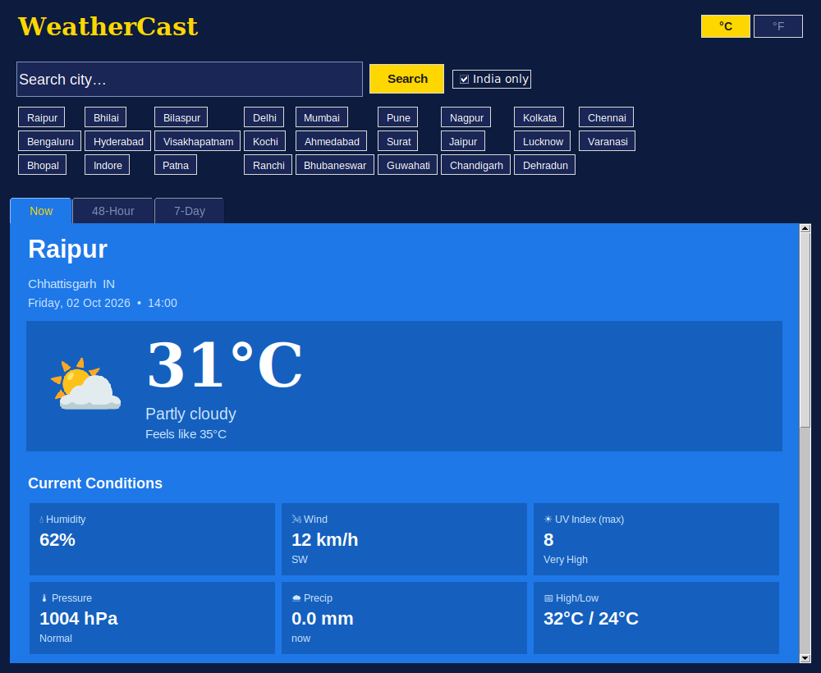
WeatherCast
Python Weather Prediction App
Tkinter GUI • Open-Meteo API
Project presentation | Python Mini Project

Slide 2
1. Introduction
WeatherCast is a desktop weather app written in Python with the Tkinter GUI toolkit. It fetches live data from the free Open-Meteo API and shows it in a clean, colour-adaptive interface.
Search any Indian city (or worldwide)
Live conditions, 48-hour and 7-day forecast
Air quality: US AQI, PM2.5 and PM10
No API key and no extra libraries needed
25
Indian cities preloaded for instant search
3
Views: Now, 48-Hour and 7-Day
0
API keys or pip installs required

Slide 3
2. Objectives
01 Real-time weather
Show live temperature, humidity, wind, pressure and UV index.
02 Reliable forecasts
Provide a 48-hour table and a 7-day outlook with rain chances.
03 Easy city search
Geocode any city name; 25 quick-select chips for Indian cities.
04 Air-quality insight
Display US AQI, PM2.5 and PM10 with a health label.
05 Smooth experience
Use background threads so the window never freezes.
06 Adaptive design
Theme changes with weather; °C / °F toggle on one click.

Slide 4
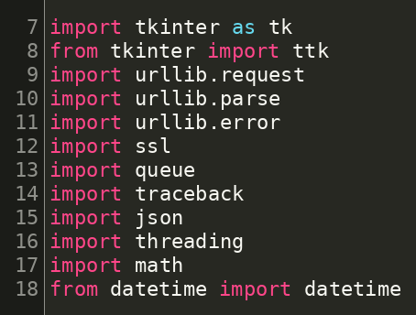
3. Technology used
Python 3
Core programming language
Tkinter / ttk
GUI: windows, tabs, canvas, tables
urllib + json + ssl
HTTP requests and JSON parsing
threading + queue
Background loading, thread-safe UI updates
datetime + math
Local time, sun arc and wind compass
Imports — lines 7–18 of weather_app.py

Slide 5
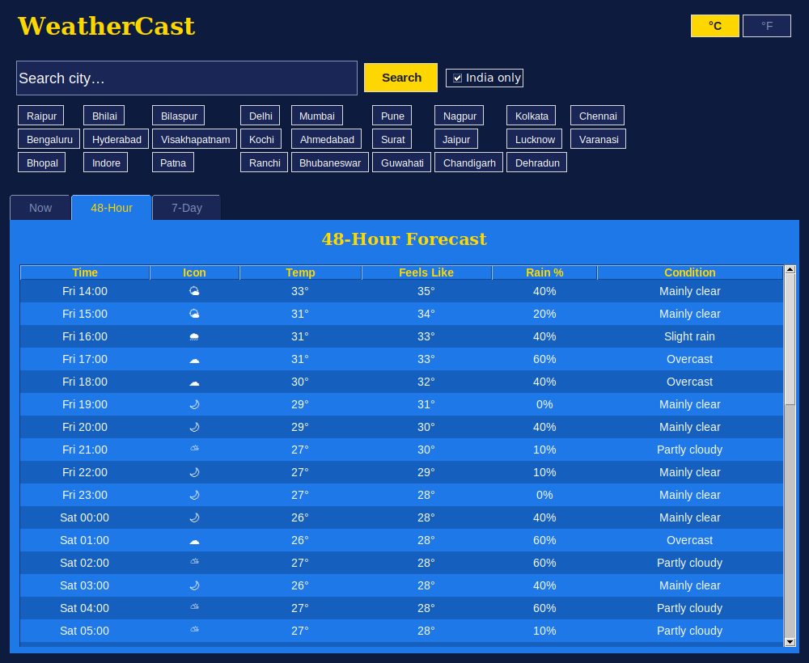
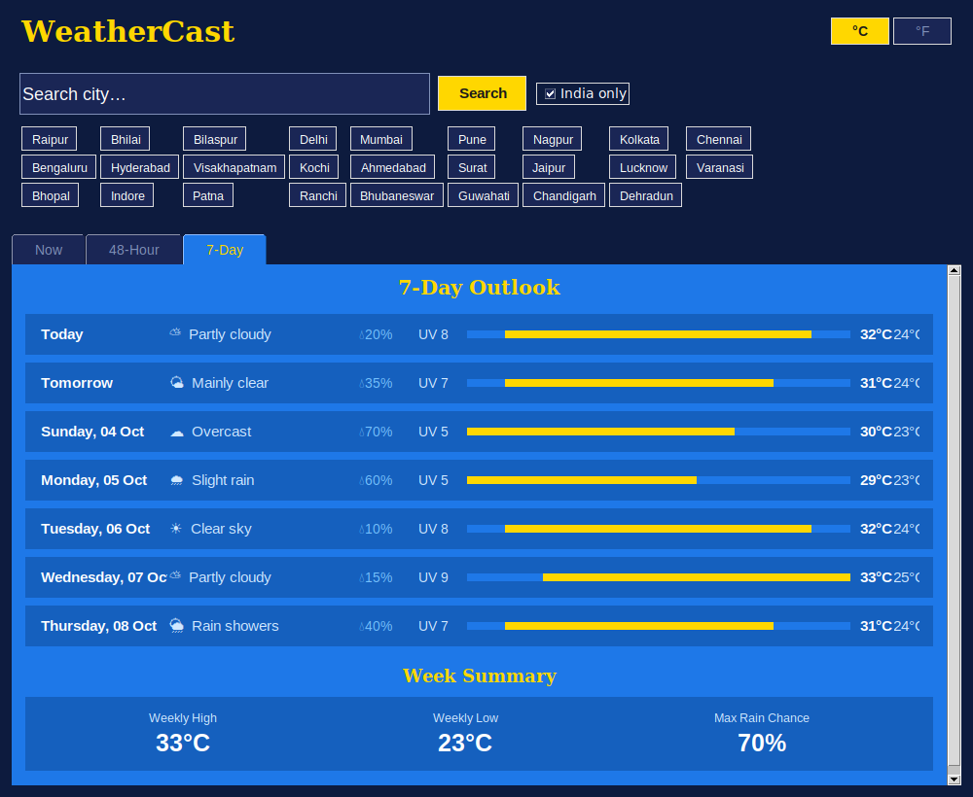
4. Application screenshots
Now tab
Temperature card, humidity, wind, UV, pressure tiles, AQI, sun arc and wind compass.
48-Hour tab
Hourly table: time, icon, temperature, feels-like, rain % and condition.
7-Day tab
Daily outlook with temperature bars, rain chance, UV and a week summary.
Screenshots captured from the running app (sample data for Raipur).

Slide 6
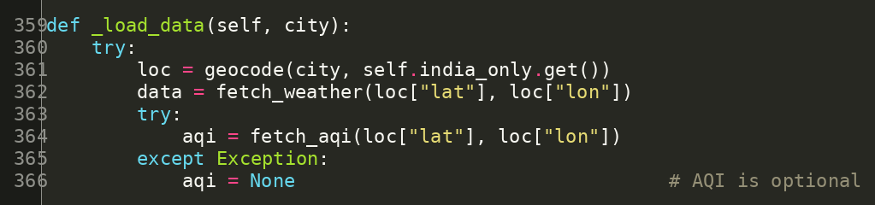
5. Working principle
1
User searches a city
Type a name or tap a city chip.
2
Geocoding
City name becomes latitude / longitude.
_load_data() — lines 359–367
3
Worker thread fetches
Weather and AQI APIs are called off the UI thread.
4
Queue hands result back
_poll_queue() runs every 100 ms.
Why a queue?
Tkinter is not thread-safe, so the worker only posts a function to the queue; the UI thread runs it.
5
Render screen
_render_all() picks theme and draws all tabs.

Slide 7
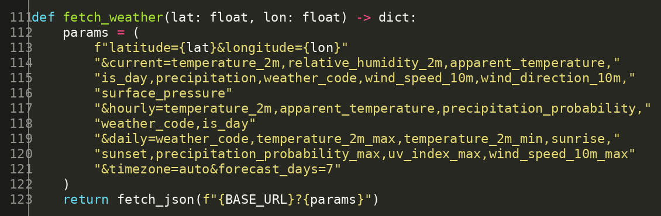
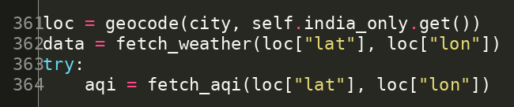
6. API integration
API | Function | Used in
Forecast | fetch_weather() L111 | _load_data() L362
Geocoding | geocode() L88 | _load_data() L361
Air quality | fetch_aqi() L68 | _load_data() L364
fetch_weather() — lines 111–123
Where to use it in the code
URLs are set at lines 21–25. Call them only inside _load_data() (worker thread). All requests go through fetch_json() L74, which also retries on SSL errors. No API key is needed.
API calls in _load_data() — lines 361–364

Slide 8
7. Advantages
Free to use
Open-Meteo needs no API key, account or billing.
Zero setup
Uses only the Python standard library.
Never freezes
Threads + queue keep the UI responsive.
Rich data
Weather, AQI, UV, wind, sunrise and sunset.
Smart themes
Colours change for day, night, rain, snow, storm.
Resilient
Retries SSL errors; AQI failure never breaks the app.

Slide 9
8. Feature enhancements
1
Weather alerts
Notify users about storms, heat waves and heavy rain.
2
Interactive charts
Plot temperature and rain trends with matplotlib.
3
Auto location
Detect the user's city using IP or GPS.
4
Favourites & history
Save cities and searches in JSON or SQLite.
5
Radar & maps
Show rain and cloud maps for the selected city.
6
Languages & packaging
Add Hindi UI and ship as a Windows .exe.

Slide 10
9. Conclusion
WeatherCast shows how a complete, useful desktop app can be built with only Python's standard library and a free public API.
It combines API integration, multi-threading and a dynamic Tkinter interface, and it can grow with alerts, charts and maps.
Live data
Open-Meteo weather + AQI
Responsive
Thread + queue design
Extensible
Clear functions, easy to enhance
Thank you

Slide 11
Template A: image + text
Your heading here
Replace the image on the left with any screenshot
Keep three or four short points
Use it for demos, results or diagrams

Slide 12
Template B: stats + comparison
00
Label one
00
Label two
00
Label three
Before
Describe the old way or the problem here.
After
Describe the new way or the solution here.

Slide 13
Thank you
Questions & discussion
Your name • Class / Roll no.

