Slide 1
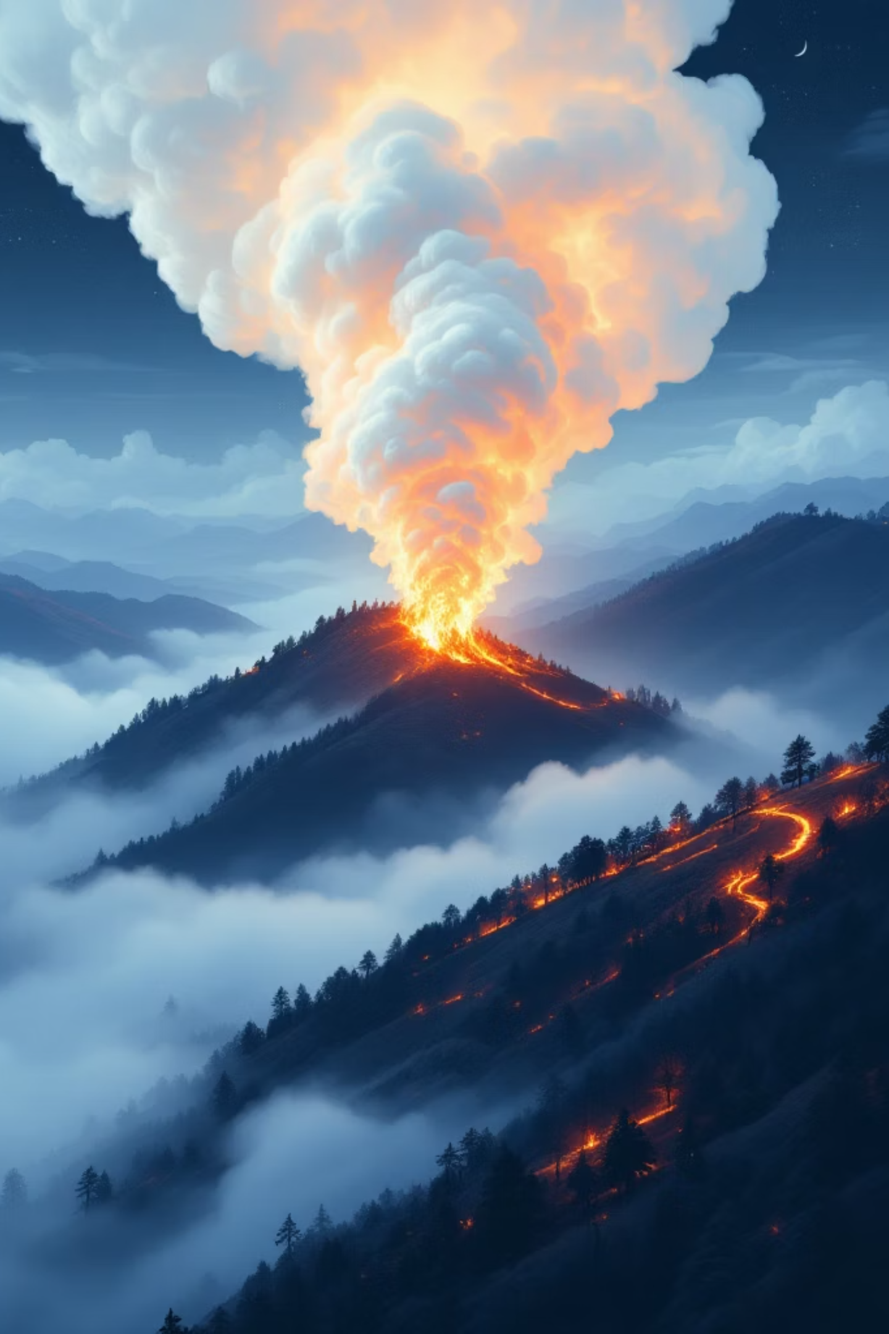

A Real-Time Wildfire Resilience Digital Twin
Group: N-Dimensional
Prince Savsaviya · Viswanadh R. Challa · Anish Ashok Kale · Ali Rezayi Nejad
Group Number: 3
1

Slide 2
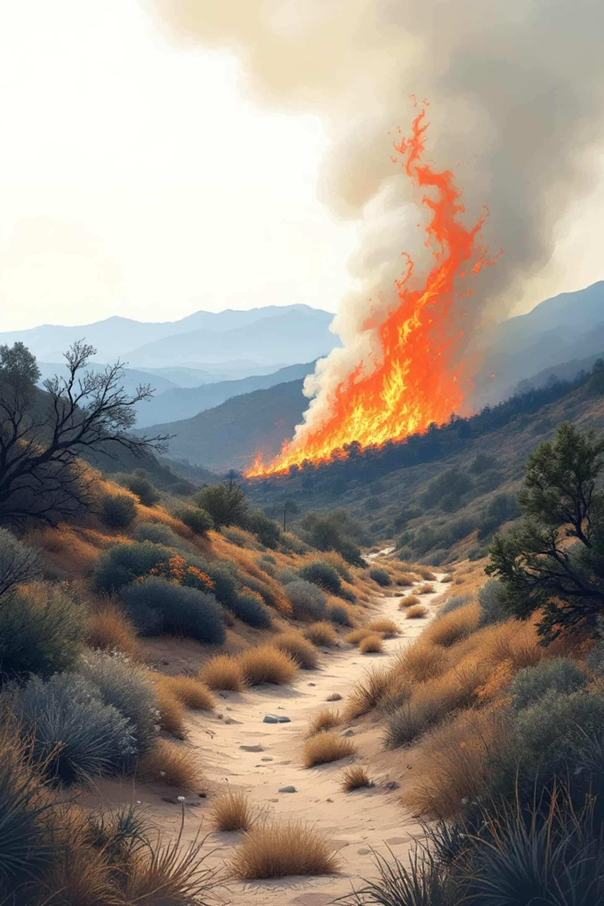
INTRODUCTION
Background & Motivation
The Threat
Wildfires increasingly threaten infrastructure, ecosystems, and human safety, particularly in urban-dense regions like California.
The Gap
Current monitoring systems often lack real-time data integration and interactive decision-making capabilities.
The Solution
A "Digital Twin" that mirrors real-world environments in real time to provide updated risk representations.
2

Slide 3
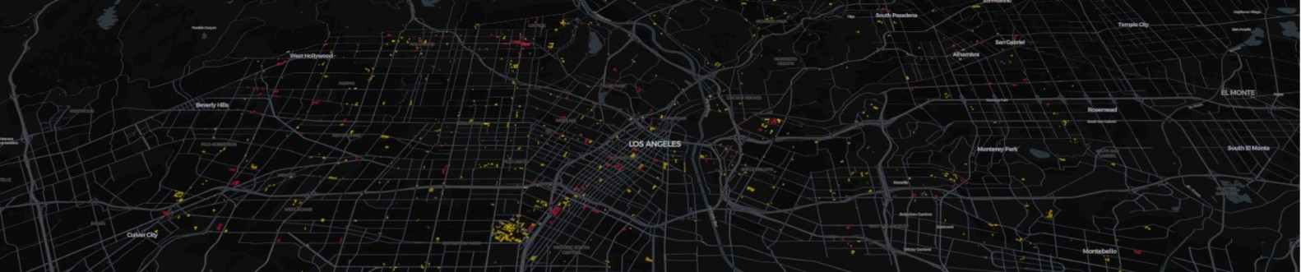
FOCUS
Project Overview & Big Data Relevance
System Goal
Volume
Support rapid situational awareness through streaming data ingestion and geospatial analytics.
Processing over 11.5 million building polygons for the entire state of California.
Velocity
Variety
Ingesting high-velocity fire events via Apache Kafka streaming pipeline.
Fusing dynamic sensor feeds (temperature, wind) with static infrastructure data.
3

Slide 4
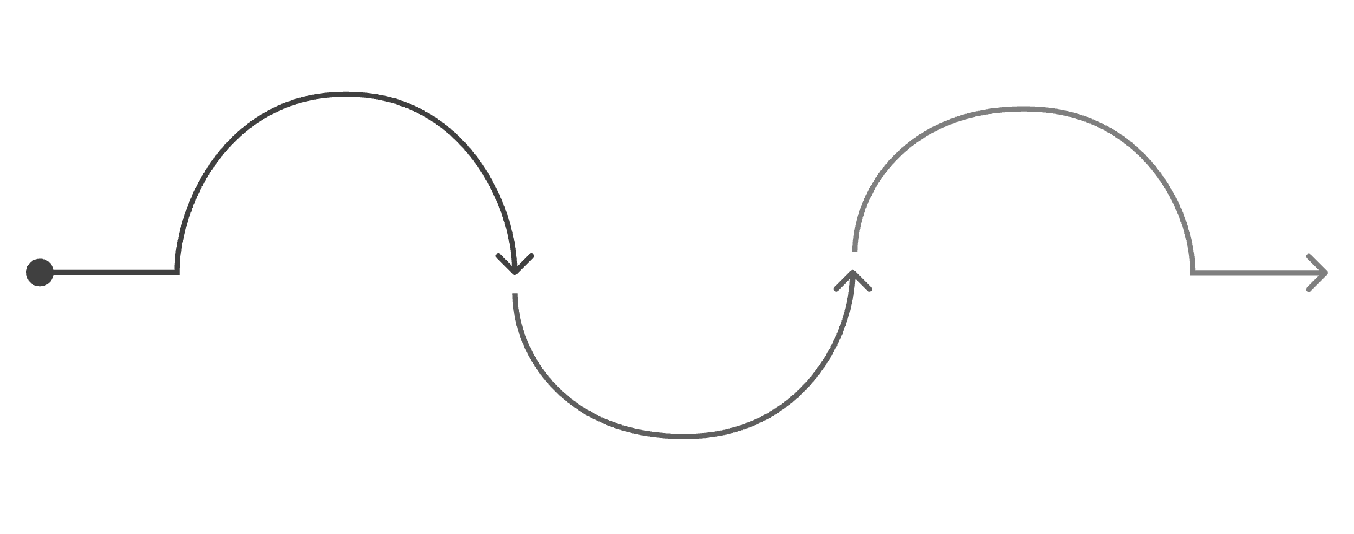
LITERATURE
Related Work
Current Landscape
Predictive modeling approaches (e.g., Next Day Wildfire Spread)
Conceptual digital twin frameworks without live implementation
No end-to-end system coupling visualization to a streaming backend
Predictive Modeling
Digital Twin Frameworks
Research Gap
No end-to-end live implementation
Next-day wildfire spread forecasts
Conceptual architectures for simulation
Our Contribution
A concrete, end-to-end implementation connecting live event ingestion to an infrastructure-aware dashboard with multi-resolution context.
The existing body of work is divided between predictive models and theoretical frameworks, leaving a gap for concrete, streaming-backed implementations.
4

Slide 5




ARCHITECTURE
System Architecture
Ingestion
Processing
Storage
Visualization
Kafka topic fire_events captures high-velocity fire event streams in real time.
Apache Spark & Sedona perform spatial cross-referencing against building and POI data.
DuckDB for live alerts; GeoParquet for static building context across California.
A real-time dashboard renders fire risk zones, building alerts, and infrastructure context.
5

Slide 6
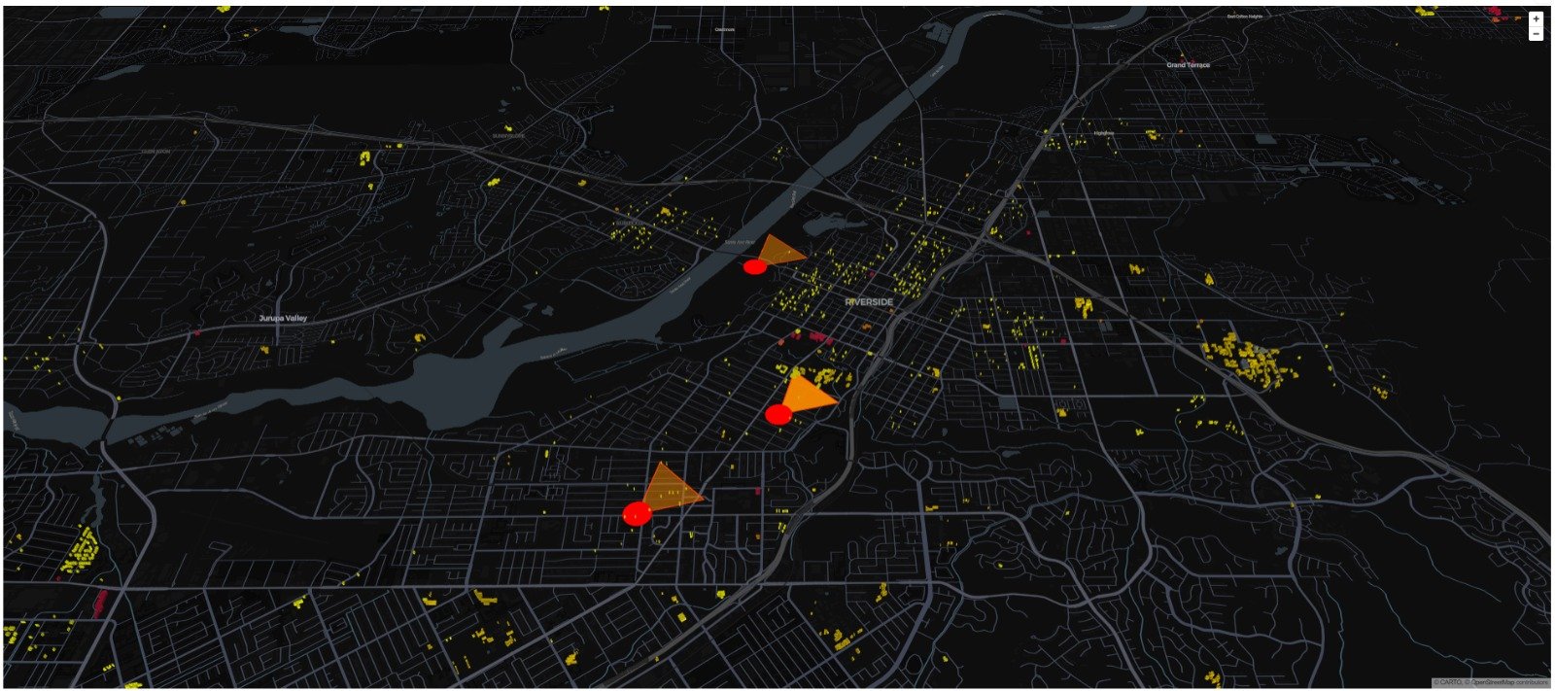
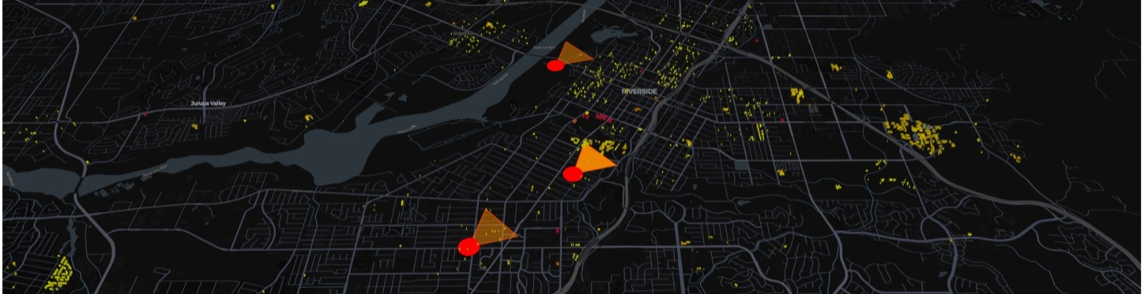



MAIN WORK
Key Outcome
Data Engineering & Enrichment
Infrastructure-Aware Risk
11.5M Building Footprints
Essential buildings are pre-classified, enabling the system to immediately surface the most critical at-risk assets during any fire event.
Converted Microsoft building polygons to Sedona-compatible GeoParquet format.
Semantic Join
ST_Contains used to join building polygons with OpenStreetMap POIs.
~80,000 Essential Buildings
Hospitals, schools, and emergency services identified for prioritized risk analysis.
6

Slide 7
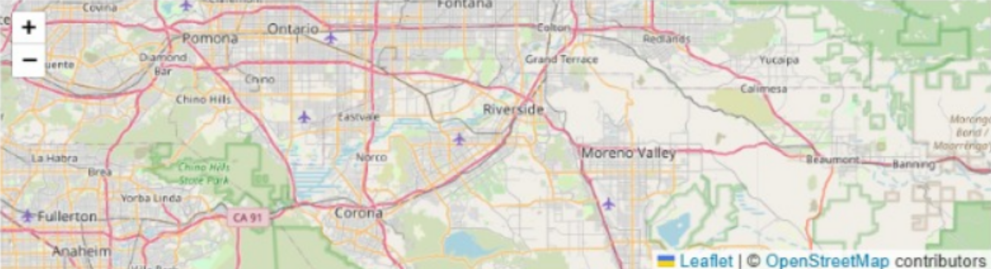



MAIN WORK
Real-Time Risk Modeling
Geospatial Reasoning
Directional Model
Infrastructure Intersection
Incoming fire events are transformed into geometric risk regions projected onto the map.
Evolved from simple circular buffers to cone-shaped regions influenced by wind speed and direction.
System identifies infrastructure within the predicted spread zone and generates prioritized alert records.
7

Slide 8
EVALUATION
Evaluation Methodology & Scalability
<5s
11.5M
~80K
City-Scale Load
Building Polygons
Essential Buildings
Buildings + alerts rendered in under 5 seconds for a full city-scale view.
Statewide California dataset processed with H3 indexing for multi-resolution access.
Critical infrastructure pre-identified for fast prioritized alerting.
H3 Indexing
Partition Pruning
Statewide data aggregated into coarse cells; finer details load only when zooming in, reducing render overhead dramatically.
Restricted GeoParquet reads to specific spatial regions, avoiding full dataset scans and speeding up queries.
8

Slide 9

EVALUATION
Simulation & Evaluation
Scenario Testing
Validated via interactive simulations where users inject fire events with custom weather data parameters.
Results
System successfully generated intuitive risk regions that correctly highlighted at-risk infrastructure in the dashboard across all tested scenarios.
Responsiveness
Decoupling DuckDB from Kafka ensures the UI remains stable and performant during high-throughput ingestion bursts.
9

Slide 10



CONCLUSION
Conclusion & Future Directions
Live Data
Terrain Dynamics
Decision Support
Transition from simulated events to live NASA FIRMS fire data feeds
Incorporate terrain elevation and fuel load data for higher-fidelity spread modeling
Expand "what-if" analysis tools for emergency planners and decision-makers
Key Takeaways
Thank You
Built a scalable, multi-resolution digital twin using a modern big data stack: Kafka, Spark, Sedona, DuckDB
Questions and Discussion
Enables "what-if" analysis for decision-makers to explore potential fire impacts under varying conditions
End-to-end pipeline from live event ingestion to infrastructure-aware geospatial dashboard
10

