Slide 1



YELP
Customer Ratings Prediction
By
Robert D. Driesch
Todd Miller
Parastoo Karacic
Shraddha Mandhale
Suraj Jois
Princewill Eneh

Slide 2
Project Overview
Objective :
To build a model to help predict the star ratings a business is likely to receive based upon previous customer written reviews while taking into account differences observed within the data corpus for different geographies.
YELP REVIEWS
ANALYSIS
PREDICTION









Slide 3
Workflow
Import & Parse Data
Sentiment Analysis
Transpose Sentiment
⧫


Predict
Test
Train
Analyze Result
3
1
2
Algorithms

Slide 4
Tools



SAP HANA
AFM
MATLAB
XLSTAT
DQ ANALYZER

Slide 5
Preliminary Analysis

Slide 6
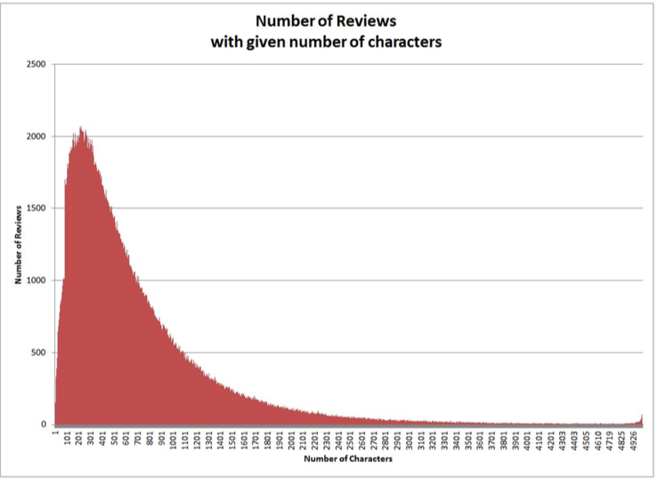
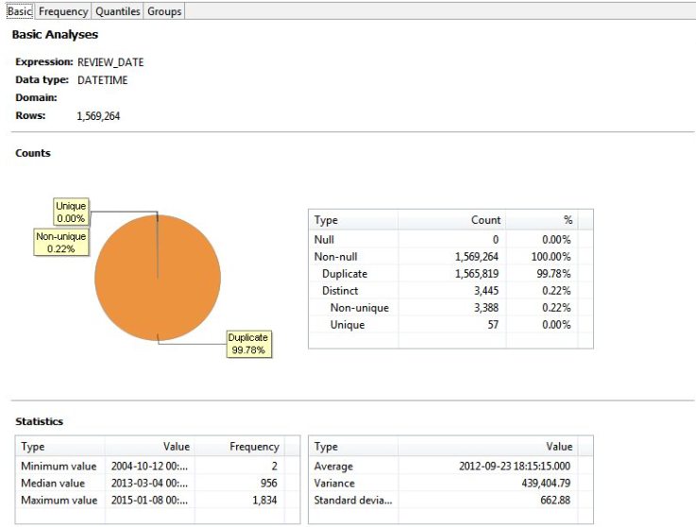
Data Profiling

Slide 7

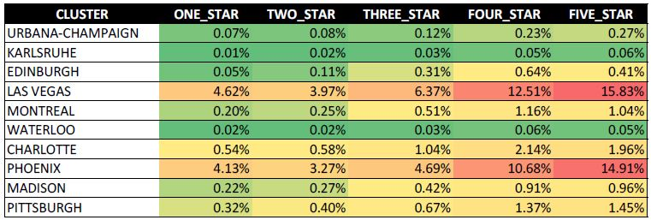
CANADA

USA

Distribution of Star ratings based on All reviews
Las Vegas:
Montreal:
All Cities:
1k 25K 50k
Subset for Training and Test Data we used

Slide 8
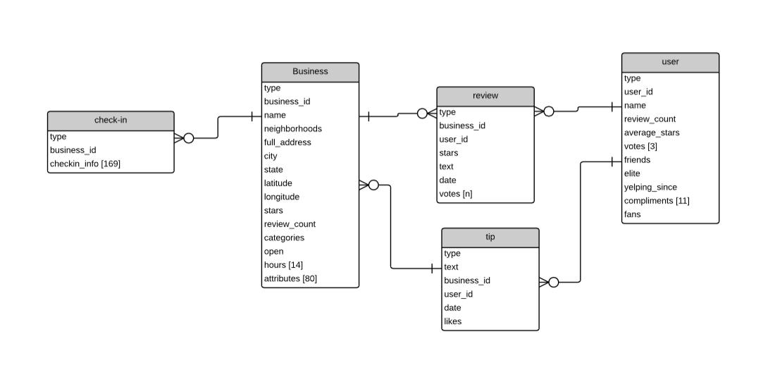
Yelp ERD

Slide 9
Yelp Review Table
Review _ id | Id | User_ id | Business _id | Review data | Text | Stars
ae3udsjd | 1 | ejfjdsfs | widsjfqak | 21-MAY-11 | Awesome Place to Eat | 5
djeualdda | 2 | fswowew | sjfajqwhaa | 1-JAN-10 | Good Service | 4
eienfjsjs | 3 | ssdsdsfa | qjqdooma | 21-JUN-11 | I like it | 3
eeeerwr4 | 4 | sdqdqdq | ifnafuqdqd | 8-FEB-14 | Not good | 2
ddfoejd | 5 | seqeqr | dadkanda | 17-AUG-13 | Worst place ever | 1

Slide 10
Sentiment Analysis

Slide 11
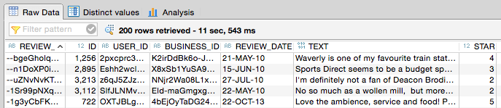
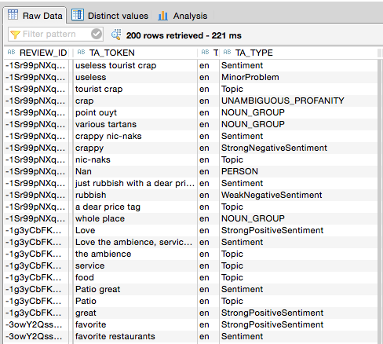
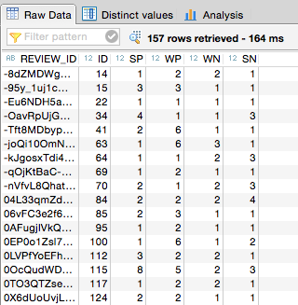
Original Data
Sentiment Analysis
Transposed And Counted

Slide 12
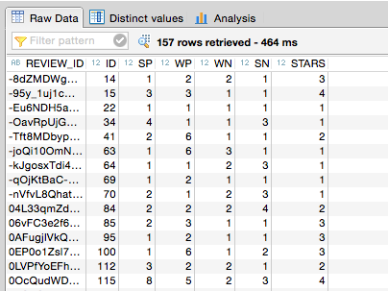
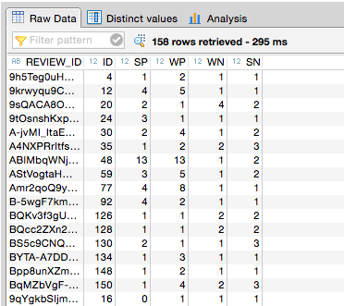

Training & Test Dataset
25%
TEST
75% TRAINING
Training Data
Test Data
Las Vegas:
Montreal:
All Cities:
1k 25K 50k
Subset for Training and Test Data we used

Slide 13
Algorithms






NAÏVE BAYES
NEURAL NETWORK
DECISION TREES

Slide 14
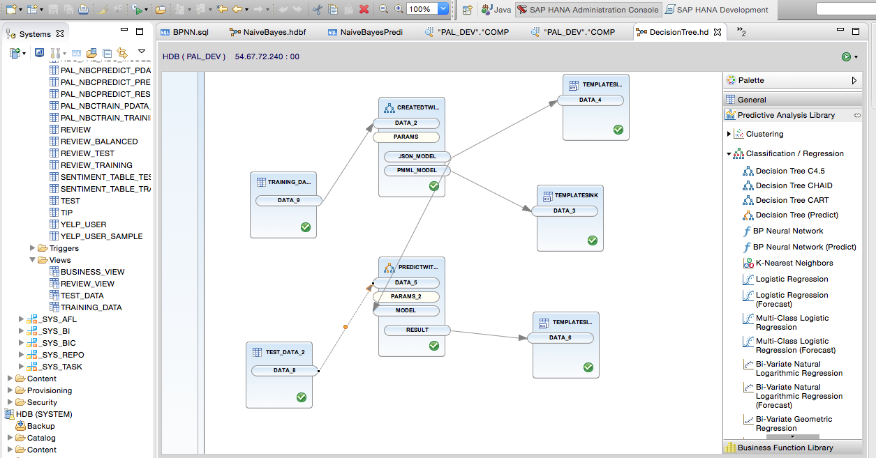
Application Function Modeler (AFM)
Separate AFM models for each Algorithm.

Slide 15
Result Analysis
Confusion Matrix , Roc Curve & Percent Off Diagonal

Slide 16
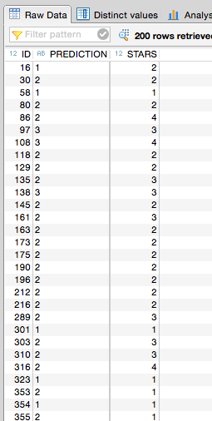
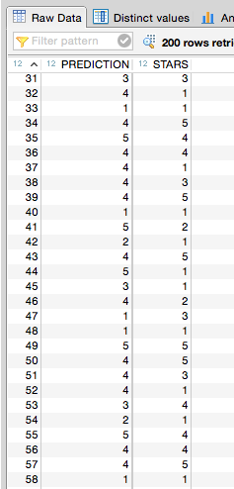
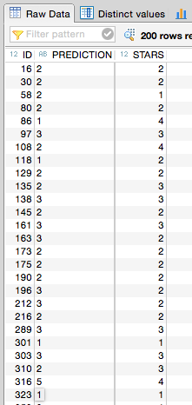
Results
VS
VS
Naïve Bayes
Neural Network
Decision Tree

Slide 17
Results All Cities
Naïve Bayes
VS
Neural Network
VS
Decision Tree

Slide 18
LAS VEGAS
Confusion Matrix
MONTREAL
ALL CITIES
Naïve Bayes
VS
Neural Network
VS
Decision Tree

Slide 19
LAS VEGAS
ROC Curve
MONTREAL
ALL CITIES
Naïve Bayes
VS
Neural Network
VS
Decision Tree

Slide 20
Average AUC
0.851
0.8
0.827
All Naïve Bayes
All Neural Network
All Decision Tree
All Cities and All Samples Tested.

Slide 21
Percent Off Diagonal
 |  |  |  | Actual
 |  | 1 | 2 | 3 | 4 | 5
 | 1 | 12.04% | 6.41% | 1.94% | 0.18% | 0.42%
 | 2 | 5.12% | 6.32% | 5.03% | 2.08% | 0.92%
Predicted | 3 | 1.29% | 3.14% | 5.95% | 3.09% | 0.97%
 | 4 | 0.51% | 1.66% | 3.55% | 6.09% | 4.57%
 | 5 | 1.38% | 1.43% | 3.74% | 9.13% | 13.05%
 |  |  |  | Pct Off Diagonal: 56.55%
 |  | On Diagonal |  | Total |  | Off Diagonal
 |  | 43.45% |  | 100.00% |  | 56.55%
 |  |  |  | Actual
 |  | 1 | 2 | 3 | 4 | 5
 | 1 | 9.64% | 6.46% | 1.98% | 0.60% | 0.46%
 | 2 | 2.91% | 4.06% | 3.55% | 2.35% | 0.88%
Predicted | 3 | 5.30% | 4.43% | 8.21% | 4.57% | 3.04%
 | 4 | 1.01% | 1.71% | 2.68% | 3.41% | 3.74%
 | 5 | 1.48% | 2.31% | 3.78% | 9.64% | 11.81%
 |  |  |  | Pct Off Diagonal: 62.87%
 |  | On Diagonal |  | Total |  | Off Diagonal
 |  | 37.13% |  | 100.00% |  | 62.87%
 |  |  |  | Actual
 |  | 1 | 2 | 3 | 4 | 5
 | 1 | 11.76% | 7.89% | 2.81% | 0.69% | 0.42%
 | 2 | 4.20% | 4.01% | 3.83% | 2.49% | 1.06%
Predicted | 3 | 2.44% | 4.43% | 6.00% | 3.32% | 1.38%
 | 4 | 0.60% | 1.06% | 3.78% | 4.06% | 4.15%
 | 5 | 1.34% | 1.57% | 3.78% | 10.01% | 12.92%
 |  |  |  | Pct Off Diagonal: 61.25%
 |  | On Diagonal |  | Total |  | Off Diagonal
 |  | 38.75% |  | 100.00% |  | 61.25%
UNBUCKETED
 |  |  |  | Actual
 |  | 1 & 2 |  | 3 | 4 & 5
 | 1 & 2 | 29.89% |  | 6.96% | 3.60%
Predicted | 3 | 4.43% |  | 5.95% | 4.06%
 | 4 & 5 | 4.98% |  | 7.29% | 32.84%
 |  |  |  | Pct Off Diagonal: 31.32%
 |  | On Diagonal |  | Total |  | Off Diagonal
 |  | 68.68% |  | 100% |  | 31.32%
 |  |  |  | Actual
 |  | 1 & 2 |  | 3 | 4 & 5
 | 1 & 2 | 23.06% |  | 5.54% | 4.29%
Predicted | 3 | 9.73% |  | 8.21% | 7.61%
 | 4 & 5 | 6.50% |  | 6.46% | 28.60%
 |  |  |  | Pct Off Diagonal: 40.13%
 |  | On Diagonal |  | Total |  | Off Diagonal
 |  | 59.87% |  | 100% |  | 40.13%
 |  |  |  | Actual
 |  | 1 & 2 |  | 3 | 4 & 5
 | 1 & 2 | 27.86% |  | 6.64% | 4.66%
Predicted | 3 | 6.87% |  | 6.00% | 4.70%
 | 4 & 5 | 4.57% |  | 7.56% | 31.13%
 |  |  |  | Pct Off Diagonal: 35.01%
 |  | On Diagonal |  | Total |  | Off Diagonal
 |  | 64.99% |  | 100% |  | 35.01%
BUCKETED
All Naïve Bayes
All Neural Network
All Decision Tree

Slide 22
Challenges
Pre-processing the data before importing into SAP.
Handling the Skew of the data
Tool learning curve (AFM, Python, XLSTAT)
Focusing on a specific problem.

Slide 23
Conclusion
Naïve Bayes performed best because it allows each attribute to contribute equally towards the final decision.
Predication accuracy for different geographic location were consistent because we used the same configuration file /dictionary to perform our text analysis.
Binning the predictions 1-2, 3 ,4-5 gave us the best result.

Slide 24
Thanks and Questions

